Slide 1
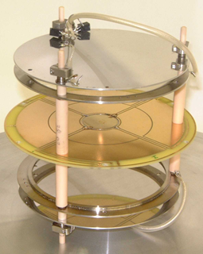
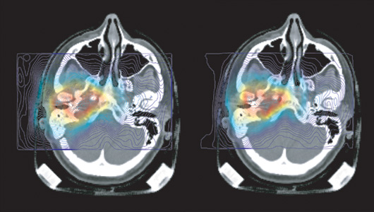
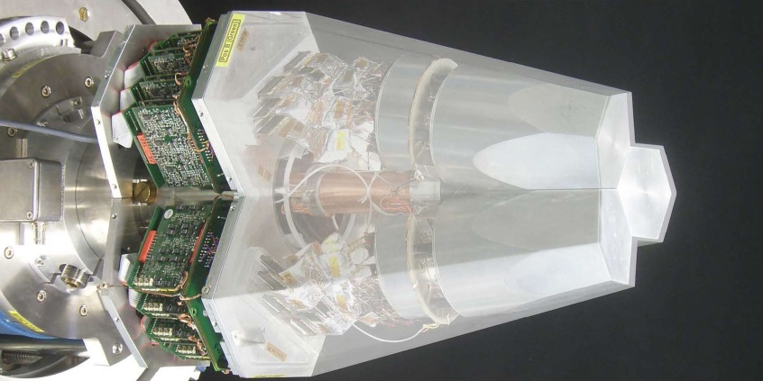
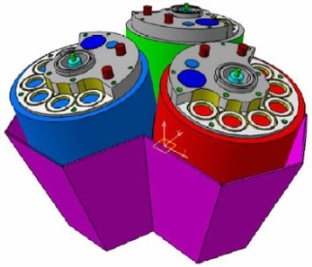
Particle and Radiation Detectors: Advances & Applications
Lecture: Hans-Jürgen Wollersheim
e-mail: h.j.wollersheim@gsi.de

Slide 2
Tentative outline of detector lecture
Charged particle interaction in matter
relevant formulas
Bethe-Bloch formula
interaction of β-particles in matter
Bremsstrahlung
Synchrotron radiation
Interaction of gamma-rays in matter
photoelectric effect
Compton scattering
e⁺e⁻ pair production
Semiconductor detectors
bond model for semiconductors
doping: n- and p-type silicon
Silicon surface barrier detector
micro-strip detector
Germanium detector
Segmented detectors
Doppler effect
Euroball, Miniball, AGATA
Electronics
signal processing
constant fraction discriminator
coincidences
Gas detectors
ionization detectors
ionization chamber
proportional counter
multi-wire proportional chamber
time projection chamber
Geiger-Müller counter
Scintillation detectors
organic and inorganic scintillators
Liouville’s theorem
photomultiplier tube
neutron detector
Neutral particles
neutrons
neutrino
Imaging

Slide 3
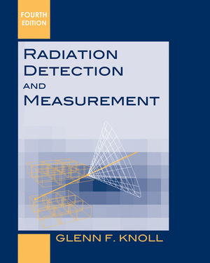
Literature
Recommended Textbook
Recommended Textbook

Slide 4
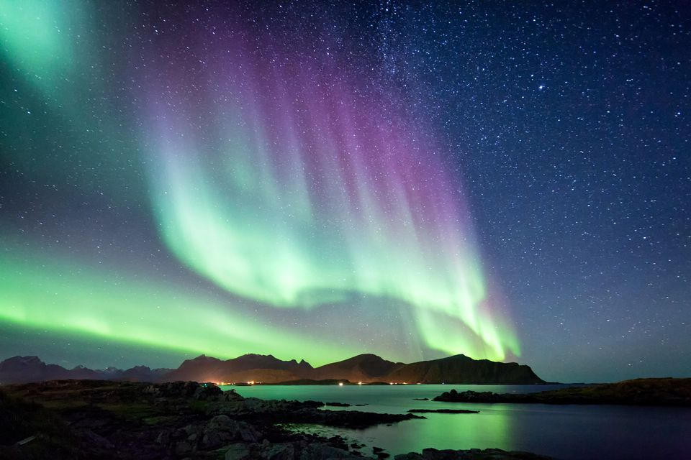
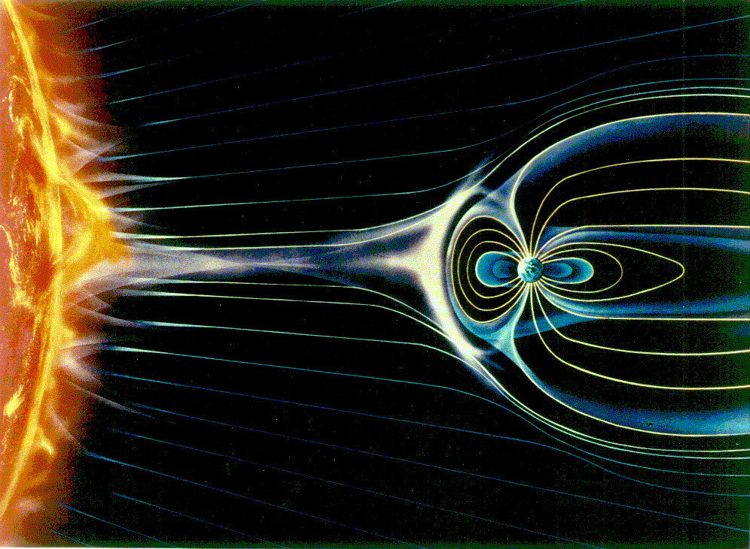
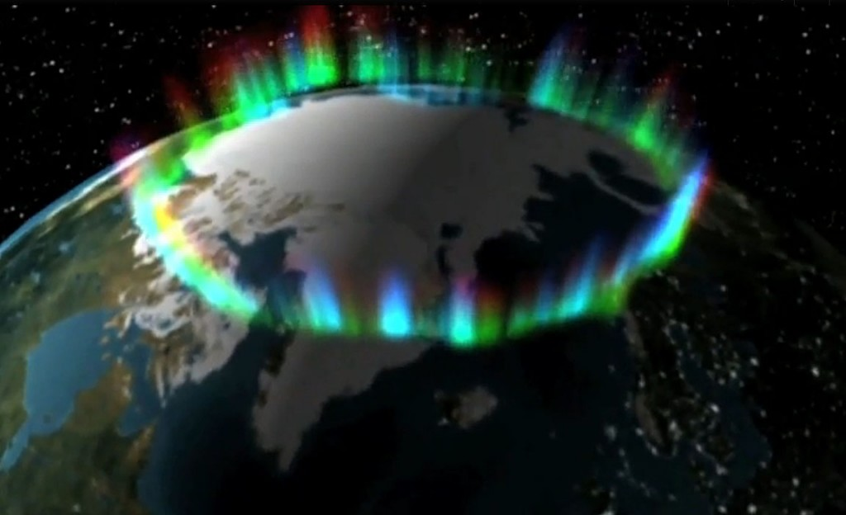
Particle Interaction with Matter
Aurora Borealis
Ionization

Slide 5
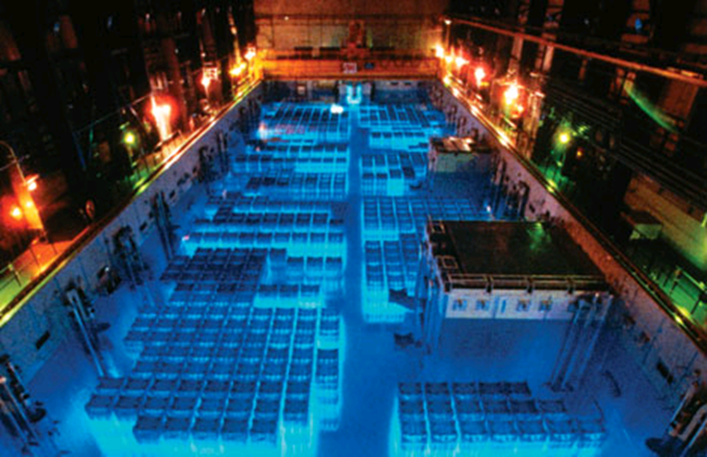
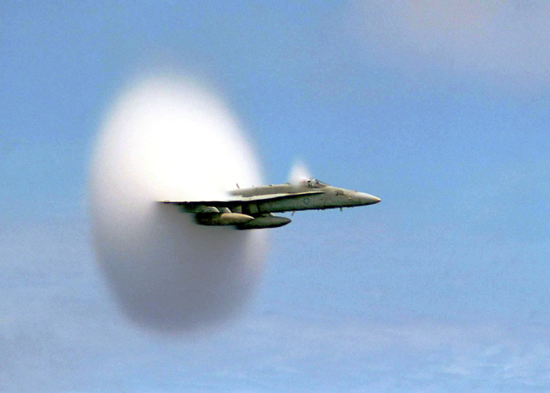
Particle Interaction with Matter
Characteristic glow from a reactor
Cherenkov Light
Cherenkov radiation is an effect similar to sonic booms when the plane exceeds the velocity of sound

Slide 6
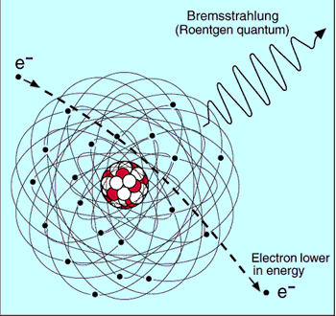
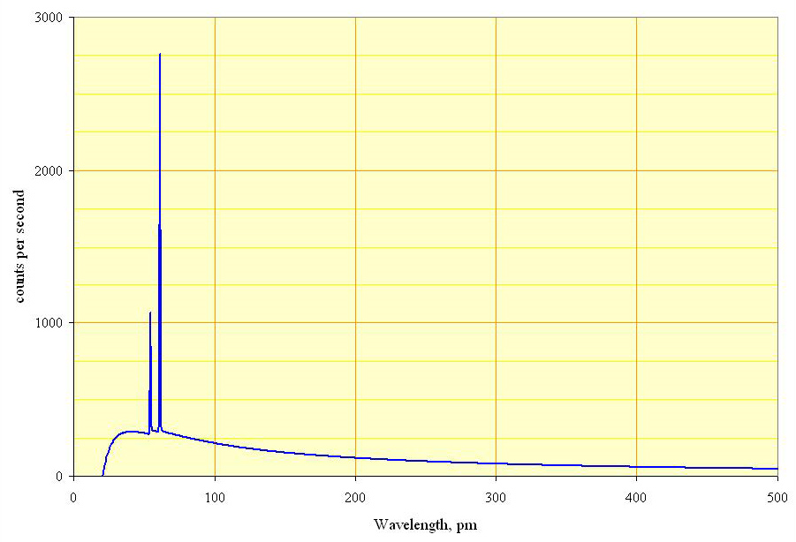
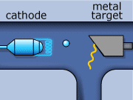
Particle Interaction with Matter
Bremsstrahlung or ‘braking radiation’
Spectrum of the X-rays emitted by an X-ray tube with a rhodium target, operated at 60 kV. The continuous curve is due to bremsstrahlung, and the spikes are characteristic K lines for rhodium.
Bremsstrahlung

Slide 7
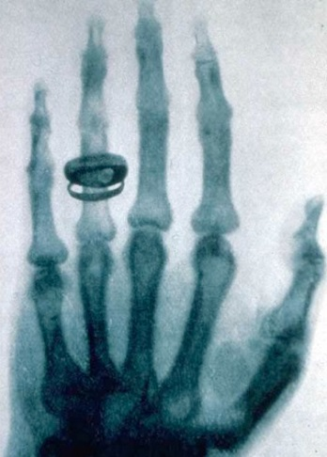
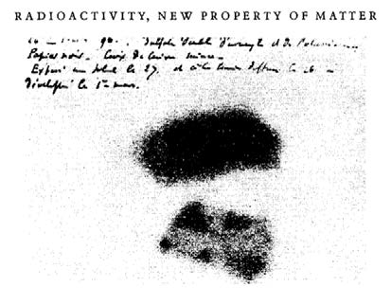
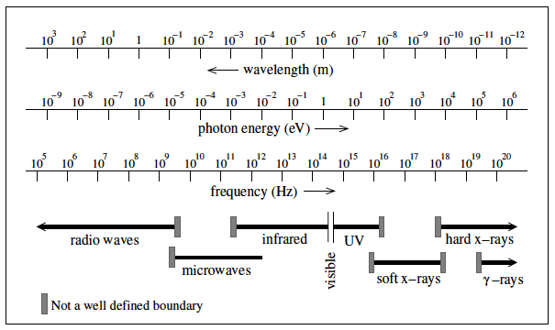
First Detectors – photographic plates
First X-ray image by Wilhelm Conrad Roentgen (1895)
Henri Bequerel’s first “picture” of Uranium (1896)
$$γ−rays$$
$$β−rays$$

Slide 8
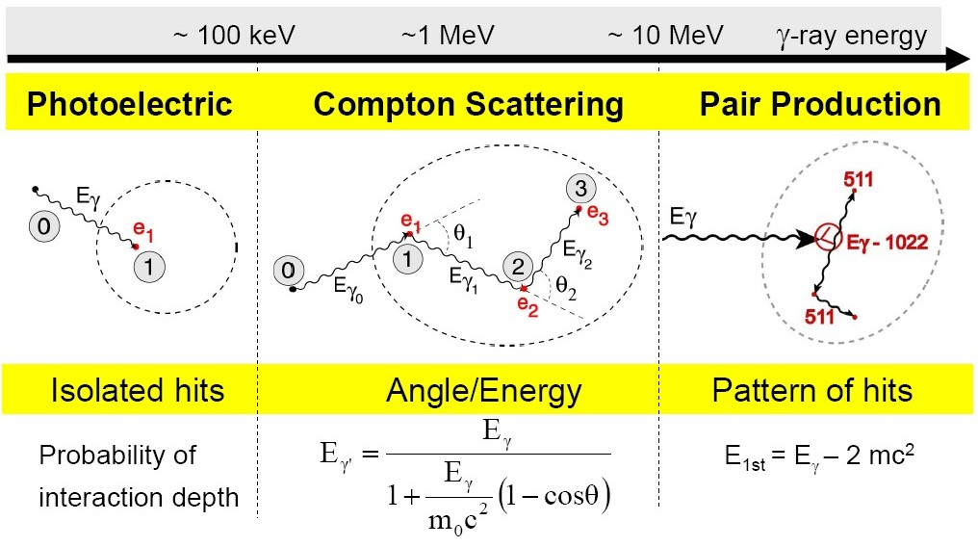
Interaction of gamma rays with matter

Slide 9
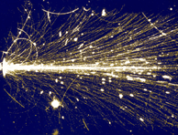
Energy loss – dE/dx
Particles interact differently with matter. Important for detectors is the energy loss per path length. The total energy loss per path length is the sum of all contributions.
$$−{\left(\frac{dE}{dx}\right)}_{tot}=−{\left(\frac{dE}{dx}\right)}_{coll}−{\left(\frac{dE}{dx}\right)}_{rad}−{\left(\frac{dE}{dx}\right)}_{photoeff}−{\left(\frac{dE}{dx}\right)}_{compton}−{\left(\frac{dE}{dx}\right)}_{pair}−{\left(\frac{dE}{dx}\right)}_{hadron}⋯$$
Depending on the particle type, the particle energy and the material some processes dominate, other do not occur. For instance only charged particles will interact with electrons of atoms and produce ionization, etc.

Slide 10
Measurement Principles
A measurement requires an interaction of the particle with the material of the detector. The interaction provokes two effects:
1st Creation of a detectable signal, e.g.
ionization → charges
excitation → scintillation
excitation of phonons → heat
2nd Alternation of the particles properties, e.g.
energy loss
change of trajectory due to scattering
absorption
unwanted side effects. They need to be as small as possible and well understood.

Slide 11
Measurement Principles
A particle detector is an instrument to measure one or more properties of a particle …
Properties of a particle |  | Type of detection principle:
- position and direction | $$x, \overset{⃑}{x}$$ | position and tracking
- momentum | $$\left|\overset{⃑}{p}\right|$$ | tracking in a magnetic field
- energy | $$E$$ | calorimetry
- mass | $$m$$ | spectroscopy and PID
- velocity | $$β$$ | Cherenkov radiation or time of flight
- transition radiation | $$γ$$ | TRD
- spin, lifetime

Slide 12
What is a Particle?
Strong force
Electromagnetic force
Weak force

Slide 13
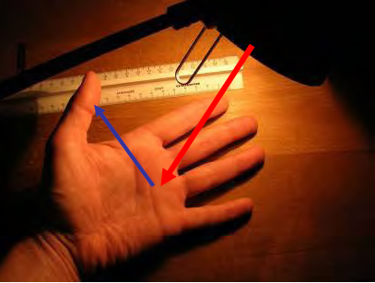
How do we see Particles?
A light bulb shines on a hand and the different reflections make the fine structure visible.
With a magnifying glass or microscope more details can be seen, but there is a fundamental limit:
The wavelength of the light (1/1000 mm) determines the size of the resolvable objects.
available wavelength
→ electromagnetic waves
$$E=\frac{hc}{λ}$$
LW | 3000 m
MW | 300 m
KW | 30 m
UKW | 3 m
GPS | 0.3 m
Infrared | 10⁻⁶ m
light | 5·10⁻⁷ m | 2 eV
UV | 10⁻⁷ m | 10 eV
X-ray | 10⁻¹⁰ m | 10⁴ eV
γ-ray | 10⁻¹² m | 10⁶ eV
light bulb → accelerator
magnifying glass or microscope → detector

Slide 14
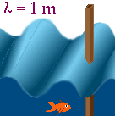
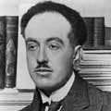
Energy, Wavelength and Resolution
Small objects (smaller than λ) do not disturb the wave → small object is not visible
Large objects disturb the wave → large object is visible
wavelength versus resolution
all particles have wave properties:
$$λ=\frac{h}{p}=\frac{hc}{\sqrt{E_{kin}∙\left(E_{kin}+2m_{0}c^{2}\right)}}$$
de Broglie wavelength
Louis de Broglie
10⁻¹m
10⁻⁹m
10⁻¹⁰m
10⁻¹⁴m
10⁻¹⁵m
h·c = 1239.84 [MeV fm]

Slide 15
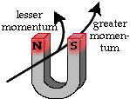
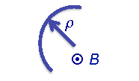
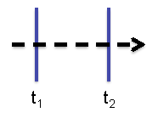
Detection and Identification of Particles
Detection = particle counting (is there a particle?)
Identification = measurement of mass and charge of the particle
(most elementary particle have $Ze=±1$)
How:
- charged particles are deflected by B fields such that:
$$ρ=\frac{p}{ZeB}∝\frac{p}{Z}=\frac{γm_{0}βc}{Z}$$
$$p=particle momentum$$
$$m_{0}=rest mass$$
$$βc=particle velocity$$
- particle velocity measured with time-of-flight (ToF) method
$$β∝\frac{1}{∆t}$$
ToF for known distance
Ionization $−\frac{dE}{dx}=f\left(β\right)$
Cherenkov radiation
Transition radiation

Slide 16
Detection and Identification of Particles
Detection = particle counting (is there a particle?)
Identification = measurement of mass and charge of the particle
(most elementary particle have $Ze=±1$)
How:
- kinetic energy determined via a calorimetric measurement
$$E_{kin}=\left(γ−1\right)m_{0}c^{2}$$
$$γ=\frac{1}{\sqrt{1−β^{2}}}$$
- for Z=1 the mass is extracted from $E_{kin}$ and $p$
- to determine Z (particle charge) a Z-sensitive variable is e.g. the ionization
energy loss
$$\frac{dE}{dx}∝\frac{z^{2}}{β^{2}}ln\left(a∙β^{2}γ^{2}\right)$$
a = material-dependent constant

Slide 17
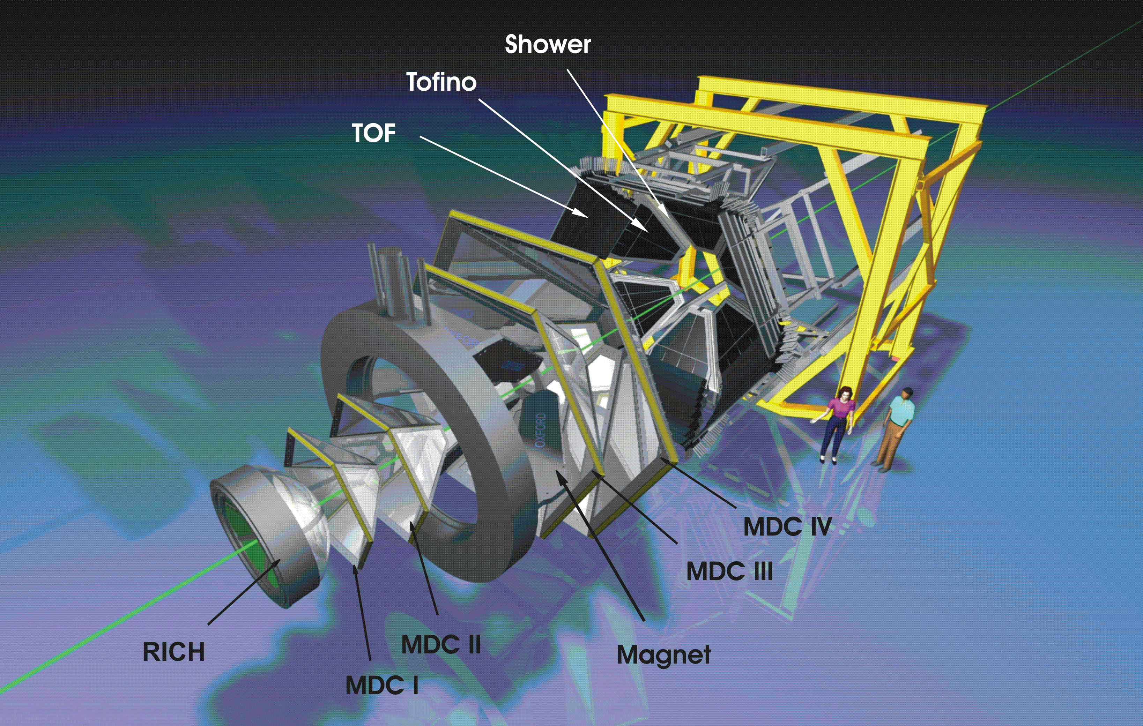
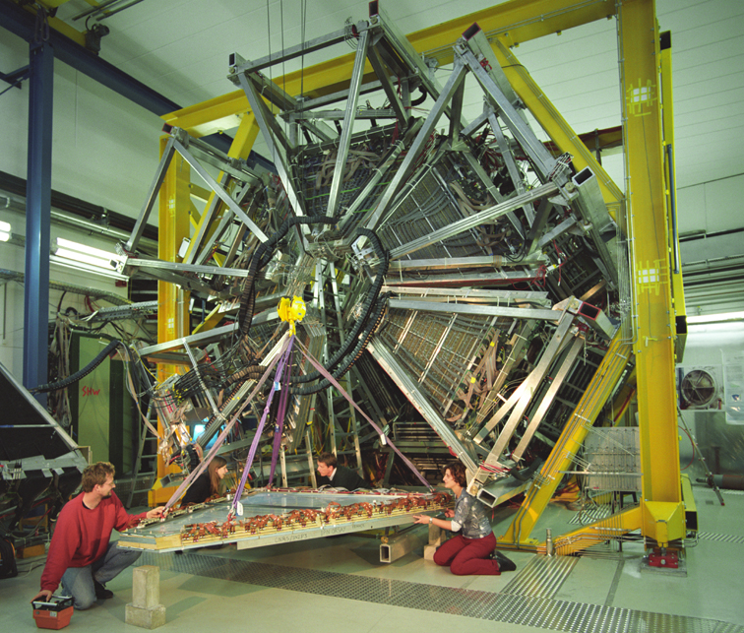
The HADES experiment @ GSI

Slide 18
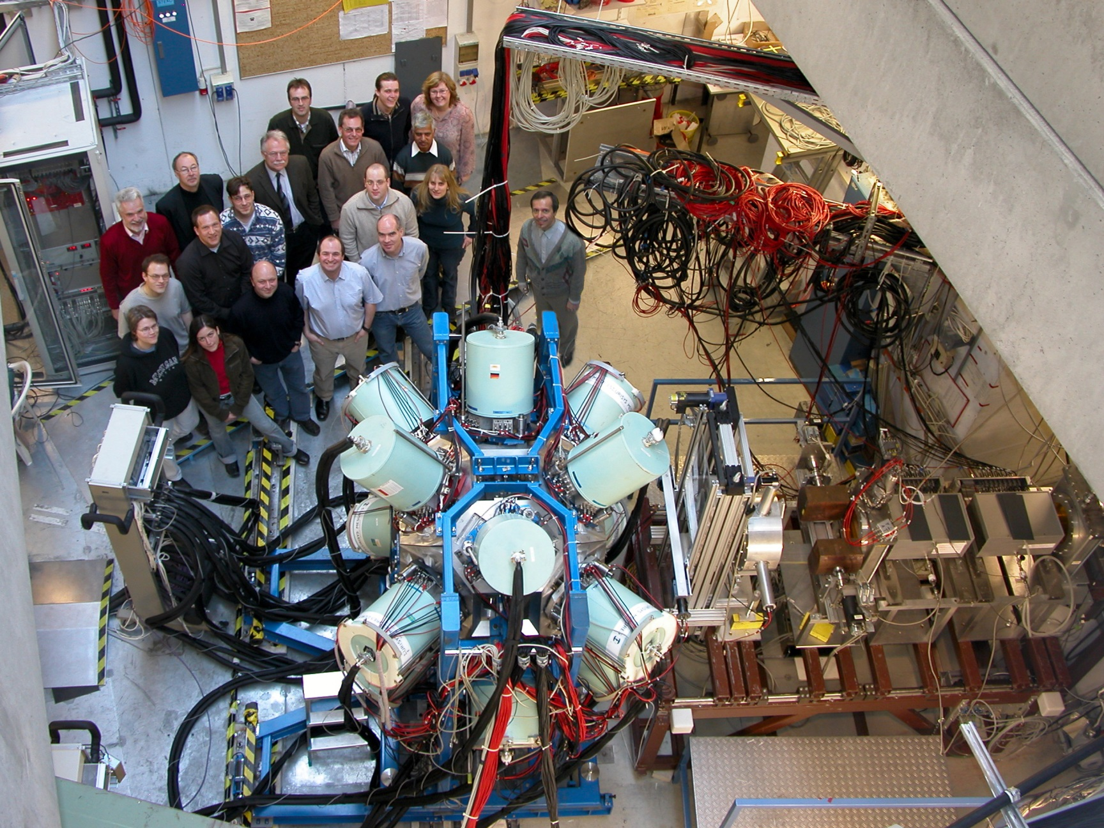
Rare ISotope INvestigation at GSI

