Slide 1

Outline: Rutherford scattering
Lecturer: Hans-Jürgen Wollersheim
e-mail: h.j.wollersheim@gsi.de
web-page: https://web-docs.gsi.de/~wolle/ and click on
history
impact parameter
distance of closest approach
orbital angular momentum
differential cross section
nuclear radius

Slide 2
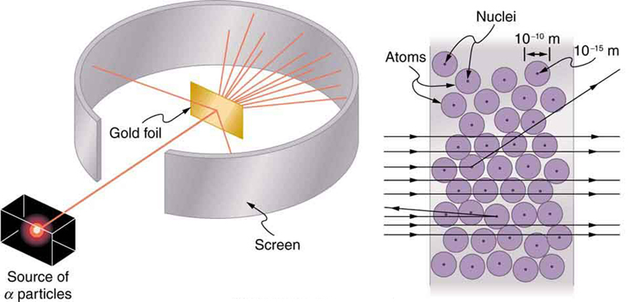
Rutherford scattering discovery of nucleus

Slide 4
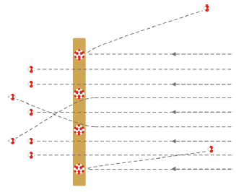
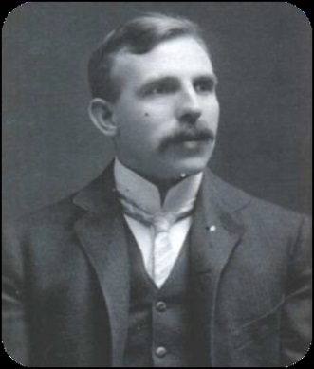
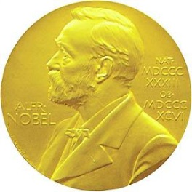
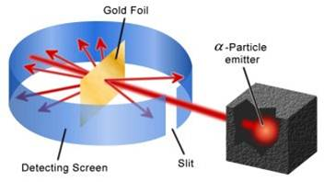
Rutherford scattering discovery of nucleus
1909: Rutherford, Geiger and Marsden studied in Manchester
the scattering of α-particles on thin gold foils.
Aim: from the angular distribution of the scattered
α-particles they wanted to gain information on
the structure of the scattering center.
Experimental set-up: Ra-source with E_{kin}(α) = 4.78 MeV
thin Au-foils (Z = 79, d = 2000 atomic layers)
detection of scattered α‘s with ZnS scintillator
1908: Nobel price
for chemistry
‘disintegration of elements’
Ernest Rutherford
(1871-1937)

Slide 5
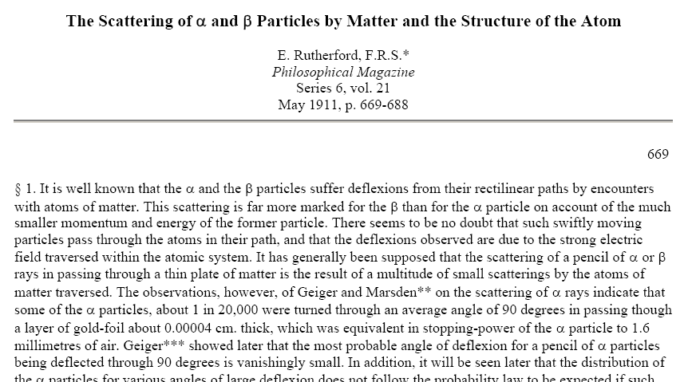
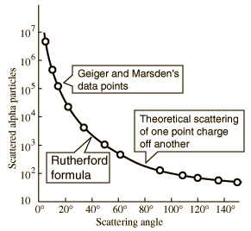
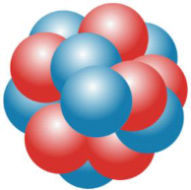
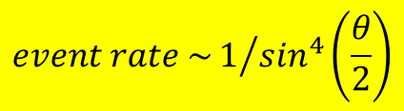
Rutherford scattering discovery of nucleus
observation:
$$event rate \sim 1/{\sin^{4}\left(\frac{θ}{2}\right)}$$
scattering on a point-like atomic nucleus

Slide 6
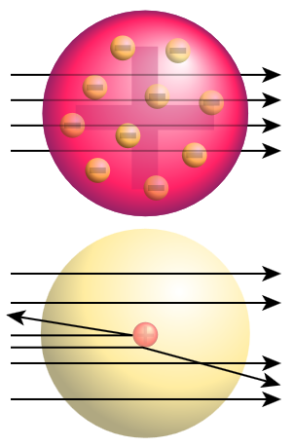
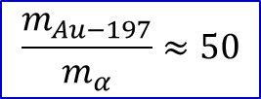
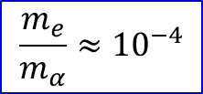
Rutherford scattering discovery of nucleus
Kinematic of elastic scattered α-particles
energy and momentum conservation
α-particles on electrons (Thomson model)
$$\frac{m_{e}}{m_{α}}≈{10}^{−4}$$
max. momentum transfer Δp ~ 10⁻⁴·p_{i}
only small scattering angles θ ~ 0⁰
α-particles on Au-nuclei (Rutherford model)
$$\frac{m_{Au−197}}{m_{α}}≈50$$
max. momentum transfer Δp ~ 2·p_{i}
scattering angles up to θ_{max} ~ 180⁰
(backscattered α-particles)
m_{α} = 4 GeV/c²
m_{e} = 0.511 MeV/c²
m_{AU-197} = 197 GeV/c²

Slide 7
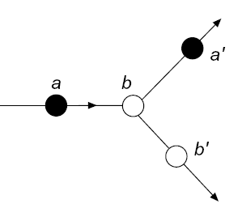
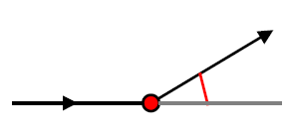
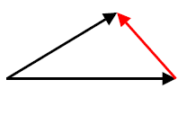





Elastic scattering
In an elastic process
a + b → a’ + b’
the same particles are present both before and after the scattering, i.e. the initial and the final state are identical (including quantum numbers) up to momenta and energy.
incoming particle:
projectile
target nucleus
The target b remains in its ground state, absorbing merely the recoil momentum and hence changing its kinetic energy.
The scattering angle and the energy of the projectile a and the recoil energy and energy of the target b are unambiguously correlated.
scattered outgoing particle a’
$$\vec{p_{a′}}$$
$$\vec{p_{a′}}$$
$$∆\vec{q}=\vec{p_{a′}}−\vec{p_{a}}$$
beam particle a
scattering angle θ
θ
$$\vec{p_{a}}$$
target nucleus b
$$\vec{p_{a}}$$

Slide 8
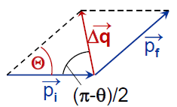
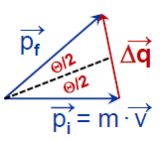
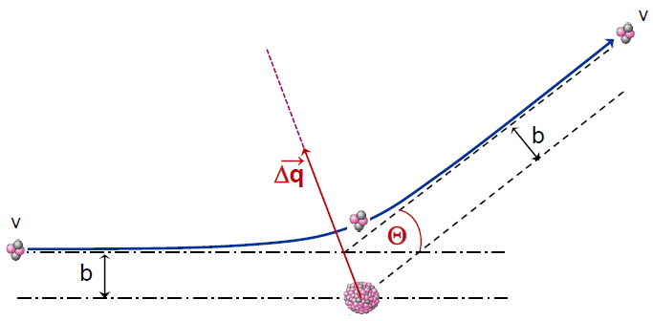



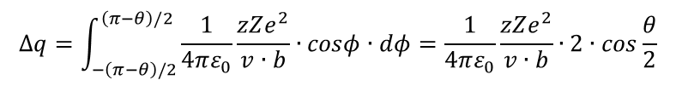


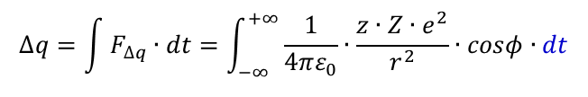
Rutherford scattering
$$V\left(r\right)\sim \frac{z∙Z∙e^{2}}{r}$$
In the repulsive Coulomb potential the α-particle experiences a momentum change
$$∆\vec{q}=\vec{p_{f}}−\vec{p_{i}}$$
$$∆q=2∙m∙v∙sin\frac{θ}{2}$$
$$∆q=\int{F_{∆q}∙dt}=\int_{−∞}^{+∞}{\frac{1}{4πε_{0}}∙\frac{z∙Z∙e^{2}}{r^{2}}∙cosφ∙dt}$$
$$\vec{L}=\left|\vec{r}×m∙\vec{v}\right|=m∙v∙b=m∙\frac{dφ}{dt}∙r^{2}$$
$$∆q=\int_{−\left(π−θ\right)/2}^{\left(π−θ\right)/2}{\frac{1}{4πε_{0}}\frac{zZe^{2}}{v∙b}∙cosφ∙dφ=\frac{1}{4πε_{0}}\frac{zZe^{2}}{v∙b}∙2∙cos\frac{θ}{2}}$$
angular momentum:
relation between impact parameter b and scattering angle θ:
position
r(t), ϕ(t)
$$tan\frac{θ}{2}=\frac{1}{4πε_{0}}\frac{z∙Z∙e^{2}}{m∙v^{2}}∙\frac{1}{b}$$
ϕ

Slide 9
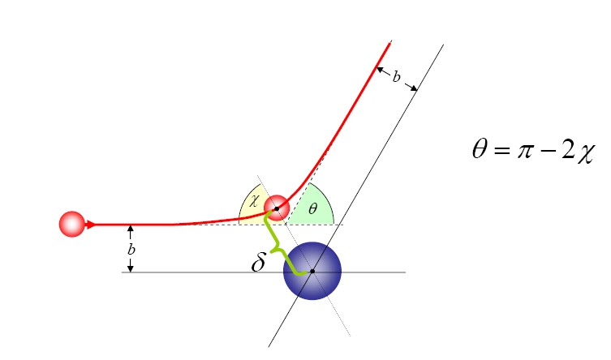






Rutherford scattering scattering parameters
impact parameter:
$$b=a∙cot\frac{θ_{cm}}{2}$$
distance of closest approach:
$$D=a∙\left[\sin^{−1}\frac{θ_{cm}}{2}+1\right]$$
orbital angular momentum:
D
$$ℓ=k_{∞}∙b=η∙cot\frac{θ_{cm}}{2}$$
half distance of closest approach
in a head-on collision (θ_{cm}=180⁰):
θ_{cm}
$$a=\frac{0.72∙Z_{1}Z_{2}}{T_{lab}}∙\frac{A_{1}+A_{2}}{A_{2}} \left[fm\right]$$
b
D
asymptotic wave number:
$$k_{∞}=0.219∙\frac{A_{2}}{A_{1}+A_{2}}∙\sqrt{A_{1}∙T_{lab}} \left[{fm}^{−1}\right]$$
Sommerfeld parameter:
$$η=k_{∞}∙a=0.157∙Z_{1}Z_{2}∙\sqrt{\frac{A_{1}}{T_{lab}}}$$
center of mass system

Slide 10
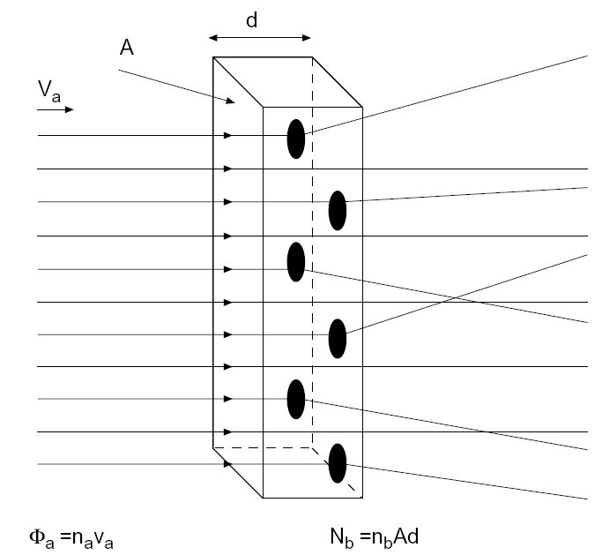
Cross section
The cross section gives the probability of a reaction between the two colliding particles
Consider an idealized experiment:
we bombard the target with a monoenergetic beam of point-like particles a with a velocity v_{a}.
a thin target of thickness d and a total area A with N_{b} scattering centers b and with a particle density n_{b}.
each target particle has a cross-sectional area σ_{b}, which we have to find by experiment!
→ Some beam particles are scattered by the scattering centers of the target, i.e. they are deflected from their original trajectory. The frequency of this process is a measure of the cross section area of the scattered particles σ_{b}.

Slide 11
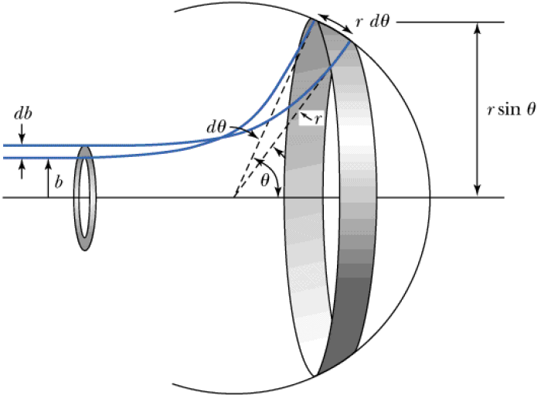
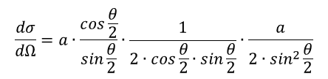
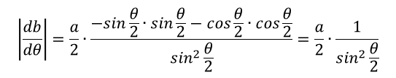

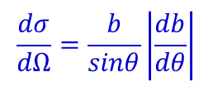

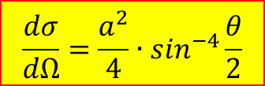
Rutherford cross section
Particles from the ring defined by the impact parameter b and b+db scatter between angle θ and θ+dθ
$$j∙2π∙b∙db=j∙2π∙sinθ∙\frac{dσ}{dΩ}$$
$$\frac{dσ}{dΩ}=\frac{b}{sinθ}\left|\frac{db}{dθ}\right|$$
impact parameter:
$$b=a∙cot\frac{θ}{2}$$
ring area:
2πb db
$$\left|\frac{db}{dθ}\right|=\frac{a}{2}∙\frac{−sin\frac{θ}{2}∙sin\frac{θ}{2}−cos\frac{θ}{2}∙cos\frac{θ}{2}}{\sin^{2}\frac{θ}{2}}=\frac{a}{2}∙\frac{1}{\sin^{2}\frac{θ}{2}}$$
solid angle:
2π sinθ dθ
$$\frac{dσ}{dΩ}=a∙\frac{cos\frac{θ}{2}}{sin\frac{θ}{2}}∙\frac{1}{2∙cos\frac{θ}{2}∙sin\frac{θ}{2}}∙\frac{a}{2∙\sin^{2}\frac{θ}{2}}$$
$$\frac{dσ}{dΩ}=\frac{a^{2}}{4}∙\sin^{−4}\frac{θ}{2}$$
an atomic nucleus exist

Slide 12
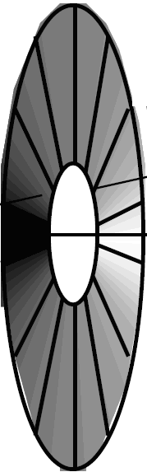
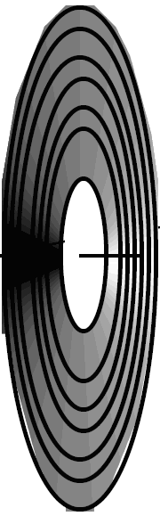
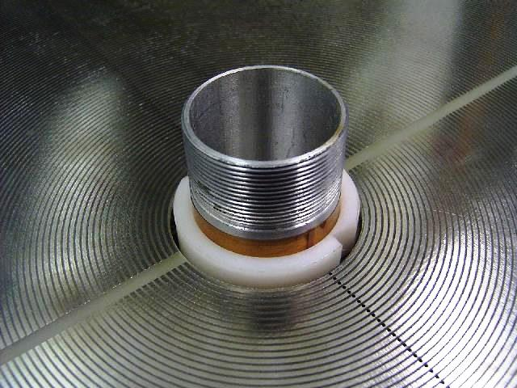
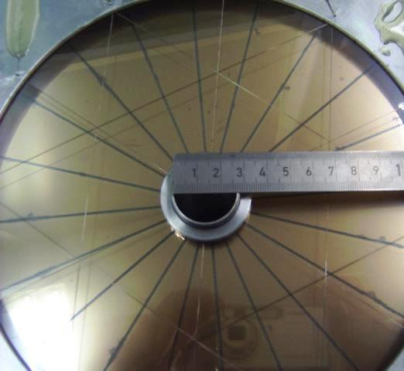
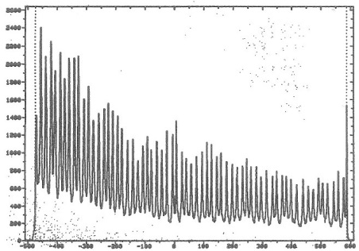
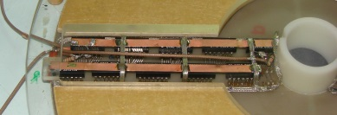
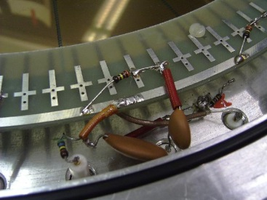
Annular gas-filled parallel-plate avalanche counter (PPAC)
V₀ ~ 500 V
p = 5-10 Torr
gap ~ 3 mm (anode-cathode)
¹²²Sn
⁵⁸Ni beam
Δt ~ tanϑ
o
i
i
i
delay line
Δtime →
A. Jhingan detector laboratory at IUAC

Slide 13
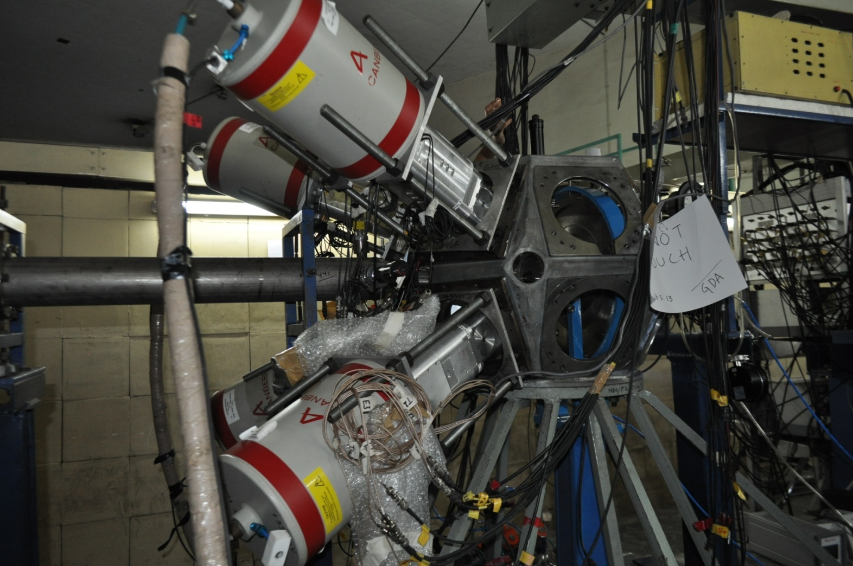

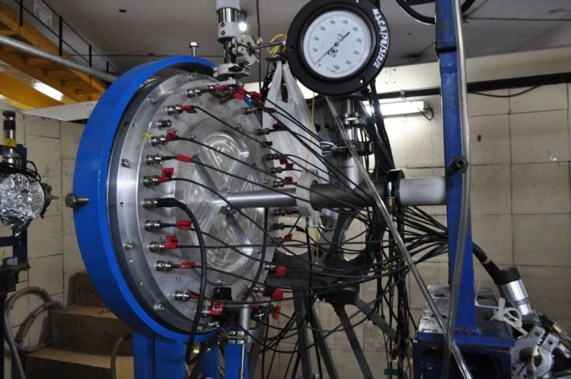
Experimental set-up at IUAC
TARGET
CLOVER DETECTORS
@ backward angles
PPAC @ forward angle

Slide 14
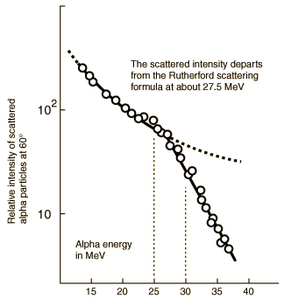
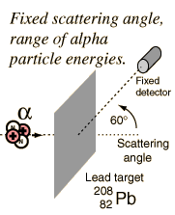
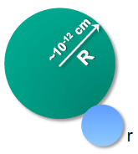




Elastic scattering and nuclear radius
$${}_{2}^{4}{He}+{}_{82}^{208}{Pb}$$
θ_{1/4} = 60⁰, E_{α} = 30 MeV
→ R_{int} = 12.0 [fm]
$$R_{int}≅R_{He}+R_{Pb}+3fm$$
$$D=a∙\left[\sin^{−1}\frac{θ_{cm}}{2}+1\right]$$
$$a=\frac{0.72∙Z_{1}Z_{2}}{T_{lab}}∙\frac{A_{1}+A_{2}}{A_{2}} \left[fm\right]$$
R.M. Eisenberg and C.E. Porter, Rev. Mod. Phys. 33, 190 (1961)

Slide 15
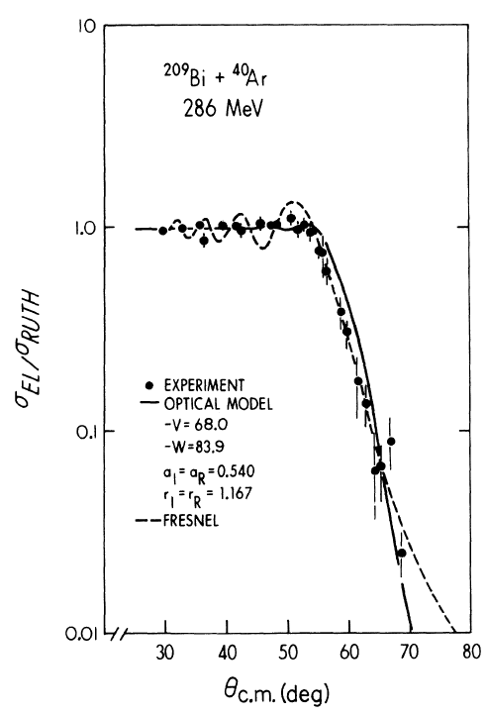
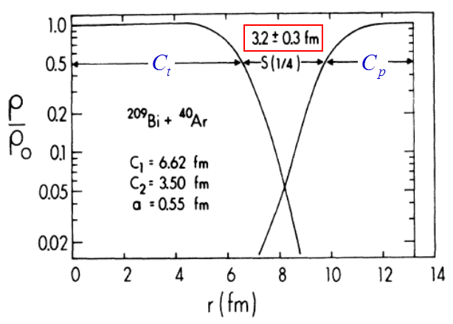
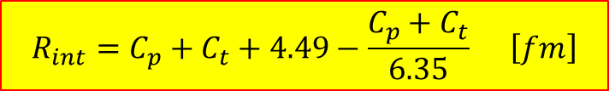



Elastic scattering and nuclear radius
Nuclear interaction radius: (distance of closest approach)
$$R_{int}=D=a∙\left[\sin^{−1}\frac{θ_{1/4}}{2}+1\right]$$
$$R_{int}=C_{p}+C_{t}+4.49−\frac{C_{p}+C_{t}}{6.35} \left[fm\right]$$
$$C_{i}=R_{i}∙\left(1−R_{i}^{−2}\right) \left[fm\right]$$
$$R_{i}=1.28∙A_{i}^{1/3}−0.76+0.8∙A_{i}^{−1/3} \left[fm\right]$$
Nuclear density distributions at the nuclear interaction radius
θ_{1/4} = 60⁰ → R_{int} = 13.4 [fm]
→ ℓ_{gr} = 152 [ħ]
J.R. Birkelund et al., Phys.Rev.C13 (1976), 133

Slide 16
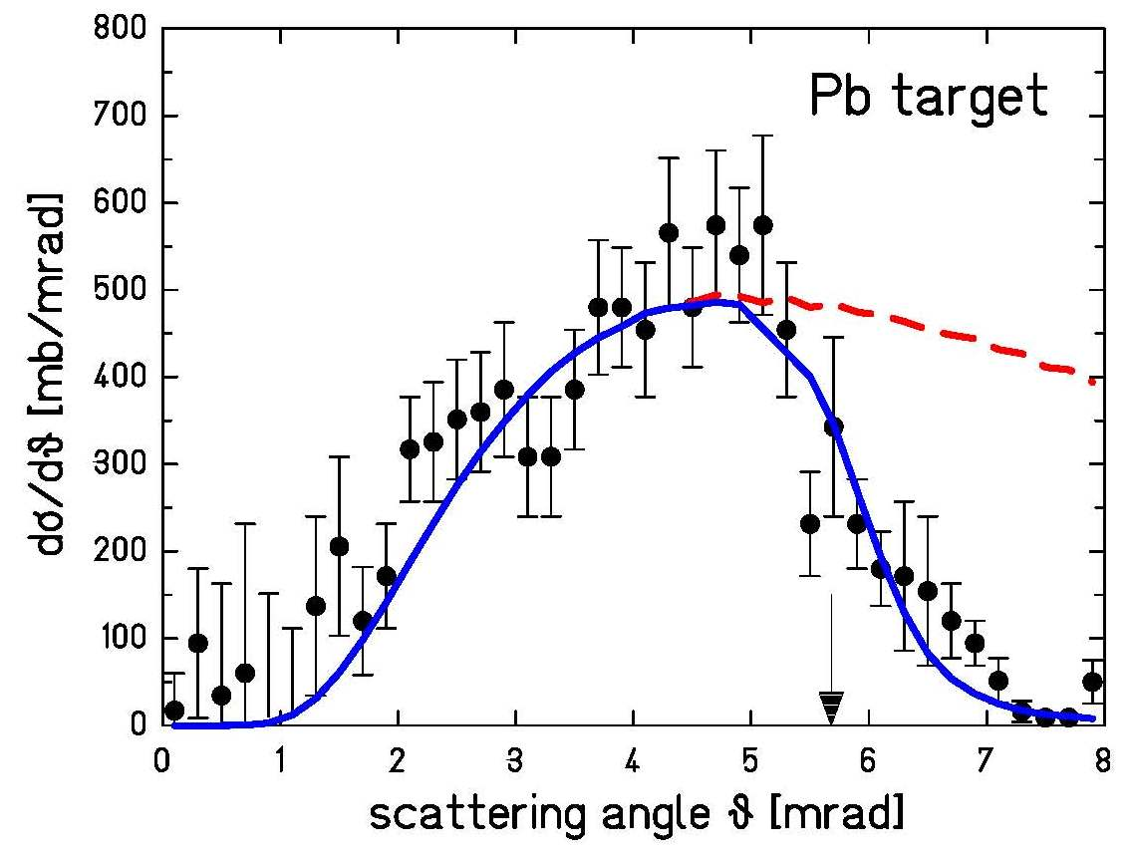
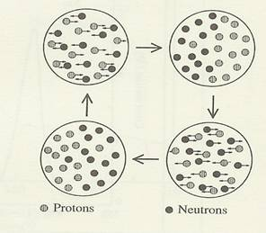
High-energy Coulomb excitation grazing angle
¹³⁶Xe on ²⁰⁸Pb at 700 MeV/u
excitation of giant dipole resonance
Coulomb ex.
Protons
Neutrons
For relativistic projectiles ( ):
π
ν
A.Grünschloß et al., Phys. Rev. C60 051601 (1999)

Slide 17
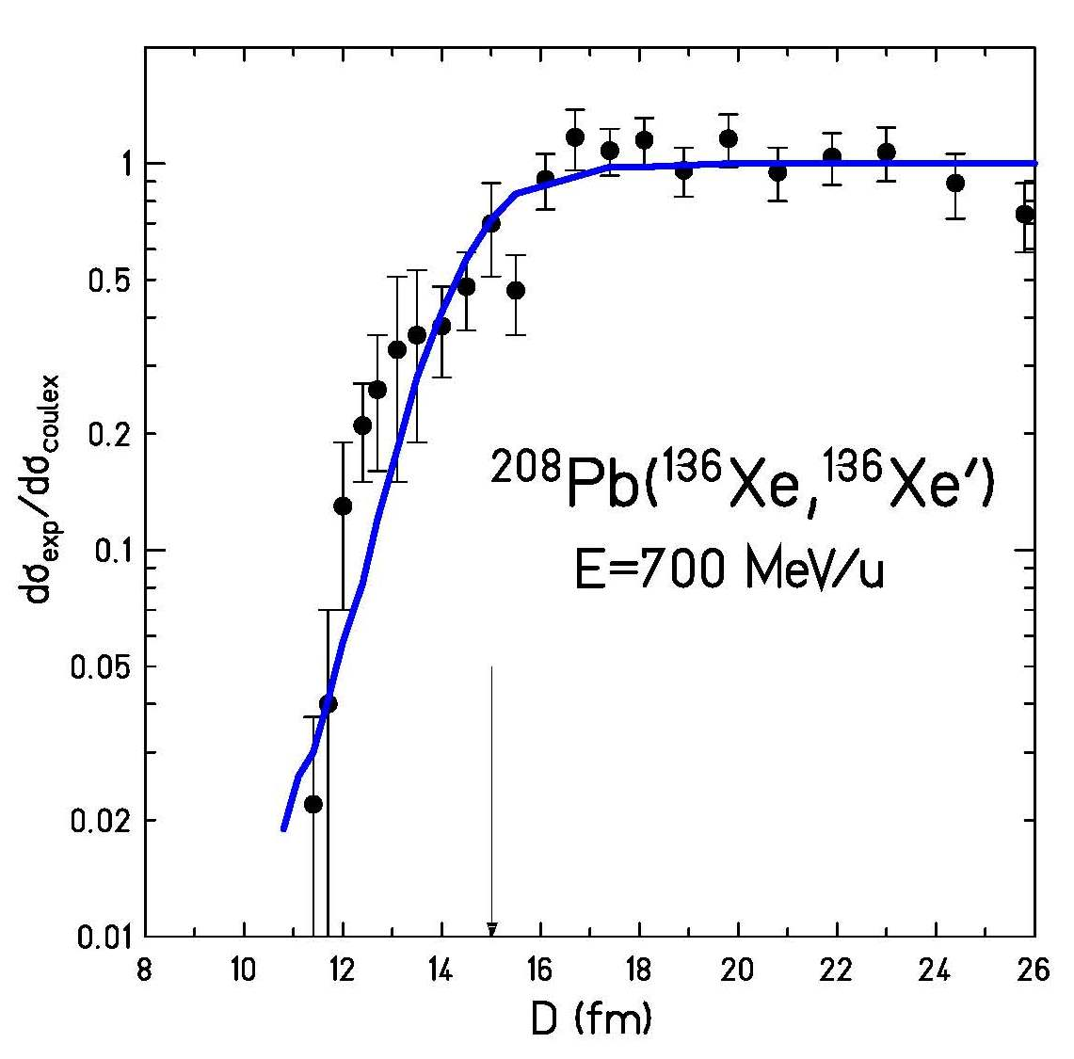
High-energy Coulomb excitation grazing angle
¹³⁶Xe on ²⁰⁸Pb at 700 MeV/u
excitation of giant dipole resonance
Coulomb ex.
Protons
Neutrons
For relativistic projectiles ( ):
π
ν
A.Grünschloß et al., Phys. Rev. C60 051601 (1999)

