Slide 1

Outline: Neutrino
Lecturer: Hans-Jürgen Wollersheim
e-mail: h.j.wollersheim@gsi.de
web-page: https://web-docs.gsi.de/~wolle/ and click on
β-decay and the proposed neutrino
neutrino’s from the sun
neutrino oscillations
Dirac or Majorana fermions

Slide 2
1930: Energy conservation violated in β-decay
alpha-decay
beta-decay
expectation 1930
Th 234
Pa 234
U 238
Th 234
α (He 4)
β (electron)
energy
conservation
J
measurement
L
counts
counts
expectation
α-energy
β-energy

Slide 3
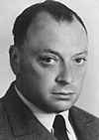
The new particle proposed by Pauli
Beta-decay
Leptonen
Charge −1
Charge 0
e
ν_{e}
Wolfgang Pauli
Electron
e-Neutrino
μ
ν_{μ}
Myon
μ-Neutrino
*
τ
ν_{τ}
Pa 234
Tauon
τ-Neutrino
β (electron)
Th 234
ν
In addition to an electron a light
neutral particle is created which
carries away the missing energy!
„Today I have done something, what one should not do in theoretical physics. I have
explained something, what is not understood, by something, which can not be observed!"

Slide 4
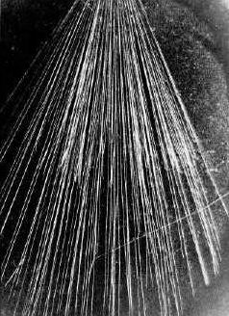
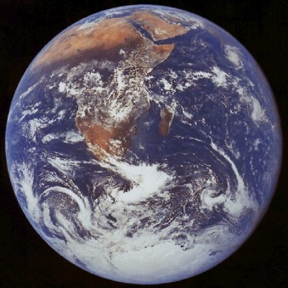
Neutrino detection
Detection of particles:
  Interaction of particles with matter (detector)
Interaction with matter depends strongly on the particle:
  Charge particles: Ionization of matter
  Photons: Energy transfer to charged particles
  Neutrons: Nuclear reactions yield charge particles
cloud chamber
Neutrinos interact very weakly:
  Only one out of 100 billions neutrinos from the
  β-decay will be recognized by the earth.
ν
Calculated 1934: „Hopeless“

Slide 5
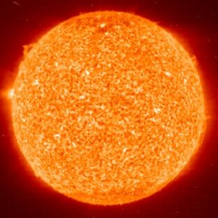
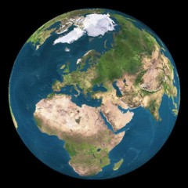
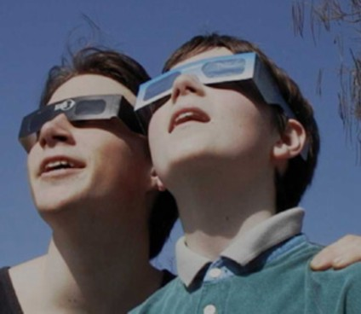
Sun glasses for neutrinos
8.3 light minutes
A lead layer with a thickness
of several light years is needed
Bethe & Peierls 1934
„ … this means, that one obviously will
never be able to observe a neutrino.”

Slide 6
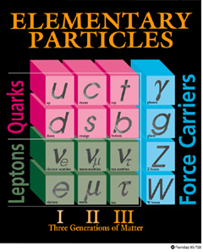
Neutrino, the story
Proposed by W. Pauli in 1930
Reactor ν_{e} observed,1953
ν_{e}≠ ν_{μ}, 1960-64
Electro-weak theory GWS
Neutral current discovered, 1973
Z, W observed at LEP, 1983
Z width ⇒ 3 ν families
ν_{τ,}
Standard Model almost complete

Slide 7
Neutrino oscillations

Slide 8
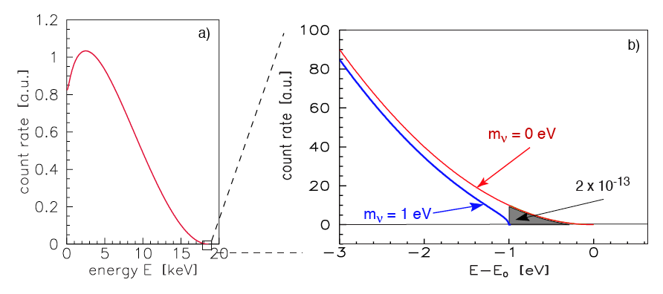
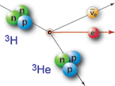
Kinematical experiments

Slide 9
Kinematical experiments
Challenges:
  Small rate at the tail ⇒ low Q_{β}
  Energy resolution ~ m_{ν} ⇒ non-traditional detectors
  Effect is at the scale of atomic energy (H line 13.6 eV) ⇒ enormous effort to control systematic error
  ³H 18 keV β-decay (Troitsk, Maiz, Katrin) ⇒ Use of MAC-E filter
  ¹⁸⁷Re 2.47 keV β-decay (MARE) ⇒ Use of cryogenic bolometer (see CUORE experiment for bolometer detector)

Slide 10
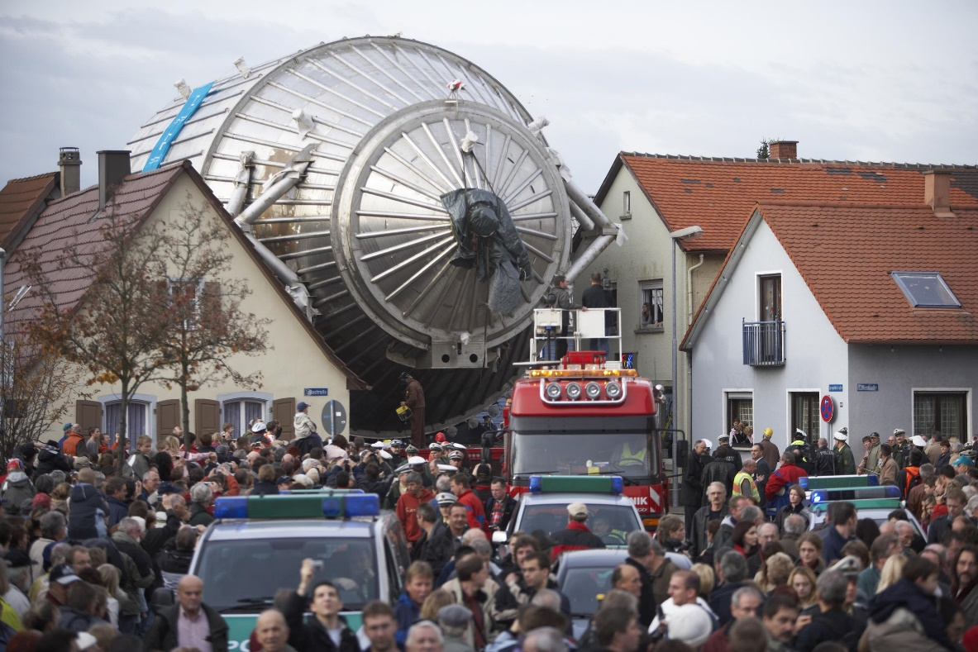
Kinematical experiments
KATRIN
ΔE = E×B_{min}/B_{max} = 0.93 eV
Double beta decay primer

Slide 11
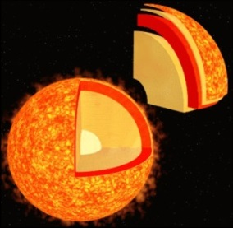
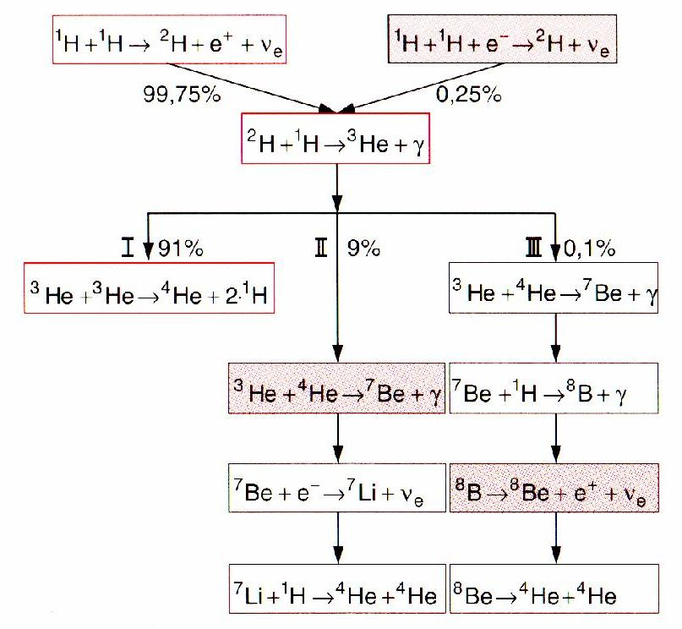
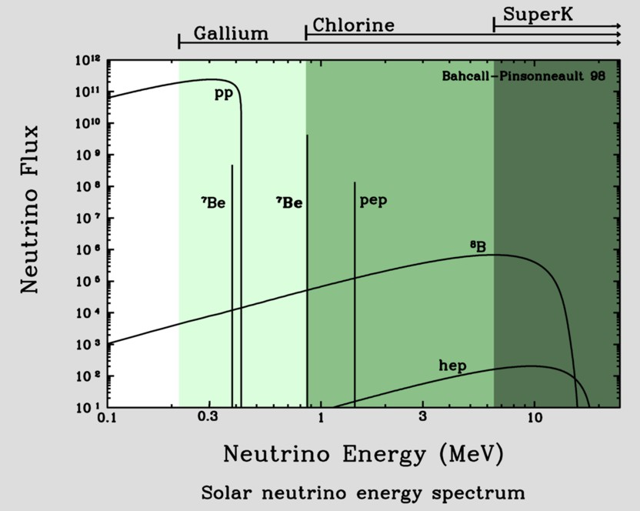
Neutrinos from the sun
Known: total emitted energy
Known: energy per fusion process
number of created neutrinos per sec!
on earth: 66 billions ν per (cm² · s¹)
Standard solar model

Slide 12
Neutrinos from the sun
Known: total emitted energy
Known: energy per fusion process
number of created neutrinos per sec!
on earth: 66 billions ν per (cm² · s¹)
proton-proton-cycle
pp-neutrino
pep-neutrino
p+p => ²H+e⁺+ν_{e} (99%)
p+e⁻+p => ²H+ν_{e} (1%)
2H+p => ³He+γ
hep-neutrino
³He+³He => ⁴He+2p (86%)
³He+p => ⁴He+ν_{e}+e⁺ (<<1%)
³He+⁴He => ⁷Be+γ (14%)
⁷Be-neutrino
⁸B-neutrino
⁷Be + e⁻ =>⁷Li + ν_{e}
⁷Li + p => 2 ⁴He (99%)
⁷Be + p => ⁸B + γ
⁸B => ⁸Be + e⁺+ ν_{e}
⁸Be => 2 ⁴He (1%)

Slide 13
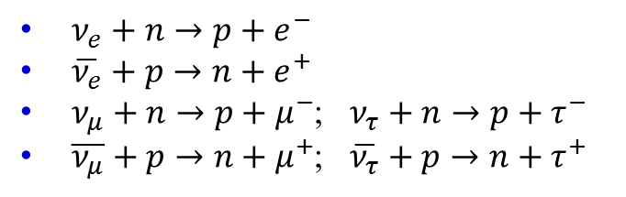
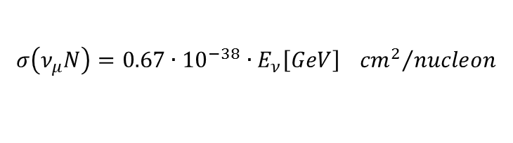
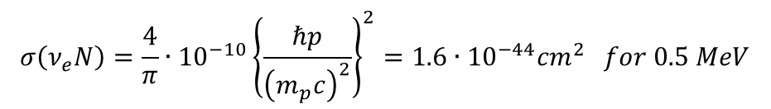
Interaction of Neutrinos
$ν_{e}+n→p+e^{−}$
$\overline{ν_{e}}+p→n+e^{+}$
$ν_{μ}+n→p+μ^{−}$; $ν_{τ}+n→p+τ^{−}$
$\overline{ν_{μ}}+p→n+μ^{+}$; $\overline{ν_{τ}}+p→n+τ^{+}$
(discovery of the neutrino)
Small cross section for MeV neutrinos:
$$σ\left(ν_{e}N\right)=\frac{4}{π}∙{10}^{−10}{\left\{\frac{ℏp}{{\left(m_{p}c\right)}^{2}}\right\}}^{2}=1.6∙{10}^{−44}{cm}^{2} for 0.5 MeV$$
Rate of solar neutrinos interacting in the Earth:
$$N∙σ∙d∙ρ∙flux=6.022∙{10}^{23}∙1.6∙{10}^{−44}{cm}^{2}∙1.2∙{10}^{9}cm∙5.5\frac{g}{{cm}^{3}}∙6.7∙{10}^{10}{cm}^{−2}s^{−1}=4{cm}^{−2}s^{−1}$$
For high energies (GeV-range):
$$σ\left(ν_{μ}N\right)=0.67∙{10}^{−38}∙E_{ν}\left[GeV\right] {{cm}^{2}}/{nucleon}$$

Slide 14
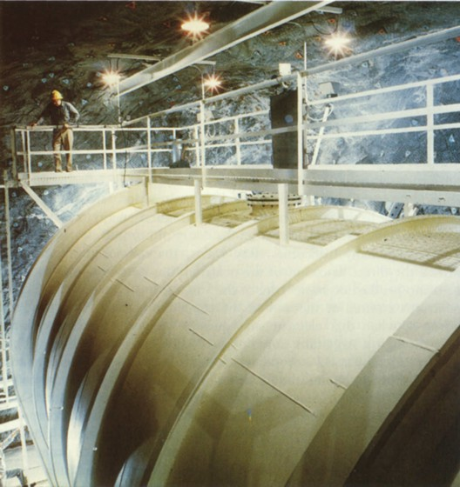
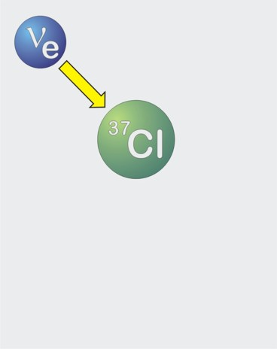
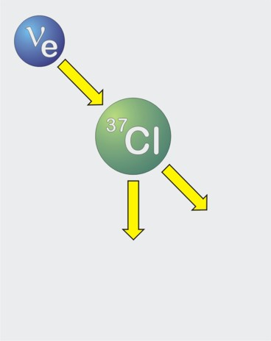
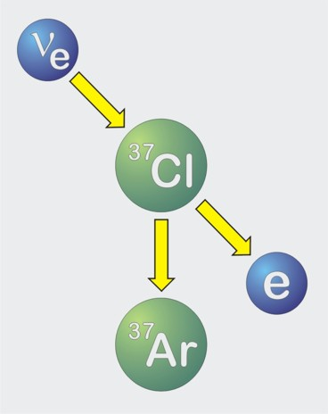
First measurements of the solar neutrinos
Inverse beta-decay
(„neutrino-capture”)
40 days of neutrino exposure …
Expected: 60 atoms ³⁷Ar
600 tons
carbon tetrachloride
Homestake Solar Neutrino
Observatory (1967−2002)

Slide 15
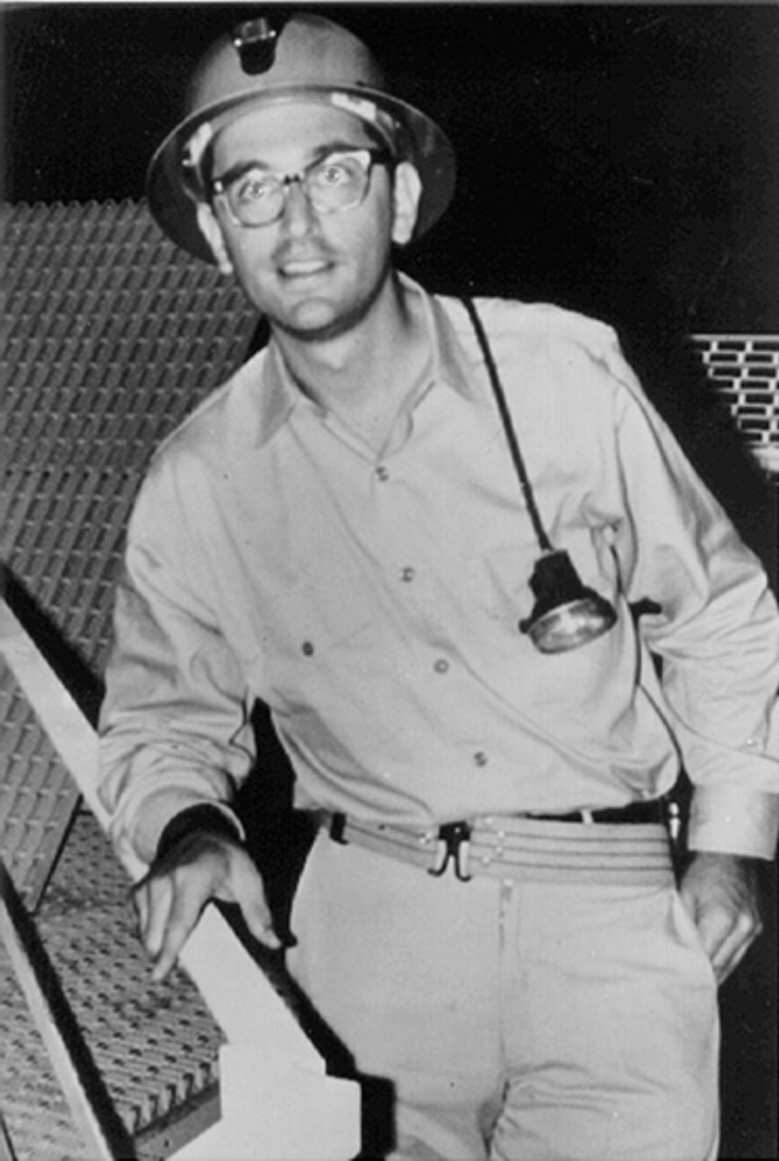
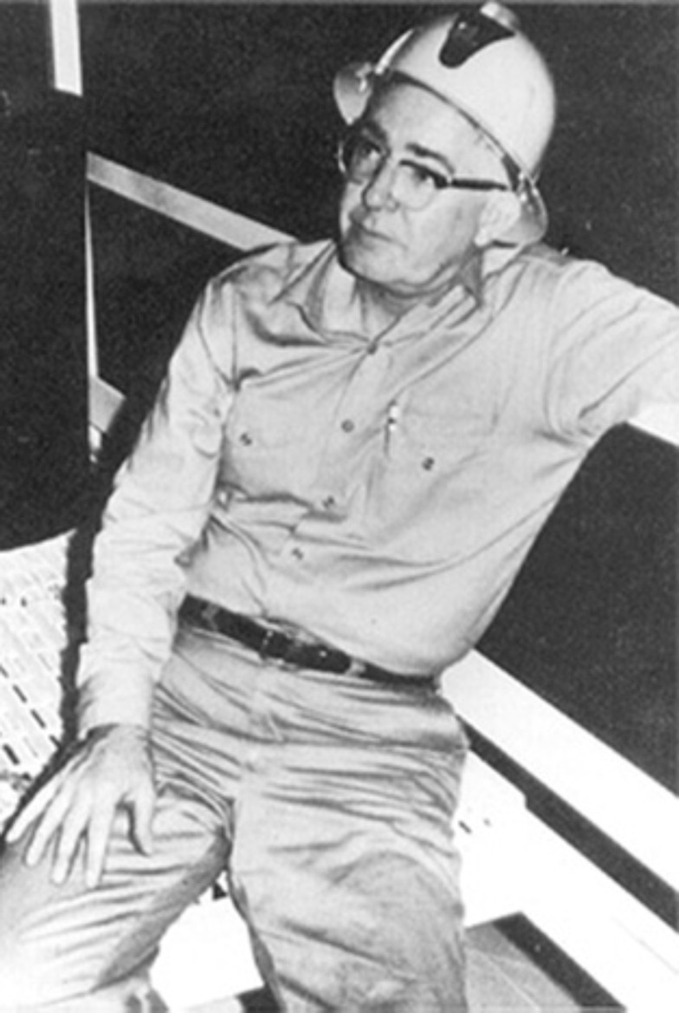
Problem of the “missing” solar neutrinos
Homestake
Chlorine
⁸B
Calculation of the solar
neutrino flux from different
source reactions
CNO
⁷Be
Measurements (1970 – 1995)
John Bahcall
1934 − 2005
Raymond Davis Jr.
1914 − 2006

Slide 16
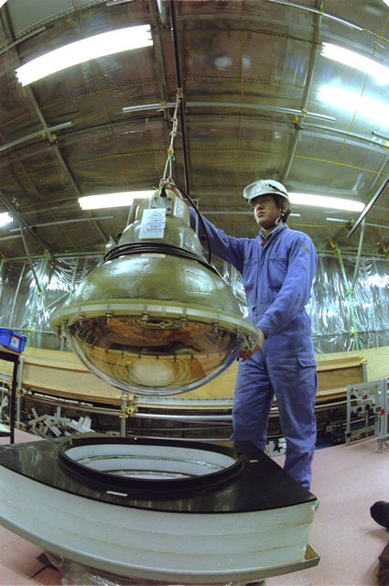
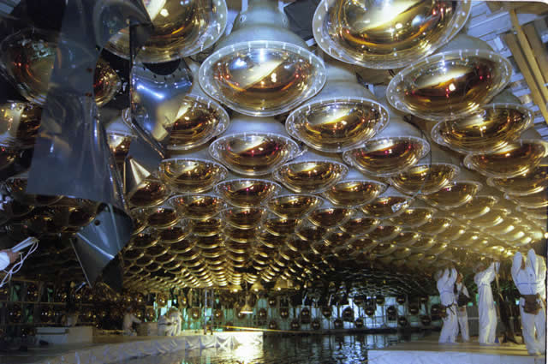
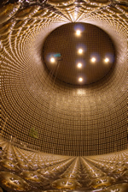
Super Kamiokande – the Detector
40 m water tank
filled with 50 ktons pure water
largest water Cherenkov detector in the world!
>11,000 photomultipliers (PMTs) to detect light
PMTs + electrical connections waterproof

Slide 17
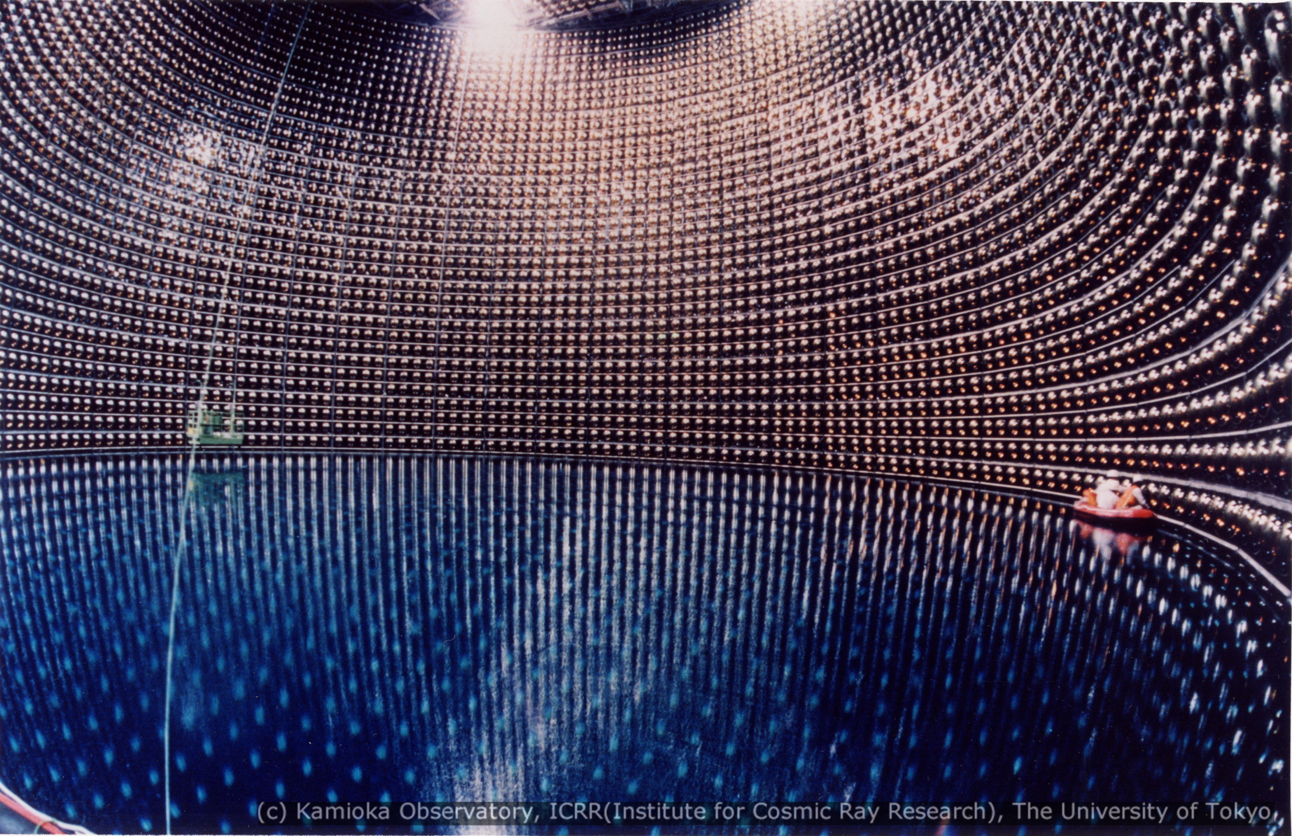
Super Kamiokande – the Detector

Slide 18
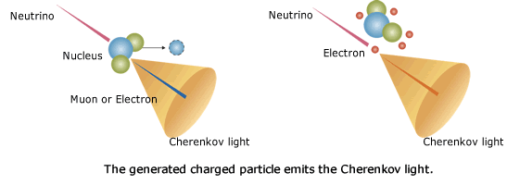
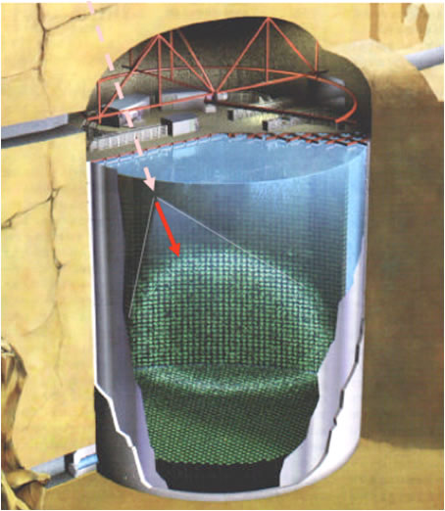
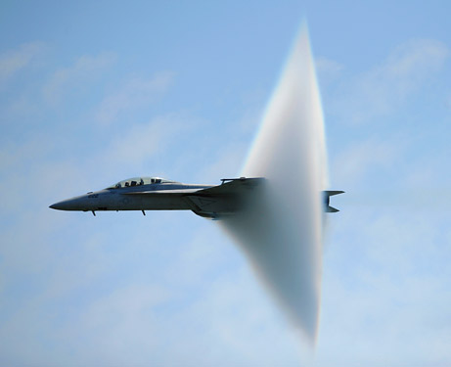
Super Kamiokande – Detection Concept
Muon neutrinos interact with nucleons via charged current to produce ultra relativistic muons
The muons travel faster than the speed of light in the detector (still slower than c)
This produces a cone of Cherenkov light (same principle as a sonic boom)
Light is detected by photo sensors

Slide 19



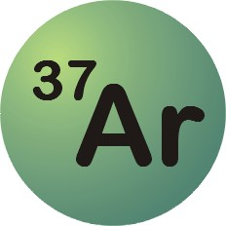




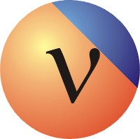
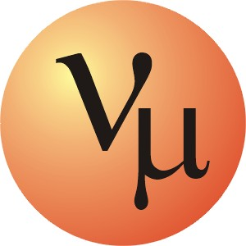
Neutrino conversion is the solution of the problem
detector
Sun
Sun
detector

Slide 20
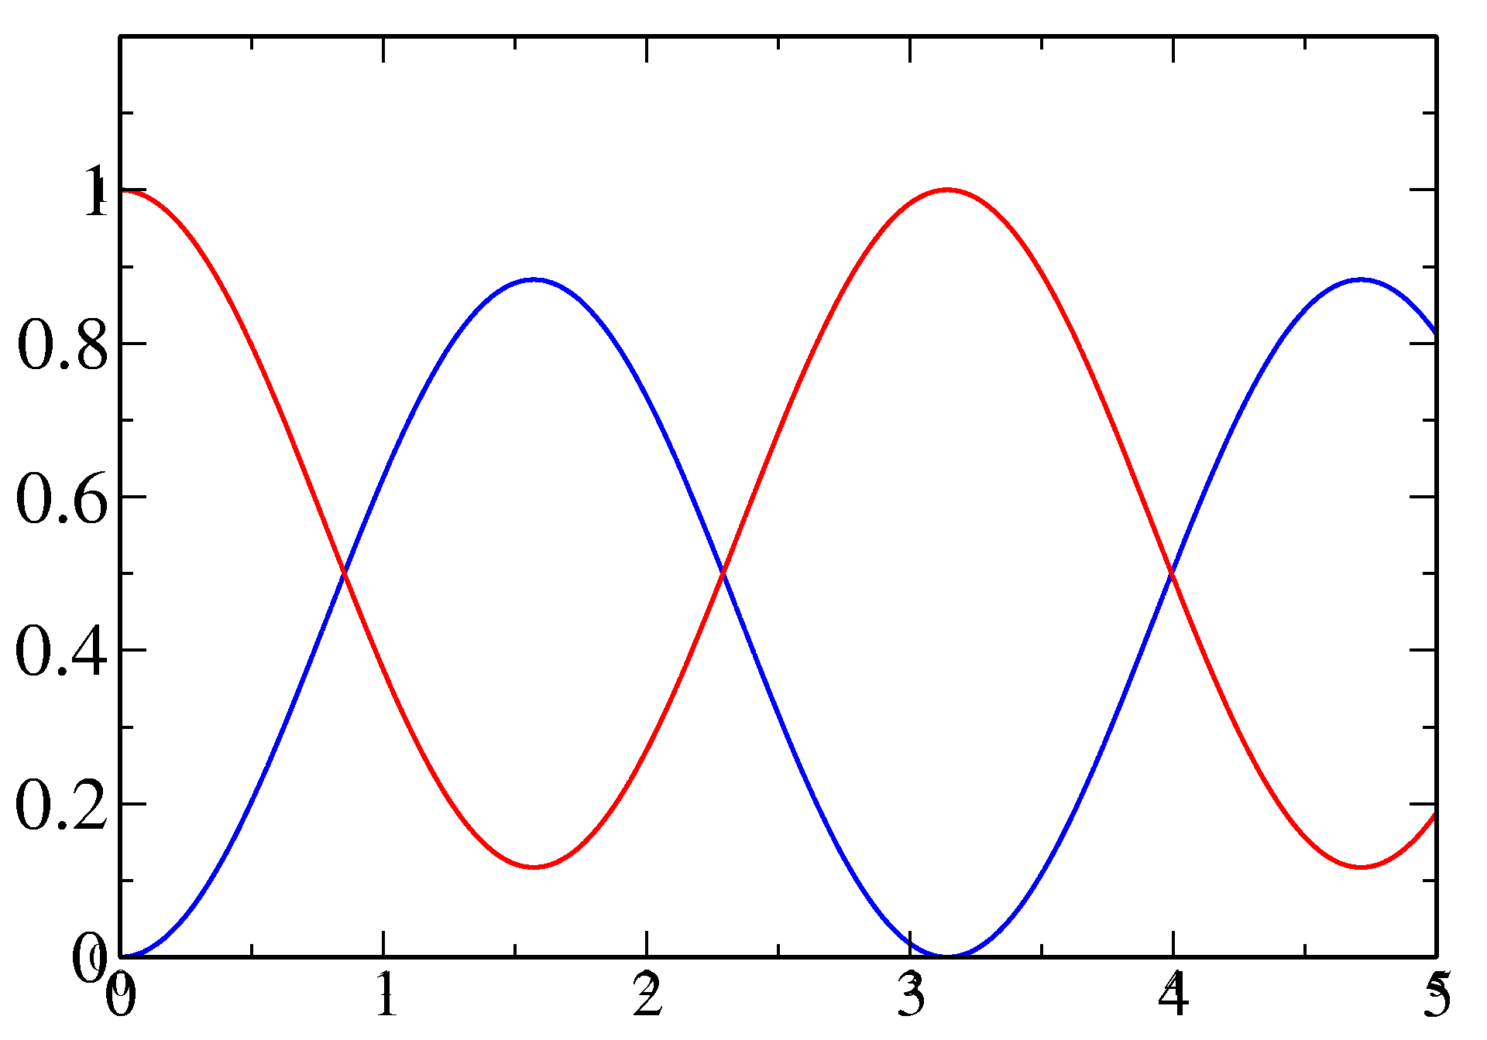
Neutrino oscillations
Electron e
Myon μ
Tau τ
e-Neutrino
μ-Neutrino
τ-Neutrino
Idea: when neutrinos have a mass, they may convert into each other!
Assumption: Mixture of
Conversion of a neutrino
beam with the distance from the neutrino source:
ν_{e}
ν_{μ}
ν_{e} and ν_{μ}
Portion of the beam
distance from the source
1998: Confirmation of the oscillations between Myon- and Tau-neutrinos with methods of Super-Kamiokande (Myon-neutrinos from the atmosphere)

Slide 21
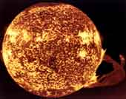
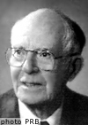
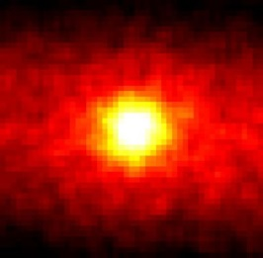
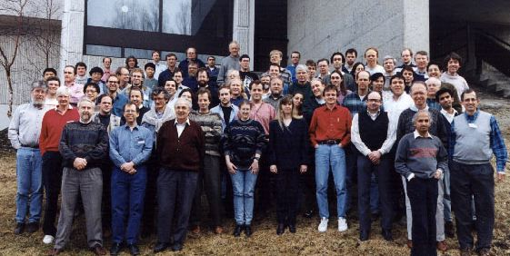
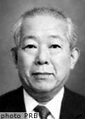
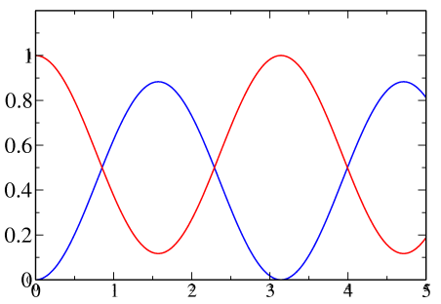
The solar neutrino problem
Sun
since 4.5 billion years
fusion
66 billion neutrinos/s/cm²
since 1964: detection with
Homestake-experiment
expected: 1,5 reactions/d
measured: 0.5 reactions/d
solar
neutrino
problem
prediction
exp
Since 1986 Kamiokande:
confirms Homestake
2002 SNO-experiment:
examines neutrino-oscillation
possible explanation:
neutrino-oscillation
ν₂
solar
neutrino
problem
solved!
all neutrinos
ν₁
prediction
ν_{e}

Slide 22
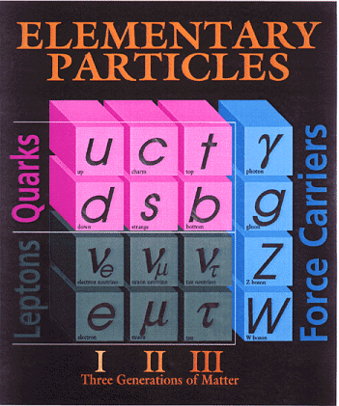
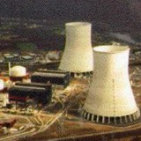
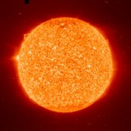

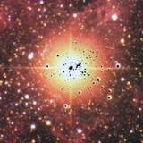

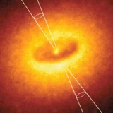


Neutrinos as astrophysical messenger
nuclear reactors
✓
Sun
✓
Supernovae
(collapsing stars)
particle accelerator
✓
SN 1987A ✓
earth atmosphere
(cosmic radiation)
✓
astrophysical
accelerators soon ?
earth crust
(natural radioactivity)
Big Bang of the Universe
(today 330 ν/cm³)
indirect evidence
✓

Slide 23

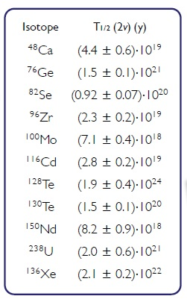
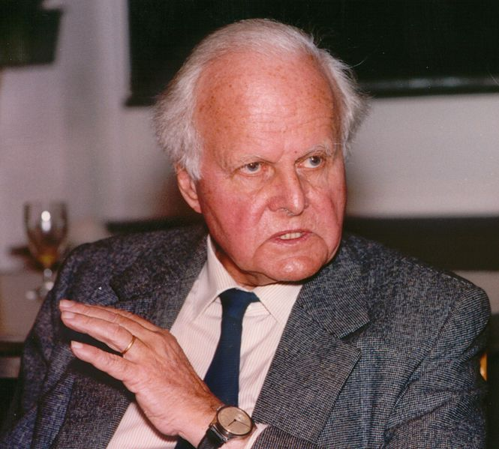
Two neutrino double beta decay
In some cases, the single beta decay is energetically forbidden.
Then the double beta decay becomes relevant
Carl von Weizäcker

Slide 24
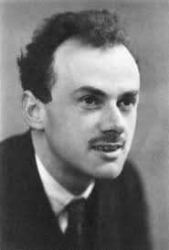
Dirac neutrino

Slide 25
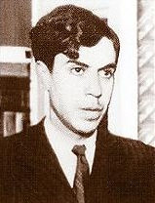
Majorana neutrino

Slide 26
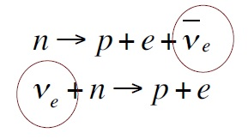
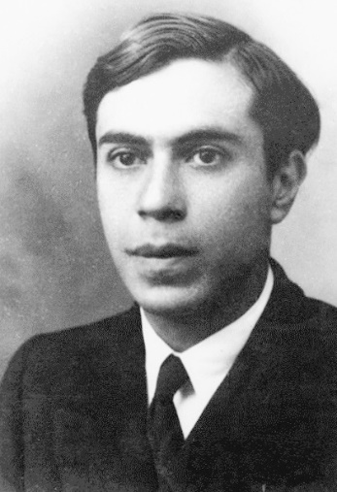
Dirac vs Majorana
Paul Dirac:
„The neutrino is not identical to the known antineutrino”
Ettore Majorana:
„The neutrino is identical to the known antineutrino”

Slide 27


Dirac vs Majorana
helicity:
projection of spin onto momentum
Paul Dirac:
„Even if the neutrino flips its helicity it is still a fundamentally different particle. The reaction is not possible”
Ettore Majorana:
„Neutrino only has the wrong helicity, if it can flip the helicity this reaction should be possible”

Slide 28


Why do we care if the neutrino has Majorana nature?
Matter asymmetry can be produced if
… Baryon number is violated
… Lepton number violation can be converted to
Baryon number violation
… hence we search for Lepton number violation
= Majorana nature of neutrinos
Andrei Sacharow, 1967

Slide 29


Neutrinoless ββ-decay
Golden plated channel:
2 electrons
E_{β1}+ E_{β2}=Q_{ββ}
~<m>²/E²
(A,Z)→(Z+2,A)+2e⁻

Slide 30

Double beta (ββ2ν) decay
(A,Z)→(Z+2,A)+2e⁻+2ν_{e}
allowed in Standard Model
very rare, ~G_{F}⁴
typical T_{1/2}=10¹⁸-10²¹ years
First indirect confirmation for ⁸²Se, ¹³⁰Te by geochemical analysis
First direct observation: TPC with ⁸²Se foil, 32 events.
Elliott SR Hahn AA and Moe MK, 1987

Slide 31

The experimental signature
2νββ: neutrinos and electrons share the energy
0νββ: the electrons get all the energy
= energy of the two electrons
total energy released in the decay

Slide 32

Appendix: Lepton number

