Slide 1

Outline: Nuclear shell structure exotic nuclei
Lecturer: Hans-Jürgen Wollersheim
e-mail: h.j.wollersheim@gsi.de
web-page: https://web-docs.gsi.de/~wolle/ and click on
shell structure of super-heavy nuclei (²⁵⁰Fm, ²⁵⁴No)
classical anomalies: ¹¹Be, ¹¹Li
monopole interaction of the tensor force: N=20, N=28
neutron-proton pairing in ⁹²Pd

Slide 2
New challenges in nuclear structure new magic numbers
126
doubly magic nuclei:
⁴He, ¹⁶O, ⁴⁰Ca, ⁴⁸Ca, ²⁰⁸Pb
82
50
protons
82
28
20
50
instable: ⁴⁸Ni, ⁵⁶Ni, ⁷⁸Ni, ¹⁰⁰Sn, ¹³²Sn
8
no ²⁸O !
28
neutrons
2
20
2
8

Slide 3
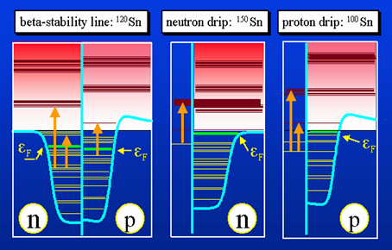
New challenges in nuclear structure new magic numbers
126
S_{p} = 0
82
proton drip-line
explored up to Z = 83
50
protons
82
28
20
50
S_{n} = 0
8
28
2
20
neutrons
2
8
neutron drip-line
known up to N = 20 !

Slide 4
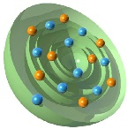
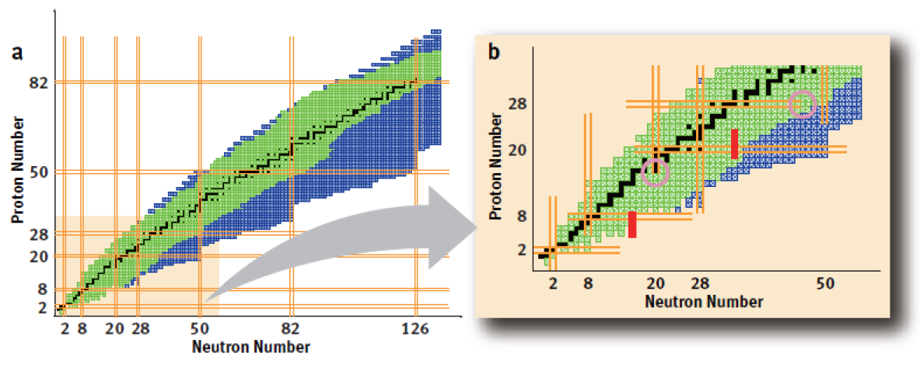
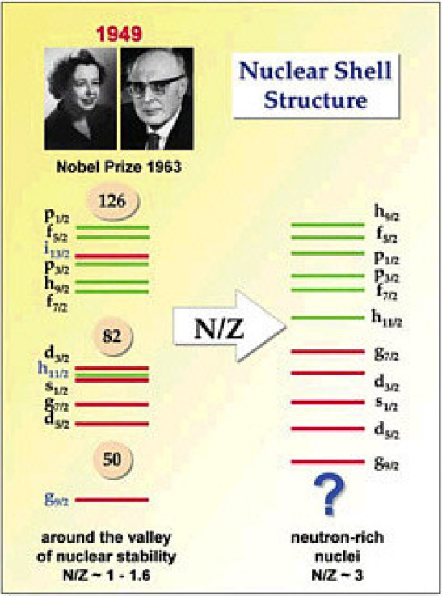
Chart of the nuclei mirror nuclei and the nuclear shell model
70
40

Slide 5
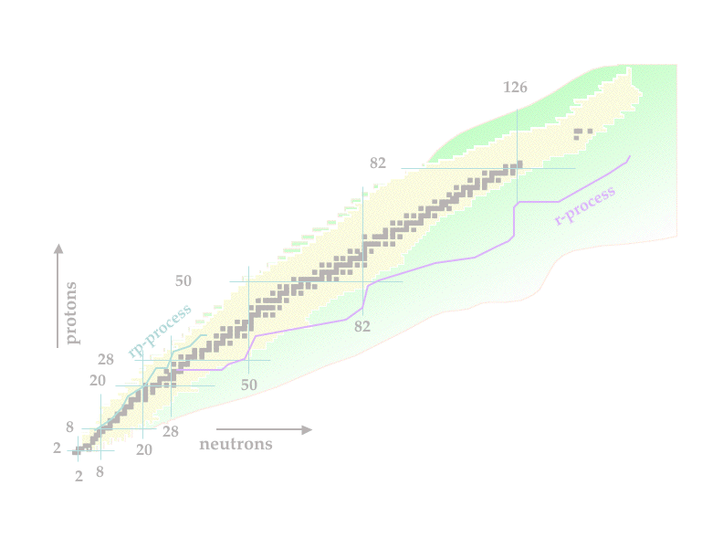
Shell structure far away from stability
Introduction
Shell structure of super-heavy nuclei
  Nuclear structure of transfermium elements ( ²⁵⁰Fm, ²⁵⁴No)
  deformed shell model
Nuclear shell model
  classical anomalies: ¹¹Be, ¹¹Li
  experimental results of the deuteron
  Monopole interaction of the tensor force
  Nuclei around N=20: ⁴⁰Ca, ³⁸Ar, ³⁶S, ³⁴Si, ³²Mg, ³⁰Ne
  Nuclei around N=28: ⁴⁸Ca, ⁴⁶Ar, ⁴⁴S
  Neutron-proton pairing in ⁹²Pd
Summary and outlook

Slide 6
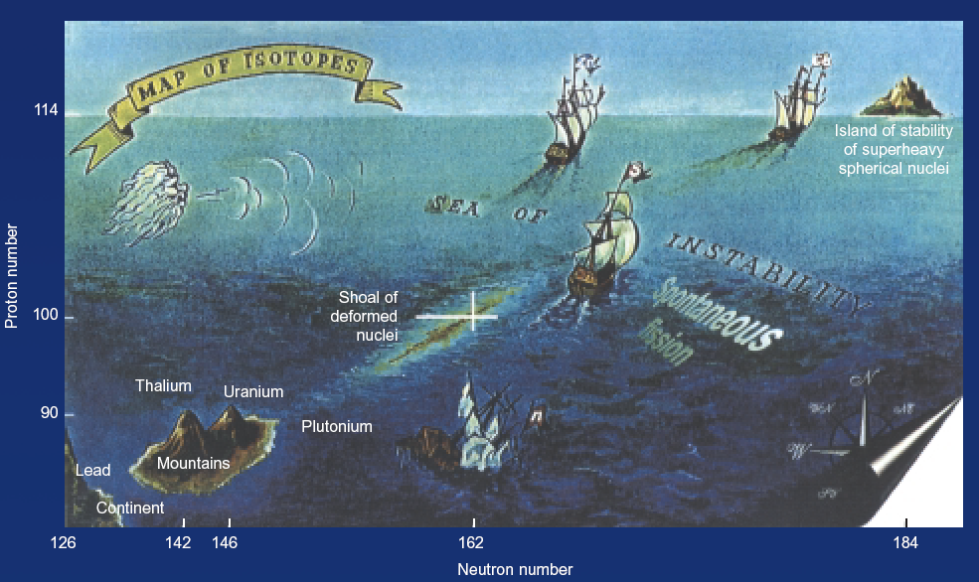
Spectroscopy of transfermium nuclei (Z=100-103) super–heavy elements

Slide 7
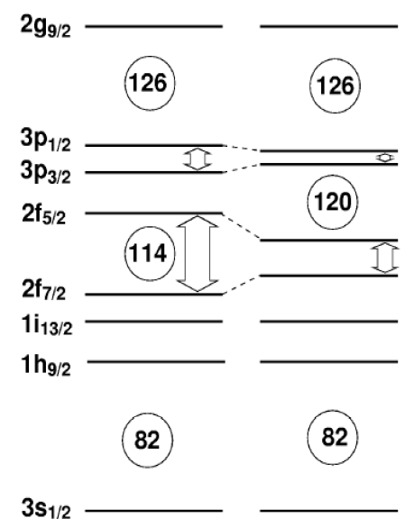
Nucleare shell structure
Where is the next shell closure ?
J
3
The deformation of the nucleus changes
the order of the single particle states ( Nilsson model )

Slide 8

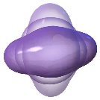
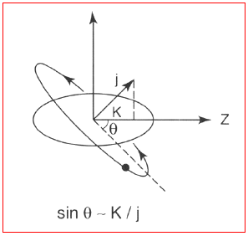
Deformed shell model – Nilsson model
Nilsson-model
deformed oscillator potential
axially symmetry around the z-axis
→ nuclei can rotate
Hamiltonian
$$H=−\frac{ℏ^{2}}{2∙m}∙∆+\frac{m}{2}∙\left[ω_{⊥}^{2}∙\left(x^{2}+y^{2}\right)+ω_{z}^{2}∙z^{2}\right]+C∙\vec{L}∙\vec{S}+D∙{\vec{L}}^{2}$$
deformation parameter δ
separation of laboratory system and
body-fixed (intrinsic) system
K = projection of the single-particle
angular momentum onto the symmetry
axis
Rotation perpendicular to the symmetry
axis does not change the K-quantum
number
$$H=−\frac{ℏ^{2}}{2∙m}∙∆+\frac{m}{2}∙ω_{0}^{2}∙r^{2}+C∙\vec{L}∙\vec{S}+D∙{\vec{L}}^{2}−m∙ω_{0}^{2}∙r^{2}∙δ∙\frac{4}{3}∙\sqrt{\frac{5}{4∙π}}∙Y_{20}\left(θ,φ\right)$$
shell model with H.O. potential
H_{def}

Slide 9
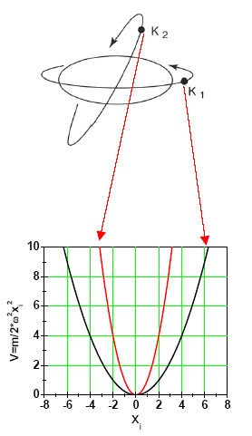
Deformed shell model – Nilsson model
Nilsson-model
deformed oscillator potential
axially symmetry around the z-axis
→ nuclei can rotate
Orbital 1 is closer to the center of gravity than orbital 2.
The energy of orbital 1 is lowest.
(attention: negative sign in Hamiltonian)
Hamiltonian
deformation parameter δ
shell model with H.O. potential
H_{def}

Slide 10
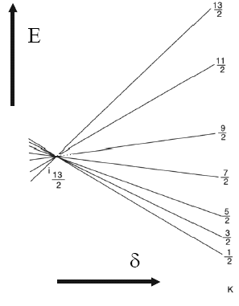
Deformed shell model – Nilsson model
Nilsson-model
deformed oscillator potential
axially symmetry around the z-axis
→ nuclei can rotate
Orbital 1 is closer to the center of gravity than orbital 2.
The energy of orbital 1 is lowest.
(attention: negative sign in Hamiltonian)
Intruder
Orbitals are lifted or lowered, that orbitals from other shells with opposite parity are crossed

Slide 11
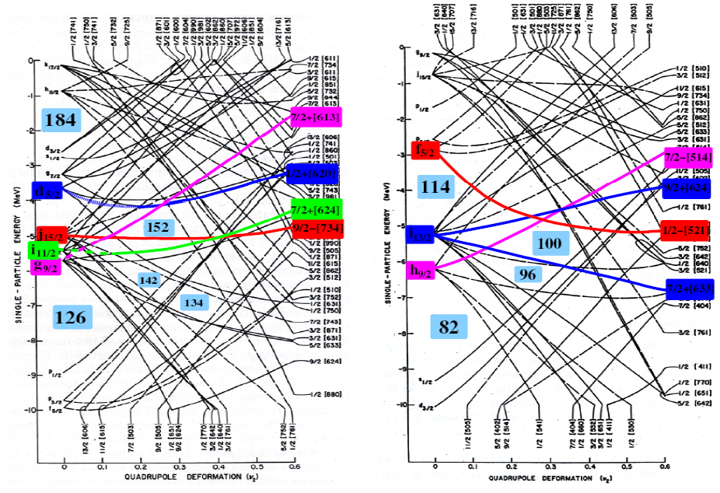
Deformed shell model
Which structure have SHE ? (indirect attempt)
deformed shell model closures for transfermium elements
²⁵⁴No₁₅₂ β₂~0.28
Oblate
Prolate

Slide 12
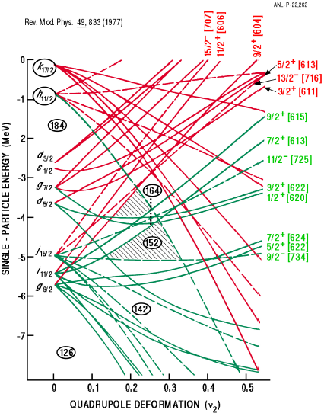
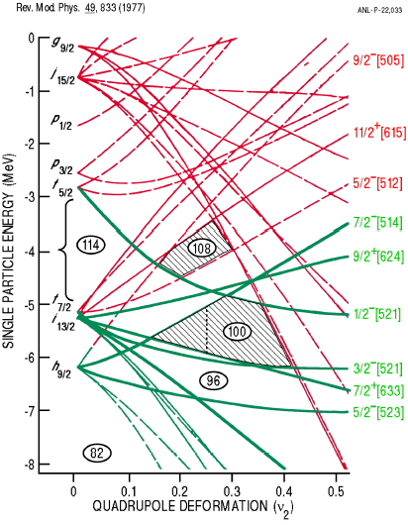

Single particle orbitals
R. Chasman et al. Rev. Mod. Phys. 49 (1977), 833
Which structure have SHEs ? (indirect attempt)
deformed shell model closures for transfermium elements
oblate
prolate

Slide 13
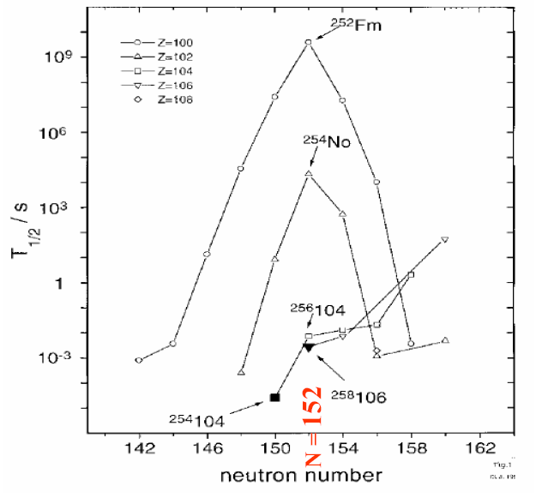
Stability of heavy elements – Nilsson energy levels
N = 152
²⁵⁴No (Z=102), ²⁵²Fm (Z=100) and ²⁵⁰Cf (Z=98) with N=152
seem to be more stable than their neighbors

Slide 14
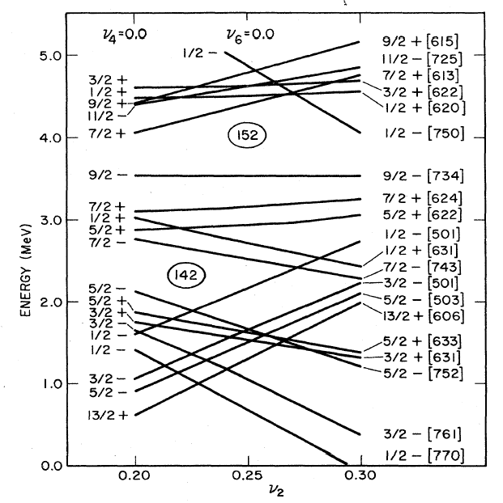
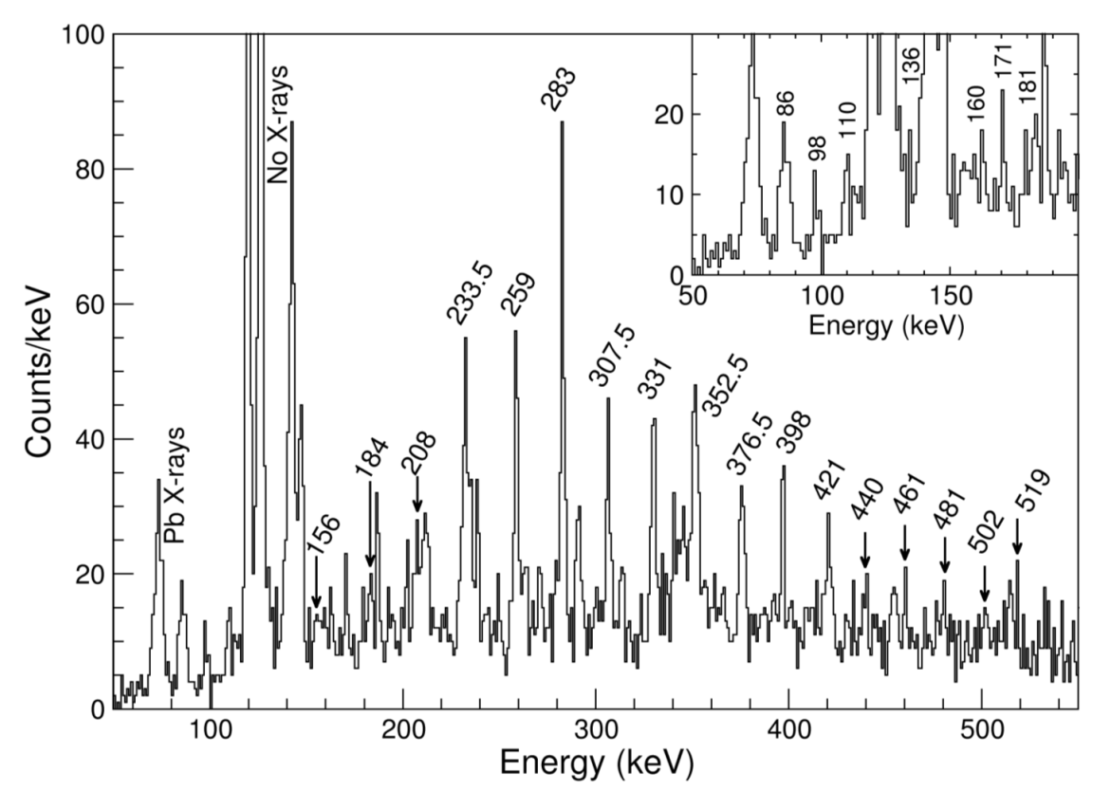
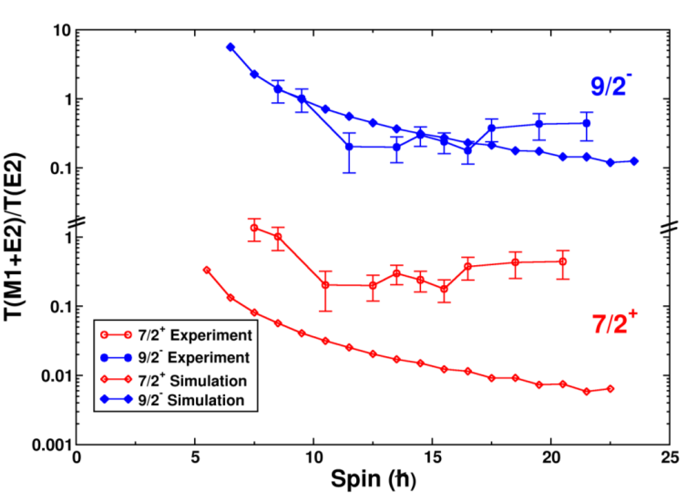
Level scheme of ²⁵³No (151 neutrons)
ground state 9/2⁻
excited state 7/2⁺
rotational band observed at Gammasphere & JUROGAM
9/2⁻ [734]
7/2⁺ [624]
M1
R. Chasman et al.; Rev. Mod. Phys. 49 (1977) 833

Slide 15
Stability of heavy elements
²⁵⁴No (Z=102) and ²⁵²Fm (Z=100) with N=152 seem to be more stabile than their neighbors

Slide 16
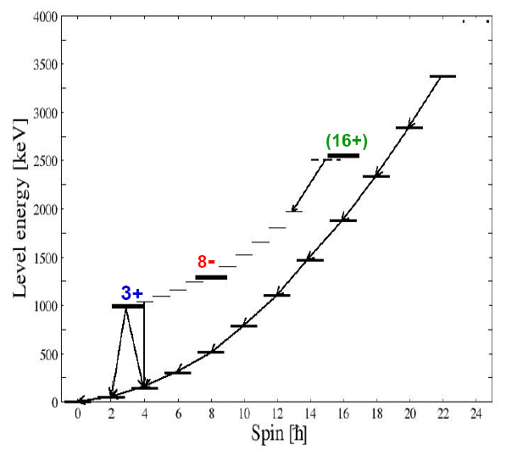
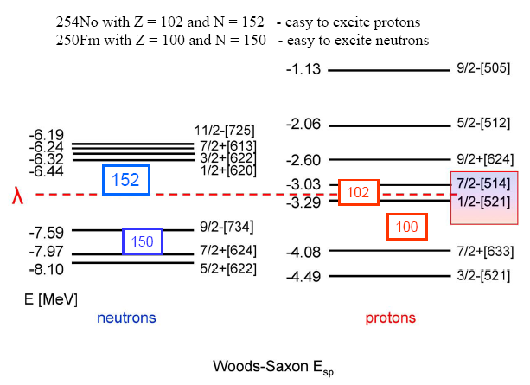
Woods-Saxon levels
Experimental results: excitation of isomeric states
Yrast – plot ( ²⁵⁴No)
²⁵⁴No with Z=102 and N=152 – protons will be easy excited
²⁵⁰Fm with Z=100 and N=150 – neutrons will be easy excited

Slide 17
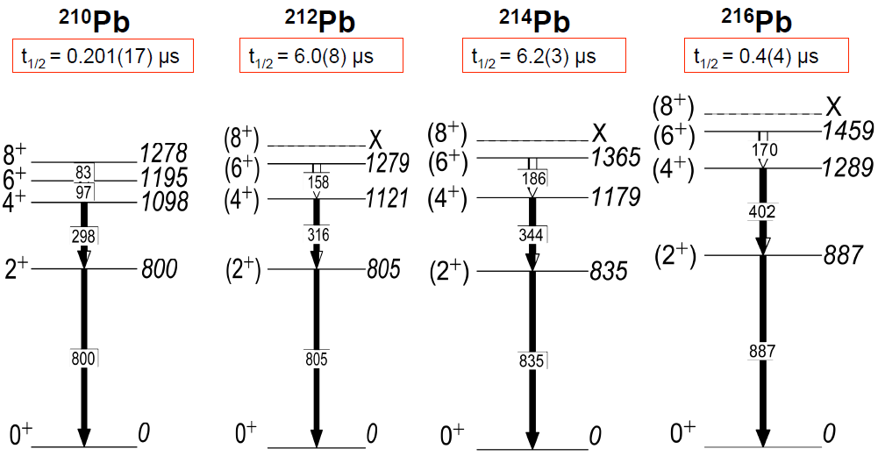
Level schemes in neutron-rich Pb isotopes
Pb216
Pb217
Pb218
g_{9/2}

Slide 18
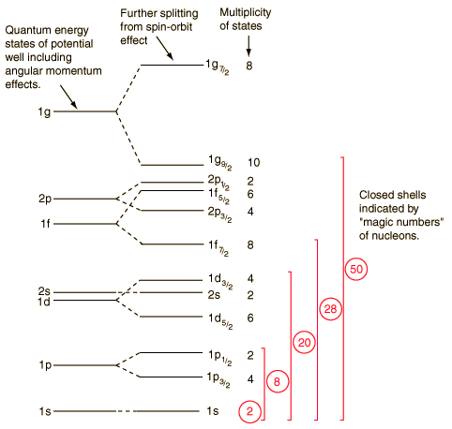
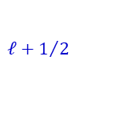
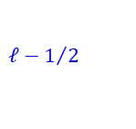
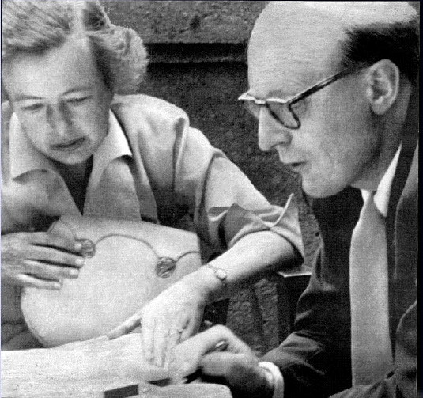

The magic numbers near stable nuclei
$$ℓ−1/2$$
$$∆E_{ℓs}=\frac{2∙ℓ+1}{2}∙ℏ^{2}∙\left\langle V_{ℓs}\right\rangle$$
$$ℓ+1/2$$
Maria Goeppert-Mayer (1906-1972)
Hans Jensen (1907-1973)
magic numbers with constant shell closures
are not so robust, as we thought.

Slide 19
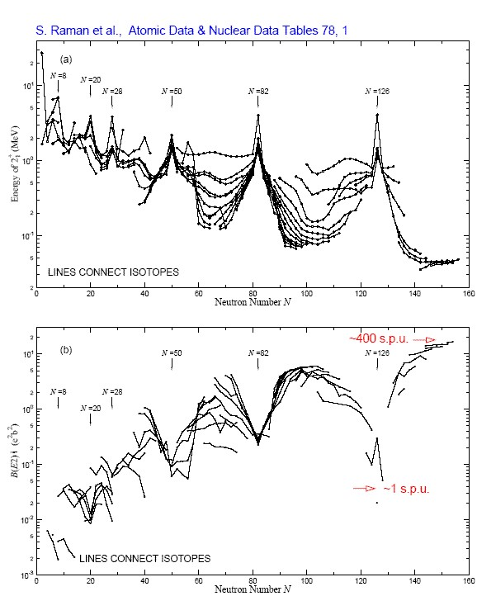
Nuclear shell structure experimental hints for magic numbers
nuclei with magic numbers
neutron / proton:
high energies for 2₁⁺ states
small B(E2; 2₁⁺→0⁺) values
transition probabilities are measured in
Weisskopf units (spu)
What happens far away from the valley of stability?

Slide 20
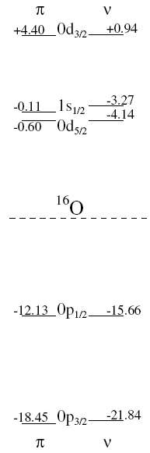
Extreme single-particle shell model
energies of shell closure:
positive parity
good prediction of
spin
parity π = (-1)^{ℓ}
magnetic moment
negative parity
proton
neutron

Slide 21
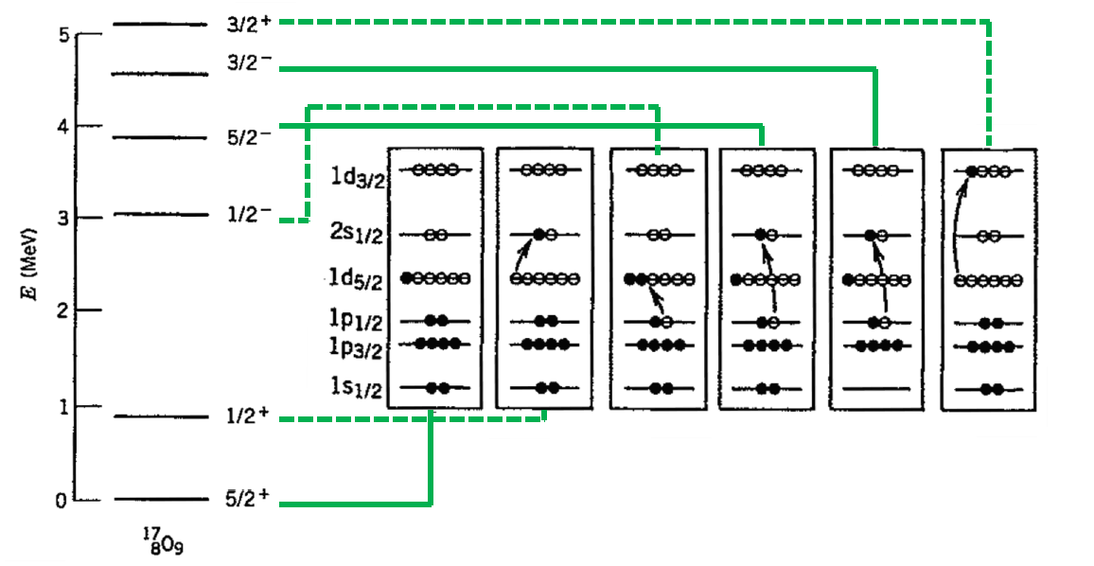
Single-particle energies
8
2
¹⁷O: 1/2 ⁻ state already at 3.1 MeV
residual interaction is needed,
to reduce the gap between the shells
Single-particle states observed in odd-A nuclei (especially one nucleon + doubly magic nucleus as ⁴He, ¹⁶O, ⁴⁰Ca) are characterized by the single-particle energies in the shell model picture.

Slide 22
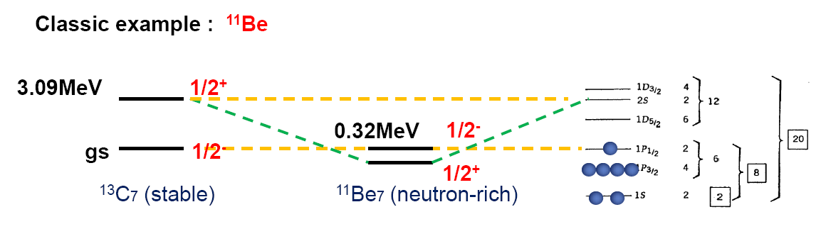
Classic example of anomaly
Several anomalies were observed in shell structures of exotic nuclei: proton-rich or neutron-rich
expected !
The 2s_{1/2} orbital (parity +) and the 1p_{1/2} orbital (parity -) are inverted ?? (parity inversion)

Slide 23

Nilsson-Model (quadrupole interaction)
Nilsson model is a single-particle model for deformed nuclei.
with
For characterizing states asymptotic quantum numbers Ω^{π}[Nn_{z}Λ] are used.
Ω projection of the total particle angular momentum onto the symmetry axis
π parity of the wave function
N total number of oscillator quanta
n_{z} number of nodes of the radial wave function in z-direction
Λ projection of the angular momentum ℓ onto the symmetry axis
ground state of ¹¹Be: intruder-configuration ! 1s_{1/2} 0d_{5/2} und 0d_{3/2}

Slide 24
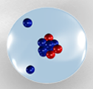
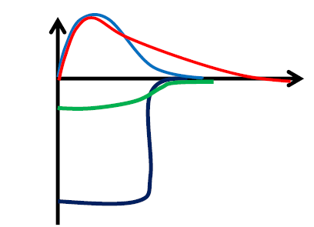


Formation of halos and the s-orbital
The s component in the ground state is essential for creating a halo structure.
Schrödinger equation:
$$\left[−\frac{ℏ^{2}}{2∙μ}∇^{2}+V\left(r\right)\right] Ψ\left(r\right)=E Ψ\left(r\right)$$
$$\frac{d^{2}u}{dr^{2}}+\frac{2}{r}\frac{du}{dr}+\left[\frac{2∙μ}{ℏ^{2}}\left(E−V\left(r\right)\right)−\frac{ℓ∙\left(ℓ+1\right)}{r^{2}}\right] u\left(r\right)$$
centrifugal barrier ( ℓ = 0 for s-wave )
neutron-rich nuclei (¹¹Be, ¹¹Li)
→ instable: flat nuclear potential
→ the wave function is extended
→ for s-orbitals, the radial extension
is not blocked by the centrifugal barrier
( halo )

Slide 25


Halo nuclei
What can we expect at the neutron-dripline?
wave function outside of the potential
$$κ^{2}=\frac{2∙μ∙E}{ℏ^{2}}≈0.05∙E\left(MeV\right) \left[{fm}^{−2}\right]$$
The smaller the binding energy, the more extended is the wave function
$$\left\langle r^{2}\right\rangle =\frac{1}{2∙κ^{2}}∙\left(1+κ∙R\right)≈\frac{ℏ^{2}}{4∙μ∙S_{n}}$$
E | κ² | κ | 1/κ ~ r
7 MeV | 0.35 fm⁻² | 0.6 fm⁻¹ | 1.7 fm
1 MeV | 0.05 fm⁻² | 0.2 fm⁻¹ | 4.5 fm
0.1 MeV | 0.005 fm⁻² | 0.07 fm⁻¹ | 14 fm

Slide 26
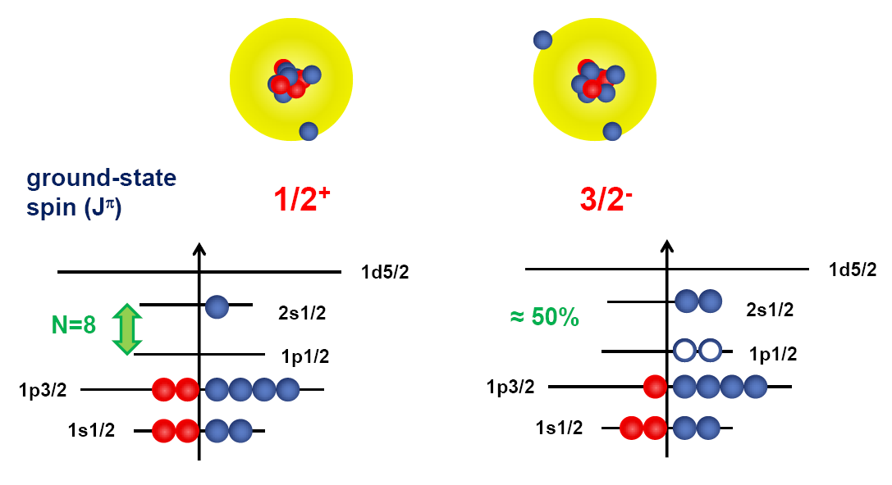
Halo nuclei
Anomalies of the shell structure was first observed in
¹¹Be (Z=4, N=7) and ¹¹Li (Z=3, N=8) ,
the most famous one-neutron halo and two-neutron halo-nuclei.

Slide 27
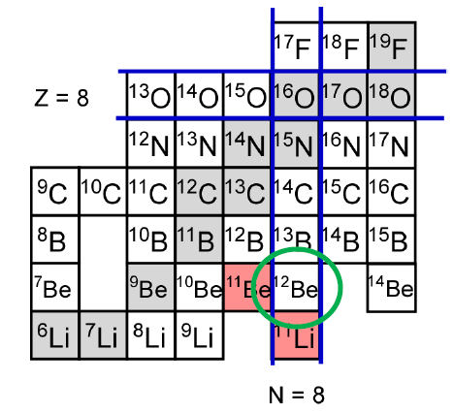
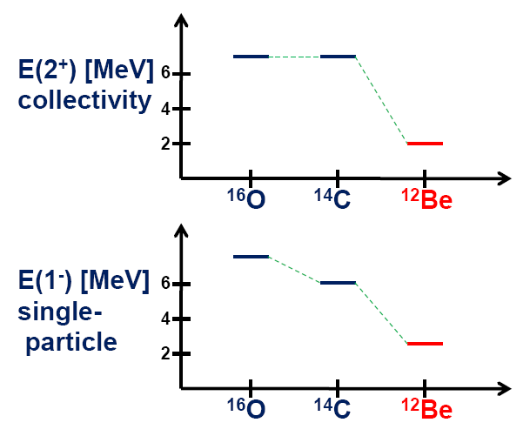
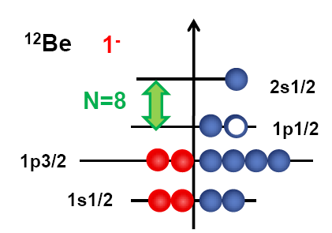
Change of the magic number near N=8: ¹²Be
Is the magic number changed only in halo nuclei ?
No! It holds also for ¹²Be.
This observation indicates a universal evolution of the shell structure.

Slide 28
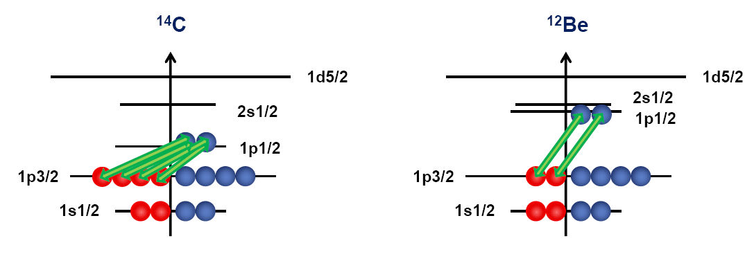
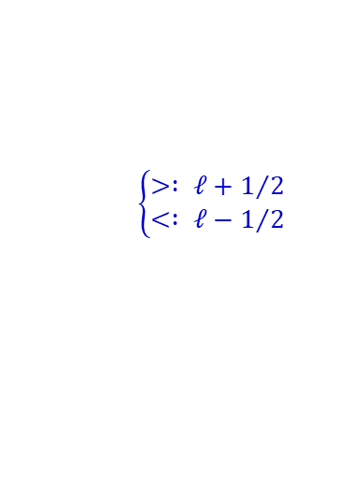
Simplified picture of monopole effects of the tensor force nucleon-nucleon residual interaction
The specific proton-neutron interaction ( monopole term of the tensor-force ) can change the single-particle order, depending on the proton-neutron ratio of the nucleus.
The strong attractive p-n force between J> and J< orbitals ( for example, π p_{3/2} and ν p_{1/2} )
$$\left\{\begin{matrix}> : ℓ+1/2 \\ < : ℓ−1/2\end{matrix}\right.$$

Slide 29
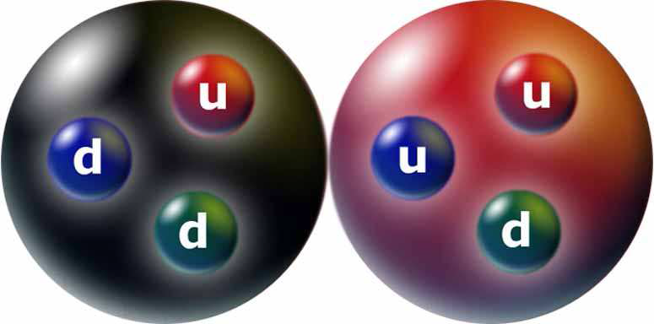
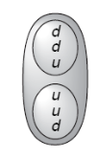
The deuteron
mass (MeV/c²) | 1875.61
charge (e) | 1
I^{π} | 1⁺
binding energy (MeV) | 2.2245
magnetic moment (μ_{N}) | 0.8574
quadrupole moment (b) | 0.0029
n
p
0.8798 μ_{N} = μ_{S} (${}_{1}^{2}H$) → the deuteron can not be a pure s state! ~ 96% s and 4% d.
not spherical consistent with s/d-ratio = 96/4
The deuteron is an ideal candidate for tests of our basic understanding of nuclear physics

Slide 30
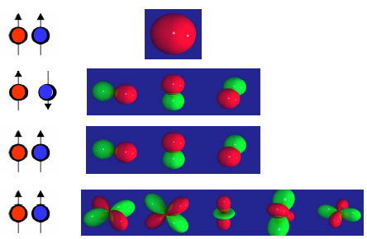





Deuteron
Possible combinations of the spins and the relative orbital angular momenta:
The nuclear force is
spin dependent !
The measured nuclear spin of the deuteron is J=1
$$\left\langle {\vec{J}}^{2}\right\rangle =J∙\left(J+1\right)ℏ^{2}$$
experiment !
Parity of the deuteron:
Properties of the emitted gamma radiation following neutron capture on proton results, that the parity of the deuteron is positive (π = +1).
Properties of the spherical harmonics for the parity are (-1)^{ℓ} = +1 and hence
only even angular momenta of ℓ = 0 and ℓ = 2 can occur.
experiment !

Slide 31



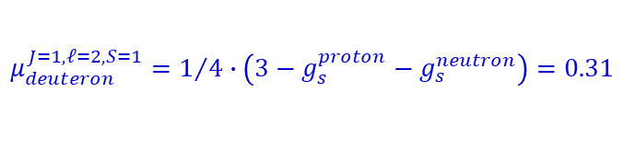
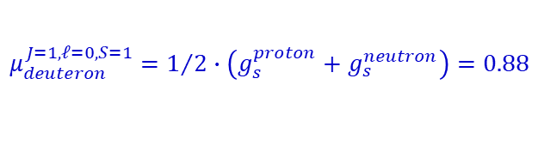
Deuteron: magnetic moment
The measured nuclear spin of the deuteron is J = 1
The parity of the deuteron is positive, only even angular momenta ℓ = 0 and ℓ = 2 .
The magnetic moment of the deuteron, which can be determined by e.g. nuclear magnetic resonance (NMR),
results to:
The gyromagnetic factor g is the proportionality constant between the magnetic moment of a particle and the spin (in case of the deuteron angular momentum g = 1):
$$\vec{μ}=g∙\frac{e∙ℏ}{2∙m_{p}∙c}∙\vec{S}≡g∙μ_{K}∙\vec{S}$$
$$μ_{K}=\frac{e∙ℏ}{2∙m_{p}∙c}$$
denotes the spin operator and the nuclear magneton
For a point-like proton (s=1/2) one expects g = 2. The inner structure of a proton (uud) and neutron (udd) shows in the experimental values
$$\vec{S}$$
g_{s}^{proton} = 5.5857, g_{s}^{neutron} = -3.8261
For a parallel alignment of the nucleon spin S = 1 and an assumed angular momentum of ℓ = 0 or ℓ = 2 one obtains for the sum of the magnetic moment for proton and neutron
$$μ_{deuteron}^{J,ℓ,S}=\frac{μ_{N}}{4∙J∙\left(J+1\right)}\left\{\left(g_{s}^{proton}+g_{s}^{neutron}\right)∙\left(J∙\left(J+1\right)−ℓ∙\left(ℓ+1\right)+S∙\left(S+1\right)\right)+J∙\left(J+1\right)+ℓ∙\left(ℓ+1\right)−S∙\left(S+1\right)\right\}$$
The wave function of the deuteron consists of
96% of the ℓ = 0 state and
4% of the ℓ = 2 state
$$μ_{deuteron}^{J=1,ℓ=0,S=1}=1/2∙\left(g_{s}^{proton}+g_{s}^{neutron}\right)=0.88$$
$$μ_{deuteron}^{J=1,ℓ=2,S=1}=1/4∙\left(3−g_{s}^{proton}−g_{s}^{neutron}\right)=0.31$$

Slide 32

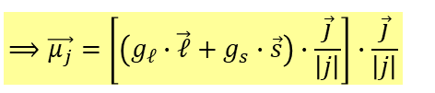
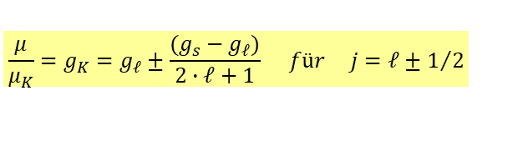


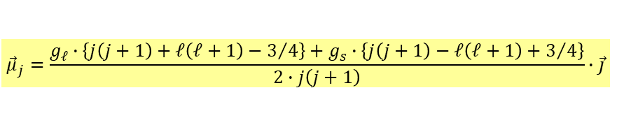

Erinnerung: Schalenmodell
Magnetische Momente:
Für den g-Faktor g_{j} gilt:
mit
Einfache Beziehung für den g-Faktor
von Einteilchenzuständen
$$\vec{μ_{j}}=g_{ℓ}∙\vec{ℓ}+g_{s}∙\vec{s}=g_{j}∙\vec{j}$$
$$⟹\vec{μ_{j}}=\left[\left(g_{ℓ}∙\vec{ℓ}+g_{s}∙\vec{s}\right)∙\frac{\vec{j}}{\left|j\right|}\right]∙\frac{\vec{j}}{\left|j\right|}$$
$${\vec{ℓ}}^{2}={\left(\vec{j}−\vec{s}\right)}^{2}={\vec{j}}^{2}−2∙\vec{j}∙\vec{s}+{\vec{s}}^{2}$$
$${\vec{s}}^{2}={\left(\vec{j}−\vec{ℓ}\right)}^{2}={\vec{j}}^{2}−2∙\vec{j}∙\vec{ℓ}+{\vec{ℓ}}^{2}$$
$${\vec{μ}}_{j}=\frac{g_{ℓ}∙\left\{j\left(j+1\right)+ℓ\left(ℓ+1\right)−3/4\right\}+g_{s}∙\left\{j\left(j+1\right)−ℓ\left(ℓ+1\right)+3/4\right\}}{2∙j\left(j+1\right)}∙\vec{j}$$
$$g_{j}=\frac{1}{2}∙\left(g_{ℓ}+g_{s}\right)+\frac{1}{2}∙\frac{ℓ∙\left(ℓ+1\right)−s∙\left(s+1\right)}{j∙\left(j+1\right)}∙\left(g_{ℓ}−g_{s}\right)$$
$$\frac{μ}{μ_{K}}=g_{K}=g_{ℓ}±\frac{(g_{s}−g_{ℓ})}{2∙ℓ+1} für j=ℓ±1/2$$

Slide 33
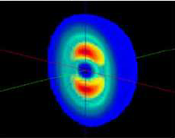
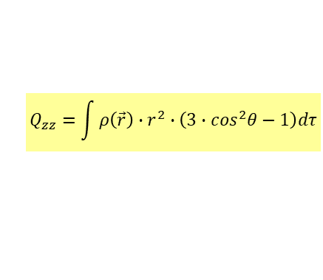
Deuteron: quadrupole moment
The measured nuclear spin of the deuteron is J = 1
The parity of the deuteron is positive, only even angular momenta ℓ = 0 and ℓ = 2 .
The magnetic moment of the deuteron yields to The angular momentum has to 4% the value of ℓ = 2
The deuteron is not spherical.
It has an experimentally determined quadrupole moment of Q = 0.00282 eb.
A free neutron and a free proton have no electric quadrupole moment.
The deuteron can only possess a quadrupole moment because of its angular momentum of ℓ = 2.
A pure ℓ = 0 wave function has a vanishing quadrupole moment, because of its rotational symmetry.
$$Q_{zz}=\int{ρ\left(\vec{r}\right)}∙r^{2}∙\left(3∙\cos^{2}θ−1\right)dτ$$
The nuclear force is spin dependent !
The nuclear forces must raise a torsional moment, that depend on the radius r and the angle θ .
If the nuclear force depends on r and θ , then there is a non-central force component a Tensor force

Slide 34
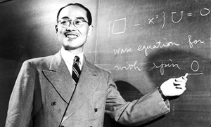
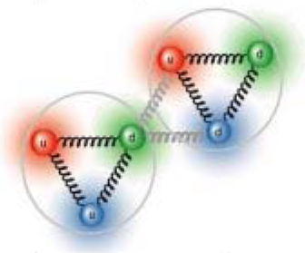
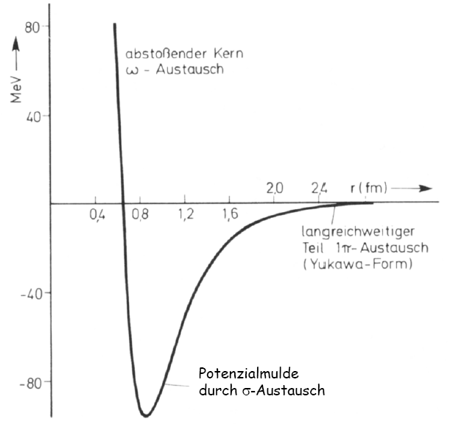
Nucleon-nucleon potential
repulsive part
ω (3π) - exchange
All contributions of the N-N interaction are based on meson exchange
long-range part
1π – exchange
constant distance between nucleons ~ 1fm
→ constant nuclear density
1π – exchange ~ Tensor force (r,θ)
potential minimum due to
σ – exchange
( 2π are coupled to spin 0)
m(π) ≈ 140 MeV/c²
m(σ) ≈ 500-600 MeV/c²
m(ω) ≈ 784 MeV/c²
Yukawa Potential:

Slide 35
Effective single-particle energy effective single-particle energy ESPE
ESPE is changed by N v_{m}
Monopole interaction, v_{m}
N particles
ESPE :
Total effect on single-particle energies due to interaction with other valence nucleons

Slide 36

Simplified picture of monopole effects of the tensor force nucleon-nucleon residual interaction
wave function of relative motion
spin of nucleon
large relative momentum
small relative momentum
attractive
repulsive
Monopole energy of the tensor interaction:
T. Otsuka et al., Phys. Rev. Lett. 95, 232502 (2005), Phys. Rev. Lett. 97, 162501 (2006)

Slide 37
Simplified picture of monopole effects of the tensor force nucleon-nucleon residual interaction
The example shows the proton configuration (0p_{3/2}) of ¹⁴C₈. The more protons are in 0p_{3/2} orbital, the more the 0p_{1/2} neutron orbital will be attracted and the shell closure at N=8 develops.
For ¹²Be₈ the proton orbital 0p_{3/2} will be emptied, the interaction is weaker and the neutron orbital 0p_{1/2} will be lifted.
j'<
j'<
j'>
j'>
j<
j<
j>
j>
proton
neutron
proton
neutron
T. Otsuka et al., Phys. Rev. Lett. 95, 232502 (2005), Phys. Rev. Lett. 97, 162501 (2006)

Slide 38
Simplified picture of monopole effects of the tensor force nucleon-nucleon residual interaction
The example shows the proton configuration (0p_{3/2}) of ¹⁴C₈. The more protons are in 0p_{3/2} orbital, the more the 0p_{1/2} neutron orbital will be attracted and the shell closure at N=8 develops.
For ¹²Be₈ the proton orbital 0p_{3/2} will be emptied, the interaction is weaker and the neutron orbital 0p_{1/2} will be lifted.
T. Otsuka et al., Phys. Rev. Lett. 95, 232502 (2005), Phys. Rev. Lett. 97, 162501 (2006)

Slide 39
Monopole interaction of the tensor force nucleon-nucleon residual interaction
j<
neutron
Tensor Monopole Interaction :
total effects vanished for
spin-saturated case
no change
j>
j’<
proton
j’>
Same Identity with different interpretation
( j’ j>)
( j’ j<)
(2j> +1) v_{m,T} + (2j< +1) v_{m,T} = 0
v_{m,T} : monopole strength for isospin T
T. Otsuka et al., Phys. Rev. Lett. 95, 232502 (2005), Phys. Rev. Lett. 97, 162501 (2006)

Slide 40
Monopole interaction of the tensor force nucleon-nucleon residual interaction
j<
neutron
Tensor Monopole Interaction
vanished for s orbit
j>
s_{1/2}
proton
For s orbit, j> and j< are the same :
( j’ j>)
( j’ j<)
(2j> +1) v_{m,T} + (2j< +1) v_{m,T} = 0
v_{m,T} : monopole strength for isospin T
T. Otsuka et al., Phys. Rev. Lett. 95, 232502 (2005), Phys. Rev. Lett. 97, 162501 (2006)

Slide 41
The effect of the tensor force on the ℓs-coupling
V_{T} reduces ls-splitting.
V_{T} enhances ls-splitting.
j< - j<’ or j< - j<’: repulsion
j< - j>’: attraction
If both j<’ and j>’ orbits are fully occupied the tensor force does not act.
cf. Bouyssy et al. PRC 36 (1987) 380
Otsuka et al. PRL 95 (2005) 232502
V_{T} does not act.

Slide 42
The effect of the tensor force on the ℓs-coupling
The tensor force does not act
The tensor force reduces the ℓs-splitting

Slide 43
Michimasa et al.
(from NPA 787 (2007) 569)
5 MeV
3/2+
²³F
5/2+
¹⁷F
Bohr & Mottelson vol. 1

Slide 44
Application to other shells
low-lying 2⁺

Slide 45





Nuclear shell model
Experimental evidence of the magic number
N=20
N=20
4
E(2⁺) [MeV]
3
2
₂₀Ca
1
₁₂Mg
₁₆S
³²Mg
0
12
16
20
24
N
Evidence of the nuclear shell model:
high energies for the 2₁⁺ state
for nuclei with magic numbers

Slide 46


Nuclear shell model
Experimental evidence of the magic numbers
N=20
N=20
N=28
Z=20
⁴⁰Ca
⁴²Ca
⁴⁴Ca
⁴⁶Ca
⁴⁸Ca
N=20
Z=18
³⁸Ar
⁴⁶Ar
Z=16
³⁶S
⁴⁴S
E(2⁺) [MeV]
Z=14
³⁴Si
⁴²Si
Z=12
³²Mg
⁴⁰Mg
12 16 20 24 N
Z=10
³⁰Ne
³⁸Ne
Evidence of the nuclear shell model:
high energies of the 2₁⁺ states
for nuclei with magic numbers

Slide 47


Monopole-interaction of the tensor force
Experimental evidence of the magic number
N=20
f_{7/2}
N=20
N=20
d_{3/2}
s_{1/2}
E(2⁺) [MeV]
d_{5/2}
π ν
12 16 20 24 N

Slide 48
Monopole-interaction of the tensor force
Experimental evidence of the magic number
N=20
f_{7/2}
N=20
N=20
d_{3/2}
s_{1/2}
E(2⁺) [MeV]
d_{5/2}
π ν
12 16 20 24 N

Slide 49
Monopole-interaction of the tensor force
Experimental evidence of the magic number
N=20
f_{7/2}
N=20
N=20
d_{3/2}
s_{1/2}
E(2⁺) [MeV]
d_{5/2}
π ν
12 16 20 24 N

Slide 50
Monopole-interaction of the tensor force
Experimental evidence of the magic number
N=20
f_{7/2}
N=20
N=20
d_{3/2}
( j< )
s_{1/2}
( j> )
E(2⁺) [MeV]
d_{5/2}
π ν
12 16 20 24 N

Slide 51

Monopole-interaction of the tensor force
Experimental evidence of the magic number
N=20
f_{7/2}
N=20
d_{3/2}
N=20
( j< )
s_{1/2}
( j> )
E(2⁺) [MeV]
d_{5/2}
π ν
12 16 20 24 N

Slide 52
Monopole-interaction of the tensor force
Experimental evidence of the magic number
N=20
f_{7/2}
N=20
d_{3/2}
N=20
( j< )
s_{1/2}
( j> )
E(2⁺) [MeV]
d_{5/2}
π ν
12 16 20 24 N

Slide 53
Monopole-interaction of the tensor force
Experimental evidence of the magic number
N=20
N=20
E(2⁺) [MeV]
f_{7/2}
d_{3/2}
N=20
12 16 20 24 N
( j< )
s_{1/2}
( j> )
d_{5/2}
π ν

Slide 54
Monopole-interaction of the tensor force
Experimental evidence of the magic number
N=20
N=20
E(2⁺) [MeV]
f_{7/2}
d_{3/2}
N=20
12 16 20 24 N
( j< )
s_{1/2}
( j> )
d_{5/2}
π ν

Slide 55


Nuclear shell structure
Experimental evidence of the magic number
N=20
The shell structure is strongly influenced by the attractive p-n force between J> and J< orbitals ( π d_{5/2} and ν d_{3/2} ).

Slide 56

Nuclear shell structure
Experimental evidence of the magic number
N=28
³²Mg
Evidence of the nuclear shell model:
Nuclear field theory:
Nuclear many-particle problem will be solved relativistically
with the consequence: attractive scalar field (S-V)
repulsive vector field (S+V)
high energies of the 2₁⁺ states
for nuclei with magic number
Relativistic quasi-particle random phase approximation

Slide 57

Nuclear shell structure
Experimental evidence of the magic number
N=28
N=20
N=28
Z=20
⁴⁰Ca
⁴²Ca
⁴⁴Ca
⁴⁶Ca
⁴⁸Ca
spherical
Z=18
³⁸Ar
⁴⁶Ar
Ca
Z=16
³⁶S
⁴⁴S
S
Z=14
³⁴Si
⁴²Si
Si
deformed
Z=12
³²Mg
⁴⁰Mg
Z=10
³⁰Ne
³⁸Ne
Evidence of the nuclear shell model:
Nuclear field theory:
Nuclear many-particle problem will be solved relativistically
with the consequence: attractive scalar field (S-V)
repulsive vector field (S+V)
high energies of the 2₁⁺ state
for nuclei with magic number
Relativistic quasi-particle random phase approximation

Slide 58

Nuclear shell structure
Large similarity between three numbers of the HO-shell model
N=8
N=20
N=40
Same mechanism :
small 2⁺ energies for N=8, 20 and 40
Inversion between normal and intruder states for N=40
Search for a (super)deformed 0⁺₂ state in ⁶⁸Ni
Proof the extreme deformation of ⁶⁴Cr
O. S. , MG Porquet PPNP (2008)

Slide 59

Nuclear shell structure development of the HO-shell closure
d_{5/2}
d_{5/2}
N=14
8
s_{1/2}
N~8
p_{1/2}
s_{1/2}
p_{1/2}
6
Role of the π p_{3/2}- ν p_{1/2} interaction
6
p_{3/2}
p_{3/2}
p_{3/2}
p_{3/2}
[ ]
ν
ν
π
π
Z=6
Z=2
p_{3/2}
f_{7/2}
N~20
p_{3/2}
N=28
20
f_{7/2}
d_{3/2}
d_{3/2}
s_{1/2}
16
SPIN –FLIP Δ =0 INTERACTION
Role of the π d_{5/2}- ν d_{3/2} interaction
s_{1/2}
14
14
d_{5/2}
[ ]
d_{5/2}
d_{5/2}
π
ν
π
d_{5/2}
$$ℓ$$
ν
Z=14
Z=8
d_{5/2}
d_{5/2}
N=50
g_{9/2}
N~40
g_{9/2}
40
f_{5/2}
p_{1/2}
34
p_{1/2}
f_{5/2}
32
Role of the π f_{7/2}- ν f_{5/2} interaction ?
p_{3/2}
p_{3/2}
f_{7/2}
[ ]
28
f_{7/2}
28
π
ν
f_{7/2}
π
f_{7/2}
Small gaps
ν
Z=28
Z=20
Large N/Z

Slide 60



Nuclear shell structure

Slide 61



Signatures near closed shells
Excitation energy
Sn isotopes
only valence neutrons

Slide 62
8⁺(g_{9/2}⁾⁻² seniority isomers in ⁹⁸Cd and ¹³⁰Cd
h_{11/2}
N=82
MeV
2.6
d_{3/2}
2.2
(8⁺)
2428
s_{1/2}
1.6
(6⁺)
N=50
Z=48
2281
d_{5/2}
0.5
(8⁺)
2128
N=82
Z=48
(4⁺)
g_{7/2}
0
(6⁺)
2083
N=50
2002
(4⁺)
1864
participating neutron-orbitals
(2⁺)
(2⁺)
1395
1325
two proton holes in the g_{9/2} orbit
No dramatic shell quenching!
0⁺
0⁺
A. Blazhev et al., Phys. Rev. C69 (2004) 064304 A. Jungclaus et al., Phys. Rev. Lett. 99 (2007), 132501

Slide 63






Isoscalar neutron-proton pairing in ⁹²Pd
four proton holes in g_{9/2} orbit
N=Z=
46 48 50
J_{max}=12
results reveal evidence for a spin-aligned, isoscalar neutron-proton coupling scheme and replaces seniority coupling
B. Cederwall et al., Nature 469 (2011), 68 T.S. Brock et al., Phys. Rev. C82 (2010) 061309

Slide 64
New magic numbers

Slide 65

Future: Nuclear- and Astrophysics

Slide 66

Shell model and element abundance
r-process abundances
exp.
pronounced shell gap
shell structure quenched
mass number A
r-process calculations show large deviations from the measured element distributions.
possible solution: modified shell model with a changed potential development for neutron-rich nuclei.
→ future experiments with unstable, neutron-rich nuclei.

Slide 67

Shell model and element abundance
H. Grawe et al., Rept. Prog. Phys. 70 (2007)1525.
A
3rd peak (A~195)
Observed solar r-abundance
distribution
N=126
2nd peak
N = 126 (Waiting point)
Z
N = 82
r-process
A half of elements heavier than Fe is considered to be produced by rapid neutron capture process (r-process)
Fe
N
67

Slide 68
Astrophysical nucleosysnthesis by r-process
H. Grawe et al., Rept. Prog. Phys. 70 (2007)1525.
A
3rd peak (A~195)
Observed solar r-abundance
distribution
N=126
2nd peak
N = 126 (Waiting point)
Z
N = 82
Nuclear characteristics (T_{1/2}, S_{n}, …)
r-process
Better understanding of r-process scenario
Actual r-process path
Astrophysical N_{n}-T condition
Duration time passing through waiting point
Actinide element production rate
A half of elements heavier than Fe is considered to be produced by rapid neutron capture process (r-process)
Fe
N
Lifetime measurements around N=126
→ Astrophysical environments of r-process
68
Notes:
68
68

Slide 69



Rare Isotope Beam Capabilities Worldwide

