Slide 1

Outline: Experimental Nuclear Astrophysics
Lecturer: Hans-Jürgen Wollersheim
e-mail: h.j.wollersheim@gsi.de
web-page: https://web-docs.gsi.de/~wolle/ and click on
Projectile fragmentation
Isotope separation on line
Waiting point nuclei
reactions, masses, radii

Slide 2
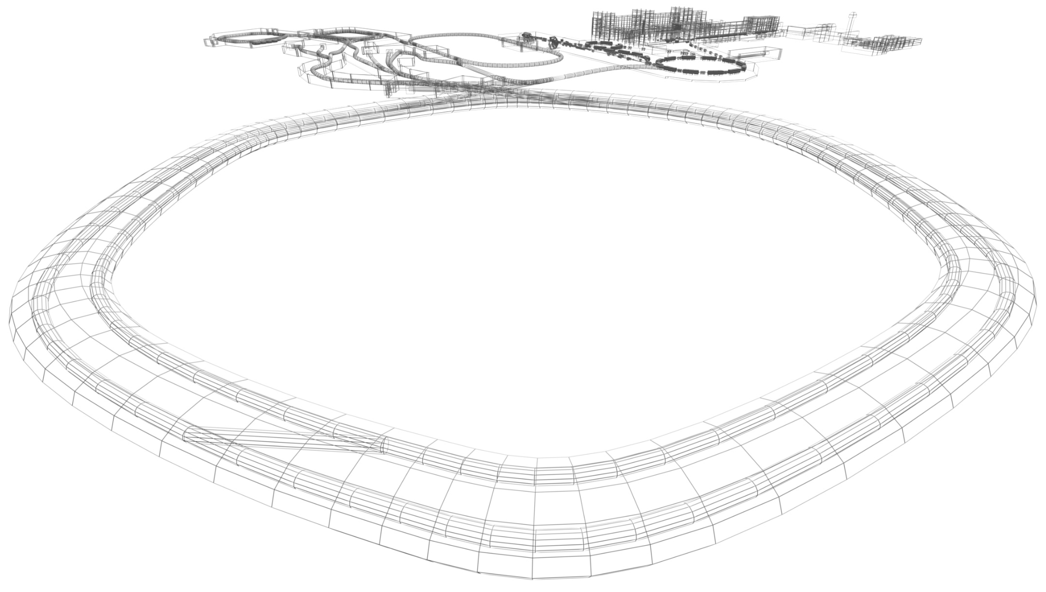

Physics with exotic nuclei
NUclear STructure, Astrophysics and Reaction

Slide 3
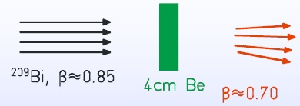
Radioactive Ion Beams production methods
Target fragmentation
Projectile fragmentation
fragmentation invented at LBNL in the 1980´s
target
beam
fragments

Slide 4
Radioactive Ion Beams production methods
Fragmentation, spallation
Coulomb dissociation, fission
Compound nuclei, fusion

Slide 5
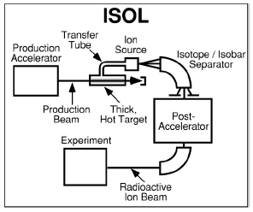
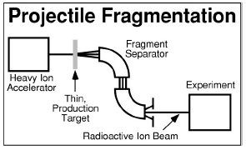
Radioactive Ion Beams production methods
Isotope Separation on Line (ISOL) (CERN, LLN, ORNL, TRIUMF)
Projectile Fragmentation (PF) (GANIL, GSI, MSU, RIKEN)
in-flight production (ANL, Notre Dame, TAMU)
batch mode production (suitable for long-lived species)
…
☺ excellent quality
high purity
high intensities
☺ independent from chemical properties
no limitations on t_{½} (fast separation)
☹ limited number of species
different production for different species
limited to nuclei with t_{½} ≥ 1s (allow for diffusion)
☹ typical beam energies too high for NA
poorer beam quality (energy, size)
possible beam contaminations
M.S. Smith and K.E. Rehm, Ann. Rev. Nucl. Part. Sci, 51 (2001) 91-130

Slide 6
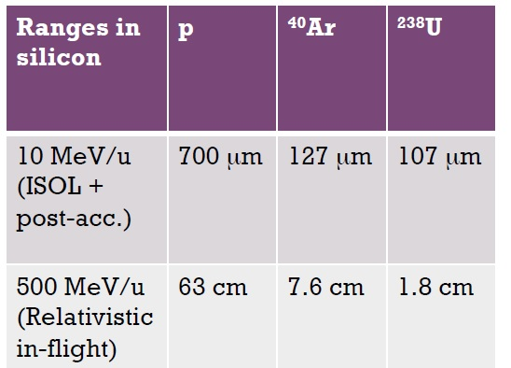
Fast radioactive beams – why?
Production by the in-flight
technique (vs ISOL)
  Chemical blindness
  Shortest half-lives
Experimental issues
  Doppler boosted
    Kinematical focusing
    Resolution
  Small energy loss
    Possible to use thick targets
    Ions, particles are hard to stop
    Can use many detectors
    – ion-by-ion tracking

Slide 7
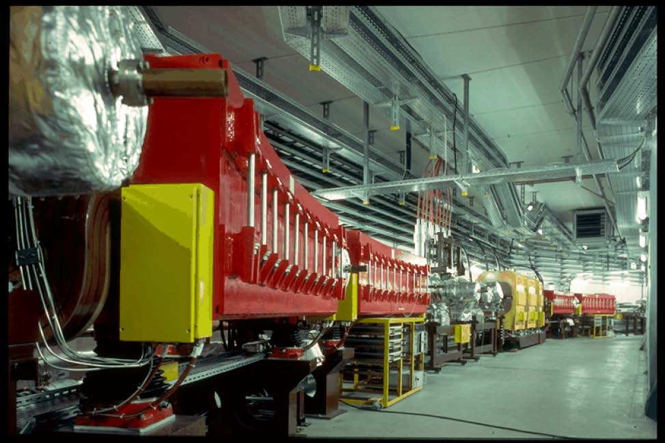
Fast radioactive beams – where?
GSI since SIS (early 90’s)
Intermediate-energy RIBs (tens of MeV/u) since many years
at GANIL, MSU, RIKEN
Future (and current) facilities
  RIBF@RIKEN
  FRIB@MSU
  FAIR-NuSTAR

Slide 8
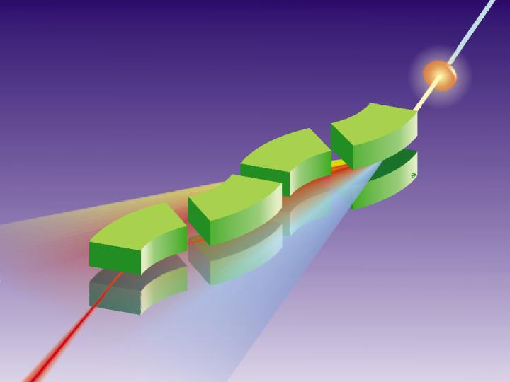
The future - FAIR
Next generation
RIBs facilities
1.0-1.5 GeV/u
all elements up to uranium

Slide 9
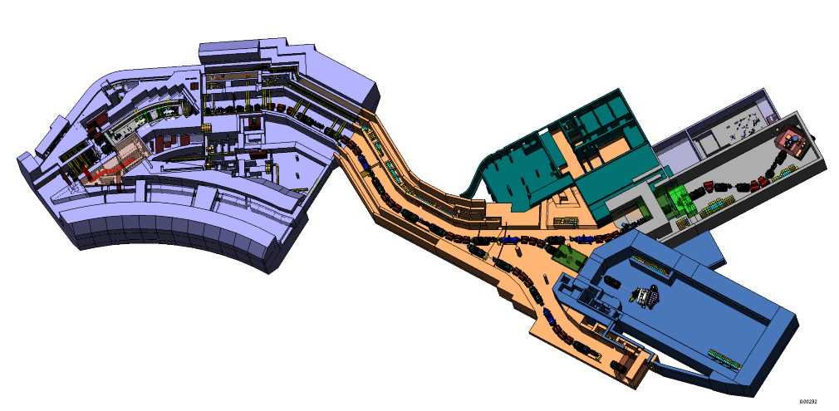
NuSTAR experiments
Nuclear reactions
  Relativistic energies R3B
  Cooled beams EXL
  High-res. spectroscopy HISPEC
Decay properties
  Stopped beams DESPEC
Ground state properties
  Masses MATS, ILIMA
  Radii, momenta LASPEC
New tools
  Electron – RIB scattering ELISe
  p-bar – RIB collider AIC
super FRagment Separator

Slide 10
Production mechanisms and cross sections

Slide 11
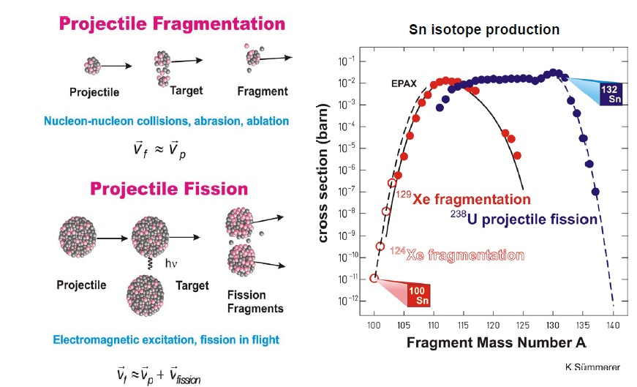
Production of exotic nuclei at relativistic energies

Slide 12
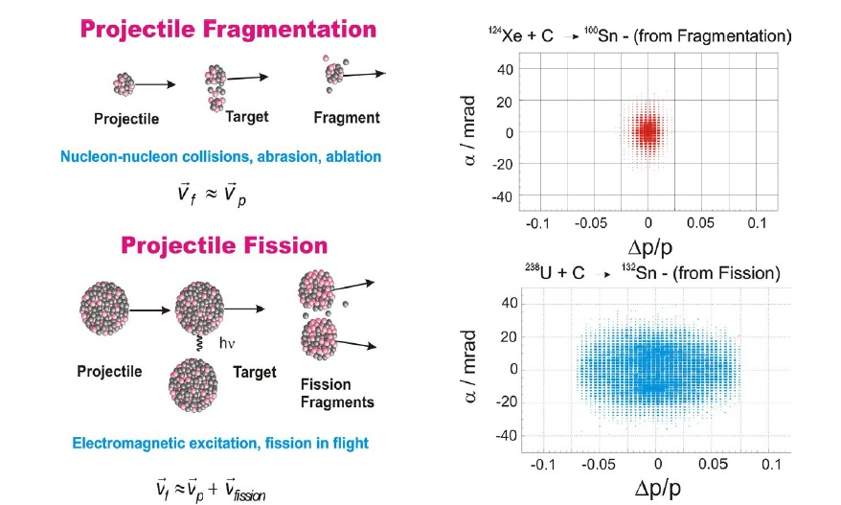
Production of exotic nuclei at relativistic energies

Slide 13
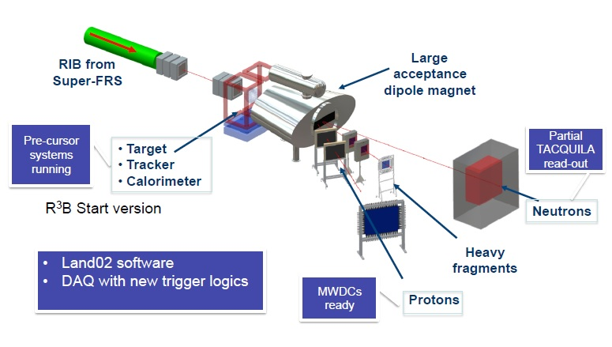
Reactions with Relativistic Radioactive Beams

Slide 14
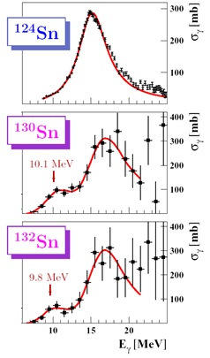
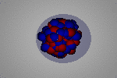
Pygmy resonances and the neutron skin
R_{n} – R_{p :}
¹³⁰Sn: 0.23 ± 0.04 fm
¹³²Sn: 0.24 ± 0.04 fm
neutron star
R_{n}-R_{p}
δr
at LAND-GSI: 10⁸/s ²³⁸U beam (10 d)
at R3B-FAIR: 10¹² ²³⁸U beam (100 s)
EoS
P. Adrich et al., PRL 95 (2005) 132501 & A.Klimkiewicz et al., PRC 2008

Slide 16
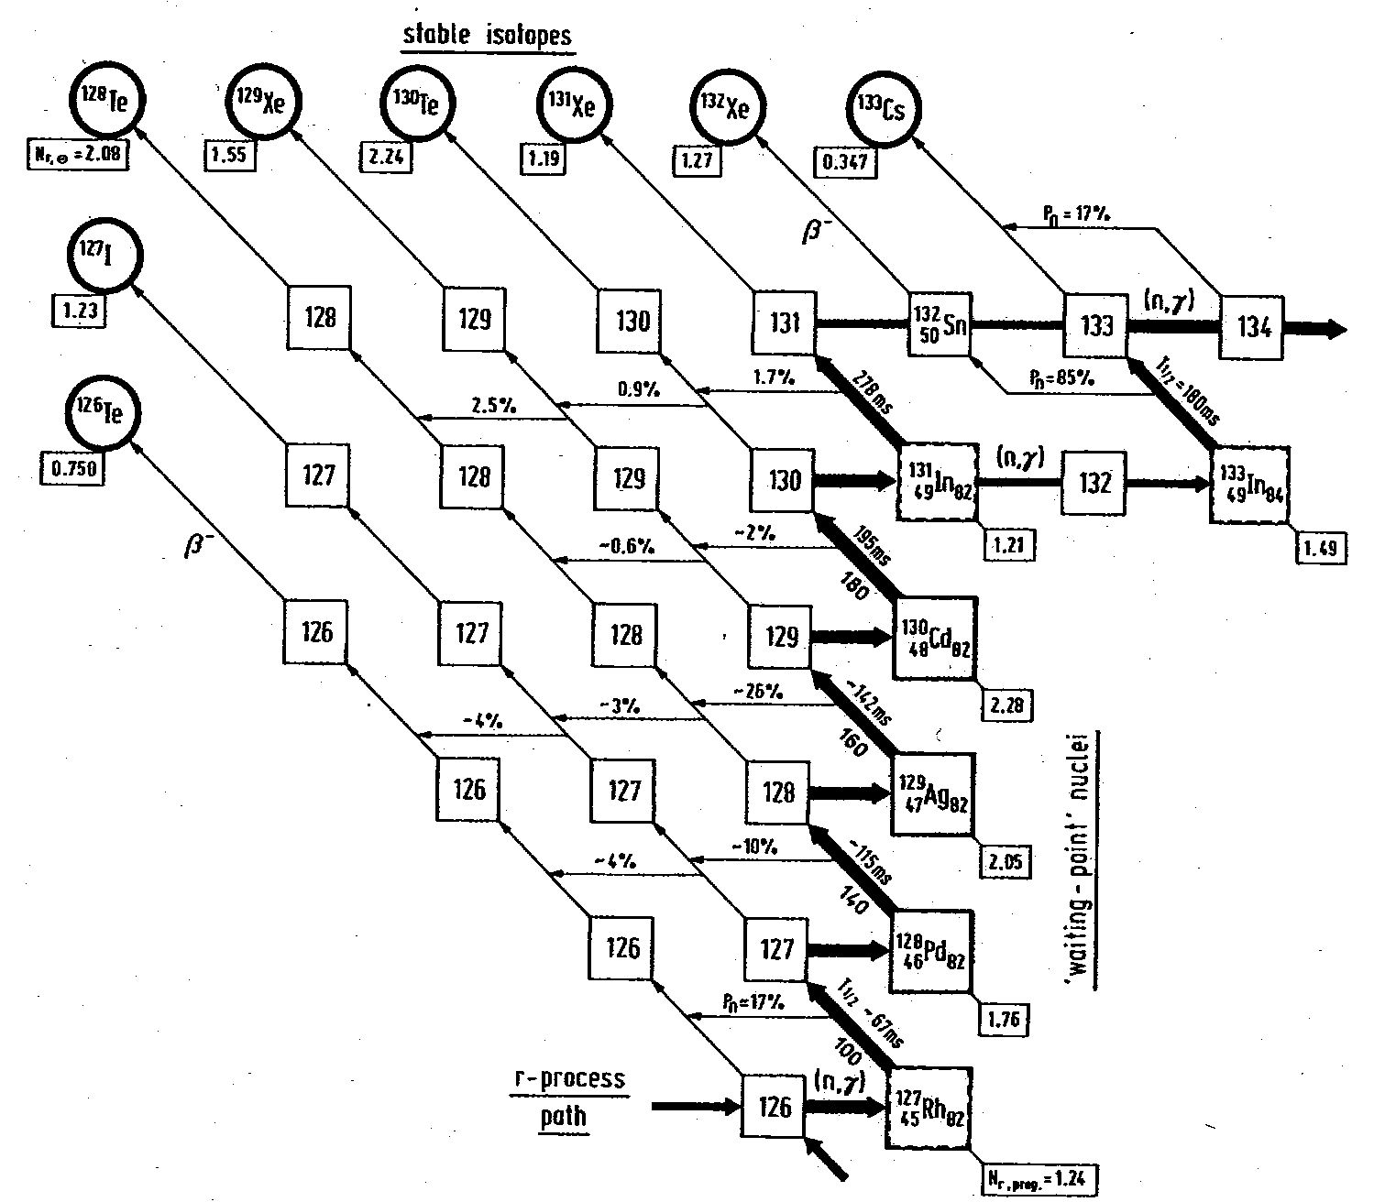
Waiting point at N=82
¹³⁰Cd
⁴⁸ ⁸²
“..the calculated r-abundance ‘hole‘ in the A ≅ 120 region reflects ... the weakening of the shell strength ... below ¹³²Sn “ K-L Kratz
bottleneck at N=82 waiting point near stability?

Slide 17
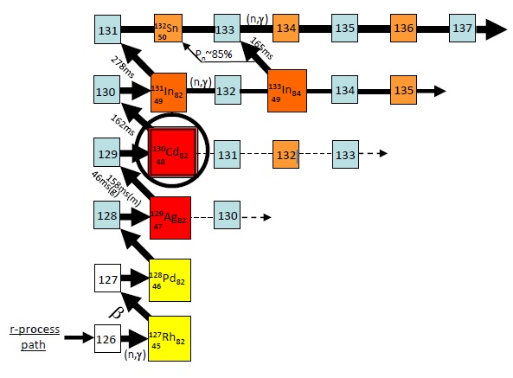
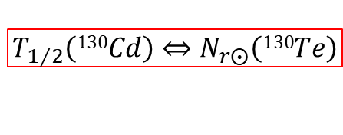
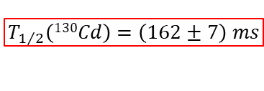
¹³⁰Cd – the key isotope at the A=130 peak
$$T_{1/2}\left(130Cd\right)⇔N_{r⨀}\left(130Te\right)$$
$$N_{r⨀}\left(130Te\right)≡solar system abundances 130Te$$
$$T_{1/2}\left(130Cd\right)=\left(162±7\right) ms$$
climb up the N=82 ladder A~130 “bottle neck”
K.-L. Kratz, Rev. Mod. Astr. 1 1988

Slide 18
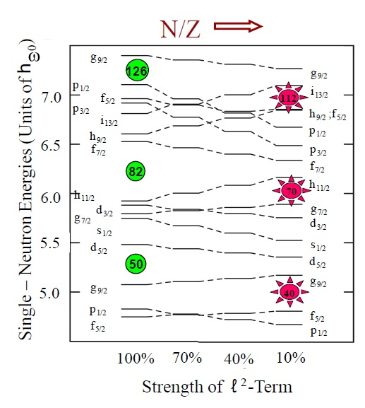
Effects of N=82 “shell quenching”
“Shell quenching”
reduction of the spin-orbit coupling strength; caused by strong interaction between bound and continuum states;
due to diffuseness of “neutron-skin” and its influence on the central potential

Slide 19
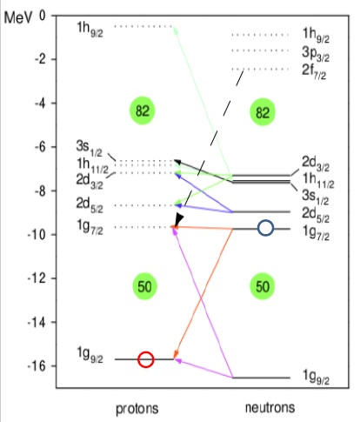
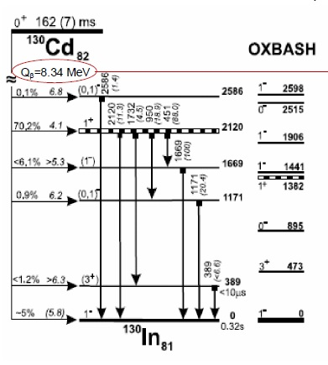
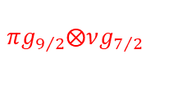
¹³⁰Cd decay spectroscopy
Large Q_{β} value best reproduced by mass models with N=82 shell quenching
$$πg_{9/2}⨂νg_{7/2}$$

Slide 20
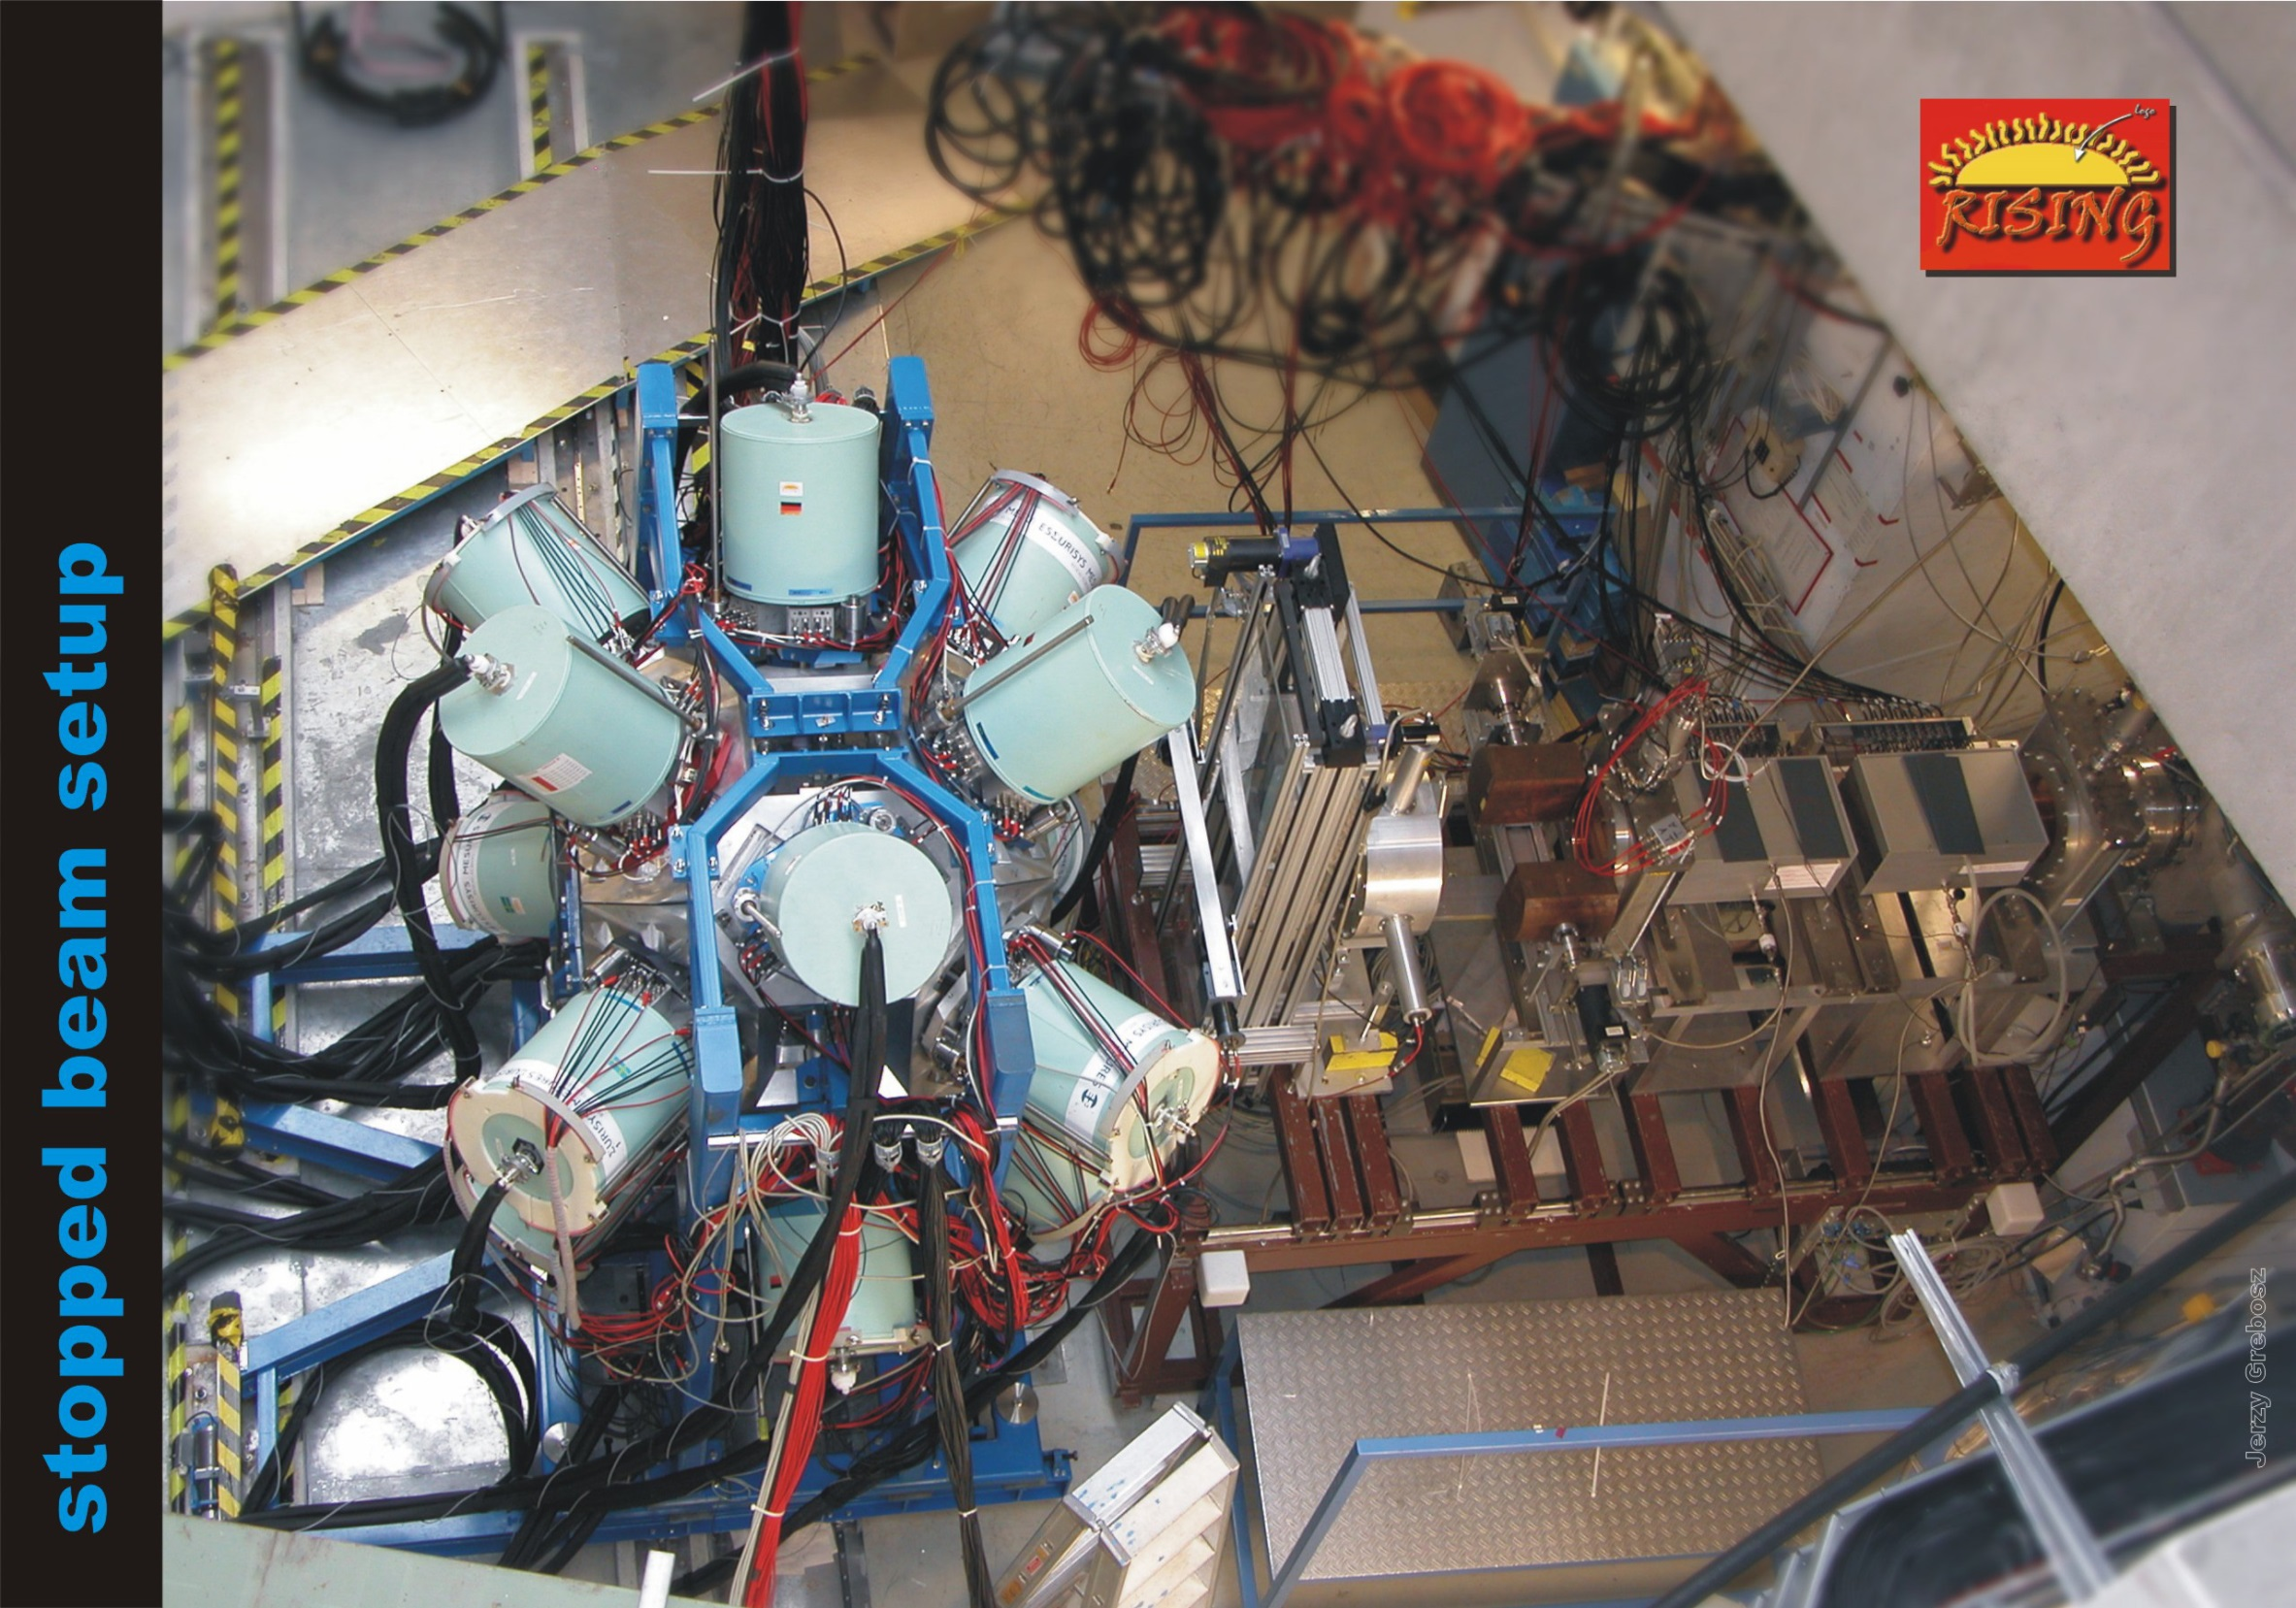
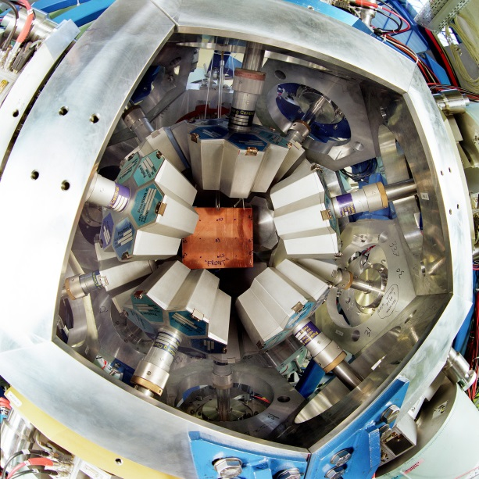
ionization
chambers
(MUSIC41,42)
scintillator
(SC41)
beam
multiwire
chambers
(MW41,MW42)
degrader

Slide 21
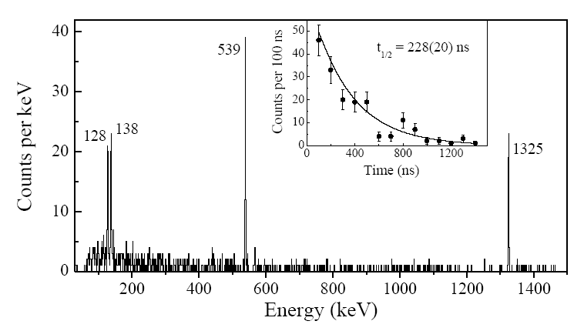
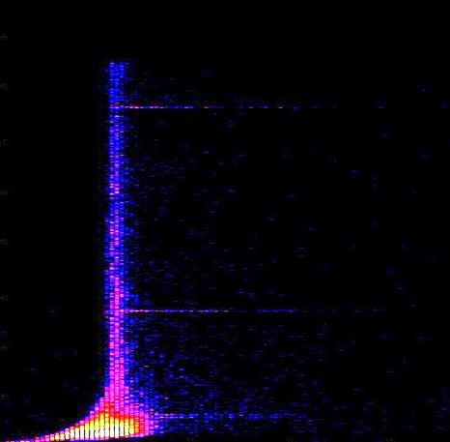
Decay spectroscopy probes shell closures
¹³⁰Cd: DGF-timing
0
1.5
1.0
0.5
0.0
Energy ( MeV )
DGF time ( arbt. units )
Prompt γ-flash
Decay time range: 20 ns ... 20 μs
A. Jungclaus et al., Phys. Rev. Lett 99, 132501 (2007)

Slide 22
8⁺(g_{9/2})⁻² seniority isomers in ⁹⁸Cd and ¹³⁰Cd
h_{11/2}
N=82
MeV
(8⁺)
2428
2.6
(6⁺)
d_{3/2}
2.2
(4⁺)
2281
s_{1/2}
1.6
(8⁺)
2128
N=50
Z=48
2083
d_{5/2}
0.5
(6⁺)
N=82
Z=48
(4⁺)
2002
g_{7/2}
0
1864
N=50
(2⁺)
participating neutron-orbitals
(2⁺)
1395
1325
two proton holes in the g_{9/2} orbit
No dramatic shell quenching!
0⁺
0⁺
A. Blazhev et al., Phys. Rev. C69 (2004) 064304 A. Jungclaus et al., Phys. Rev. Lett. 99 (2007), 132501

Slide 23
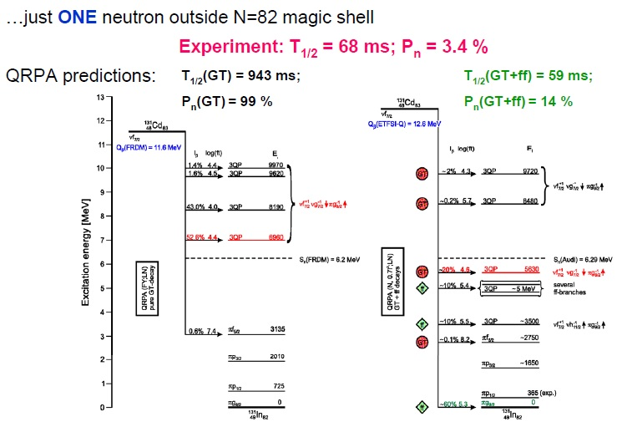
Surprising β–decay properties of ¹³¹Cd

Slide 24
The N=82 shell gap
NONE of the mass models predicts the trend correctly!

Slide 25
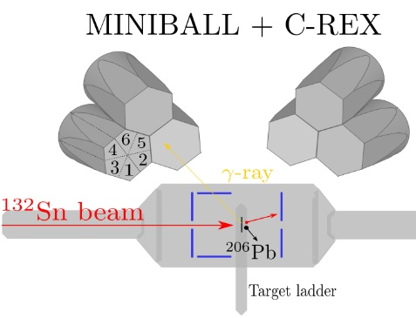
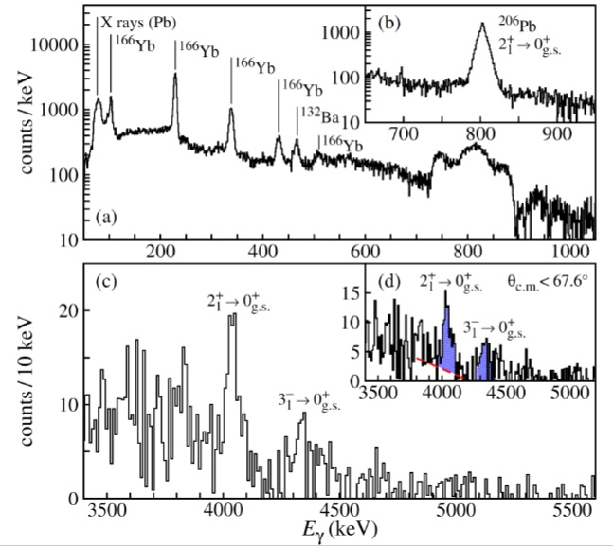
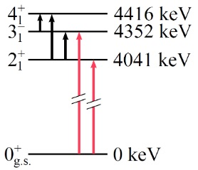
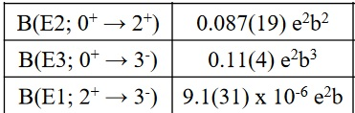
Enhanced quadrupole and octupole strength in doubly-magic ¹³²Sn
¹³²Sb ¹²³Ba ¹⁶⁶Yb
D. Rosiak et al., PRL 121, 252501 (2018)

Slide 26
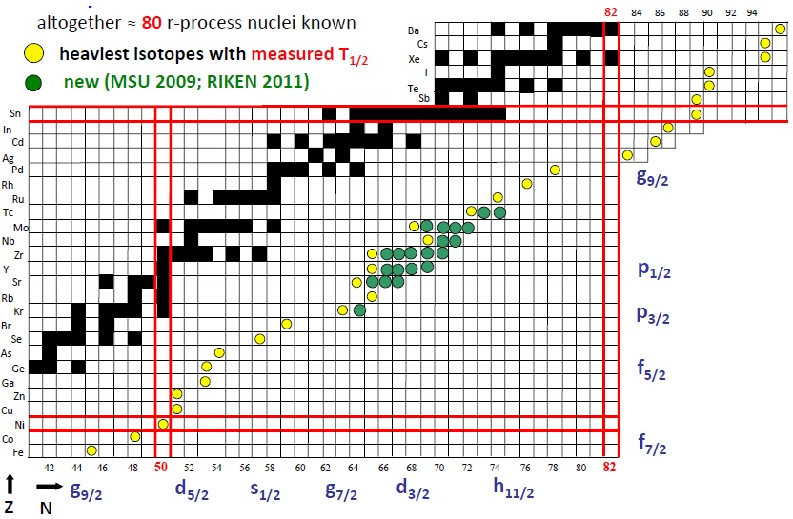
Experimental information on r-process nuclides

Slide 27
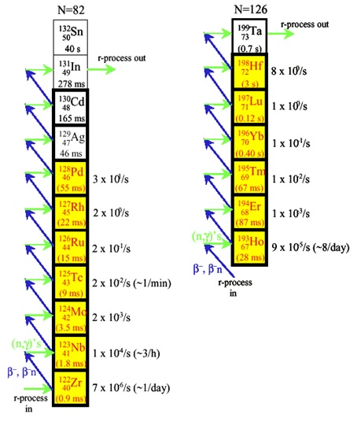
Waiting point lifetimes with fragmentation facilities
Why fragmentation?
  Lifetime measurements can be done with beams from low energy facilities
  But, fragmentation facilities have advantages:
    Use beams of mixed nuclides--Identification on event by event basis
    Greater reach toward dripline
    FAIR, GSI, RIKEN, NSCL and RIA will cover a large part of r-process path

Slide 28
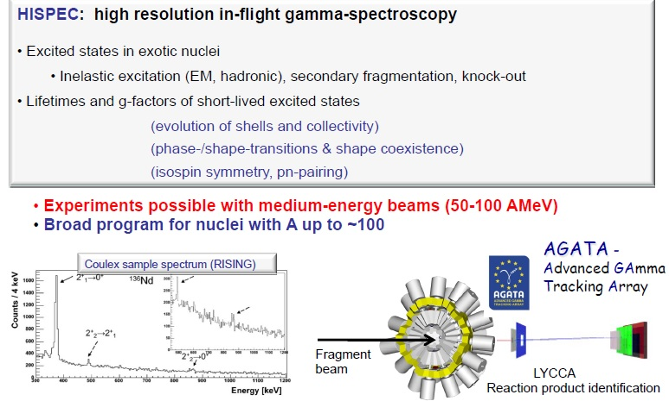
NuSTAR experiments

Slide 29
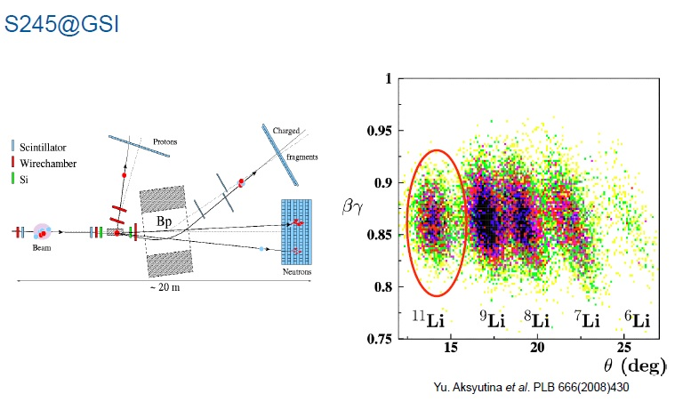
Proton knockout from 304 MeV/u ¹⁴Be

Slide 30
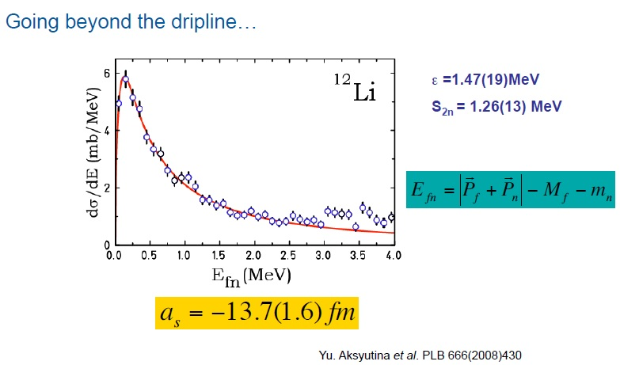
¹H(¹⁴Be,2pn)¹²Li
Breit Wigner Resonance
scattering length (virtual s-state)

Slide 31
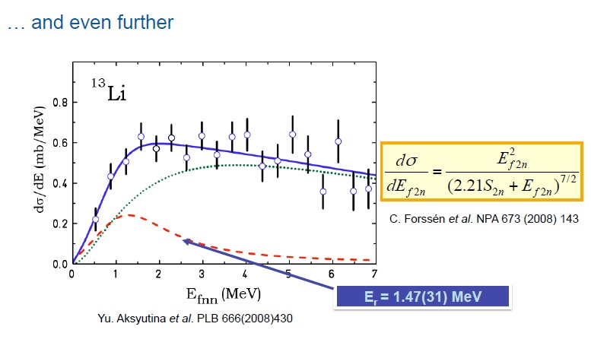
¹H(¹⁴Be,2p)¹³Li
Breit Wigner Resonance
3-body resonance state
correlated background
(from nn-correlations in initial bound-state wave function

Slide 32
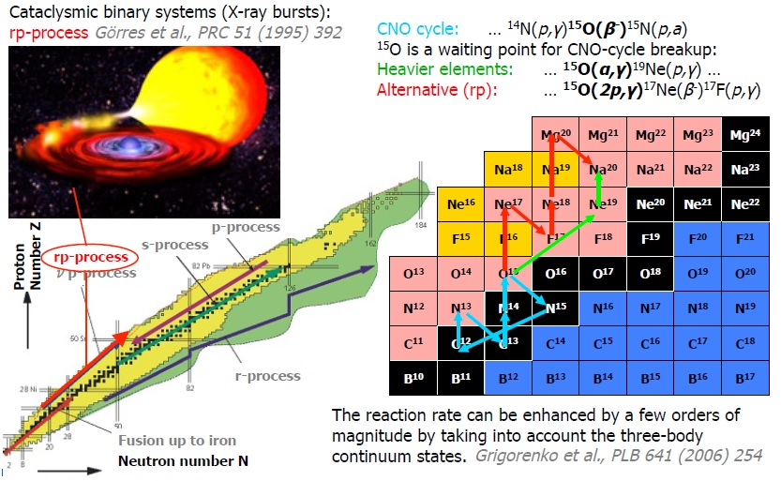
¹⁵O(2p,γ)¹⁷Ne in Nuclear Astrophysics: X-ray bursts, rp-process, neutron stars

Slide 33
Isochronous mass spectroscopy in the ESR

Slide 34
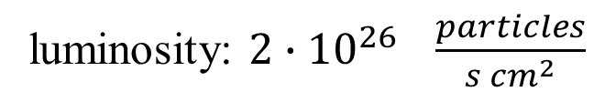
Scattering of RIB on hydrogen target
measure position and energy with Si detectors
RMS radius of ⁵⁶Ni
luminosity: $2∙{10}^{26} \frac{particles}{s {cm}^{2}}$
M. von Schmid, EXL, Phys. Scr. T116 (2015) 014005

Slide 35
⁵⁶Ni(p,p) scattering distribution
M. von Schmid, EXL, Phys. Scr. T116 (2015) 014005

Slide 36
⁵⁶Ni(p,p) scattering distribution
Diffraction pattern (like for a wave after a single slit),
Extract radius of nucleus by fitting theory with parameters.
M. von Schmid, EXL, Phys. Scr. T116 (2015) 014005

Slide 37
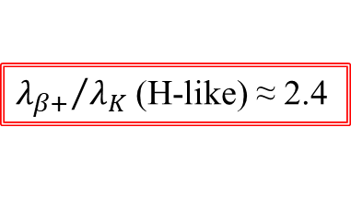
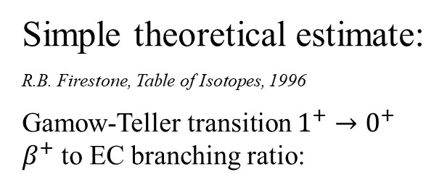
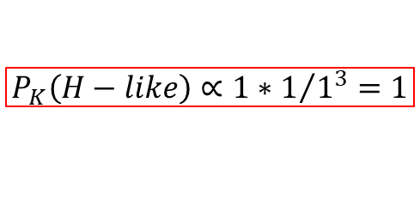
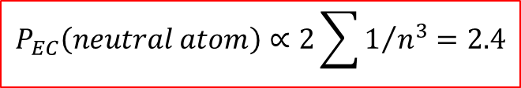
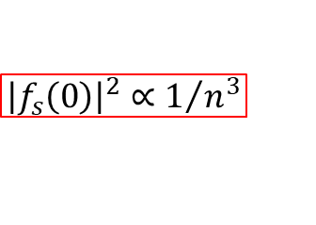
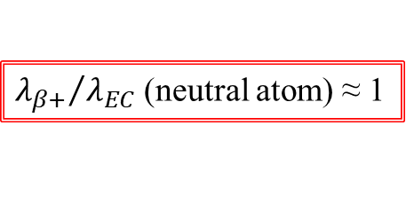
Electron capture in hydrogen-like ions
Simple theoretical estimate:
R.B. Firestone, Table of Isotopes, 1996
Gamow-Teller transition $1^{+}→0^{+}$
$β^{+}$ to EC branching ratio:
${λ_{β+}}/{λ_{EC}}$ (neutral atom) ≈ 1
W. Bambynek et al., Rev. Mod. Phys. 49, 1977
S-electron density at the nucleus:
$${\left|f_{s}\left(0\right)\right|}^{2}∝1/{n^{3}}$$
conclusion:
H-like ions should have 41% longer half-life
$$P_{EC}\left(neutral atom\right)∝2\sum{1/{n^{3}}}=2.4$$
$$P_{K}\left(H−like\right)∝1∗1/{1^{3}}=1$$
${λ_{β+}}/{λ_{K}}$ (H-like) ≈ 2.4

Slide 38

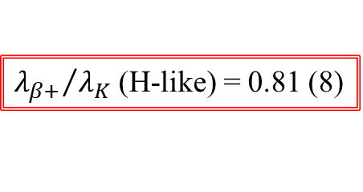
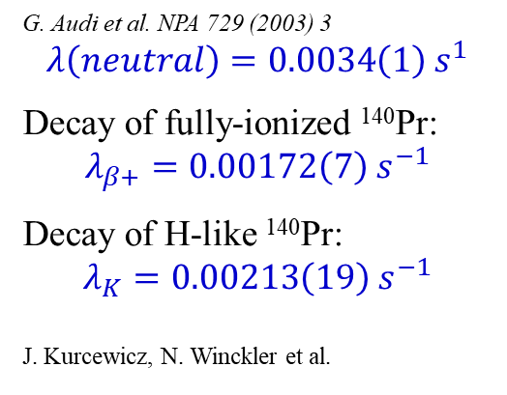
Electron capture in hydrogen-like ions
G. Audi et al. NPA 729 (2003) 3
$$λ\left(neutral\right)=0.0034\left(1\right){ s}^{1}$$
Decay of fully-ionized ¹⁴⁰Pr:
$$λ_{β+}=0.00172\left(7\right) s^{−1}$$
Decay of H-like ¹⁴⁰Pr:
$$λ_{K}=0.00213\left(19\right) s^{−1}$$
J. Kurcewicz, N. Winckler et al.
Expectation:
${λ_{β+}}/{λ_{K}}$ (H-like) ≈ 2.4
Experiment:
${λ_{β+}}/{λ_{K}}$ (H-like) = 0.81 (8)
H-like ions decay ~20% faster than neutral atom!!!

Slide 39
Electron capture in hydrogen-like ions
A.V. Gruzinov, J.N. Bahcall, Astroph. J. 490 (1997) 437
Ionization of ⁷Be in the Sun can be ~20-30%

Slide 40
Nucleosynthesis of heavier elements
M. von Schmid, EXL, Phys. Scr. T116 (2015) 014005

Slide 41
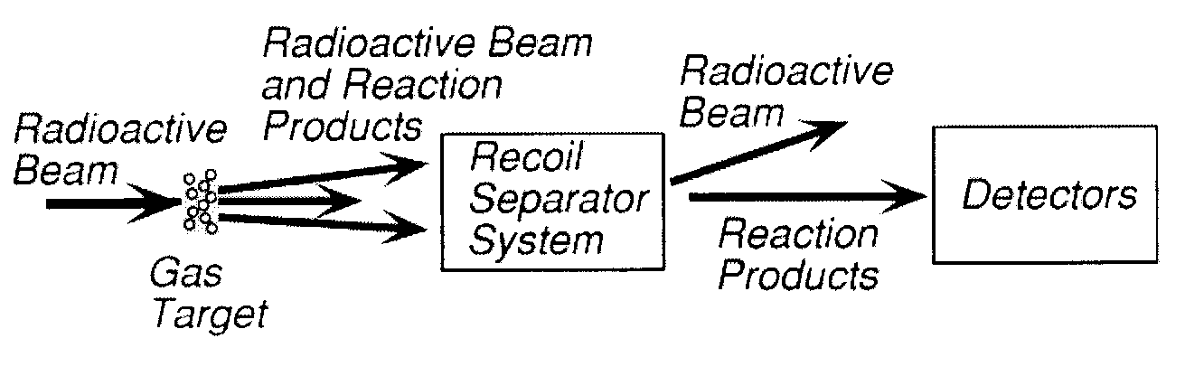
Direct approaches
X(p,γ)Y
X(α,γ)Y
RADIOACTIVE CAPTURE
among the most common reactions
in nuclear astrophysics
heavy recoil detection
inverse kinematics ⇒ forward peaked emission (θ ~ 1º)
⇒ detection efficiency ~ 100%
BUT: high suppression factors required (10¹⁰-10¹⁵)
RIB intensities ~ 10⁷ ions/s
Smith & Rehm (2001)
examples:
²¹Na(p,γ)²²Mg, ¹⁵O(α,γ)¹⁹Ne @ DRAGON – TRIUMF

Slide 42
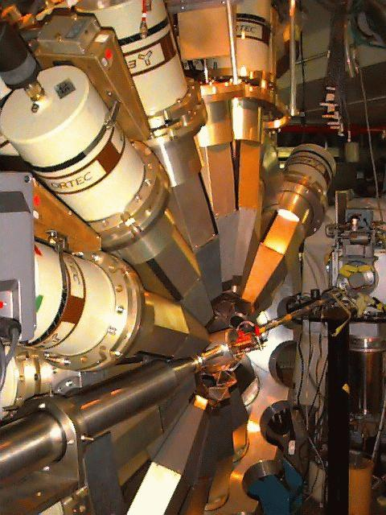
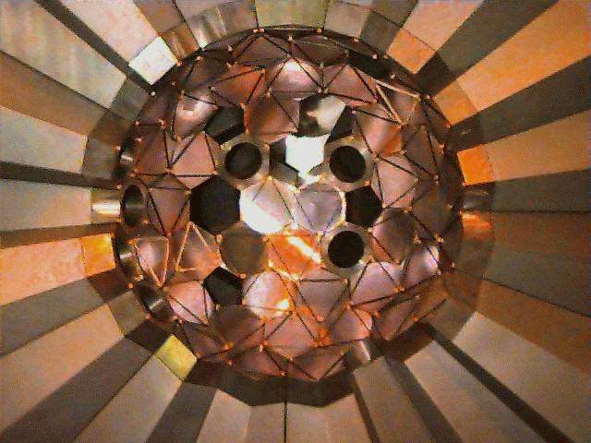
γ-ray detection
low efficiency ⇒ ~ 4π coverage needed
γ-ray background induced by β⁺ beam decay
gammasphere
courtesy: D. Jenkins
100 HPGe detector array
absolute efficiency: 9% for 1.33 MeV γ ray
example: ²²Na(p,γ)²³Mg @ ANL
delayed decay measurements
example:
¹⁹Ne(p,γ)²⁰Na(β⁺)²⁰Ne*(α)¹⁶O @ Louvain-la-Neuve

Slide 43
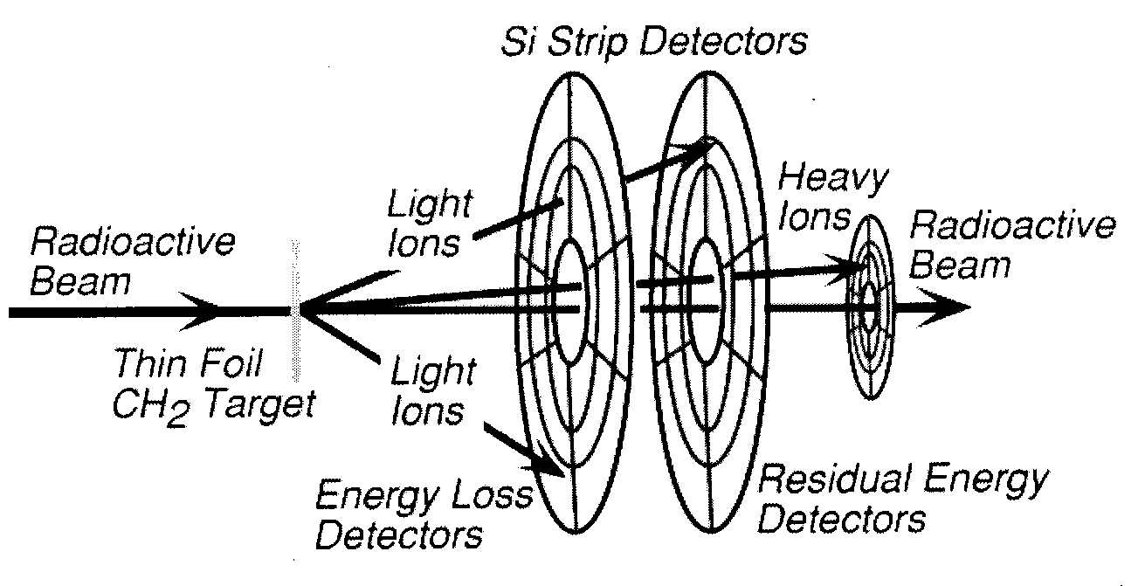
TRANSFER REACTIONS
mainly X(p,α)Y and X(α,p)Y
light-heavy nuclei coincidence
silicon strip detector arrays ⇒ large solid angle coverage (e.g. LEDA – see later)
RIB intensities ~ 10⁵ ions/s
examples:
¹⁸Ne(α,p)²¹Na @ LLN Groombridge et al.: Phys Rev C 66 (2002) 55802(10)
& TRIUMF (planned) TUDA collaboration
¹⁸F(p,α)¹⁵O @ ORNL Bardayan et al.: Phys Rev C 63 (2001) 65802(6)
Bardayan et al.: Phys Rev Lett 89 (2002) 262501(4)
¹⁴O(α,p)¹⁷F @ LLN (planned) Aliotta et al.

Slide 44
Indirect approaches
RESONANT ELASTIC SCATTERING
typically X(p,p’)X
⇒ investigate resonance properties
of compound nucleus
the method
inverse kinematics + suitably thick target (eg (CH₂)_{n}) + proton detection
proton spectrum
excitation function
target thickness ΔE
high beam
energy loss
low-energy
protons
high-energy
protons
low beam
energy loss
energy
protons undergo little energy loss,
little kinematics variation, little straggling
retain information
on resonance shape

Slide 45

A real case
¹⁹Ne(p,p’)¹⁹Ne resonant elastic scattering
excitation function
target thickness ΔE
¹⁹Ne + p
²⁰Ne
Coszach et al.: Phys Rev C 50 (1994) 1695

Slide 46
Resonant elastic scattering
relevance
useful approach when:
resonance energy not known
partial widths not known
very weak resonance(s) dominate(s) reaction rate
fit to experimental data (e.g. by R-matrix analysis) to determine resonance properties
advantage
RIB intensities ~ 10³ ions/s
typically enough thanks to high elastic scattering cross sections
limitations
requirement: proton width Γ_{p} ≥ 1 keV due to current limits in detection energy resolution
progressively harder at lower energies due to increase in Rutherford cross section
and decrease in resonance widths because of penetrability effects
examples: ¹¹C(p,p) & ⁷Be(p,p) @ LLN
²¹Na(p,p) @ TUDA - TRIUMF

Slide 47
TRANSFER REACTIONS
RIB intensities ~ 10⁴ ions/s
e.g. X(d,p)Y
⇒ investigate (n,γ) reactions for s- (or r-)process
TIME-INVERSE REACTIONS
e.g. Coulomb dissociation
⇒ investigate (x,γ) radiative capture reactions
MASS & LIFETIME MEASUREMENTS
… and much more…

Slide 48

The case for ²²Na
novae models ⇒ measurable γ-ray fluxes observable within few kilo-parsecs
idea: observe γ-ray signature to test nova models
²²Na: the fingerprint of a nova outburst
Clayton & Hoyle, ApJ L101 (1974) 187
why ²²Na?
t_{½} = 2.6 y
novae are thought to be principal galactic site for ²²Na
²²Na decay has conveniently short half-life
⇒ hence spatial and temporal limits to its detection
²²Na
β⁺
γ 1.275 MeV
²²Ne
no observation to date
unclear (nuclear) inputs?

Slide 49

²²Na production and destruction processes
in Ne-enriched envelopes of ONe novae:
José: arXiv:astro-ph/0407558 v1 27 Jul 2004
production of ²²Na
²⁰Ne(p,γ)²¹Na(β⁺)²¹Ne(p,γ)²²Na (cold NeNa)
²⁰Ne(p,γ)²¹Na(p,γ)²²Mg(β⁺)²²Na (hot NeNa)
destruction of ²²Na
²²Na(p,γ)²³Mg (mainly)
first direct measurement of the ²¹Na(p,γ)²²Mg rate
recently performed with DRAGON recoil separator @ TRIUMF
also indirect determination of the ²²Na(p,γ)²³Mg rate
carried out with the Gamma-sphere array @ ANL

Slide 50
Considerations
in A = 21 mass region and for nova (T₉ ≤ 0.4) [and X-ray burst temperatures (T₉ ≤ 2)]
nuclear level densities are low
⇒ proton capture reactions dominated by capture into narrow, isolated resonances
recall:
Breit-Wigner cross section
fold in with Maxwell-Boltzmann distribution and integrate to get:
reaction rate
resonant strength
with
stellar reaction rate
(cm³ s⁻¹mol⁻¹)
need: knowledge of resonance energy and properties of state

Slide 51


Experimental approach
in this mass and energy region:
cross sections determined by properties of single resonances in final nucleus
1st step:
locate states of interest in ²²Mg
via resonant elastic scattering
²¹Na(p,p)²¹Na
2nd step:
measure capture cross section
for ²¹Na(p,γ)²²Mg reaction
TRIUMF UK Detector Array scattering facility
Detector of Recoils And Gammas Of Nuclear reactions

Slide 52



The results
determined resonance energies, widths and spin-parity assignments
C. Ruiz et al: Phys. Rev C65 (2002) 42801 (R)
6.813

Slide 53

The DRAGON facility
Detector of Recoils And Gammas Of Nuclear reactions
differentially pumped
window-less
gas target (~ 12cm)
30 BGO
γ-ray detector array
~ 90% of 4π
two-stage
recoil separator
(magnetic and electric dipoles)
(start)
(stop)
DSSSD
double sided silicon strip detectors
for recoil detection
see: J.M. D’Auria et al., Nucl Phys A 701 (2002) 625 and D. Hutcheon et al., NIM A 498 (2003) 190 for details

Slide 54


The results
S. Bishop et al.: Phys Rev Lett 90 (2003) 162501(4)
ωγ measured for state at E_{x} = 5.714 MeV
thick-target yield measurement
E_{cm =} 202 -221 keV
²¹Na beam ~ 10⁹ s⁻¹ (t_{½} = 22.5 s)
P (H₂) = 4.6 Torr
²²Mg
ωγ = 1.03 ± 0.16_{stat} ± 0.14_{sys} meV

Slide 55
Effects of target thickness in cross section measurements
consider: resonance with width Γ and target with thickness Δ
Y/Y_{max}
σ_{max} at E= E_{R}
if Δ << Γ
thin-target case
⇒ yield measurement
proportional to resonance profile
FWHM = Γ
Y/Y_{max}
E_{R}
1
if Δ >> Γ
thick-target case
⇒ yield measurement
integrated Breit-Wigner cross section
smooth step function
3/4
1/2
negligible beam
energy spread
1/4
E_{R}
Δ → ∞
yield measurement gives directly ωγ

Slide 56

The results
J.M. D’Auria et al.: Phys Rev C 69 (2004) 65803(16)
measured ωγ for seven resonances of astrophysical relevance in E_{cm} = 200-1103 keV
thick-target yield measurement
E_{cm =} 0.2 – 1.1 MeV
²¹Na beam ≤ 10⁹ s⁻¹ (t_{½} = 22.5 s)
P (H₂) ~ 5 Torr
note: little agreement on spin-parity values of excited states, except for E_{x} = 5.714 MeV
also, state at E_{x} = 5.837 MeV observed once but not confirmed by other experiments

Slide 57



Astrophysical implications
stellar reaction rate
novae
novae
X-ray bursts
new
rate
uncertainties
from previous
estimates
S. Bishop et al.: PRL 90 (2003) 162501(4)
J.M. D’Auria et al.: PRC 69 (2004) 65803(16)
higher rate ⇒ lower ²²Na abundance
⇒ lower detection limits
consistent with non-observation with COMPTEL
maximum γ-ray detection distance ~ 1 kpc (with INTEGRAL)

