Slide 1
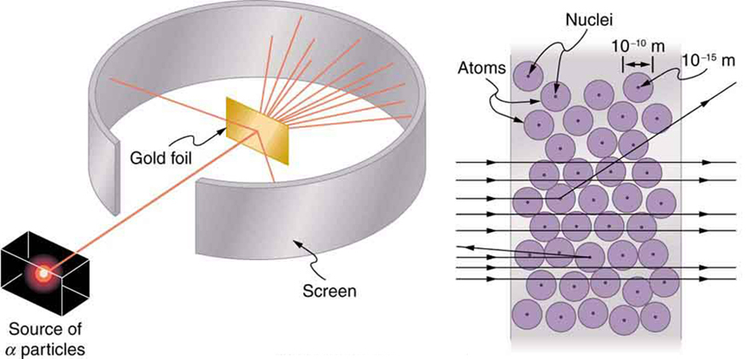
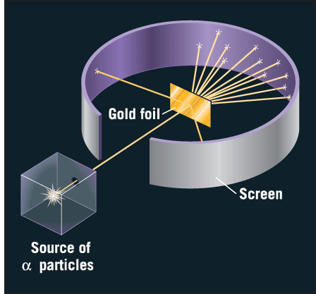
Elastic Scattering
Hans-Jürgen Wollersheim

Slide 2
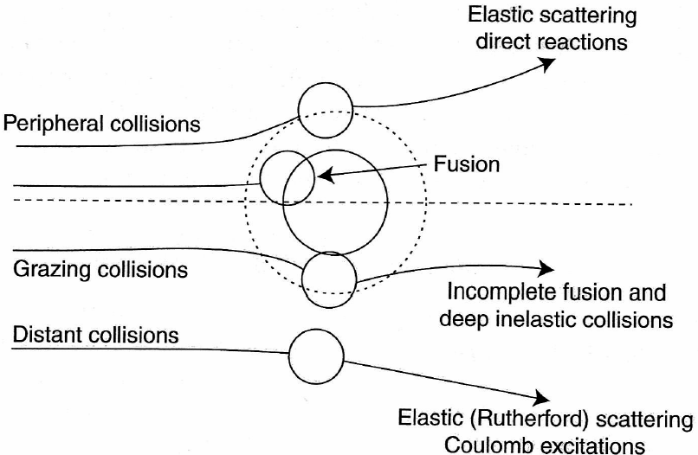
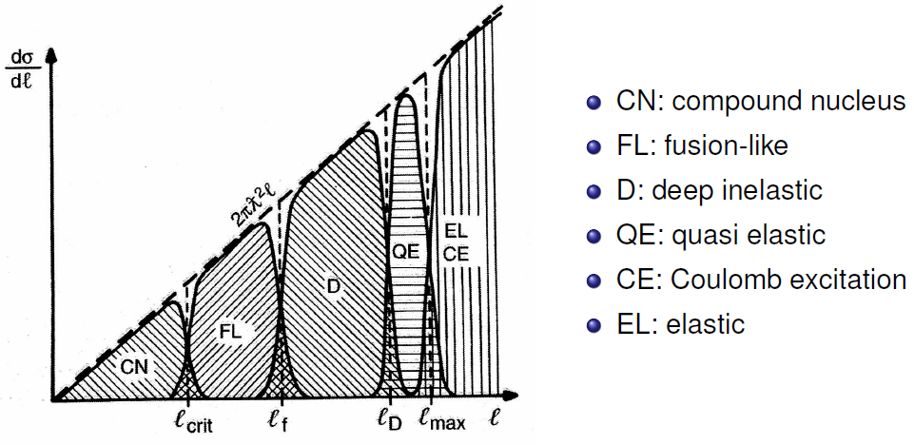
Classification of heavy ion collisions
elastic scattering
Fresnel & Fraunhofer scattering
scattering parameters
differential cross section
optical model analysis
nuclear radius
total reaction cross section
cross sections at high energy
influence of nuclear structure
partial cross section vs. angular momentum

Slide 3
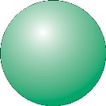
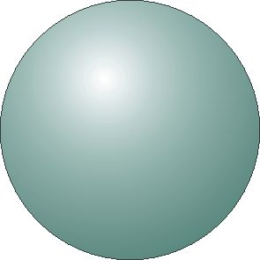
elastic scattering
b

Slide 4
elastic scattering
b

Slide 5
elastic scattering
b

Slide 6
elastic scattering
b
nucleon transfer

Slide 7
elastic scattering
b≈0
nucleon transfer

Slide 8
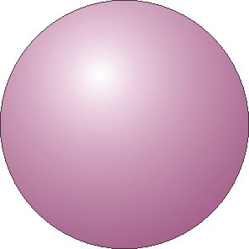
elastic scattering
b≈0
nucleon transfer

Slide 9
elastic scattering
b≈0
compound nucleus
formation
nucleon transfer

Slide 10

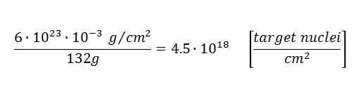

Nuclear reaction cross sections
Consider a beam of projectiles of intensity Φ_{a} particles/sec which hits a thin foil of target nuclei with the result that the beam is attenuated by reactions in the foil such that the transmitted intensity is Φ particles/sec.
The fraction of the incident particles disappear from the beam, i.e. react, in passing through the foil is given by
The number of reactions that are occurring is the difference between the initial and transmitted flux
d
A
v_{a}
$$dΦ=−Φ∙n_{b}∙σ∙dx$$
$$Φ_{initial}−Φ_{trans}=Φ_{initial}\left(1−exp\left[−n_{b}∙d∙σ\right]\right)$$
$$≈Φ_{initial}∙N_{b}∙σ$$
(for thin target)
Example:
Φ_{a} = n_{a}·v_{a}
N_{b} = n_{b}·A·d
A particle current of 1 pnA consists of 6·10⁹ projectiles/s.
A ¹³²Sn target (1 mg/cm²) consists of 5·10¹⁸ nuclei/cm²
$$\frac{6∙{10}^{23}∙{10}^{−3} g/{{cm}^{2}}}{132g}=4.5∙{10}^{18} \left[\frac{target nuclei}{{cm}^{2}}\right]$$
Luminosity = projectiles [s⁻¹] · target nuclei [cm⁻²]
Luminosity (projectile → ¹³²Sn) = 3·10²⁸ [s⁻¹cm⁻²]
Reaction rate [s⁻¹] = luminosity · cross section [cm²]
= projectiles [s⁻¹] · target nuclei [cm⁻²] · cross section [cm²]

Slide 11
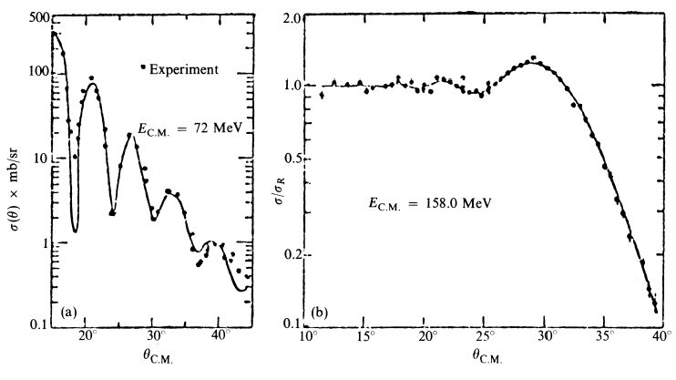

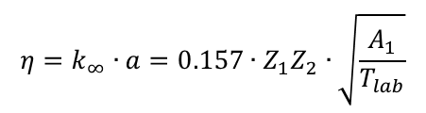


Elastic Scattering
Fraunhofer (left) and Fresnel (right) diffraction
¹²C + ¹⁶O
¹⁶O + ²⁰⁸Pb
η = 2
η = 32
Born approximation (quantum description) or classical description:
half distance of closest approach for head-on collision
wave length of projectile ƛ = (k∞)⁻¹
$$η=\frac{a}{λ}$$
ƛ
$$η=k_{∞}∙a=0.157∙Z_{1}Z_{2}∙\sqrt{\frac{A_{1}}{T_{lab}}}$$
$$a=\frac{0.72∙Z_{1}Z_{2}}{T_{lab}}∙\frac{A_{1}+A_{2}}{A_{2}} \left[fm\right]$$
$$k_{∞}=0.219∙\frac{A_{2}}{A_{1}+A_{2}}∙\sqrt{A_{1}∙T_{lab}} \left[{fm}^{−1}\right]$$

Slide 12
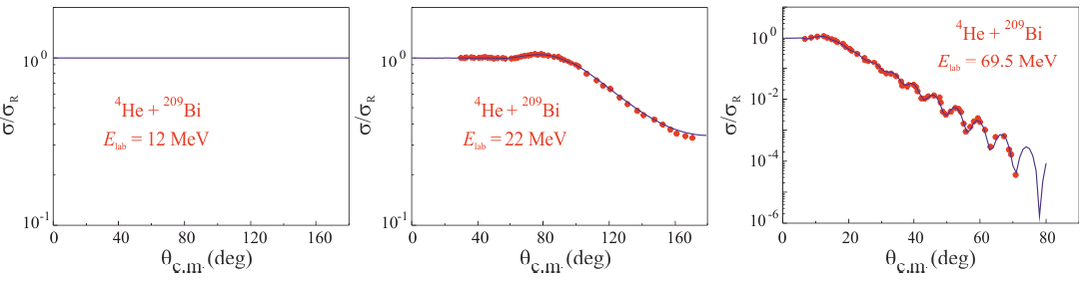
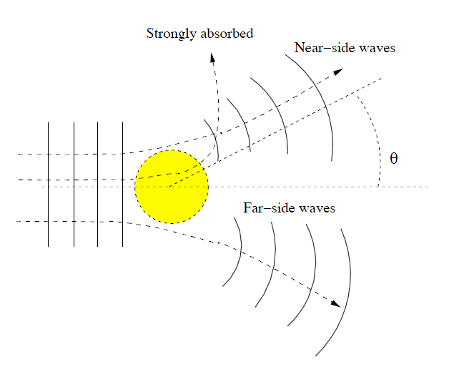
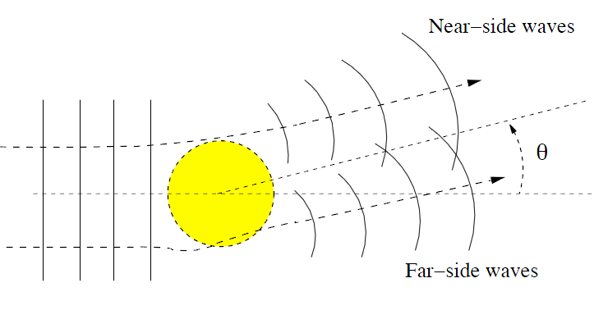
Elastic Scattering
⁴He + ²⁰⁹Bi
E_{lab} = 69.5 MeV
⁴He + ²⁰⁹Bi
E_{lab} = 12 MeV
⁴He + ²⁰⁹Bi
E_{lab} = 22 MeV
Rutherford scattering
η = 15
Fresnel scattering
η = 11
Fraunhofer scattering
η = 6
Transition from classical (optical) picture to quantum picture

Slide 13
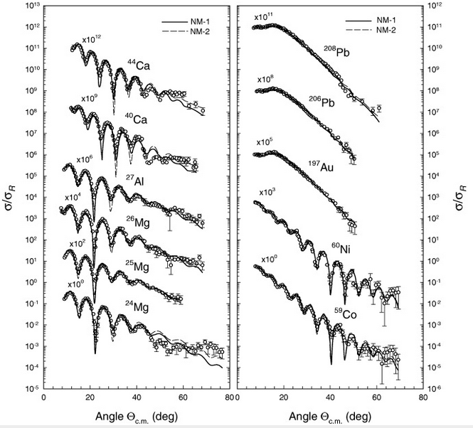

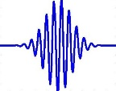
Elastic Scattering
⁶Li elastic scattering @ 88 MeV
Fresnel scattering (η≥10)
particle
η = 2.5
η = 10
η = 1.5
η = 3.3
Fraunhofer scattering (η<10)
wave
Oscillation in angular distribution → good angular resolution required
S. Hossain et al. Phys. Scr. 87 (2013) 015201

Slide 14
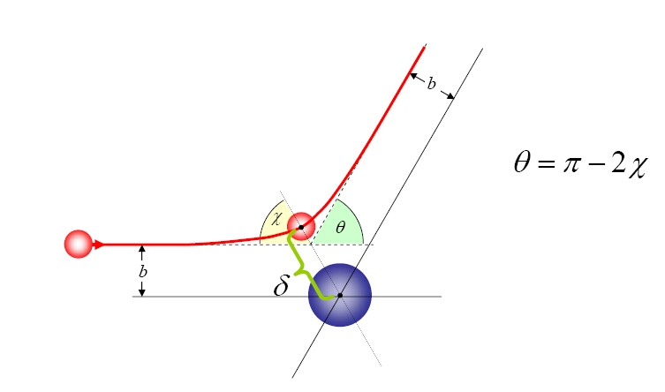
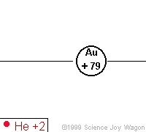






Scattering parameters
D
impact parameter:
$$b=a∙cot\frac{θ_{cm}}{2}$$
distance of closest approach:
half distance of closest approach
in a head-on collision (θ_{cm}=180⁰):
θ_{cm}
$$D=a∙\left[\sin^{−1}\frac{θ_{cm}}{2}+1\right]$$
$$a=\frac{0.72∙Z_{1}Z_{2}}{T_{lab}}∙\frac{A_{1}+A_{2}}{A_{2}} \left[fm\right]$$
b
D
asymptotic wave number:
orbital angular momentum:
$$k_{∞}=0.219∙\frac{A_{2}}{A_{1}+A_{2}}∙\sqrt{A_{1}∙T_{lab}} \left[{fm}^{−1}\right]$$
$$ℓ=k_{∞}∙b=η∙cot\frac{θ_{cm}}{2}$$
Sommerfeld parameter:
$$η=k_{∞}∙a=0.157∙Z_{1}Z_{2}∙\sqrt{\frac{A_{1}}{T_{lab}}}$$
center of mass system

Slide 15
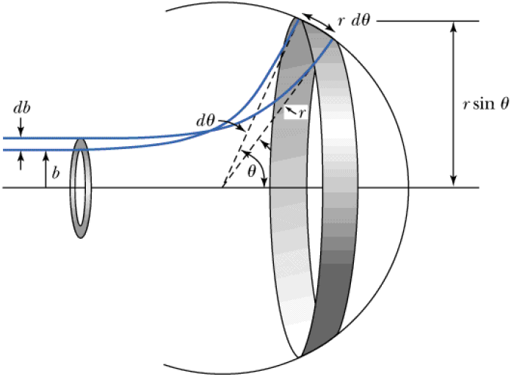
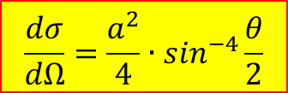

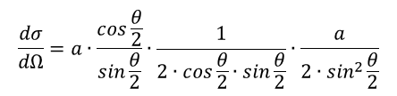
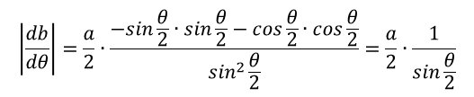

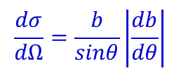
Scattering theory
Particles from the ring defined by the impact parameter b and b+db scatter between angle θ and θ+dθ
$$j∙2π∙b∙db=j∙2π∙sinθ∙\frac{dσ}{dΩ}$$
$$\frac{dσ}{dΩ}=\frac{b}{sinθ}\left|\frac{db}{dθ}\right|$$
impact parameter:
$$b=a∙cot\frac{θ}{2}$$
ring area:
2πb db
$$\left|\frac{db}{dθ}\right|=\frac{a}{2}∙\frac{−sin\frac{θ}{2}∙sin\frac{θ}{2}−cos\frac{θ}{2}∙cos\frac{θ}{2}}{\sin^{2}\frac{θ}{2}}=\frac{a}{2}∙\frac{1}{sin\frac{θ}{2}}$$
solid angle:
2π sinθ dθ
$$\frac{dσ}{dΩ}=a∙\frac{cos\frac{θ}{2}}{sin\frac{θ}{2}}∙\frac{1}{2∙cos\frac{θ}{2}∙sin\frac{θ}{2}}∙\frac{a}{2∙\sin^{2}\frac{θ}{2}}$$
$$\frac{dσ}{dΩ}=\frac{a^{2}}{4}∙\sin^{−4}\frac{θ}{2}$$

Slide 16
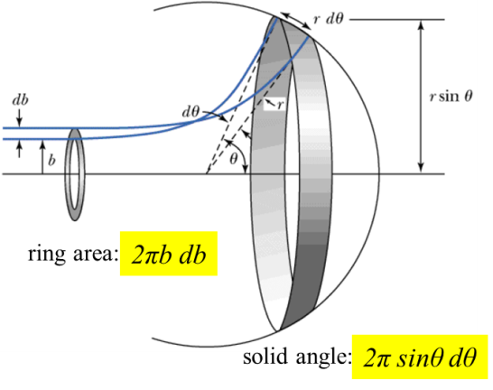
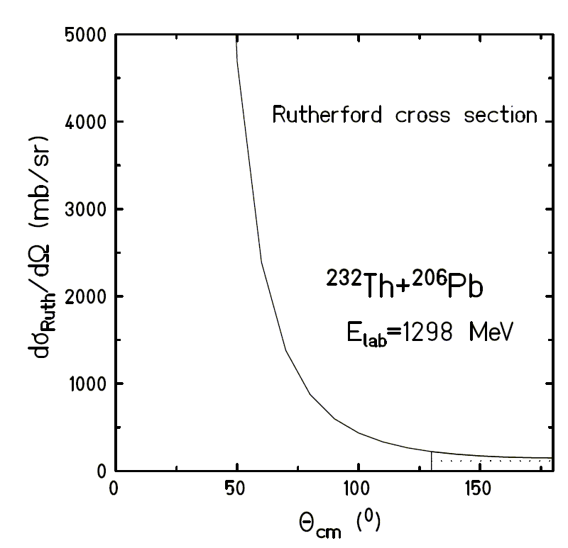

Scattering theory
ring area:
2πb db
solid angle:
2π sinθ dθ
$$\frac{dσ}{dΩ}=\frac{a^{2}}{4}∙\sin^{−4}\frac{θ}{2}$$

Slide 17
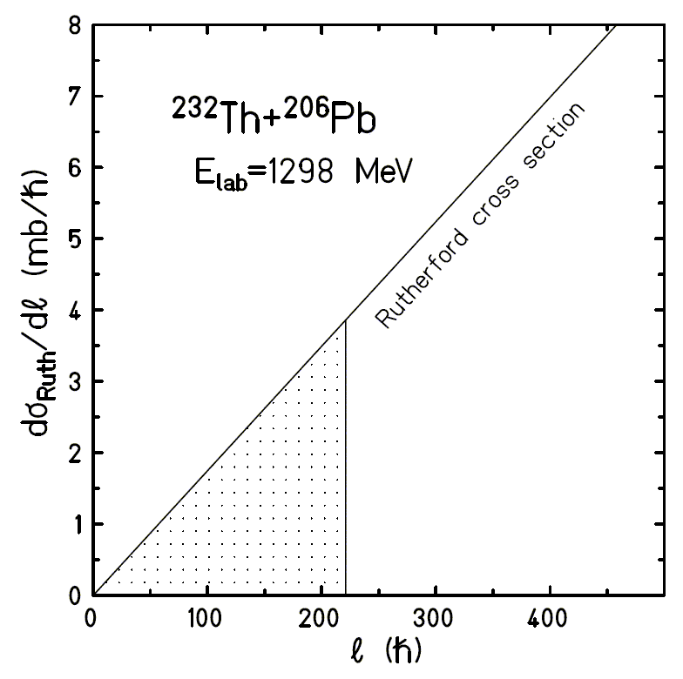










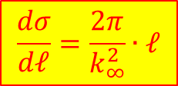
Scattering theory
angular momentum and scattering angle:
$$ℓ=b∙p=b∙\sqrt{2∙m∙T}$$
$$k_{∞}=\frac{\sqrt{2∙m∙T}}{ℏ}$$
$$ℓ=η∙cot\frac{θ}{2}$$
$$η=k_{∞}∙a$$
$$\frac{dσ}{dℓ}=\frac{dσ}{dΩ}∙\frac{dΩ}{dℓ}=\frac{a^{2}}{4}∙\sin^{−4}\frac{θ}{2}∙\frac{dΩ}{dℓ}$$
$$\frac{dΩ}{dℓ}=2π∙sinθ∙\frac{dθ}{dℓ}$$
$$\frac{dℓ}{dθ}=\frac{η}{2}∙\sin^{−2}\frac{θ}{2}$$
$$\frac{dΩ}{dℓ}=2π∙2∙cos\frac{θ}{2}∙sin\frac{θ}{2}∙\frac{2∙\sin^{2}\frac{θ}{2}}{η}$$
$$cos\frac{θ}{2}=\frac{ℓ}{η}∙sin\frac{θ}{2}$$
$$\frac{dσ}{dℓ}=\frac{a^{2}}{4}∙\sin^{−4}\frac{θ}{2}∙\frac{8π∙ℓ}{η^{2}}∙\sin^{4}\frac{θ}{2}$$
$$\frac{dσ}{dℓ}=\frac{2π}{k_{∞}^{2}}∙ℓ$$

Slide 18
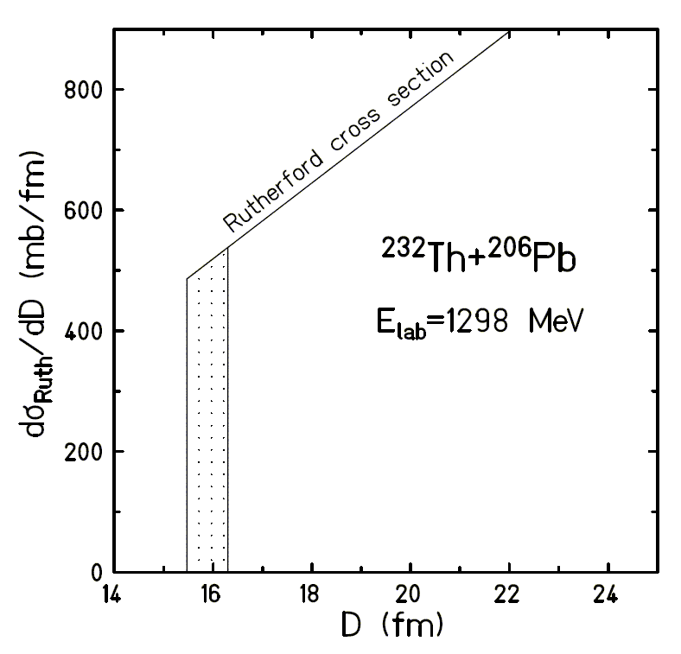
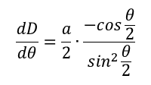

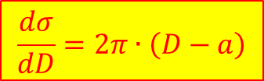
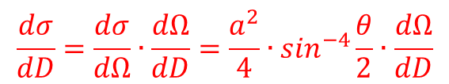




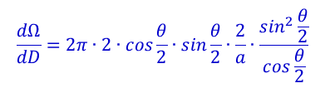
Scattering theory
distance of closest approach and scattering angle:
$$D=a∙\left[\sin^{−1}\frac{θ}{2}+1\right]$$
$$sin\frac{θ}{2}=\frac{a}{D−a}$$
$$\frac{dσ}{dD}=\frac{dσ}{dΩ}∙\frac{dΩ}{dD}=\frac{a^{2}}{4}∙\sin^{−4}\frac{θ}{2}∙\frac{dΩ}{dD}$$
$$\frac{dΩ}{dD}=2π∙sinθ∙\frac{dθ}{dD}$$
$$\frac{dD}{dθ}=\frac{a}{2}∙\frac{−cos\frac{θ}{2}}{\sin^{2}\frac{θ}{2}}$$
$$\frac{dΩ}{dD}=2π∙2∙cos\frac{θ}{2}∙sin\frac{θ}{2}∙\frac{2}{a}∙\frac{\sin^{2}\frac{θ}{2}}{cos\frac{θ}{2}}$$
$$\frac{dΩ}{dD}=\frac{8π}{a}∙\sin^{3}\frac{θ}{2}$$
$$\frac{dσ}{dD}=\frac{a^{2}}{4}∙\sin^{−4}\frac{θ}{2}∙\frac{8π}{a}∙\sin^{3}\frac{θ}{2}=\frac{2π∙a}{sin\frac{θ}{2}}$$
$$\frac{dσ}{dD}=2π∙\left(D−a\right)$$

Slide 19



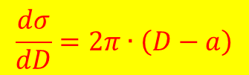
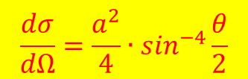


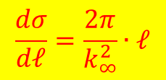
Summary
impact parameter and scattering angle:
$$b=a∙cot\frac{θ}{2}$$
$$a=\frac{Z_{p}∙Z_{t}∙e^{2}}{2∙E_{cm}}$$
$$\frac{dσ}{dΩ}=\frac{a^{2}}{4}∙\sin^{−4}\frac{θ}{2}$$
angular momentum and scattering angle:
$$ℓ=η∙cot\frac{θ}{2}$$
$$k_{∞}=\frac{\sqrt{2∙m∙E_{cm}}}{ℏ}$$
$$η=k_{∞}∙a$$
$$\frac{dσ}{dℓ}=\frac{2π}{k_{∞}^{2}}∙ℓ$$
distance of closest approach and scattering angle:
$$D=a∙\left[\sin^{−1}\frac{θ}{2}+1\right]$$
$$\frac{dσ}{dD}=2π∙\left(D−a\right)$$

Slide 20
Summary
impact parameter and scattering angle:
$$b=a∙cot\frac{θ}{2}$$
$$\frac{dσ}{dΩ}=\frac{a^{2}}{4}∙\sin^{−4}\frac{θ}{2}$$
angular momentum and scattering angle:
$$ℓ=η∙cot\frac{θ}{2}$$
$$\frac{dσ}{dℓ}=\frac{2π}{k_{∞}^{2}}∙ℓ$$
distance of closest approach and scattering angle:
$$D=a∙\left[\sin^{−1}\frac{θ}{2}+1\right]$$
$$\frac{dσ}{dD}=2π∙\left(D−a\right)$$

Slide 21
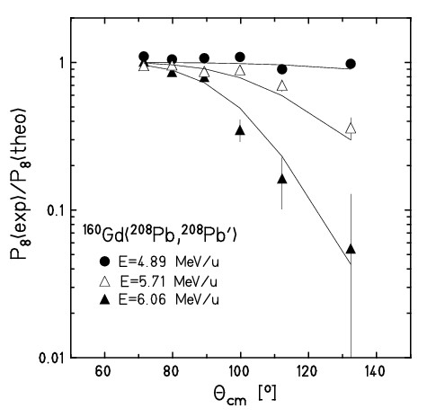
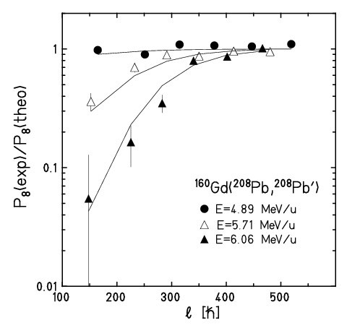
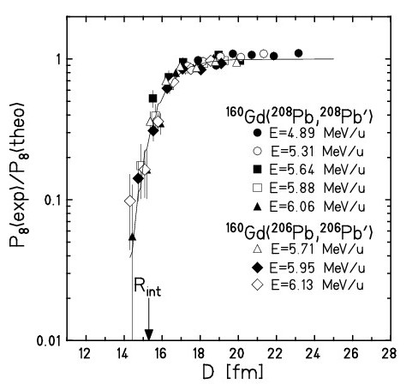
Nuclear Reactions
elastic scattering deviates from Rutherford scattering
scattering angle angular momentum distance of closest approach
Ratio of the elastic scattering and Rutherford scattering (nuclear reactions) is only independent of the bombarding energy when plotted versus the distance of closest approach D.
Data are from Coulomb excitation experiments: The excitation probability P₈(exp) of the low-lying rotational state I^{π} = 8⁺ is not only excited directly but also fed from higher-lying states and is therefore a measure of the elastic scattering. When comparing with Coulomb excitation calculations P₈(theo), which corresponds to the Rutherford scattering, the observed deviations are a clear indication of nuclear interactions (nuclear reactions).

Slide 22
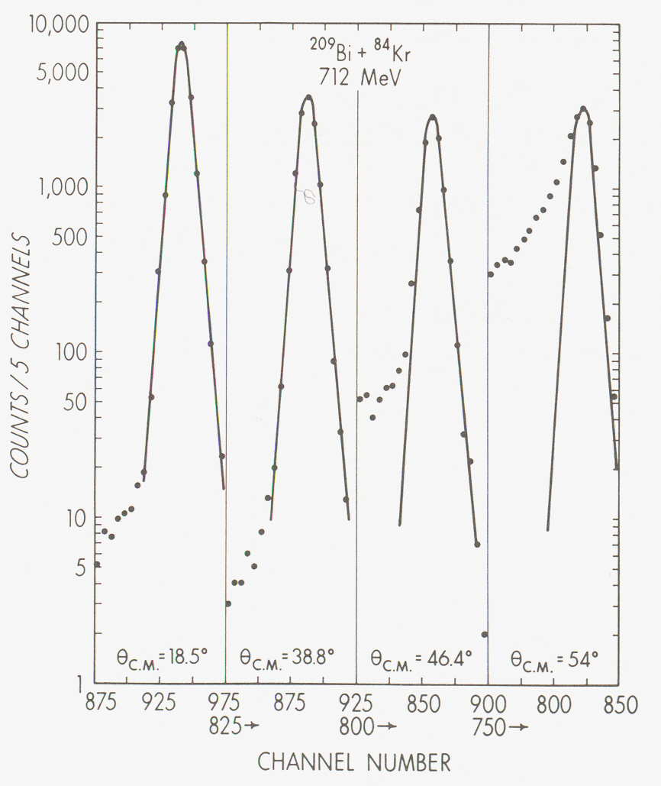
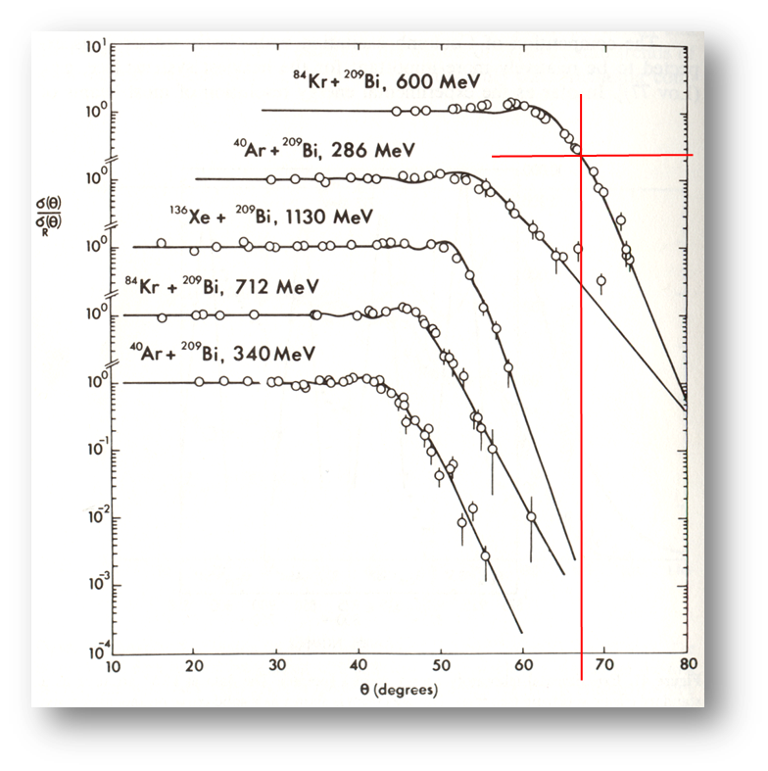
Heavy-ion elastic scattering
energy and angular distributions
determine elastic energy = f(θ), fit standard line shape, determine elastic cross section σ_{el}(θ)
plot ratio elastic/Rutherford cross section = f(θ), determine quarter-point θ_{1/4}
→ total integrated reaction cross section σ_{R}
⁸⁴Kr (600 MeV) + ²⁰⁹Bi: θ = 66.7⁰
→ ℓ_{gr} = 268 ħ, R_{int} = 14.2 fm, σ_{R} = 1.9 b
J.R. Birkelund et al., Phys.Rev.C13 (1976), 133

Slide 23
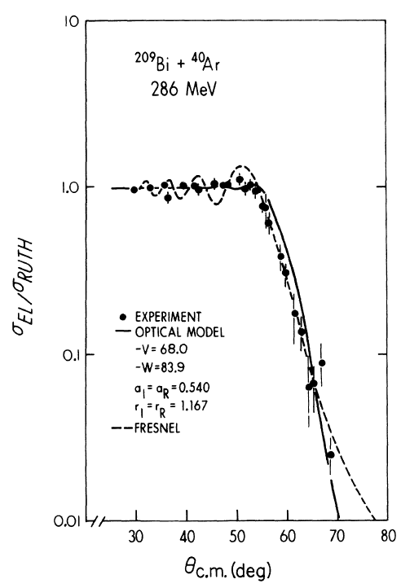
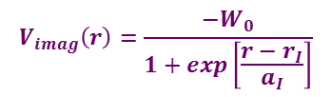
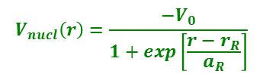
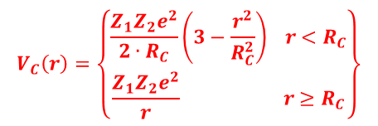
Heavy-ion elastic scattering and the optical model
V
$$V_{C}\left(r\right)=\left\{\begin{matrix}\frac{Z_{1}Z_{2}e^{2}}{2∙R_{C}}\left(3−\frac{r^{2}}{R_{C}^{2}}\right) r<R_{C} \\ \frac{Z_{1}Z_{2}e^{2}}{r} r≥R_{C}\end{matrix}\right\}$$
$$V_{nucl}\left(r\right)=\frac{−V_{0}}{1+exp\left[\frac{r−r_{R}}{a_{R}}\right]}$$
r
$$V_{imag}\left(r\right)=\frac{−W_{0}}{1+exp\left[\frac{r−r_{I}}{a_{I}}\right]}$$
r
J.R. Birkelund et al., Phys.Rev.C13 (1976), 133

Slide 24
Heavy-ion elastic scattering and the optical model
V
$$V_{C}\left(r\right)=\left\{\begin{matrix}\frac{Z_{1}Z_{2}e^{2}}{2∙R_{C}}\left(3−\frac{r^{2}}{R_{C}^{2}}\right) r<R_{C} \\ \frac{Z_{1}Z_{2}e^{2}}{r} r≥R_{C}\end{matrix}\right\}$$
$$V_{nucl}\left(r\right)=\frac{−V_{0}}{1+exp\left[\frac{r−r_{R}}{a_{R}}\right]}$$
r
$$V_{imag}\left(r\right)=\frac{−W_{0}}{1+exp\left[\frac{r−r_{I}}{a_{I}}\right]}$$
Parameters of the optical model fit:
V₀ (MeV) | r_{R} (fm) | a_{R} (fm) | W₀ (MeV) | r_{I} (fm) | a_{I} (fm) | ℓ (ħ) | σ_{R} (mb)
68.0 | 1.167 | 0.540 | 83.9 | 1.167 | 0.540 | 150 | 1937
214.5 | 1.104 | 0.536 | 261.1 | 1.104 | 0.536 | 149 | 1902
43.2 | 1.196 | 0.529 | 56.0 | 1.196 | 0.529 | 150 | 1939
θ_{1/4} = 60⁰ → R_{int} = 13.4 [fm]
→ ℓ_{gr} = 152 [ħ]
J.R. Birkelund et al., Phys.Rev.C13 (1976), 133

Slide 25
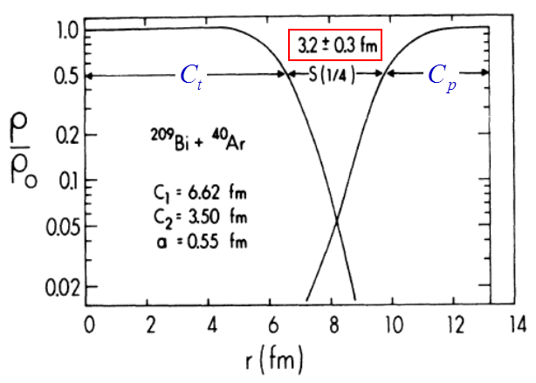

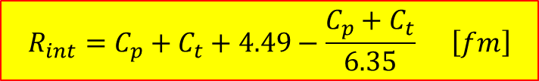


Elastic scattering and nuclear radius
Nuclear interaction radius: (distance of closest approach)
$$R_{int}=D=a∙\left[\sin^{−1}\frac{θ_{1/4}}{2}+1\right]$$
$$R_{int}=C_{p}+C_{t}+4.49−\frac{C_{p}+C_{t}}{6.35} \left[fm\right]$$
$$C_{i}=R_{i}∙\left(1−R_{i}^{−2}\right) \left[fm\right]$$
$$R_{i}=1.28∙A_{i}^{1/3}−0.76+0.8∙A_{i}^{−1/3} \left[fm\right]$$
Nuclear density distributions at the nuclear interaction radius
θ_{1/4} = 60⁰ → R_{int} = 13.4 [fm]
→ ℓ_{gr} = 152 [ħ]
J.R. Birkelund et al., Phys.Rev.C13 (1976), 133

Slide 26
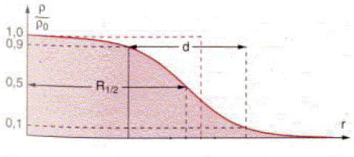
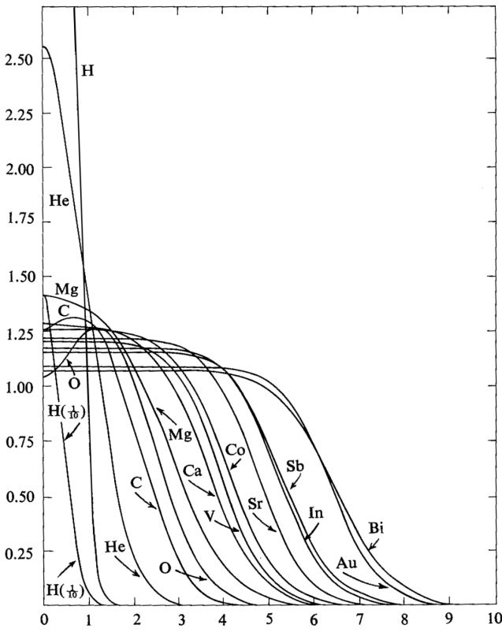


Nuclear radius
ρ/ρ₀
ρ/ρ₀
1.0
0.9
0.5
0.1
C
R
nuclear radius of a homogenous charge distribution:
$$R_{i}=1.28∙A_{i}^{1/3}−0.76+0.8∙A_{i}^{−1/3} \left[fm\right]$$
nuclear radius of a Fermi charge distribution:
r
$$C_{i}=R_{i}∙\left(1−R_{i}^{−2}\right) \left[fm\right]$$

Slide 27
Elastic scattering – nuclear reactions
impact parameter and scattering angle:
$$b=a∙cot\frac{θ}{2}$$
$$\frac{dσ}{dΩ}=\frac{a^{2}}{4}∙\sin^{−4}\frac{θ}{2}$$
θ_{1/4} = 132⁰
angular momentum and scattering angle:
$$ℓ=η∙cot\frac{θ}{2}$$
$$\frac{dσ}{dℓ}=\frac{2π}{k_{∞}^{2}}∙ℓ$$
distance of closest approach and scattering angle:
ℓ_{gr} = 206 ħ
$$D=a∙\left[\sin^{−1}\frac{θ}{2}+1\right]$$
$$\frac{dσ}{dD}=2π∙\left(D−a\right)$$
R_{int} = 16.2 fm

Slide 28

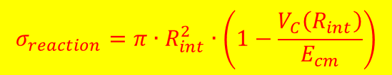

Total reaction cross section
impact parameter and scattering angle:
$$b=a∙cot\frac{θ}{2}$$
$$σ_{reaction}={2πa}^{2}∙\left[{\left(1−cos{ θ}_{1/4}^{cm}\right)}^{−1}−0.5\right]$$
θ_{1/4} = 132⁰
a = 7.73 fm
angular momentum and scattering angle:
$$ℓ=η∙cot\frac{θ}{2}$$
$$σ_{reaction}=\frac{π}{k_{∞}^{2}}∙ℓ_{gr}\left(ℓ_{gr}+1\right)$$
distance of closest approach and scattering angle:
ℓ_{gr} = 206 ħ
k∞ = 59.9 fm⁻¹
$$D=a∙\left[\sin^{−1}\frac{θ}{2}+1\right]$$
$$σ_{reaction}=π∙R_{int}^{2}∙\left(1−\frac{V_{C}\left(R_{int}\right)}{E_{cm}}\right)$$
R_{int} = 16.2 fm
V_{C}(R_{int}) = 656 MeV

Slide 29
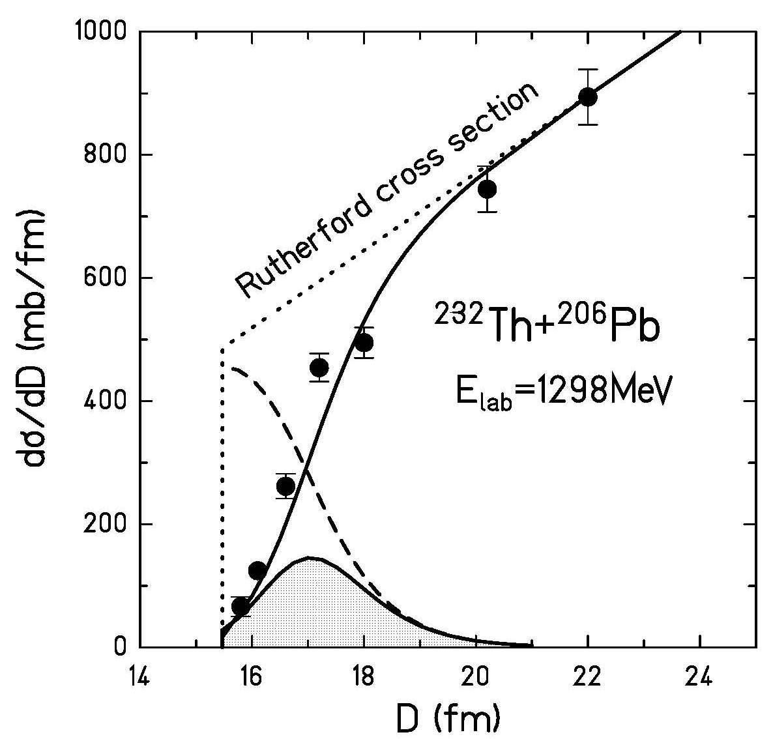
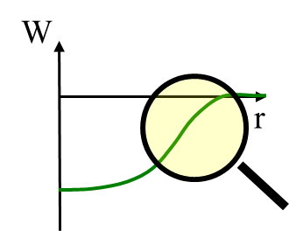




Scattering theory – nuclear absorption
elastic cross section:
$$\frac{dσ_{el}}{dD}=\left[1−P_{abs}\left(D\right)\right]\frac{dσ_{Ruth}}{dD}$$
attenuation coefficient:
$$\left[1−P_{abs}\left(D\right)\right]=exp\left\{−\frac{2}{ℏ}\int_{−∞}^{+∞}{W\left[r\left(t\right)\right]dt}\right\}$$
proximity potential:
$$W\left[r\left(t\right)\right]=W_{0}∙exp\left[−\frac{r\left(t\right)−C_{1}−C_{2}}{a_{I}}\right]$$
attenuation coefficient:
$$\left[1−P_{abs}\left(D\right)\right]=exp\left\{−\frac{2}{ℏ}∙W_{0}∙exp\left[−\frac{D−C_{1}−C_{2}}{a_{I}}\right]∙\frac{D}{v}\right\}$$

Slide 30


High-energy Coulomb excitation
grazing angle
¹³⁶Xe on ²⁰⁸Pb at 700 MeV/u
excitation of giant dipole resonance
Coulomb ex.
Protons
Neutrons
For relativistic projectiles ( ):
π
ν
A.Grünschloß et al., Phys. Rev. C60 051601 (1999)

Slide 31

High-energy Coulomb excitation
grazing angle
¹³⁶Xe on ²⁰⁸Pb at 700 MeV/u
excitation of giant dipole resonance
Coulomb ex.
Protons
Neutrons
For relativistic projectiles ( ):
π
ν
A.Grünschloß et al., Phys. Rev. C60 051601 (1999)

Slide 32



Effect of nuclear structure on elastic scattering
^{9,10}Be+⁶⁴Zn elastic scattering angular distributions @ 29MeV
⁹Be
Sn=1.665 MeV
¹⁰Be
Sn=6.88 MeV
A. Di Pietro et al. Phys. Rev. Lett. 105, 022701(2010)

Slide 33




Effect of nuclear structure on elastic scattering
¹¹Be
^{10,11}Be+⁶⁴Zn
@ Rex-Isolde, CERN
¹⁰Be+⁶⁴Zn
¹¹Be+⁶⁴Zn
Optical Model analysis:
  Volume potential responsible for the
  core-target interaction obtained from
  the ¹⁰Be+⁶⁴Zn elastic scattering fit.
  plus a complex surface DPP having
  the shape of a W-S derivative with a
  very large diffuseness.
  Very large diffuseness: a_{i} = 3.5 fm
  similar to what found in
  A. Bonaccrso, NP A706 (2002), 322
Reaction cross-sections
σ_{R}(⁹Be) ≈ 1.1b σ_{R}(¹⁰Be) ≈ 1.2b σ_{R}(¹¹Be) ≈ 2.7b
A. Di Pietro et al. Phys. Rev. Lett. 105, 022701(2010)

