Slide 1
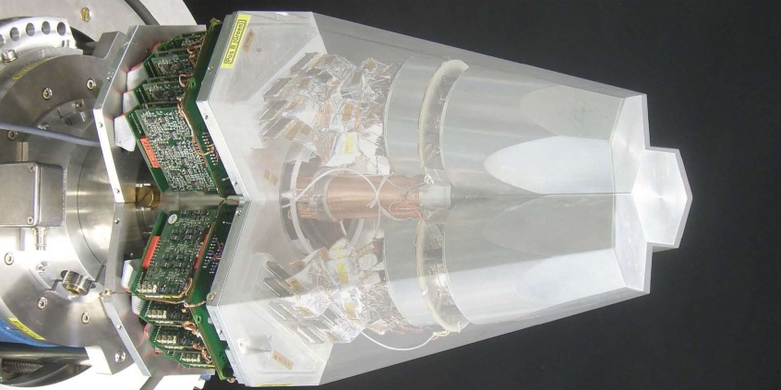
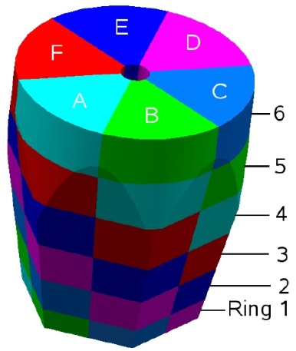
Segmented Detectors
Lecture: Hans-Jürgen Wollersheim
e-mail: h.j.wollersheim@gsi.de

Slide 2
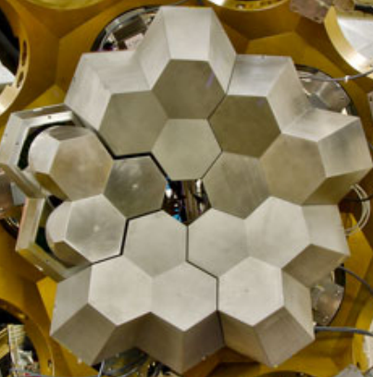
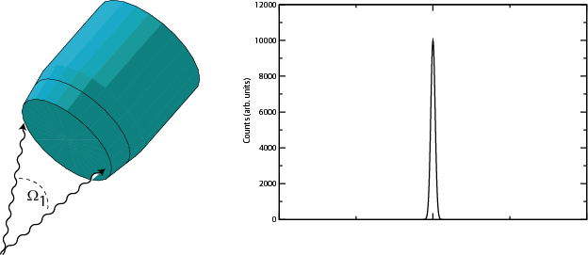
Challenges of γ-ray spectroscopy efficiency vs resolution
Emission at rest
ΔE=2keV
Counts(arb. units)
γ ray
Channel No.
Composite HPGe detectors
in ADD BACK mode

Slide 3
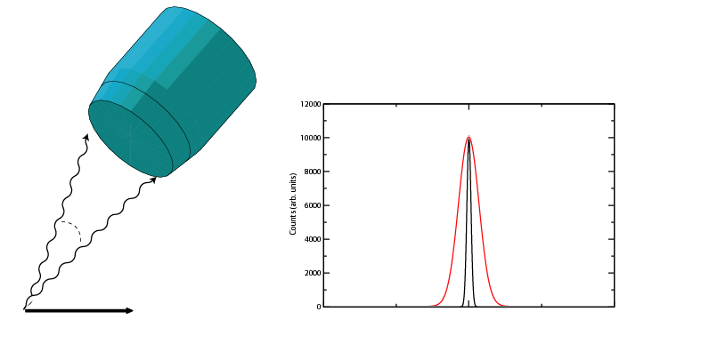
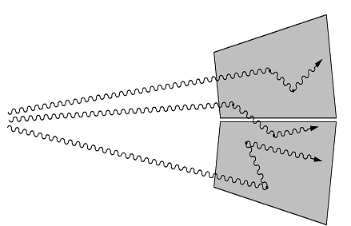
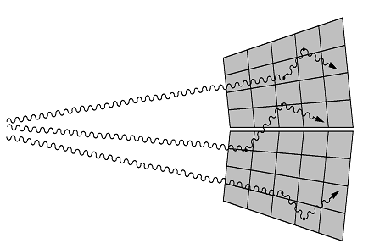
Challenges of γ-ray spectroscopy efficiency vs resolution
Doppler broadening
High M_{γ}
Emission in flight
Δө
Counts(arb. units)
ө
v
Channel No.
Solution
- Segmentation
- Gamma-ray tracking
- Pulse shape analysis
- Doppler correction

Slide 4
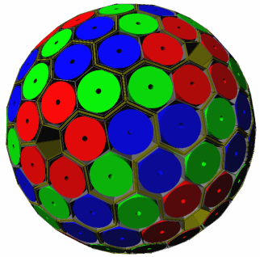
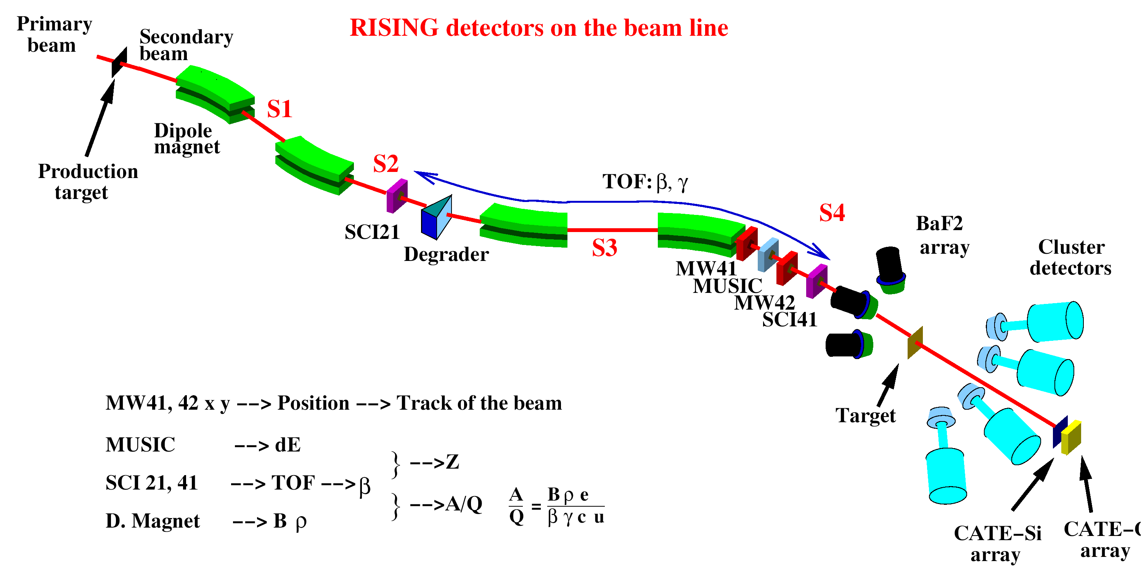
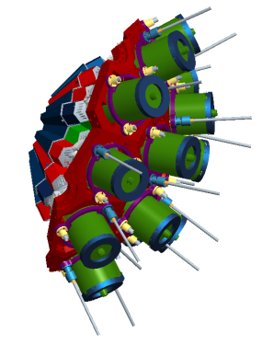
γ-ray spectroscopy with 3D position sensitive HPGe detectors
In flight γ-ray spectroscopy
HISPEC
Advanced GAmma Tracking Array
Efficiency: 43% (M_{γ} =1) 28% (M_{γ} =30)
P/T: 58% (M_{γ}=1) 49% (M_{γ}=30)
Angular resolution: ~1º
FWHM (1 MeV, v/c=50%) ~ 6 keV
Decay γ−ray spectroscopy after implantation
DESPEC

Slide 5
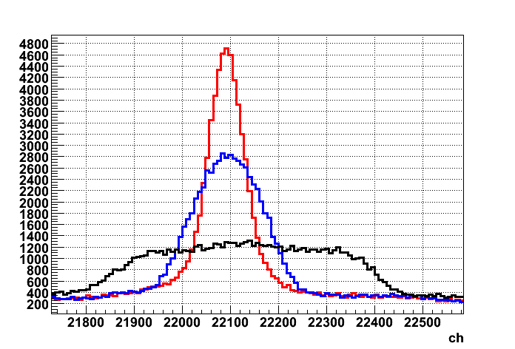
γ-ray spectroscopy with 3D position sensitive HPGe detectors
In flight γ-ray spectroscopy
Δθ
β = 0.5
Via tracking it becomes possible to determine the incident angle and preserve the good energy resolution.
θ
Decay γ−ray spectroscopy after implantation
E_{γ} = 1.3 MeV
Counts
PSA = 5 keV
Segment = 12 keV
Detector = 35 keV
Energy

Slide 6
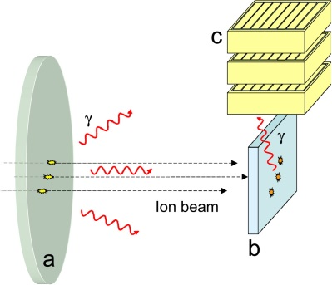
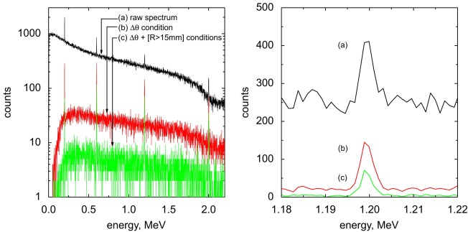
γ-ray spectroscopy with 3D position sensitive HPGe detectors
In flight γ-ray spectroscopy
θ
Background suppression and P/T can be improved by applying imaging techniques.
Decay γ−ray spectroscopy after implantation
S. Tashenov, et al. NIMA 586 (2008) 224-228

Slide 7

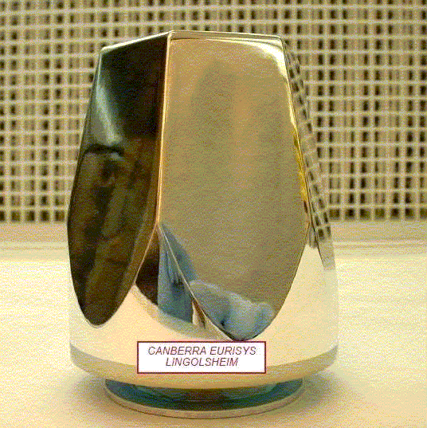
HPGe detector
7 cm
9 cm

Slide 8
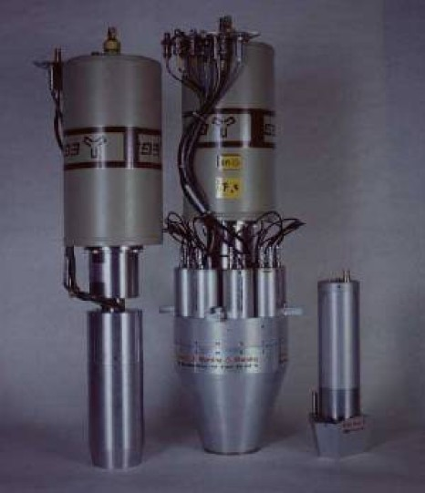
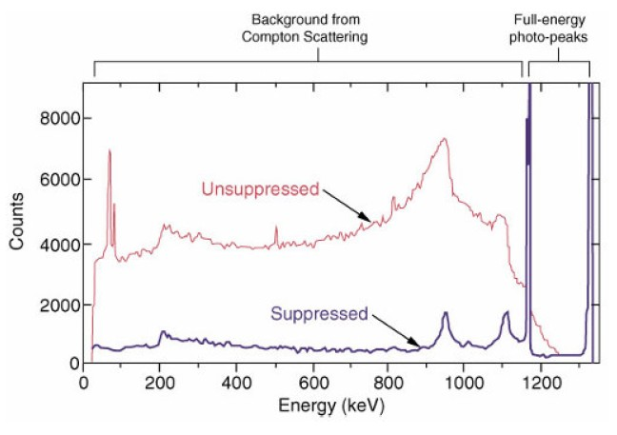
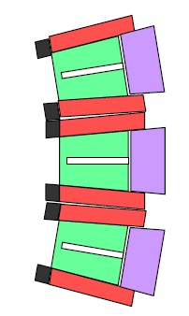
Compton suppressed Germanium detektor
Interaction in a Ge crystal:
Photo effect (low γ-ray energy)
Compton scattering (medium γ-ray energy)
Pair production e⁺e⁻ (high γ-ray energy)
peak-to-total ratio
unsuppressed
P/T~0.15
Compton suppressed
P/T~0.6

Slide 9
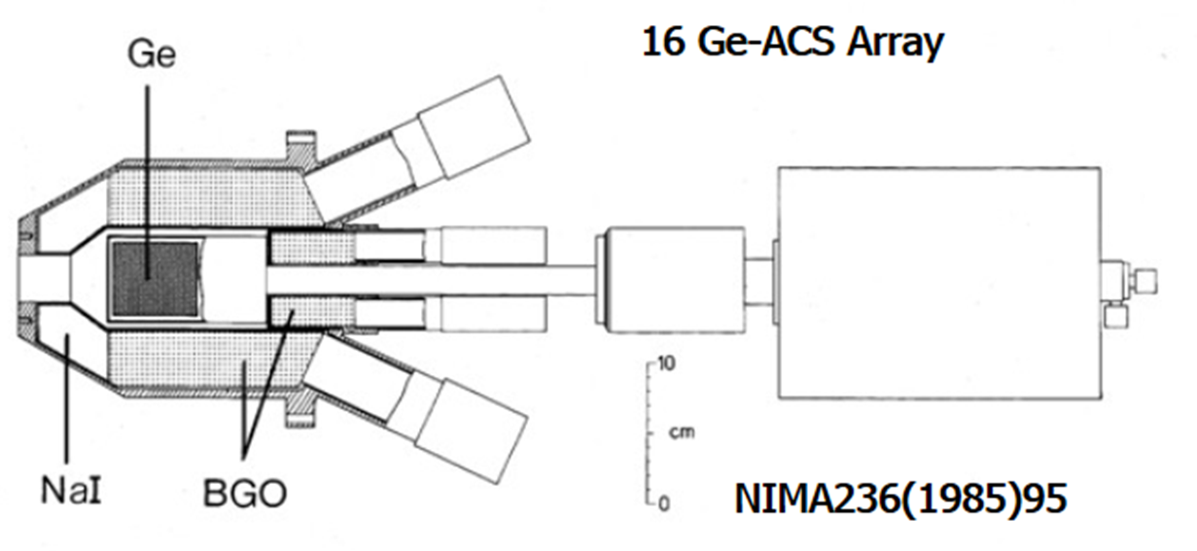
Compton suppressed Germanium detektor

Slide 10
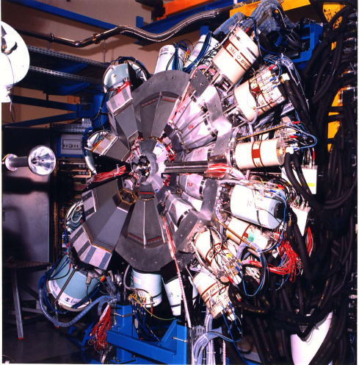
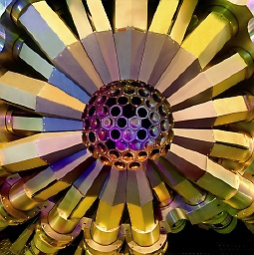
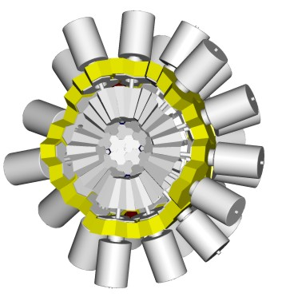
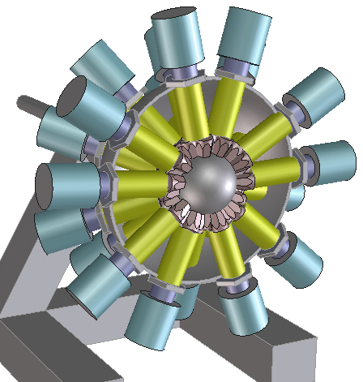
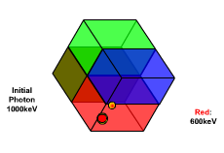
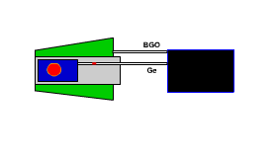
Gamma Arrays based on Compton
Suppressed Spectrometers
Tracking Arrays based on
Position Sensitive Ge Detectors
EUROBALL
GAMMASPHERE
AGATA
GRETA
ε ~ 10 - 7 %
( M_{γ} = 1 – M_{γ} = 30)
ε ~ 50 - 25 %
( M_{γ} = 1 - M_{γ} = 30)

Slide 11
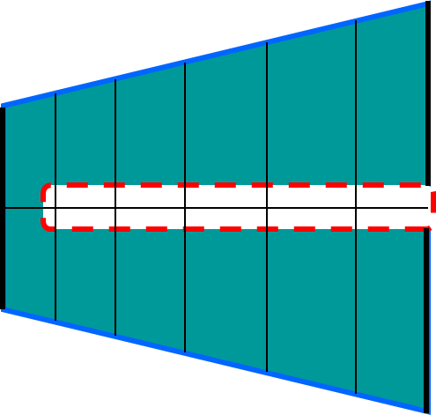
HPGe detector – working principle

Slide 12
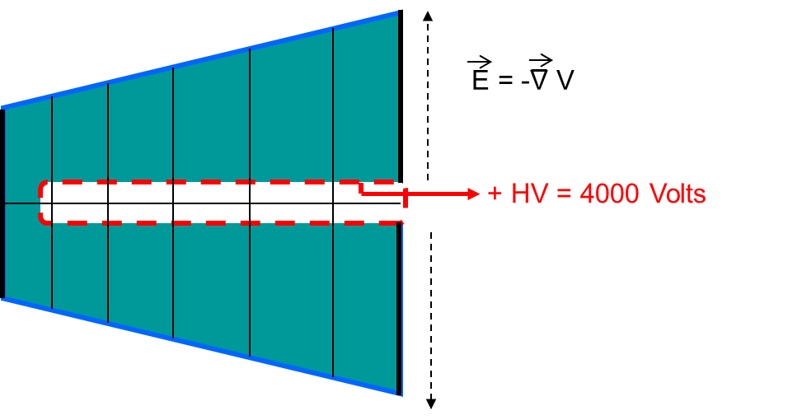
HPGe detector – working principle

Slide 13
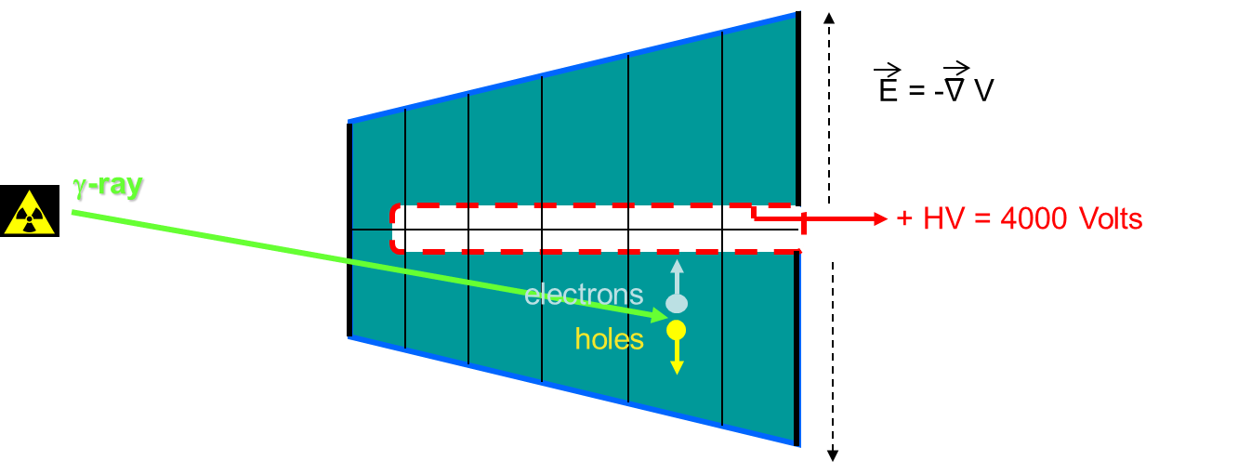
HPGe detector – working principle

Slide 14
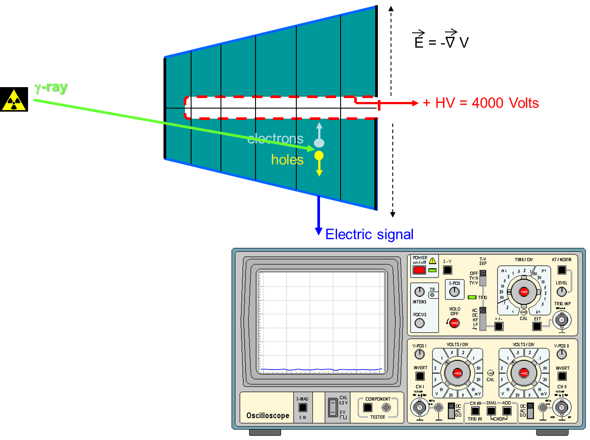
HPGe detector – working principle

Slide 15
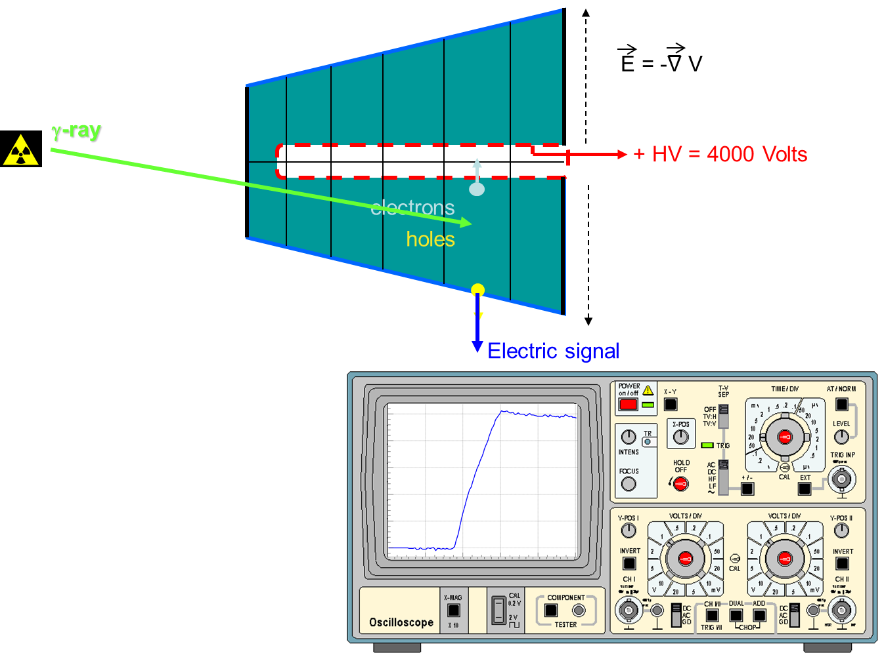
HPGe detector – working principle

Slide 16
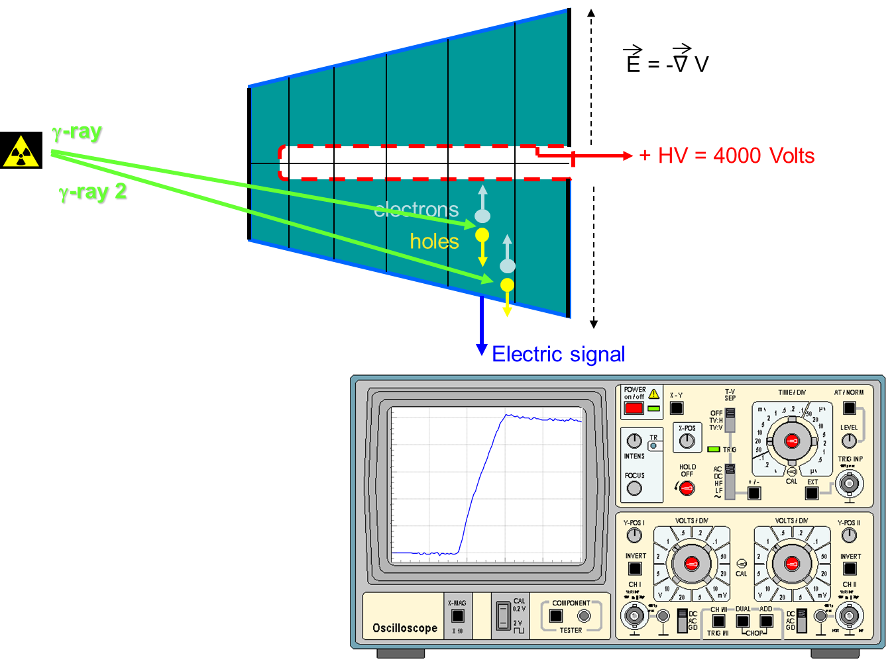
HPGe detector – position sensitivity

Slide 17
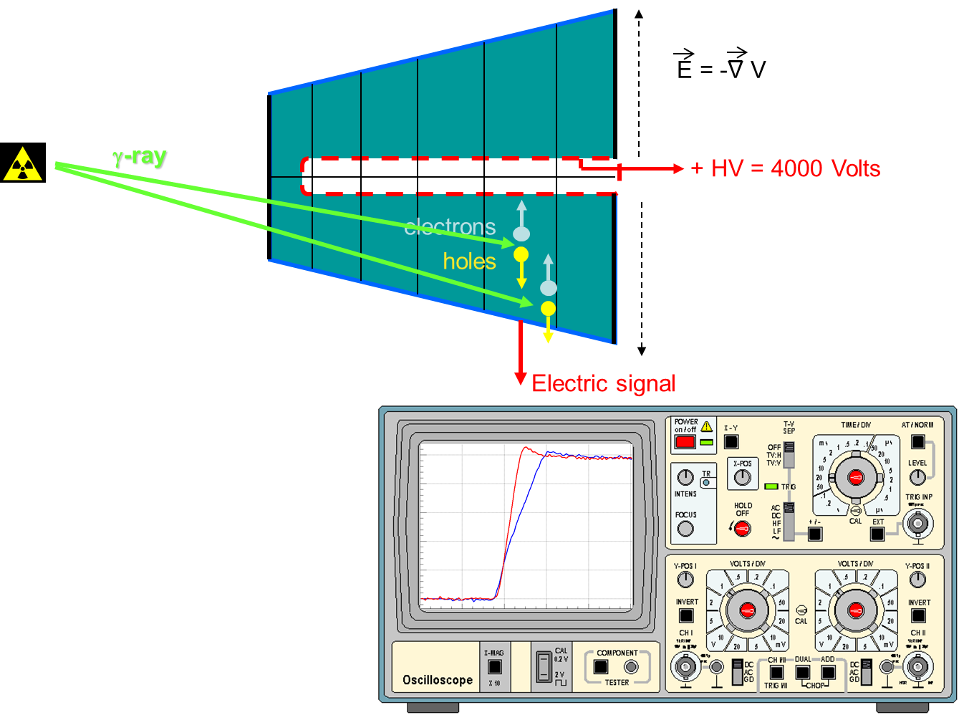
HPGe detector – position sensitivity

Slide 18
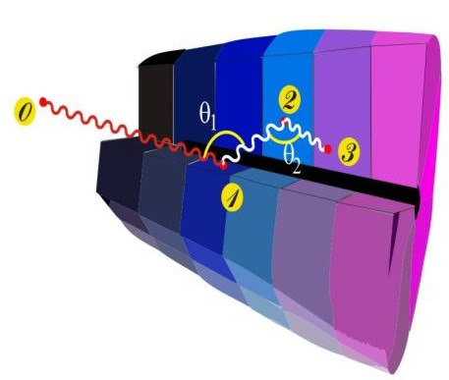
Ingredients of γ-ray tracking
Highly segmented
HPGe detectors
AGATA:
Advanced Gamma Tracking Array
Pulse Shape Analysis to identify the interaction position coordinates
Digital electronics
to record and
process segment signals
(x,y,z,E)_{i}
Reconstruction of tracks
e.g. by evaluation of permutations
of interaction points
reconstructed γ-rays

Slide 19
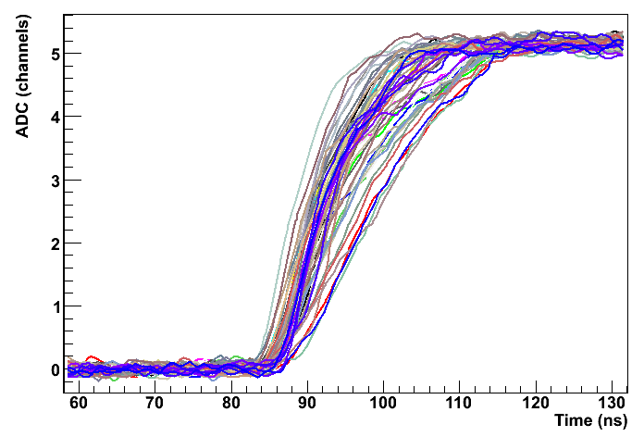
Method to characterize the pulse shape of HPGe detectors
Determine a data-base of pulse shapes S(x,y,z) which allows one to correlate an arbitrarily measured pulse, with an interaction position inside the detector.
?
How to do this?
Using PET principle in combination with γ-ray imaging techniques !

Slide 20
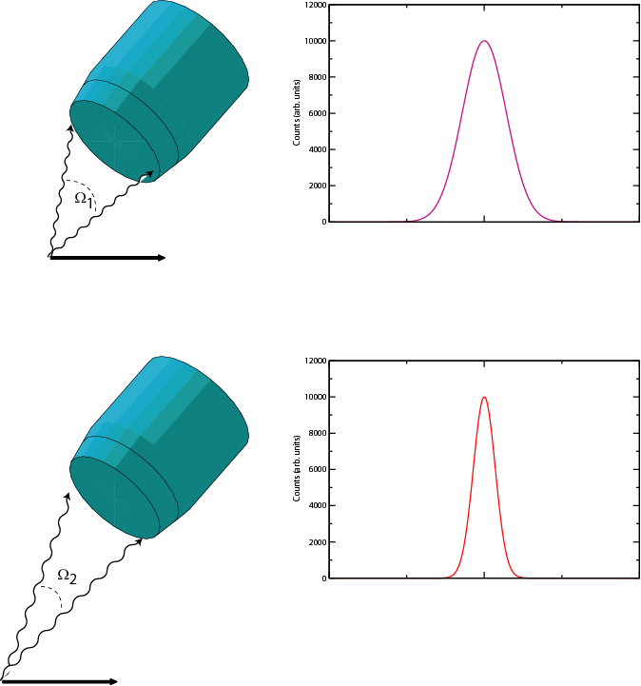
Doppler effect - Efficiency versus energy resolution
With a source at rest, the intrinsic resolution of the detector can be reached.
Efficiency decreases with the increasing detector-source distance.
With a moving source also the effective energy resolution depends on the detector-source distance (Doppler effect)
Small d
Large d
Large Ω
Small Ω
High ε
Low ε
Poor FWHM
Good FWHM

Slide 21
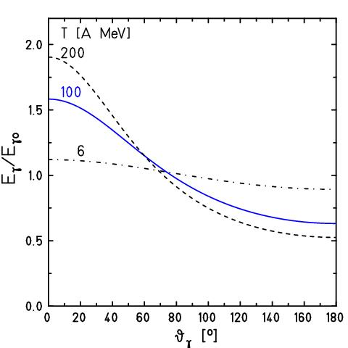
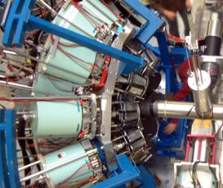
Doppler effect at relativistic energies
for
beam
Lorentz boost:

Slide 22

Doppler broadening and position resolution
Position resolution
γ ray
Angular resolution
beam
projectile
Energy resolution

Slide 23
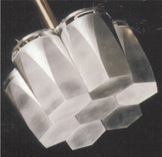
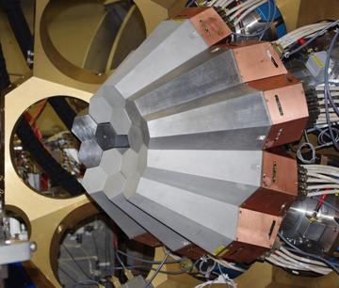
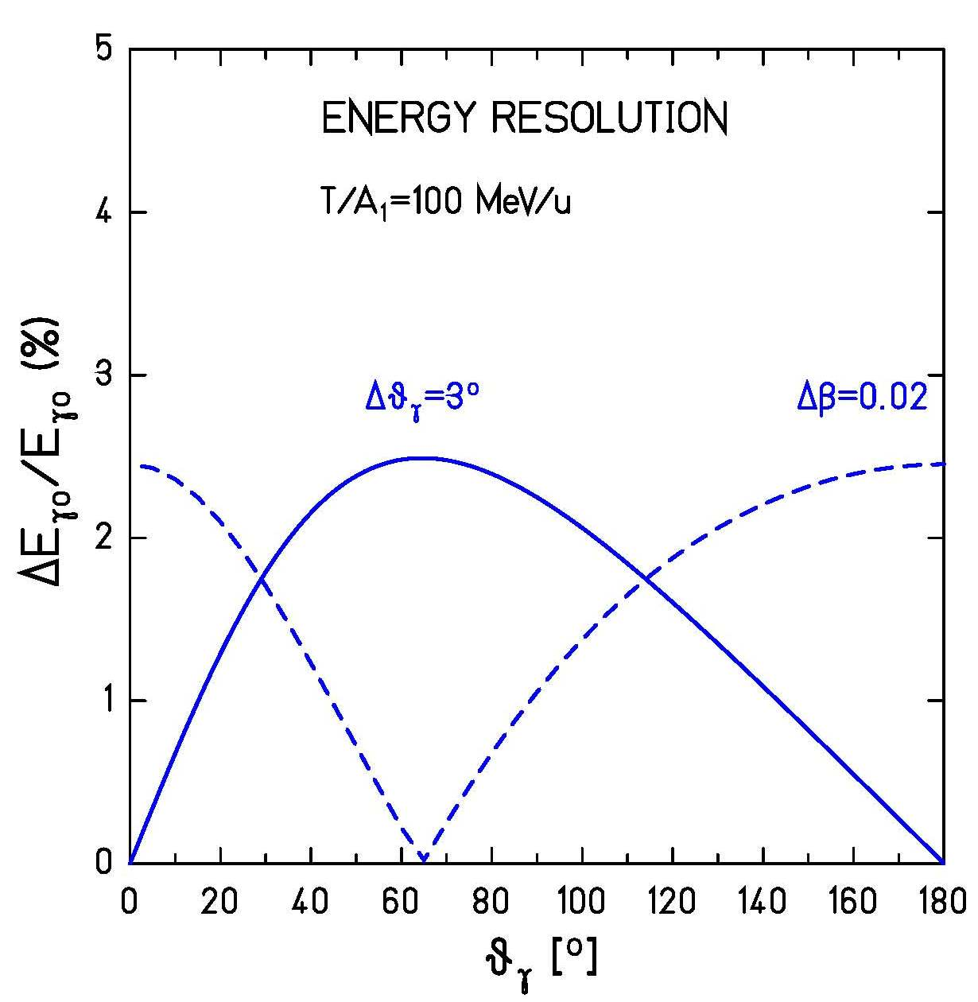
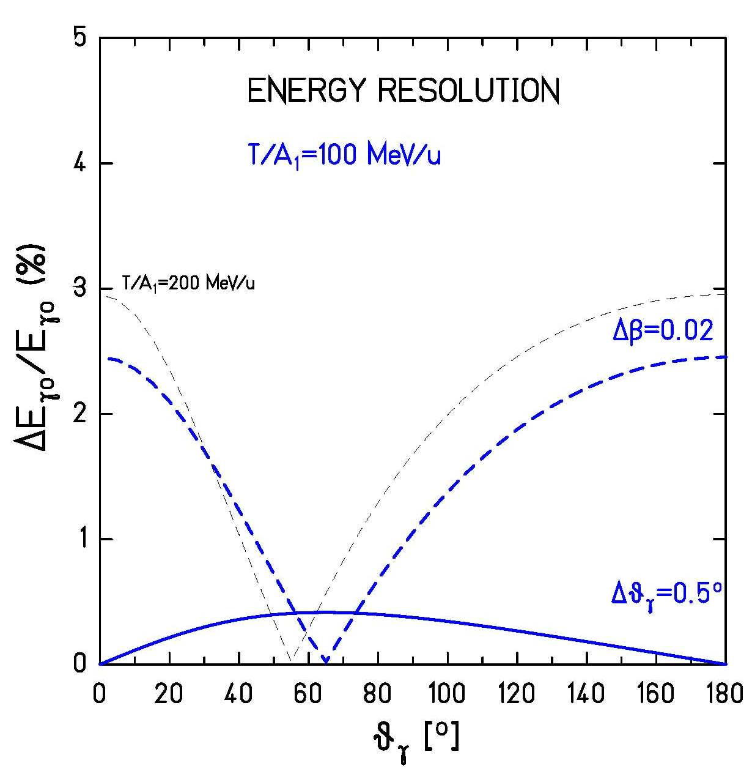



Doppler broadening

Slide 24
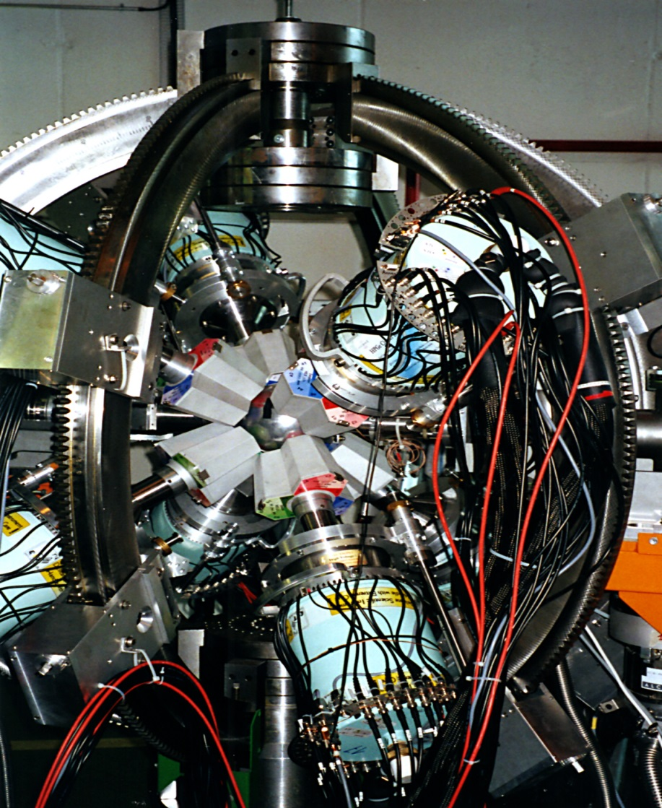
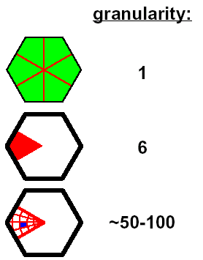

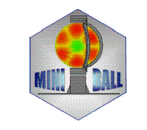
Miniball
- 8 clusters à 3 6-fold segmented crystals
total MINIBALL efficiency ~8% at 1.3 MeV
digital electronics, on-board online pulse shape analysis (PSA) for better position resolution

Slide 25
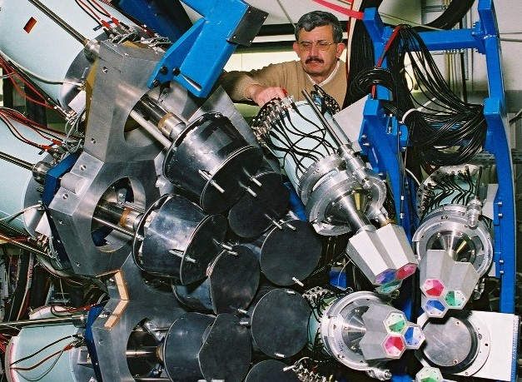

EUROBALL versus MINIBALL detectors
70cm
target
beam
20cm

Slide 26

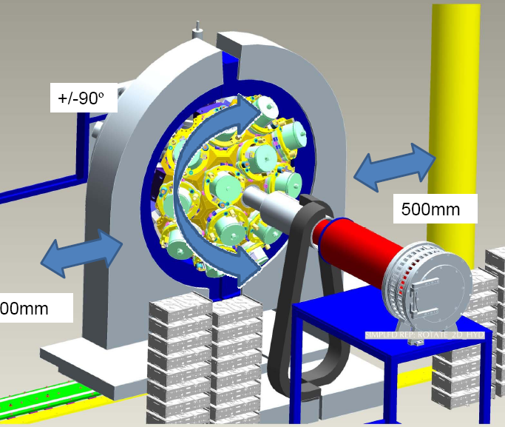

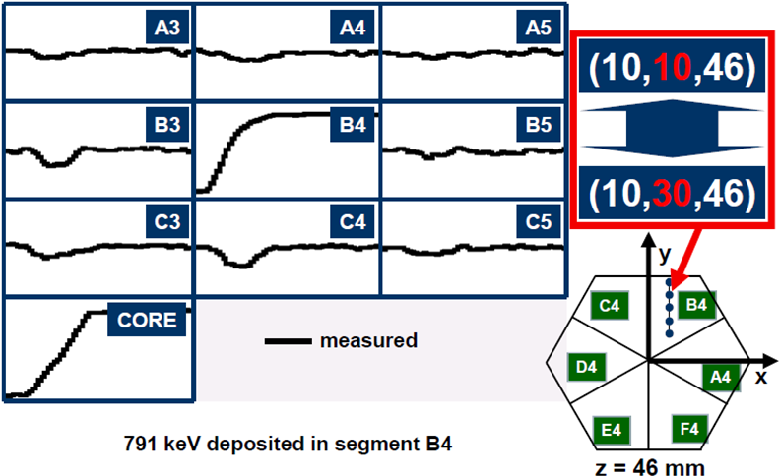
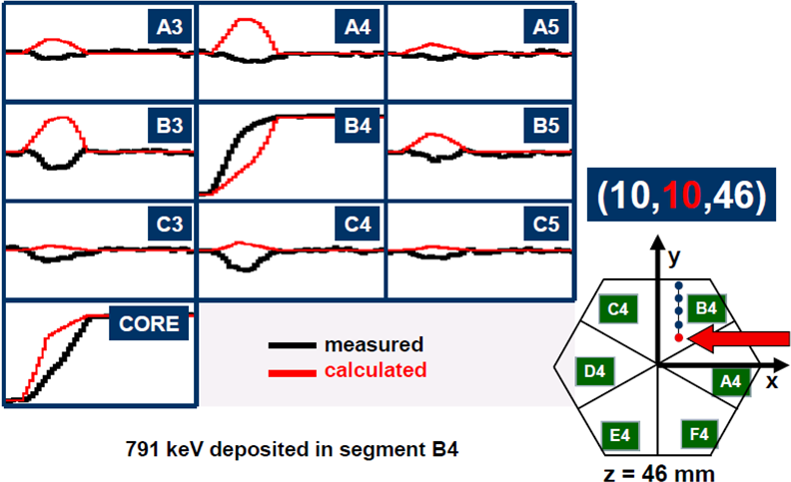

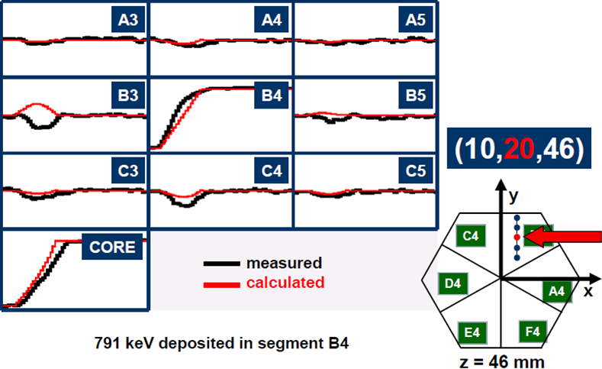

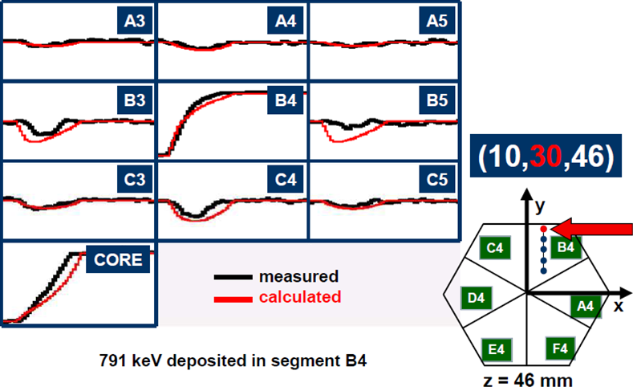
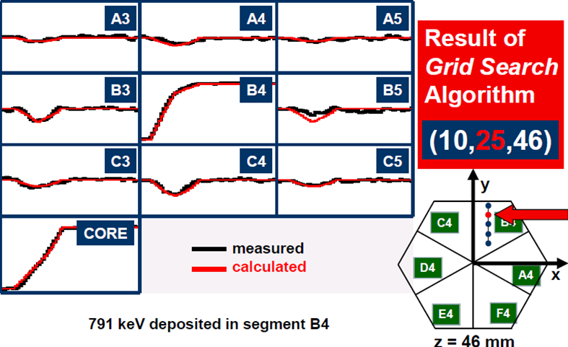


Advanced GAmma Tracking Array
Signals from 36 segments + core
are measured as a function of time
(γ-ray interaction point)
John Strachan

Slide 27




AGATA at PreSPEC
preprocessor
computer farm
AGATA
digitiser
Damian Ralet,
Stephane Pietri

Slide 28

Doppler-shift correction ²³⁸U on ¹⁹⁷Au at 183 AMeV
cos θ_{γ}
66.372 | 79 Au | K_{α3} | 0.033
66.991 | 79 Au | K_{α2} | 27.5
68.806 | 79 Au | K_{α1} | 46.4
77.577 | 79 Au | K_{β3} | 5.57
77.982 | 79 Au | K_{β1} | 10.70
80.130 | 79 Au | K_{β2} | 3.84

Slide 29

Doppler-shift correction ²³⁸U on ¹⁹⁷Au at 183 AMeV
cos θ_{γ}
93.844 | 92 U | K_{α3} | 0.099
94.654 | 92 U | K_{α2} | 28.2
98.434 | 92 U | K_{α1} | 45.1
110.421 | 92 U | K_{β3} | 5.65
111.298 | 92 U | K_{β1} | 10.70
114.445 | 92 U | K_{β2} | 4.15

Slide 30


Scattering experiment at relativistic energies
⁸⁰Kr → ¹⁹⁷Au, 150 AMeV
Doppler effect

Slide 31




Example - Coulomb excitation experiment at IUAC
⁵⁸Ni → Sn at 175MeV
γ-efficiency = 0.005
accelerator duty factor=100%
beam intensity = 0.5pnA
target thickness = 0.2mg/cm²
pγ-rate (Sn) = 1/s
^{112,116}Sn target
Doppler effect depends on $\left(θ_{γ},φ_{γ}\right)$ and $\left(θ_{p},φ_{p}\right)$
⁵⁸Ni beam
γ-ray spectrum

Slide 32







Position sensitive proportional counter
V₀ ~ 500 V
p = 5-10 Torr
~ 3 mm gap anode-cathode
target
entrance window
~ φ_{lab}
~ tanϑ_{lab}
Δt ~ tanϑ
o
Δtime →
i
i
i
delay line

Slide 33


Position sensitive proportional counter
Δt ~ tanϑ_{lab}
Δtime →
~ tan ϑ_{lab}
raw γ-ray spectrum

Slide 34

Position sensitive proportional counter
raw γ-ray spectrum
~ tan ϑ_{lab}
2⁺
Doppler-shift corrected
γ-ray spectrum

Slide 35




Position resolution – Double Sided Silicon Strip Detector (DSSSD)
surface of a Microstrip detector
bonding pads

Slide 36

Simulation result – electrical field configuration
Thomas.Eichhorn@kit.edu

Slide 37













Current density
Ionizing particle with 45⁰ angle t = 0 ns
Ionizing particle with 45⁰ angle t = 1 ns
Ionizing particle with 45⁰ angle t = 1.1 ns
Ionizing particle with 45⁰ angle t = 1.3 ns
Ionizing particle with 45⁰ angle t = 1.5 ns
Ionizing particle with 45⁰ angle t = 1.7 ns
Ionizing particle with 45⁰ angle t = 1.9 ns
Ionizing particle with 45⁰ angle t = 2.0 ns
Ionizing particle with 45⁰ angle t = 3.0 ns
Ionizing particle with 45⁰ angle t = 4.0 ns
Ionizing particle with 45⁰ angle t = 5.0 ns
Ionizing particle with 45⁰ angle t = 6.0 ns
Ionizing particle with 45⁰ angle t = 7.0 ns
all electrons are collected
Thomas.Eichhorn@kit.edu

