Slide 1
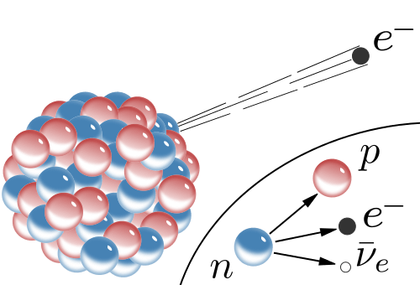



PHL424: β-decay
Beta Decay: universal term for all weak-interaction transitions
between two neighboring isobars
three different forms
β⁻, β⁺ & EC (capture of an atomic electron)
β⁺:
$$p→n+e^{+}+ν$$
EC:
$$p+e^{−}→n+ν$$
β⁻:
$$n→p+e^{−}+\overline{ν}$$
a nucleon inside the nucleus is transformed into another

Slide 2
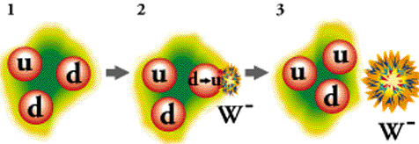
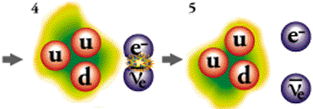
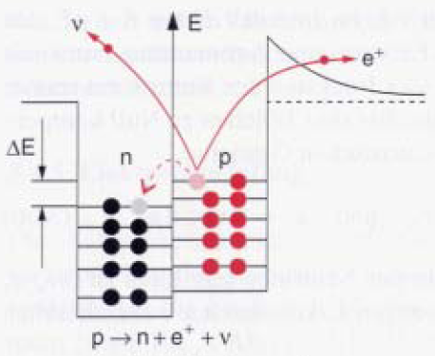
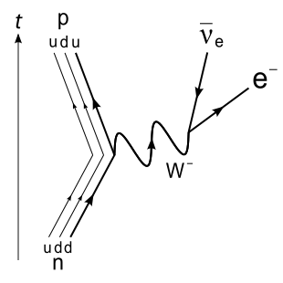

β-decay of a free neutron
neutron (udd, q=0)
d-quark (q= -1/3) → u-quark (q=2/3) + virtual W⁻ boson (q= -1)
proton (uud) and W⁻ boson separate and an electron (q=-1) and an anti-neutrino is created out of the virtual W⁻ boson.
m_{p}=1.673·10⁻²⁷ kg
938.272MeV/c²
m_{n}=1.675·10⁻²⁷ kg
939.565MeV/c²
The mean lifetime τ of free neutrons is 885.8(7) [s]
The β⁺-decay in the nucleus is only possible because the neutron mass is greater than the proton mass.
$$n→p+e^{−}+\overline{ν_{e}}+0.782 MeV$$

Slide 3
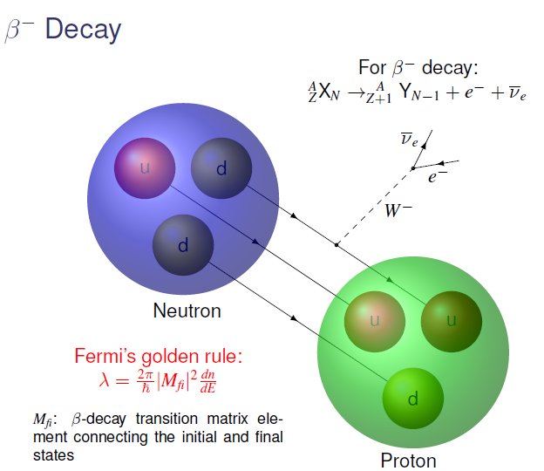
β-decay of a neutron

Slide 4
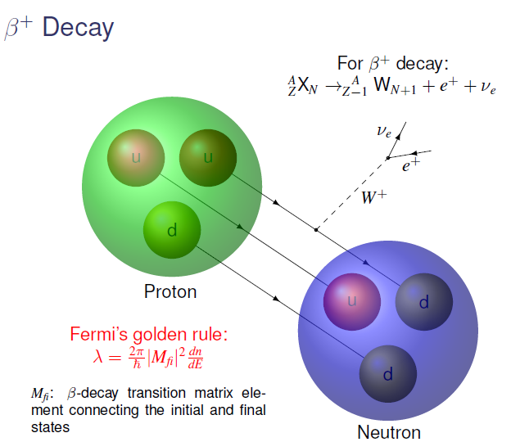
β-decay of a proton

Slide 5
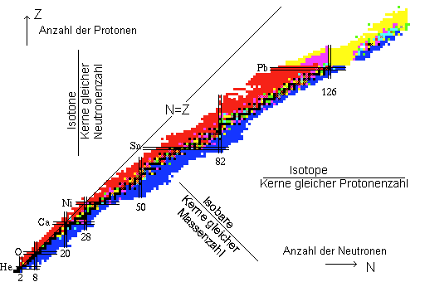
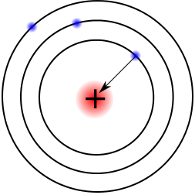
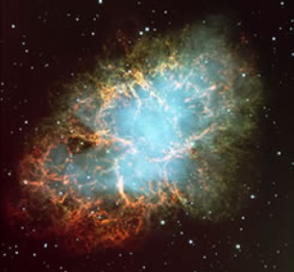



β-decay: overview
^{A}Z→A(Z±1) β-decay
^{A}Z→^{A}(Z±2) double β-decay
β⁻-decay if Q_{β} > 0
β⁺-decay if Q_{β} > 1.02 MeV
EC if Q_{β} > 0
Electron capture: proton-rich nucleus absorbs an inner electron.
number of protons
$$n→p+e^{−}+\overline{ν_{e}}$$
isotone
nuclei with equal neutron number
$$p→n+e^{+}+ν_{e}$$
$$p+e^{−}→n+ν_{e}$$
isotope
nuclei with equal proton number
isobar
nuclei with equal mass number
EC
number of neutrons
Motivation:
For the description of the nuclear synthesis in astrophysical environment one needs excellent knowledge about the β-decay properties in unstable nuclei far away from the valley of stability.

Slide 6







β-decay
For isotopes with substantial neutron excess it is energetically favorable, if a neutron changes into a proton.
For neutron deficient nuclei one has the opposite process: a proton changes into a neutron.
number of protons
isotone
nuclei with equal neutron number
β⁻-decay
β⁺-decay
isotope
nuclei with equal proton number
$$n→p+e^{−}+\overline{ν_{e}}$$
$$p→n+e^{+}+ν_{e}$$
isobar
nuclei with equal mass number
$$d→u+e^{−}+\overline{ν_{e}}$$
$$u→d+e^{+}+ν_{e}$$
number of neutrons
Necessary conditions for the different β-decays:
β⁻-decay (the created electron is already considered)
β⁺-decay (the mother nucleus has one electron more and a positron is created)
electron capture EC (ε is the excitation energy of the hole in the daughter nucleus,
EC can transform protons into neutrons at a lower energy)
$$m\left(A,Z\right)>m\left(A,Z+1\right)$$
$$m\left(A,Z\right)>m\left(A,Z−1\right)+2∙m_{e}∙c^{2}$$
$$m\left(A,Z\right)>m\left(A,Z−1\right)+ε$$

Slide 7
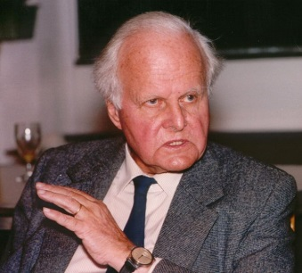
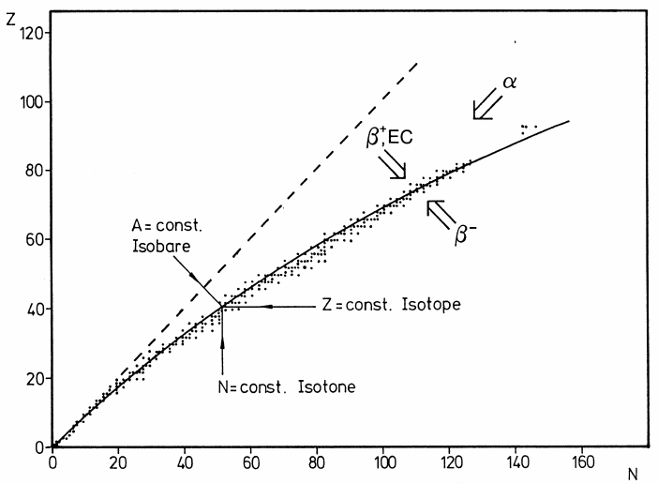
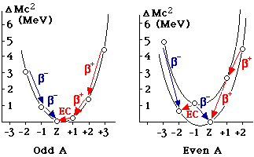

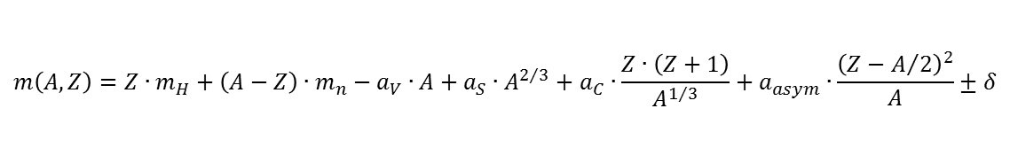



Liquid drop mass formula
$$m\left(A,Z\right)=Z∙m_{H}+\left(A−Z\right)∙m_{n}−a_{V}∙A+a_{S}∙A^{2/3}+a_{C}∙\frac{Z∙\left(Z+1\right)}{A^{1/3}}+a_{asym}∙\frac{{\left(Z−A/2\right)}^{2}}{A}±δ$$
From the mass formula one obtains
For isobar chains (nuclei with constant mass) m(A,Z) is a quadratic function of Z.
$$m\left(A,Z\right)=γ∙Z^{2}−β∙Z+α∙A±δ$$
Z
1935 Carl von Weizsäcker
Stable nuclei form a small band in the N-Z plane of the chart of nuclides.
N
$$α=\left(m_{n}−a_{V}+\frac{a_{S}}{A^{1/3}}+\frac{a_{asym}}{4}\right)$$
$$β=\left[a_{asym}+m_{n}−m\left({}_{}^{1}H\right)\right]$$
$$γ=\left(\frac{a_{C}}{A^{1/3}}+\frac{a_{asym}}{A}\right)$$

Slide 8
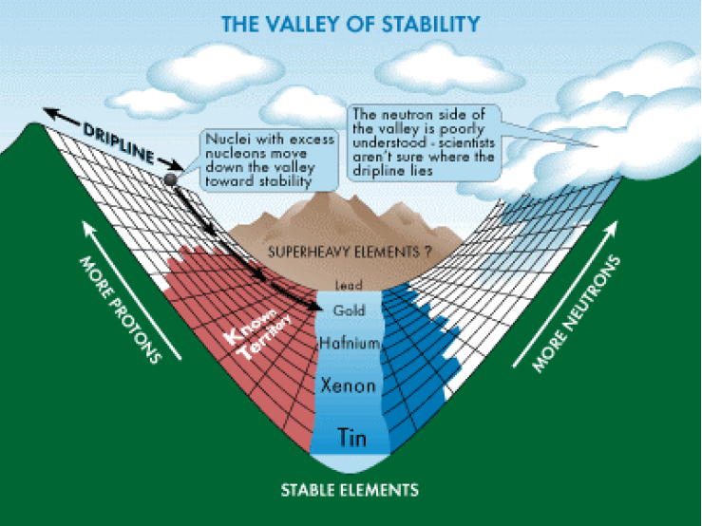
Liquid drop mass parabola

Slide 9
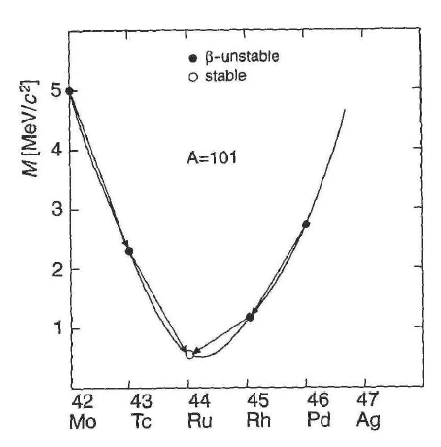






Liquid drop mass parabola for odd-A isobars
$$n→p+e^{−}+\overline{ν_{e}}$$
In β⁻ decay a neutron changes into a proton.
the mass balance for β⁻ decay is given by:
The rest mass of an anti-neutrino < 7 eV/c² can be neglected.
β⁻ decay is possible under the following condition:
example: mass parabola for A=101 isobars
What are the decays of ¹⁰¹Pd und ¹⁰¹Rh?
$$Q_{β}=\left\{\left[m\left(A,Z\right)−Z∙m_{e}\right]−\left[m\left(A,Z+1\right)−\left(Z+1\right)∙m_{e}+m_{e}\right]\right\}∙c^{2}$$
$$=\left\{m_{N}\left(A,Z\right)−m_{N}\left(A,Z+1\right)\right\}∙c^{2}$$
$$m\left(A,Z\right)>m\left(A,Z+1\right)$$
$${}_{42}^{101}{Mo}→{}_{43}^{101}{Tc}+e^{−}+\overline{ν_{e}}$$
$${}_{43}^{101}{Tc}→{}_{44}^{101}{Ru}+e^{−}+\overline{ν_{e}}$$
$${}_{44}^{101}{Ru} is stable$$

Slide 10




β⁺- decay
In neutron deficient nuclei a proton changes into a neutron:
a positron e⁺, the anti-particle of an electron (positive charge, equal mass) and an electron-neutrino ν_{e} will be emitted.
The mass balance of the β⁺ decay is given by:
Condition for β⁺ decay: m(Z,A) > m(Z-1,A) + 2·m_{e}
The term 2·m_{e} considers that a positron is created and an
an electron is left over from the mother nucleus.
The following β⁺ decays are observed for A=101:
$$p→n+e^{+}+ν_{e}$$
$$Q_{β}=\left\{\left[m\left(A,Z\right)−Z∙m_{e}\right]−\left[m\left(A,Z−1\right)−\left(Z−1\right)∙m_{e}+m_{e}\right]\right\}∙c^{2}$$
$$=\left\{m_{N}\left(A,Z\right)−m_{N}\left(A,Z−1\right)−2∙m_{e}\right\}∙c^{2}$$
$${}_{46}^{101}{Pd}→{}_{45}^{101}{Rh}+e^{+}+ν_{e}$$
$${}_{45}^{101}{Rh}→{}_{44}^{101}{Ru}+e^{+}+ν_{e}$$
$${}_{44}^{101}{Ru} is stable$$

Slide 11
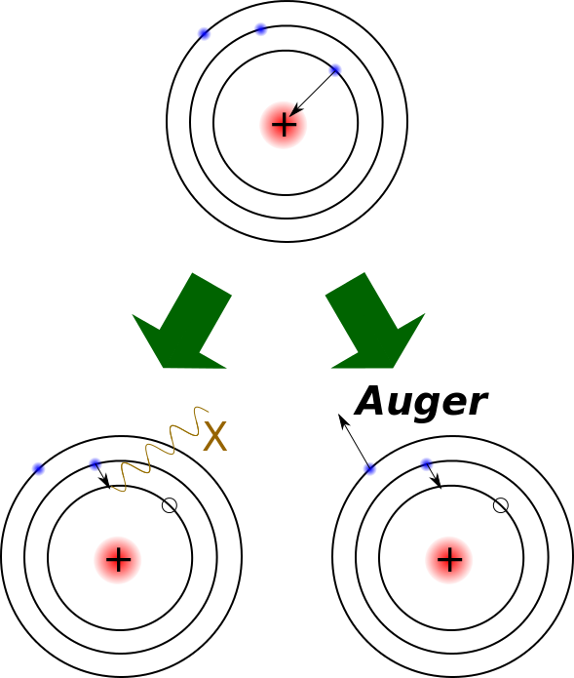


β⁺- decay versus electron capture
In neutron deficient nuclei a proton can be converted into a neutron:
A positron e⁺, the anti-particle of an electron (positive charge, equal mass) and an electron-neutrino ν_{e} will be emitted.
Condition for a β⁺ decay: m(Z,A) > m(Z-1,A) + 2·m_{e}
$$p→n+e^{+}+ν_{e}$$
m_{e} = 0.00055 [u]
Electron capture EC
In competition to the β⁺ decay is the electron capture process which is energetically more favorable to change protons into neutrons.
K-electrons have a high probability inside of the nucleus and can easily captured.
Condition for K-electron capture: m(Z,A) > m(Z-1,A) + ε
ε ~ 10⁻⁸ [u] is the excitation energy of the hole in the daughter nucleus.
$$p+e^{−}→n+ν_{e}$$
The Auger-effect is an alternative process to X-ray emission when a hole is filled in a stronger bound electron shell.

Slide 12
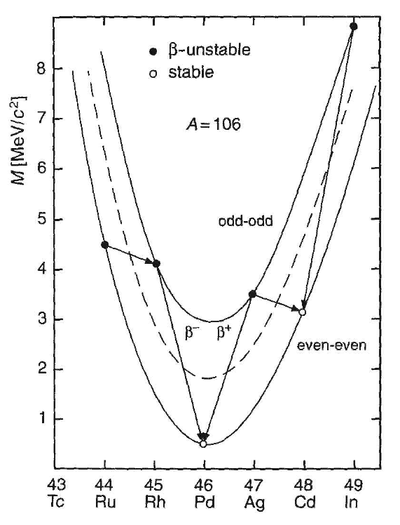



Liquid drop mass parabola for even-A isobars
In isobars with even mass number two separate parabola exist because of the pairing energy: one for even-even nuclei and one higher lying for odd-odd nuclei. The difference is 2δ, twice the pairing energy.
Consequence:
All odd-odd nuclei have at least one stronger
bound even-even nucleus (isobar) and are hence
instable.
Exceptions: ²H, ⁶Li, ¹⁰B, ¹⁴N because of the higher
asymmetry energy.
Example: mass parabola der A=106 isobars
$${}_{44}^{106}{Ru}→{}_{45}^{106}{Rh}+e^{−}+\overline{ν_{e}}$$
$${}_{45}^{106}{Rh}→{}_{46}^{106}{Pd}+e^{−}+\overline{ν_{e}}$$
$${}_{46}^{106}{Pd} is stable$$

Slide 13
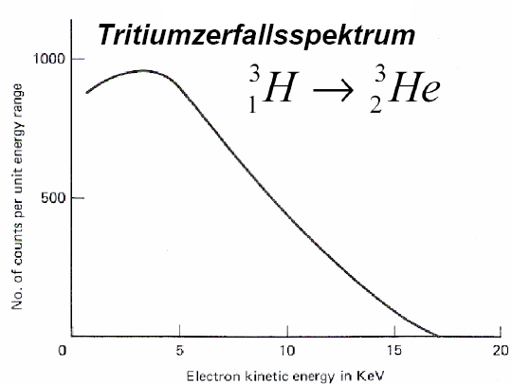
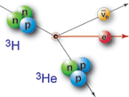

β-decay
In the β⁻ decay an electron and an electron anti-neutrino will be emitted simultaneously.
The β⁻ decay energy is given by the mass difference between mother and daughter nucleus.
This energy will be distributed as kinetic energy on
the emitting particles, the electron and the anti-neutrino.
Hence, the electron spectrum is continuous.
It starts at zero energy and ends at the maximum possible
energy E_{max} = E₀ - m_{ν}·c² (= Q_{β}).
β decays have a long lifetime and a small decay probability, the related interaction is small compared to other interactions in the nucleus, therefore time dependent perturbation theory is a good approximation.
$$n→p+e^{−}+\overline{ν_{e}}$$
Tritium decay spectrum
T_{1/2}=12.32a
Q_{β}=18.6 keV

Slide 14
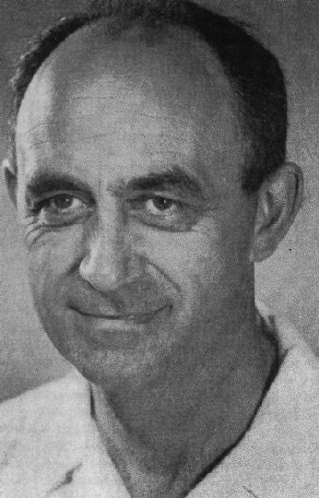

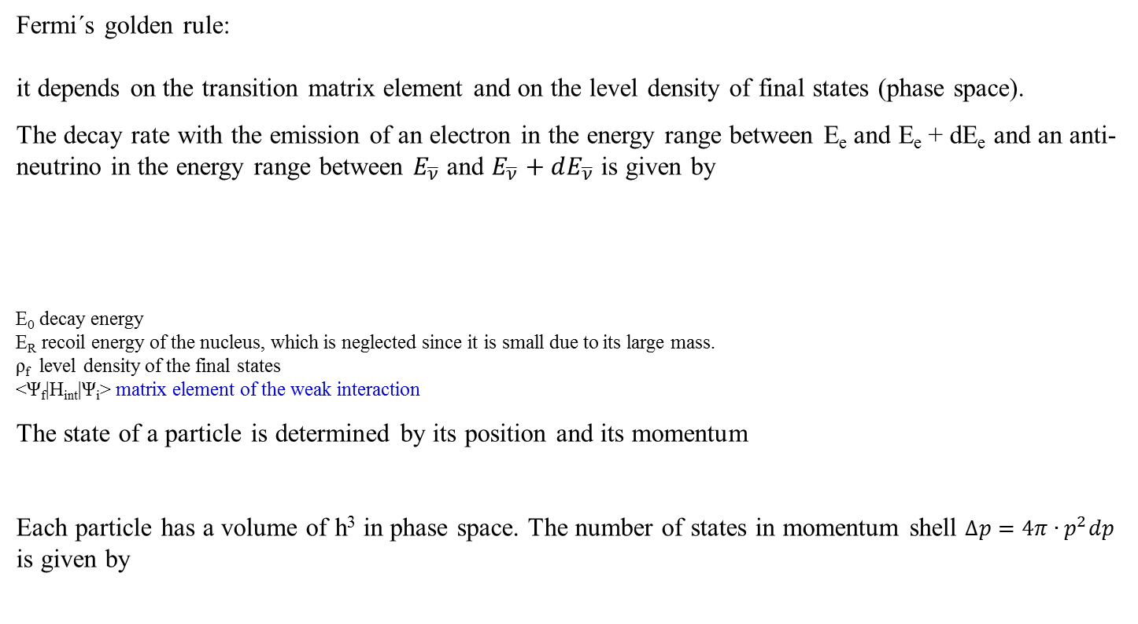



Fermi´s golden rule
$$W_{if}=\frac{2π}{ℏ}∙{\left|\left\langle Ψ_{f} | H_{int} | Ψ_{i}\right\rangle \right|}^{2}∙ρ\left(E_{f}\right)$$
Fermi´s golden rule:
it depends on the transition matrix element and on the level density of final states (phase space).
The decay rate with the emission of an electron in the energy range between E_{e} and E_{e} + dE_{e} and an anti-neutrino in the energy range between $E_{\overline{ν}}$ and $E_{\overline{ν}}+dE_{\overline{ν}}$ is given by
E₀ decay energy
E_{R} recoil energy of the nucleus, which is neglected since it is small due to its large mass.
ρ_{f} level density of the final states
<Ψ_{f}|H_{int}|Ψ_{i}> matrix element of the weak interaction
The state of a particle is determined by its position and its momentum
Each particle has a volume of h³ in phase space. The number of states in momentum shell $∆p=4π∙p^{2}dp$ is given by
$$W_{if}\left(E_{e},E_{\overline{ν}}\right)dE_{e}dE_{\overline{ν}}=\frac{2π}{ℏ}{\left|\left\langle Ψ_{f} | H_{int} | Ψ_{i}\right\rangle \right|}^{2}ρ_{f}∙δ\left(E_{0}−E_{R}−E_{e}−E_{\overline{ν}}\right)dE_{e}dE_{\overline{ν}}$$
$$∆x∙∆y∙∆z∙∆p_{x}∙∆p_{y}∙∆p_{z}≈h^{3}$$
$$dn=\frac{V∙4π∙p^{2}}{h^{3}}dp$$
level density of free particles
$$∆x∙∆y∙∆z=V$$
matrix element must be small compared to the energy intervals in the system (otherwise no perturbation theory)

Slide 15

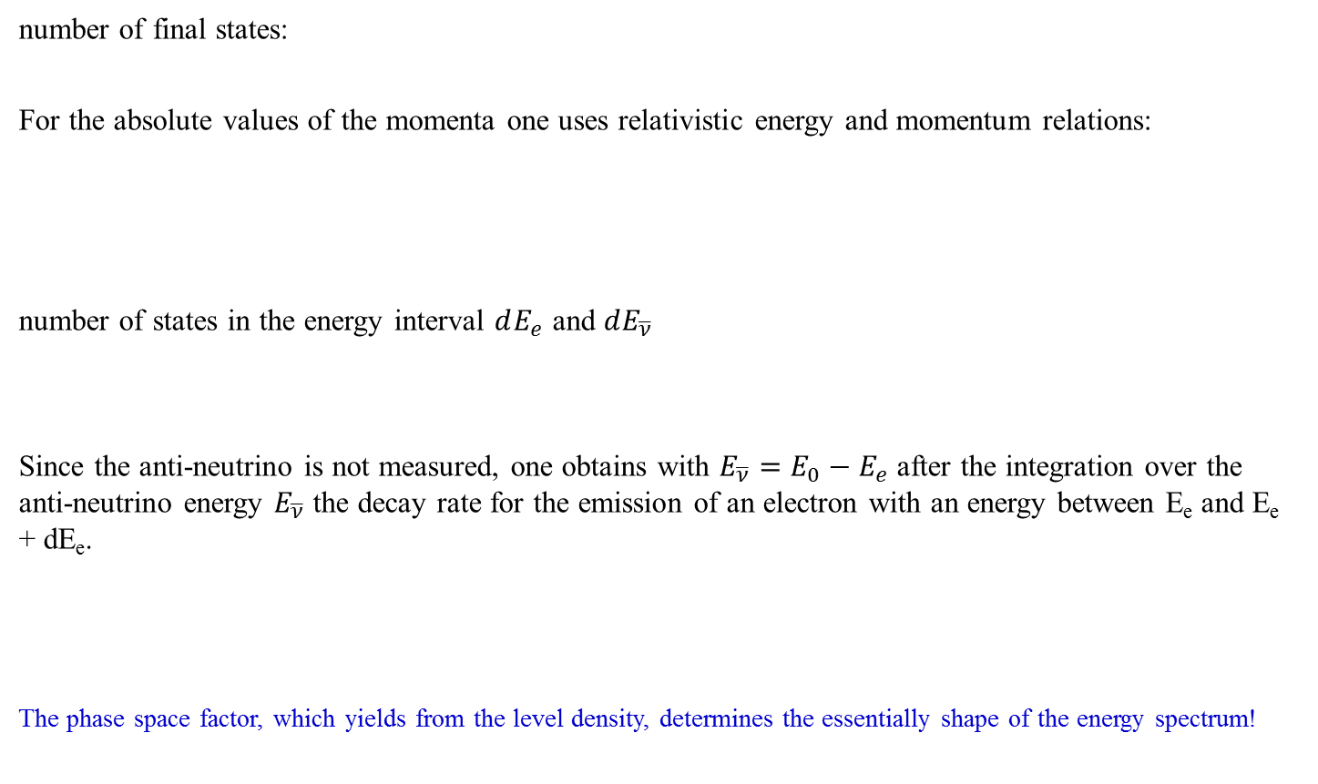




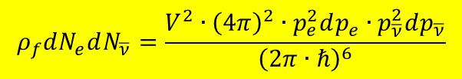
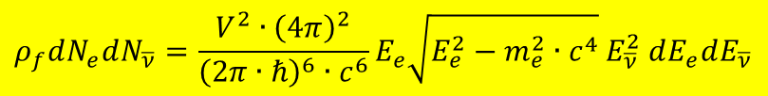
Fermi´s golden rule
$$ρ_{f}dN_{e}dN_{\overline{ν}}=\frac{V^{2}∙{\left(4π\right)}^{2}∙p_{e}^{2}dp_{e}∙p_{\overline{ν}}^{2}dp_{\overline{ν}}}{{\left(2π∙ℏ\right)}^{6}}$$
number of final states:
For the absolute values of the momenta one uses relativistic energy and momentum relations:
number of states in the energy interval $dE_{e}$ and $dE_{\overline{ν}}$
Since the anti-neutrino is not measured, one obtains with $E_{\overline{ν}}=E_{0}−E_{e}$ after the integration over the anti-neutrino energy $E_{\overline{ν}}$ the decay rate for the emission of an electron with an energy between E_{e} and E_{e} + dE_{e}.
The phase space factor, which yields from the level density, determines the essentially shape of the energy spectrum!
$$E_{e}=\sqrt{p_{e}^{2}∙c^{2}+m_{e}^{2}∙c^{4}}$$
$$E_{\overline{ν}}=p_{\overline{ν}}∙c$$
$$p_{e}dp_{e}=E_{e}dE_{e}/c^{2}$$
$$dp_{\overline{ν}}=dE_{\overline{ν}}/c$$
$$ρ_{f}dN_{e}dN_{\overline{ν}}=\frac{V^{2}∙{\left(4π\right)}^{2}}{{\left(2π∙ℏ\right)}^{6}∙c^{6}}E_{e}\sqrt{E_{e}^{2}−m_{e}^{2}∙c^{4}}{ E}_{\overline{ν}}^{2} dE_{e}dE_{\overline{ν}}$$
$$W_{if}\left(E_{e}\right)dE_{e}=\frac{2π}{ℏ}{\left|\left\langle Ψ_{f} | H_{int} | Ψ_{i}\right\rangle \right|}^{2}∙\frac{V^{2}∙{\left(4π\right)}^{2}}{{\left(2π∙ℏ\right)}^{6}∙c^{6}} dE_{e}$$
$$E_{e}\sqrt{E_{e}^{2}−m_{e}^{2}∙c^{4}}{\left(E_{0}−E_{e}\right)}^{2}$$

Slide 16


β-decay spectrum: matrix element
$$E_{e}\sqrt{E_{e}^{2}−m_{e}^{2}∙c^{4}}{\left(E_{0}−E_{e}\right)}^{2}$$
The phase space factor , which results from the level density, determines essentially the shape of the energy spectrum.
The matrix element is obtained by integrating over the position and spin variables for the electron, anti-neutrino and the nucleon in the nucleus.
Electron and anti-neutrino are described by plane waves (de Broglie wave length of electron 2·10⁻¹³ m > R_{nucleus}). For the small nucleus one performs an expansion around r = 0.
M_{fi} is the nuclear matrix element that does not depend on the electron energy.
Tritium decay spectrum
T_{1/2}=12.32a
$${\left|\left\langle Ψ_{f} | H_{int} | Ψ_{i}\right\rangle \right|}^{2}={\left|Ψ_{e}\left(0\right)\right|}^{2}∙{{\left|Ψ_{\overline{ν}}\left(0\right)\right|}^{2}∙\left|M_{fi}\right|}^{2}$$
Q_{β}=18.6 keV

Slide 17
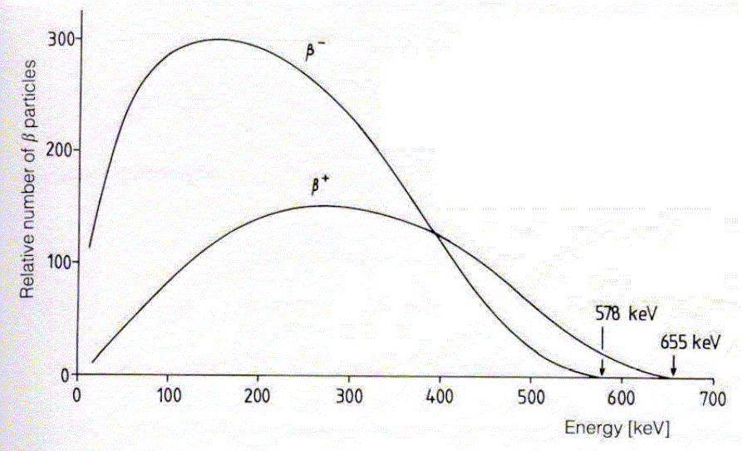

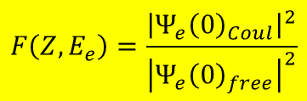
β-decay spectrum: Coulomb interaction
The electron feels the Coulomb interaction of the nucleus with the electrons of the atomic shell. The influence of the Coulomb interaction with the proton will be considered:
The function F(Z,E_{e}) is tabulated.
β⁺ vs. β⁻ spectrum under the influence
of the Coulomb field.
$$F\left(Z,E_{e}\right)=\frac{{\left|Ψ_{e}{\left(0\right)}_{Coul}\right|}^{2}}{{\left|Ψ_{e}{\left(0\right)}_{free}\right|}^{2}}$$
dual β-decay of ⁶⁴Cu
β⁻
$$W_{fi}\left(ε\right)dε=$$
$$\frac{1}{B}∙{\left|M_{fi}\right|}^{2}F\left(Z,ε\right)∙ε∙\sqrt{ε^{2}−1}∙{\left(ε_{0}−ε\right)}^{2}dε$$
β⁺

Slide 18
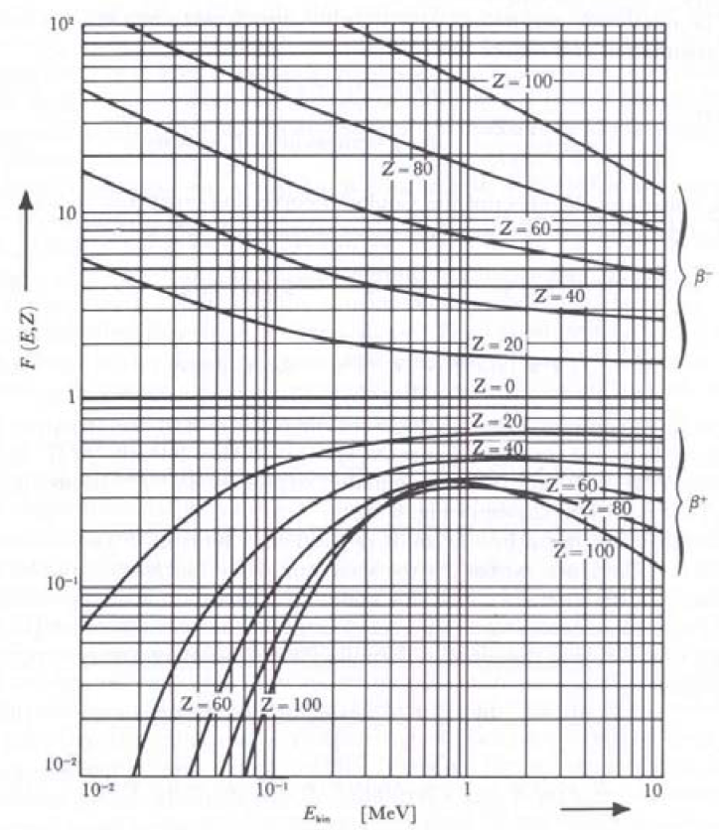
β-decay spectrum: Fermi function

Slide 19

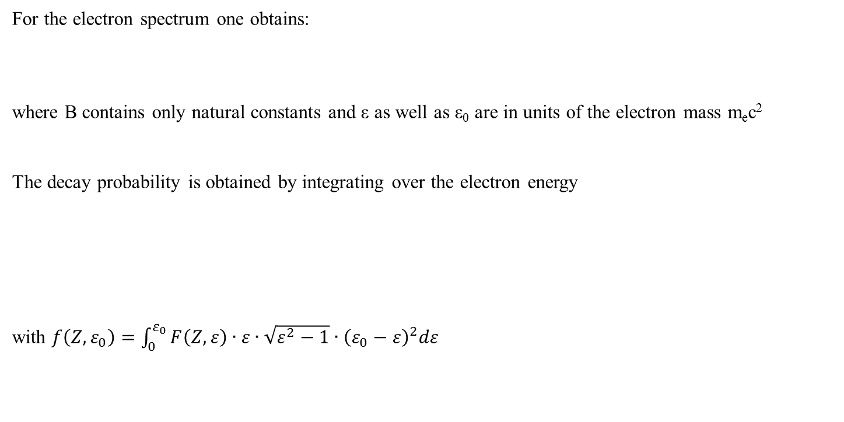
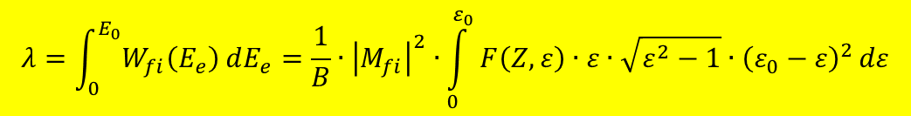
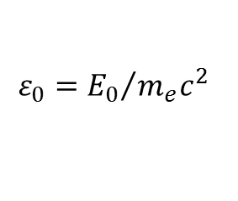
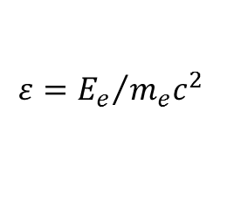

β-decay probability
For the electron spectrum one obtains:
where B contains only natural constants and ε as well as ε₀ are in units of the electron mass m_{e}c²
The decay probability is obtained by integrating over the electron energy
with $f\left(Z,ε_{0}\right)=\int_{0}^{ε_{0}}{F\left(Z,ε\right)∙ε∙\sqrt{ε^{2}−1}∙{\left(ε_{0}−ε\right)}^{2}dε}$
$$W_{fi}\left(ε\right)dε=\frac{1}{B}∙{\left|M_{fi}\right|}^{2}F\left(Z,ε\right)∙ε∙\sqrt{ε^{2}−1}∙{\left(ε_{0}−ε\right)}^{2}dε$$
$$ε={E_{e}}/{m_{e}c^{2}}$$
$$ε_{0}={E_{0}}/{m_{e}c^{2}}$$
$$λ=\int_{0}^{E_{0}}{W_{fi}\left(E_{e}\right)}dE_{e}=\frac{1}{B}∙{\left|M_{fi}\right|}^{2}∙\int_{0}^{ε_{0}}{F\left(Z,ε\right)∙ε∙\sqrt{ε^{2}−1}∙{\left(ε_{0}−ε\right)}^{2}}dε$$
$$f\left(Z,ε_{0}\right)∝ε_{0}^{5}$$

Slide 20
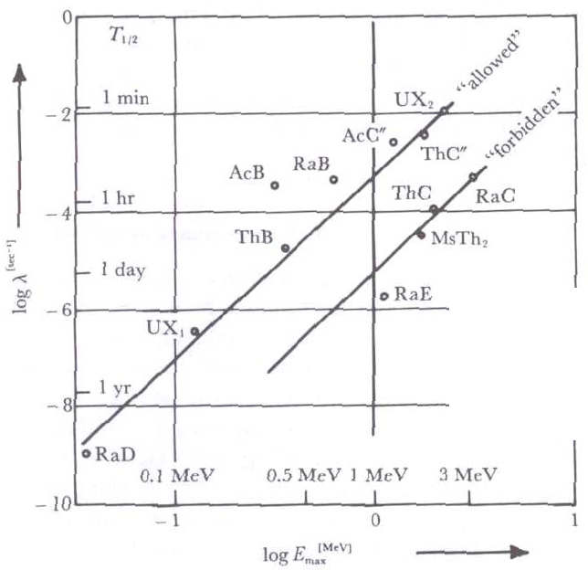
Sargent diagram
log λ = a + b · logE_{β,max}
with different a, b for light, medium and heavy nuclei
The higher the energy of the fastest electron, the larger the decay constant

Slide 21
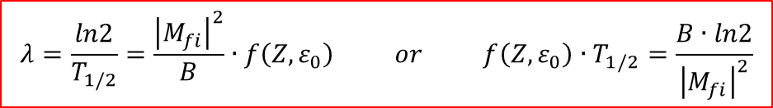

β-decay probability
For the electron spectrum one obtains:
where B contains only natural constants and ε as well as ε₀ are in units of the electron mass m_{e}c²
The decay probability is obtained by integrating over the electron energy
with $f\left(Z,ε_{0}\right)=\int_{0}^{ε_{0}}{F\left(Z,ε\right)∙ε∙\sqrt{ε^{2}−1}∙{\left(ε_{0}−ε\right)}^{2}dε}$
Typically one obtains very large numbers, therefore log ft-values.
$$W_{fi}\left(ε\right)dε=\frac{1}{B}∙{\left|M_{fi}\right|}^{2}F\left(Z,ε\right)∙ε∙\sqrt{ε^{2}−1}∙{\left(ε_{0}−ε\right)}^{2}dε$$
$$ε={E_{e}}/{m_{e}c^{2}}$$
$$ε_{0}={E_{0}}/{m_{e}c^{2}}$$
$$λ=\int_{0}^{E_{0}}{W_{fi}\left(E_{e}\right)}dE_{e}=\frac{1}{B}∙{\left|M_{fi}\right|}^{2}∙\int_{0}^{ε_{0}}{F\left(Z,ε\right)∙ε∙\sqrt{ε^{2}−1}∙{\left(ε_{0}−ε\right)}^{2}}dε$$
$$λ=\frac{ln2}{T_{1/2}}=\frac{{\left|M_{fi}\right|}^{2}}{B}∙f\left(Z,ε_{0}\right) or f\left(Z,ε_{0}\right)∙T_{1/2}=\frac{B∙ln2}{{\left|M_{fi}\right|}^{2}}$$

Slide 22
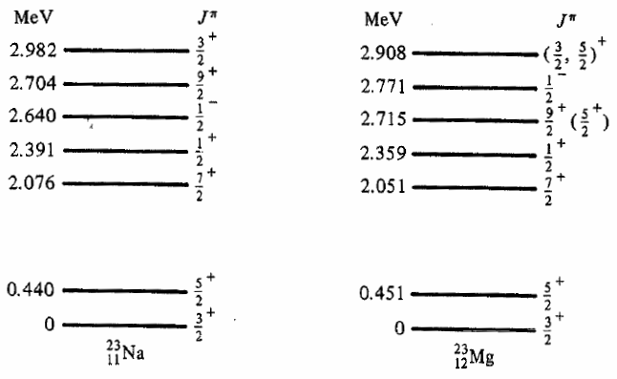
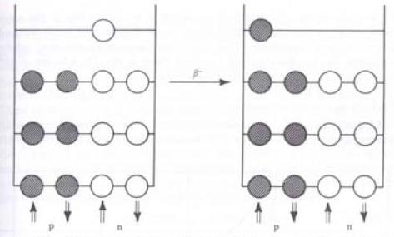
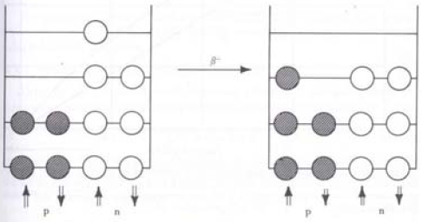

β-decay: log ft - values
$$\log{f∙T_{1/2}=log\left(B∙ln2\right)−log{\left|M_{fi}\right|}^{2}}$$
The size of log ft values are very different. It depends on the nuclear matrix element and the selection rule which determine the decay.
One distinguishes super-allowed, allowed, unique- and multiple-forbidden decays by means of the selection rules for momentum (I) and parity (π).
mirror nuclei M_{fi} one order of magnitude smaller
β⁻
β⁻
p n p n
p n p n

Slide 23
Classification of β-decay transitions
I_{i}π_{i}
Ε_{β}
I_{f}π_{f}
L_{β} = n defines the degree of forbiddenness (n)
allowed
forbidden
when L_{β} = n = 0 and π_{i}π_{f} = +1
when L_{β} = n > 0 and/or π_{i}π_{f} = -1

Slide 24
Classification of β-decay transitions
Fermi
Gamow-Teller
0⁺
0⁺
Ε_{β}
Ε_{β}
0⁺
1⁺
2⁺
mixed Fermi & Gamow-Teller
Ε_{β}
2⁺

Slide 25
Classification of β-decay transitions
Type of transition | Order of forbiddenness | ΔI | π_{i}π_{f}
Allowed |  | 0,+1 | +1
Forbidden unique | 1 2 3 4 . | k2 k3 k4 k5 . | -1 +1 -1 +1 .
Forbidden | 1 2 3 4 . | 0, k1 k2 k3 k4 . | -1 +1 -1 +1 .

Slide 26
Nuclear structure is important
j₂
First forbidden → 5 < log ft < 10
j₁
j
T_{1/2} =3.8x10¹⁰ y
7-
log ft =20
K=7
8+
log ft =19
large angular momentum re-orientation
6+
K-forbidden decay
ω
4+
j=R
2+
0+
K~0

Slide 27
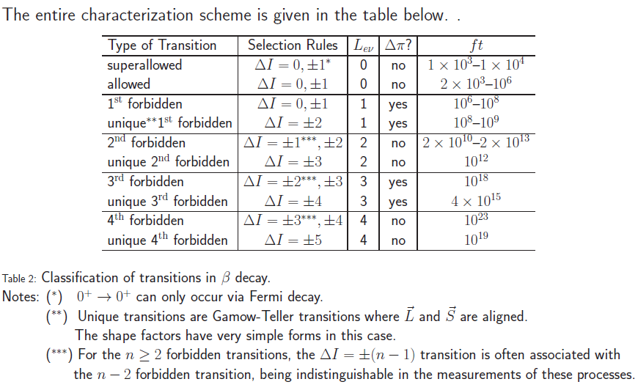
β-decay: log ft - values
$$\log{f∙T_{1/2}=log\left(B∙ln2\right)−log{\left|M_{fi}\right|}^{2}}$$
The size of log ft values are very different. It depends on the nuclear matrix element and the selection rule which determine the decay.
One distinguishes super-allowed, allowed, unique- and multiple-forbidden decays by means of the selection rules for momentum (I) and parity (π).

Slide 28
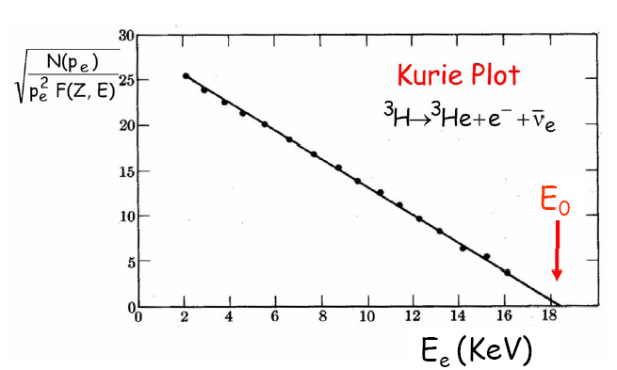
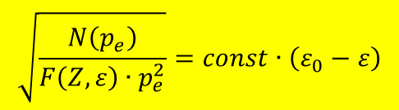

Kurie plot
Counting rate as a function of electron momentum:
Kurie-plot:
$$N\left(p_{e}\right)\sim F\left(Z,ε\right)∙p_{e}^{2}∙{\left(ε_{0}−ε\right)}^{2}$$
$$\sqrt{\frac{N\left(p_{e}\right)}{F\left(Z,ε\right)∙p_{e}^{2}}}=const∙\left(ε_{0}−ε\right)$$

Slide 29
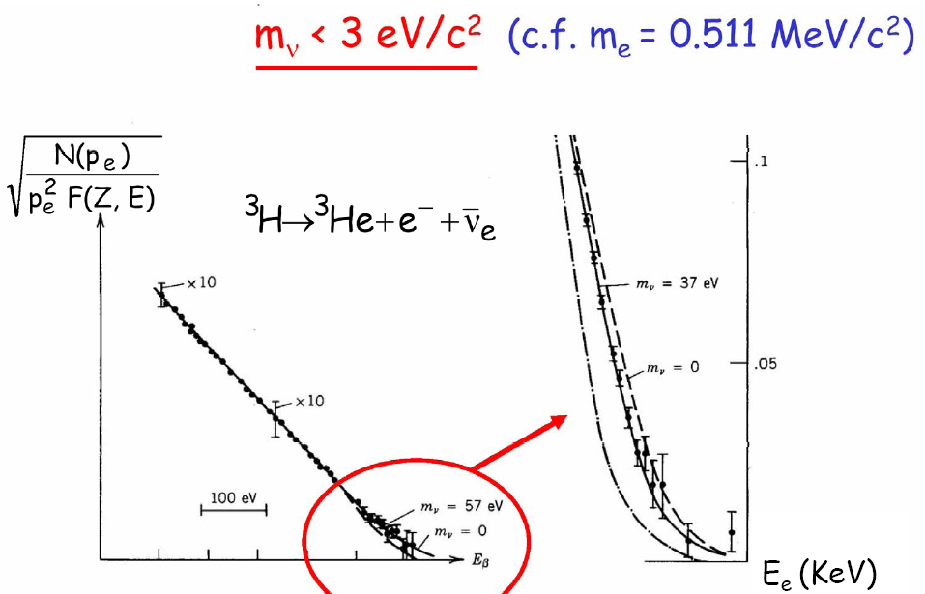
Kurie plot and neutrino mass

Slide 30
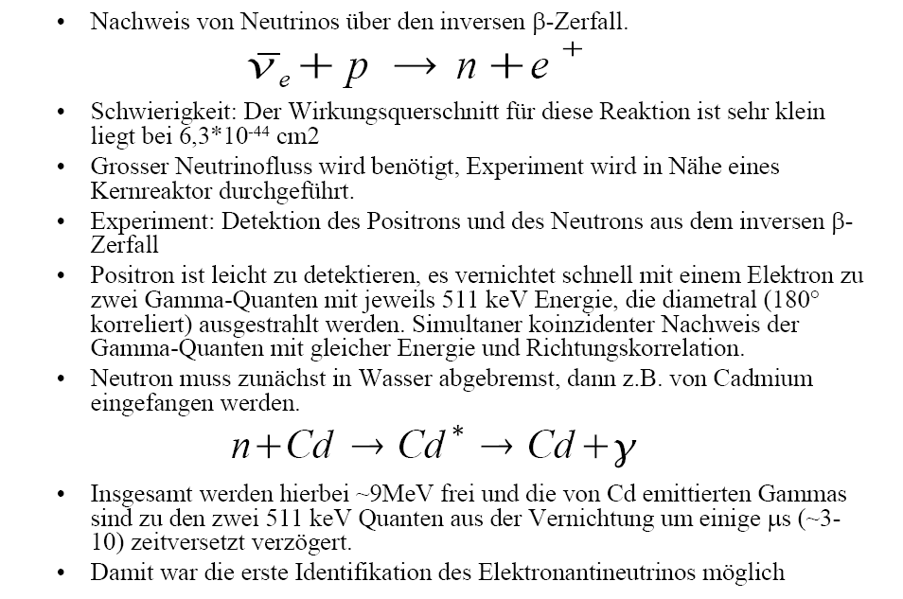
Neutrino detection

Slide 31
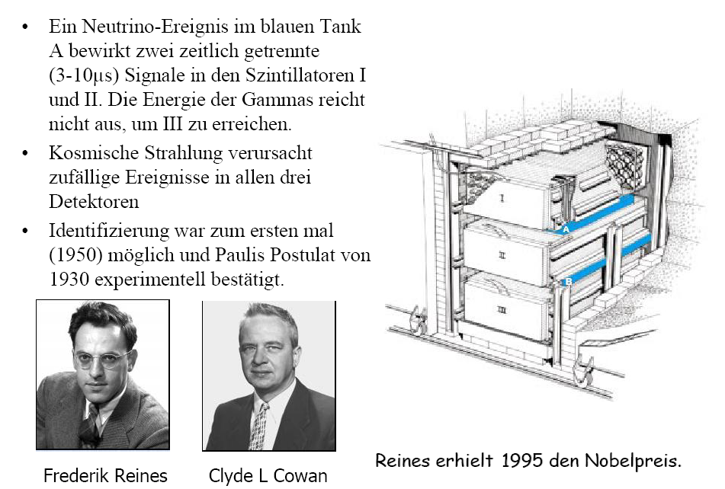
Neutrino detection

