Slide 1
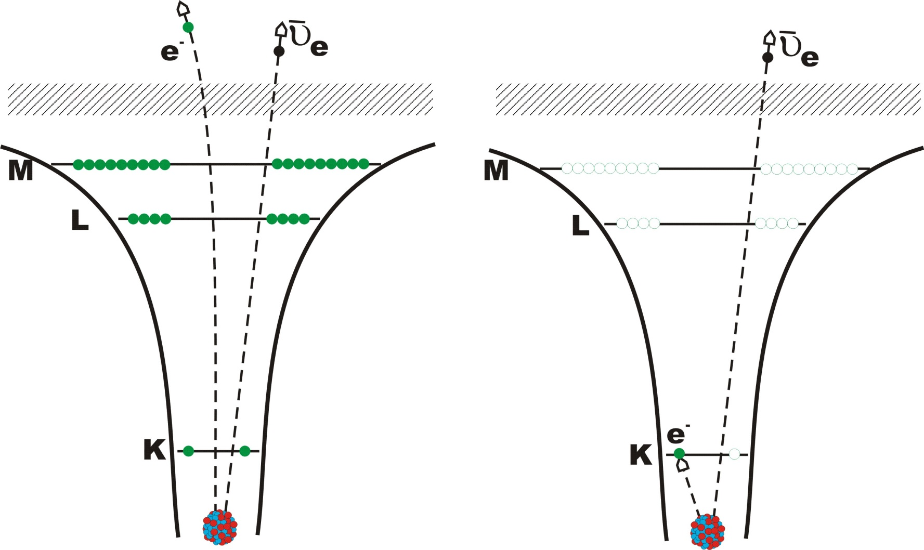
Bound β-decay
First observation at ESR (¹⁶³Dy, ¹⁸⁷Re, ^{206,207}Tl)
Time-mirrored process of orbital electron-capture decay; predicted by Jean, Daudel and Lecoin in 1947 and observed at the ESR in 1992

Slide 2
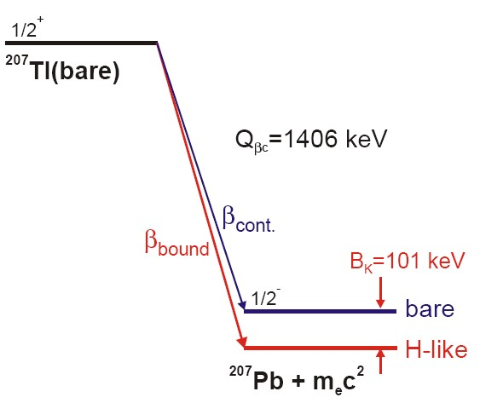
β-decay to bound states in the atomic cloud
Q-value for electric neutral atoms:
from the mass difference of the atomic masses (mass of the nucleus + mass of the bound electrons)
BE_{V} = binding energy of the outer most valence electrons (<25 eV), = mass of the antineutrinos (<2 eV )
Q-value of the completely ionized atoms:
BE_{n} = sum of the binding energies of all electrons
Q-value for the β-decay in a bound state of the K-shell:
BE_{K} = binding energy of the K-shell
For ¹⁸⁷Re, ²⁴¹Pu: is the β-decay into the continuum energetically not possible.

Slide 3
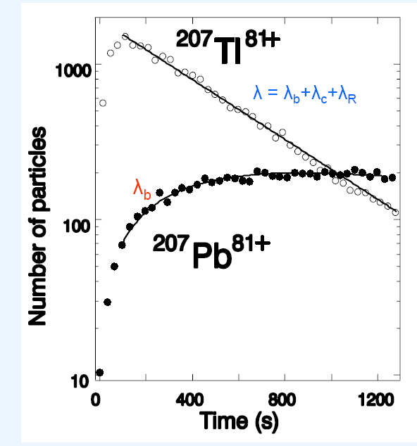
First direct observation of bound-state β-decay
Parent and daughter ions are in the same spectrum
T. Ohtsubo et al., PRL 95 (2005) 052501

Slide 4
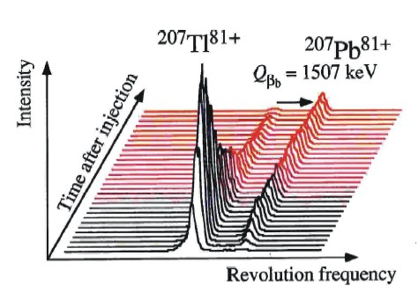
Bound β-decay: results
bound/continuum branching ratio direct Q-value determination → Fermi function f(Z) of the β⁻ decay

Slide 5
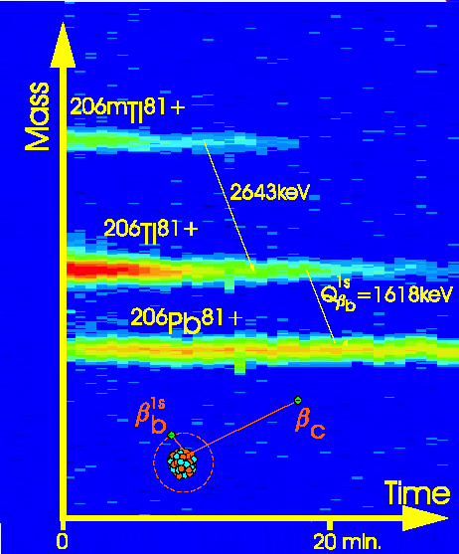
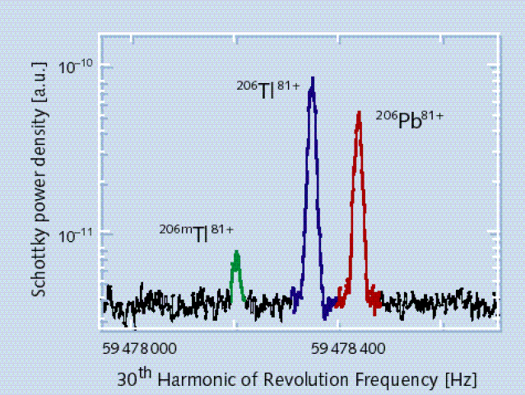
Bound β-decay: results
bound/continuum branching ratio: 10-20% direct Q-value determination

