Slide 1
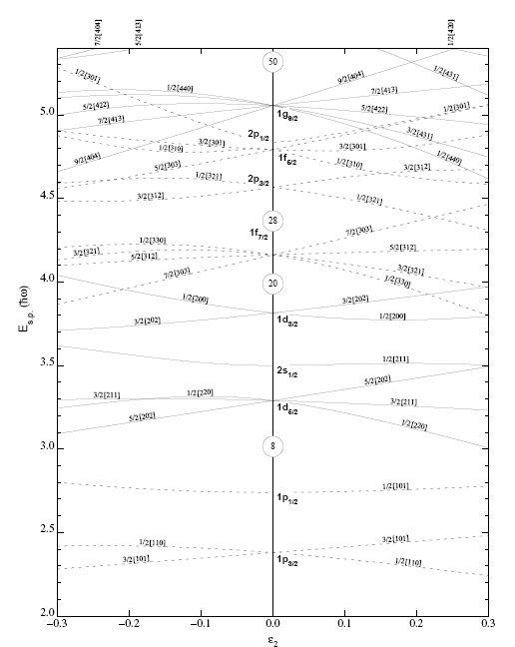
Shape parameterization
Nilssondiagramm
50
28
axially symmetric quadrupole
single particle energies
20
oblate
8
prolate
λ=2
α₂₀≠0, α_{2±1}= α_{2±2}= 0
2
elongation

Slide 2
Quadrupole deformation (λ=2)
There are five independent real parameters,
α₂₀ indicates the stretching of the 3-axis with respect to the 1- and 2-axes
α₂₂ determines the difference in length between the 1- and 2-axes
three Euler angles, which determine the orientation of the principle axis system (1,2,3)
with respect to the laboratory frame (x,y,z)
Hill - Wheeler introduced the (β, γ) – parameters:

Slide 3
Quadrupole deformation (λ=2)
Consider the nuclear shapes in the principal axis system (1, 2, 3) ≡ (x´, y´, z´)

Slide 4
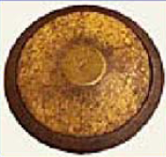
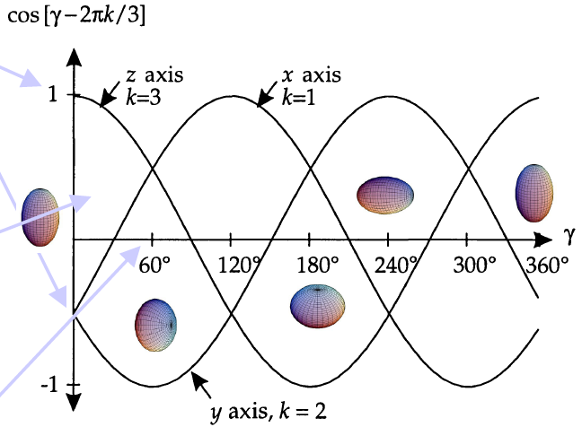
(β,γ) coordinates
At γ = 0⁰ the nucleus is elongated along the z´axis, but the x´and y´axes are equal (prolate shape for x´= y´)
As we increase γ, the x´axis grows at the expense of the y´and z´axes through a region of triaxial shapes with three unequal axis, until axial symmetry is again reached at γ = 60⁰, but now with the z´and x´axis equal in length. These two axes are longer than the y´axis (oblate shape for x´= z´)
This pattern is repeated: every 60⁰ axial symmetry repeated and prolate and oblate shapes alternate.

Slide 5
(β,γ) coordinates
Figure: The (β,γ) plane is divided into six equivalent parts by the symmetries:
the sector 0⁰ and 60⁰ contains all shapes uniquely, i.e. triaxial shapes
the types of shapes encountered along the axis: e.g. prolate x´= y´implies prolate shapes with the z´axis as the long axis and the two other axis x´and y´equal.
various nuclear shapes – prolate or oblate – in the (β,γ) plane are repeated every 60⁰. Because the axis orientations are different, the associated Euler angles also differ.
In conclusion, the same physical shape (including ist orientation in space) can be represented by different sets of deformation parameters (β,γ) and Euler angles!

Slide 6
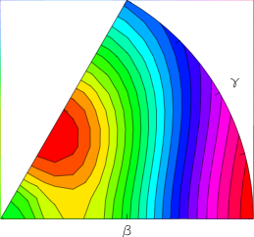
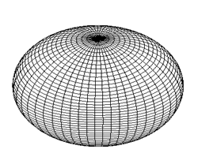


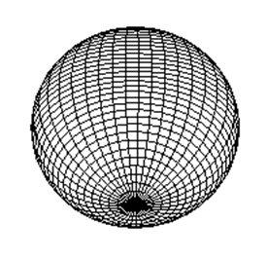
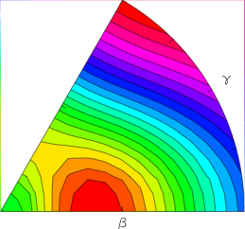
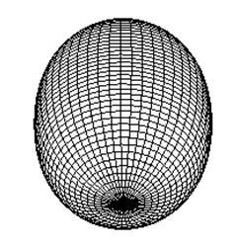
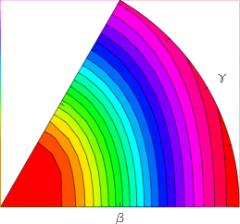
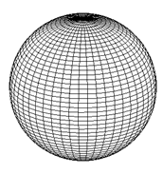
(β,γ) coordinates
V
Spherical
Non collective
oblate
(β, γ = 60⁰)
triaxial
β
Deformed
γ
spherical
β
(0,0)
collective prolate
(β, γ = 0⁰)

Slide 7
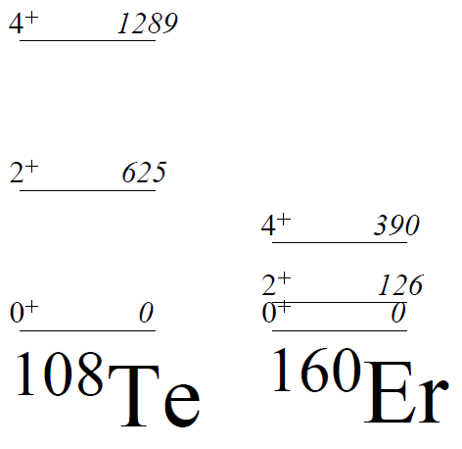
Collective excitation
E(4⁺) / E(2⁺): rotational vs vibrational
Rotational (deformed):
  E(4⁺) / E(2⁺) = 10/3
Vibrational (spherical):
  E(4⁺) / E(2⁺) = 2
¹⁰⁸Te
¹⁶⁰Er
2.1
3.1

Slide 8


Classical collective Hamiltonian of Bohr-Mottelson for quadrupole deformation
Quadrupole (λ=2) motion
where (β, γ) parameters have been used.
V
Spherical
Potential
β
Deformed

Slide 9
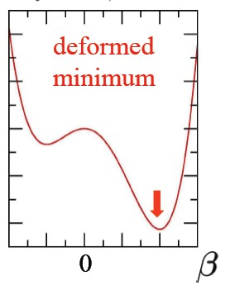
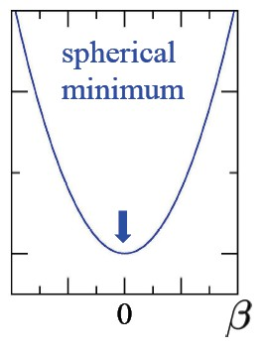
Moment of inertia
z
θ
R(θ)
Rigid body moment of inertia:
Irrotational flow moment of inertia:

Slide 10
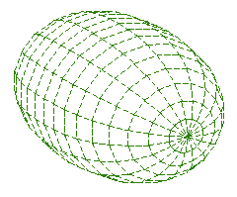
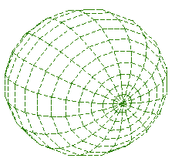
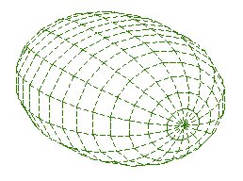
Irrotational flow moment of inertia

Slide 11
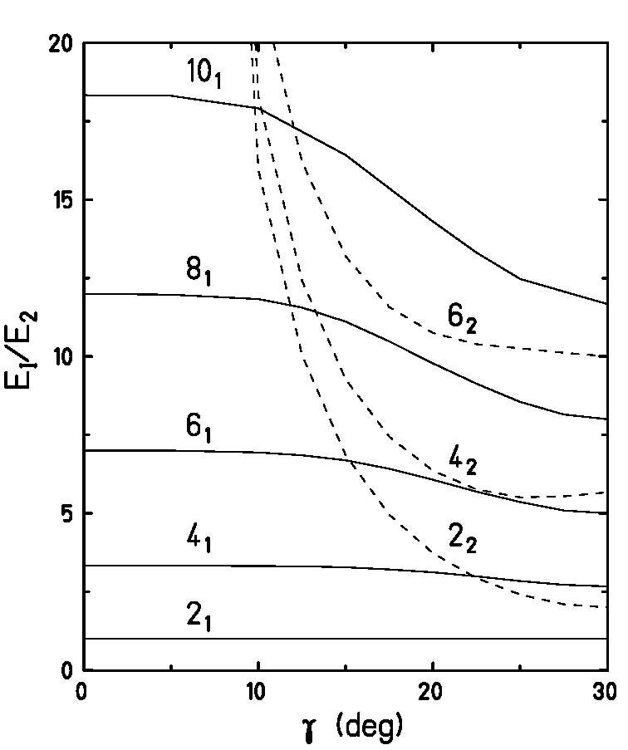
Experimental 2₂⁺ energy and estimate of γ-deformation parameter
rigid triaxial rotor model
Davydov and Filippov, Nucl. Phys. 8, 237 (1958)
γ | 0⁰ | 5⁰ | 10⁰ | 12.5⁰ | 15⁰ | 17.5⁰ | 20⁰ | 22.5⁰ | 25⁰ | 27.5⁰ | 30⁰
E(4₁)/E(2₁) | 3.33 | 3.33 | 3.32 | 3.31 | 3.28 | 3.21 | 3.12 | 2.99 | 2.84 | 2.72 | 2.67
E(6₁)/E(2₁) | 7.00 | 7.00 | 6.94 | 6.85 | 6.69 | 6.42 | 6.07 | 5.69 | 5.36 | 5.09 | 5.00
E(8₁)/E(2₁) | 12.00 | 11.97 | 11.83 | 11.56 | 11.11 | 10.48 | 9.78 | 9.13 | 8.55 | 8.15 | 8.00
E(10₁)/E(2₁) | 18.33 | 18.31 | 17.91 |  | 16.42 |  | 14.30 | 13.31 | 12.47 |  | 11.67
E(2₂)/E(2₁) | ∞ | 65.16 | 15.94 | 10.04 | 6.85 | 4.95 | 3.73 | 2.93 | 2.41 | 2.10 | 2.00
E(4₂)/E(2₁) | ∞ | 67.50 | 18.28 | 12.41 | 9.27 | 7.44 | 6.36 | 5.76 | 5.51 | 5.54 | 5.67
E(6₂)/E(2₁) | ∞ | 71.17 | 22.00 | 16.20 | 13.19 | 11.57 | 10.75 | 10.39 | 10.26 | 10.12 | 10.00

Slide 12
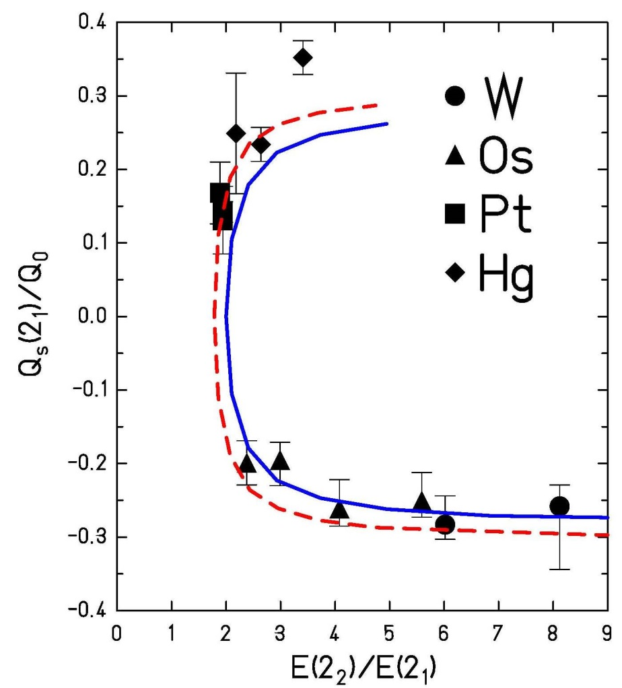
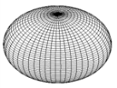
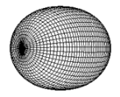
Prolate – oblate shape transition
rigid triaxial rotor model
Davydov and Filippov, Nucl. Phys. 8, 237 (1958)
rigid
soft μ=0.5
γ | 0⁰ | 10⁰ | 15⁰ | 20⁰ | 22.5⁰ | 25⁰ | 27.5⁰ | 30⁰
Q_{s}(2₁)/Q₀ | -0.28 | -0.28 | -0.27 | -0.25 | -0.22 | -0.18 | -0.10 | 0.0
soft asymmetric rotor model:
with

Slide 13
Experimental 2₂⁺ B(E2)-values and estimate of γ-deformation parameter
rigid triaxial rotor model
γ | 0⁰ | 5⁰ | 10⁰ | 15⁰ | 20⁰ | 25⁰ | 30⁰
B(E2;2₂→0)/B(E2;2₁→0) | 0 | .0075 | .0288 | .0560 | .0718 | .0445 | 0
B(E2;2₂→0)/B(E2;2₁→0) | 0 | .0111 | .0525 | .1510 | .3826 | .9058 | 1.43
B(E2;2₂→2)/B(E2;2₂→0) | 1.43 | 1.49 | 1.70 | 2.70 | 5.35 | 20.6 | ∞

Slide 14
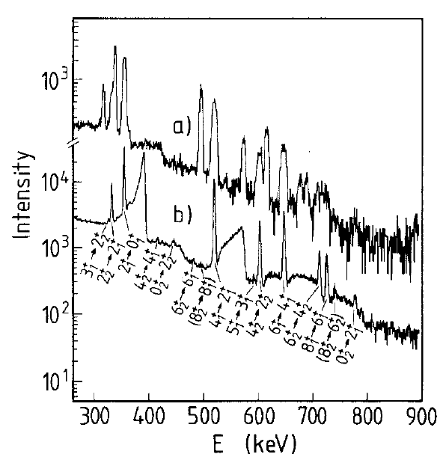
Triaxiality and γ-softness in ¹⁹⁶Pt
²⁰⁸Pb → ¹⁹⁶Pt
4.8 AMeV
position-sensitive
parallel plate counter
(Doppler correction)
87⁰≤θ_{cm}≤93⁰
75⁰≤θ_{cm}≤150⁰
A. Mauthofer et al., Z.Phys. A336, 263 (1990)

Slide 15
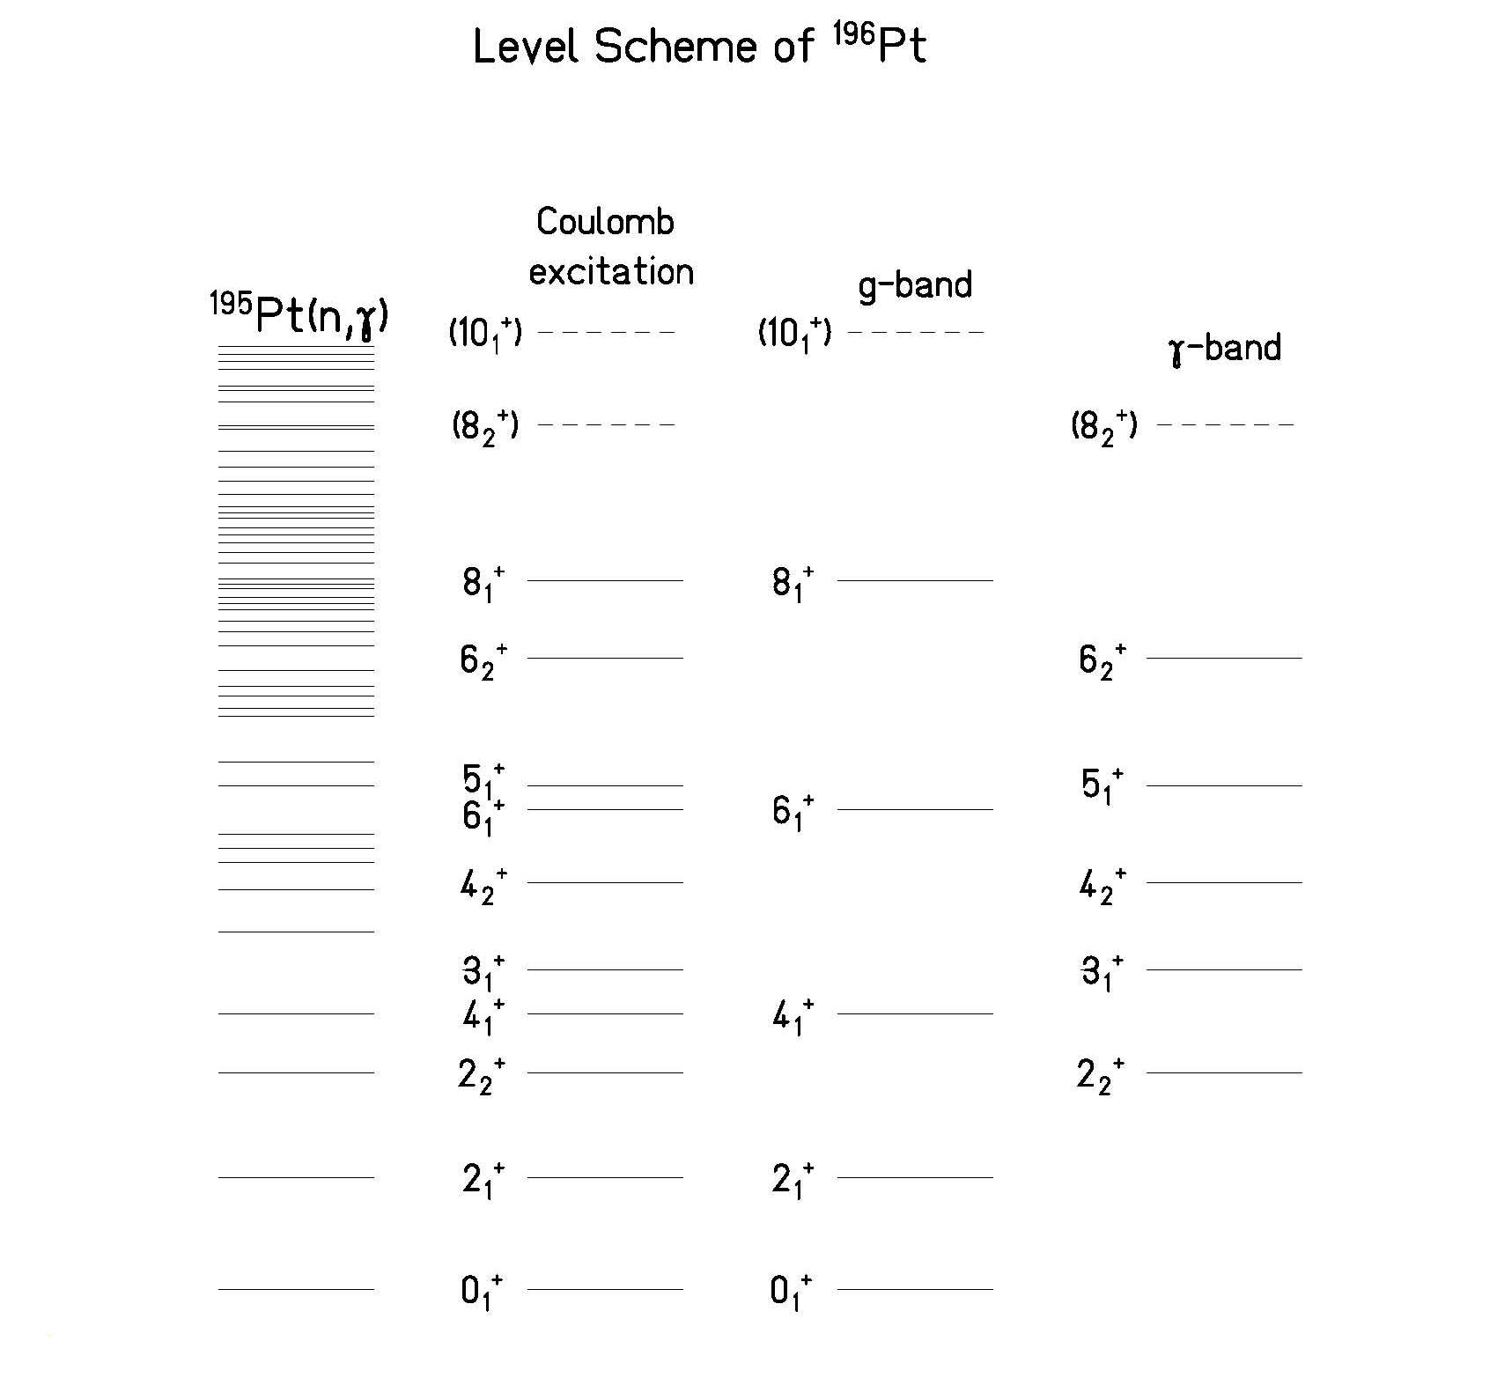
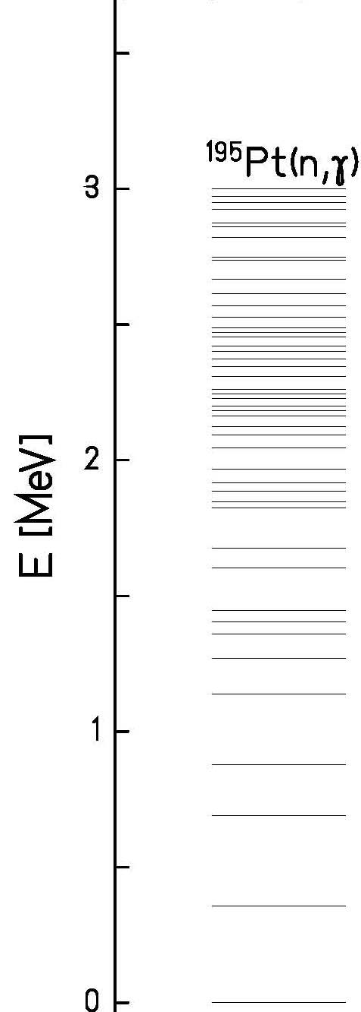
Level scheme of ¹⁹⁶Pt

Slide 16
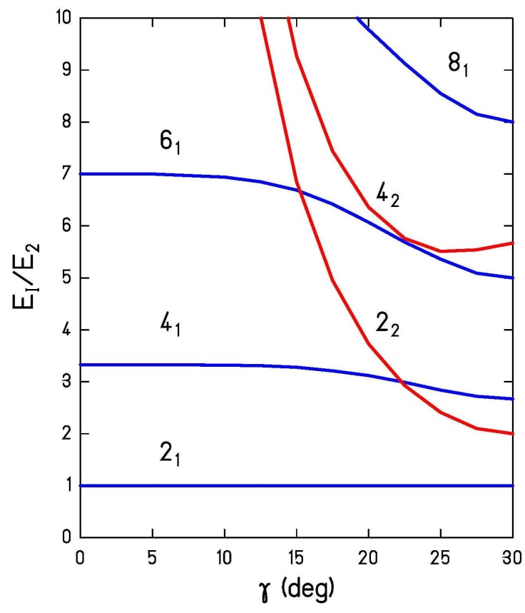
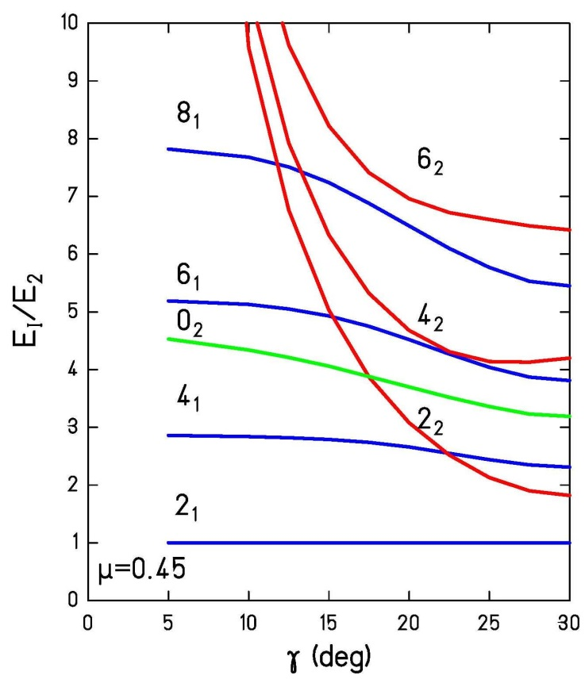
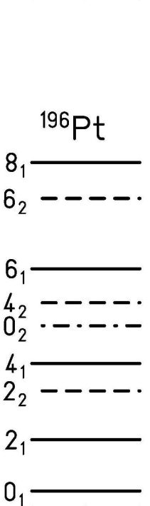
Comparison with
rigid asymmetric rotor model
Comparison with
soft asymmetric rotor model

Slide 17
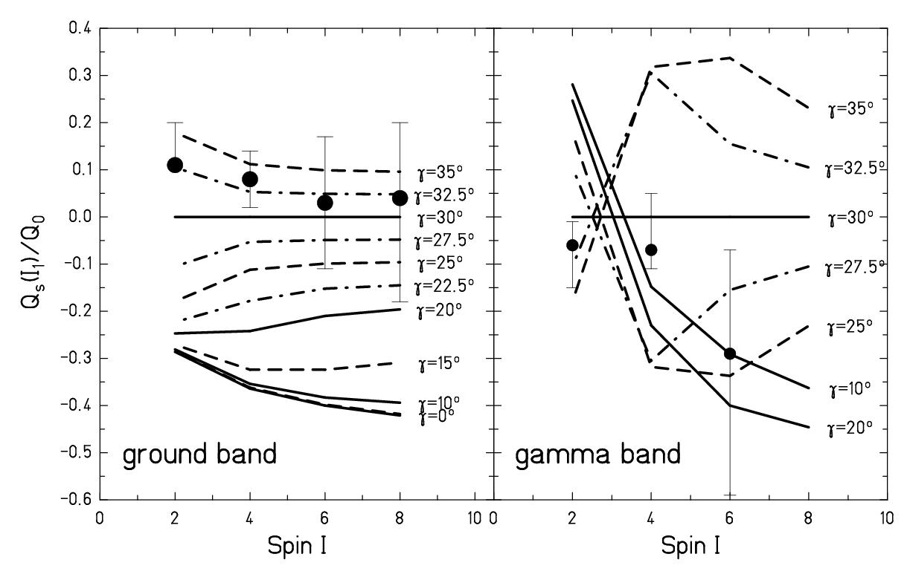
Spin dependence of the spectroscopic quadrupole moment

Slide 18
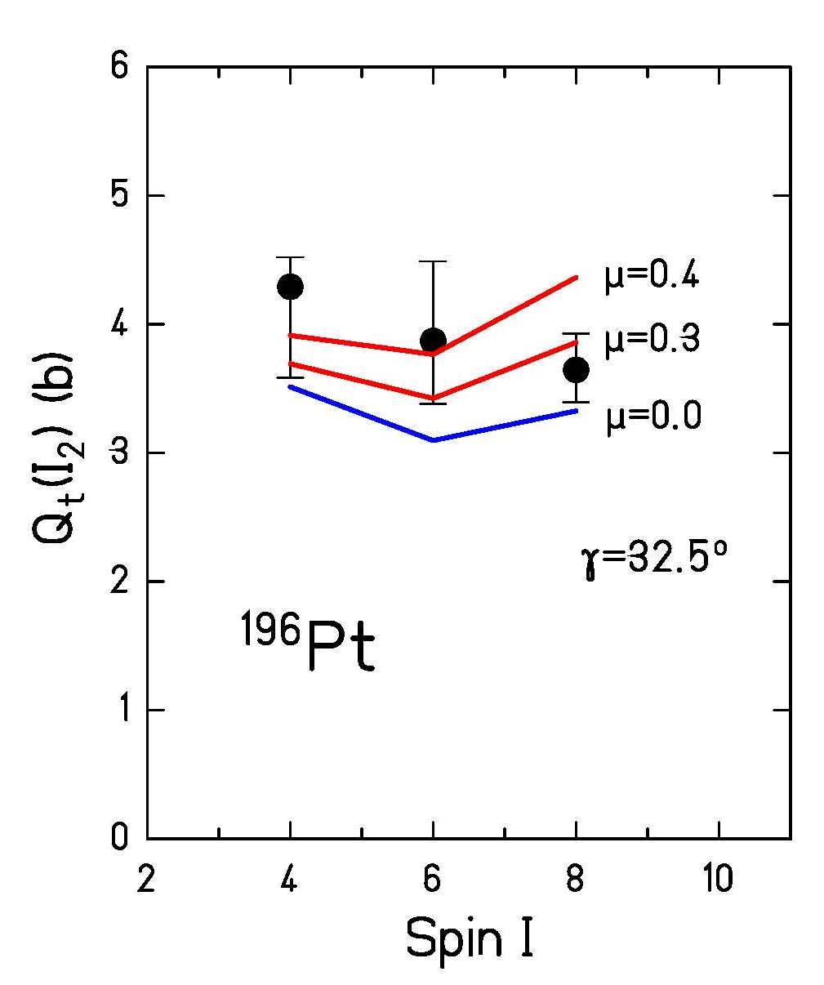
Transition quadrupole moment in the γ-band
soft ARM
rigid ARM

Slide 19
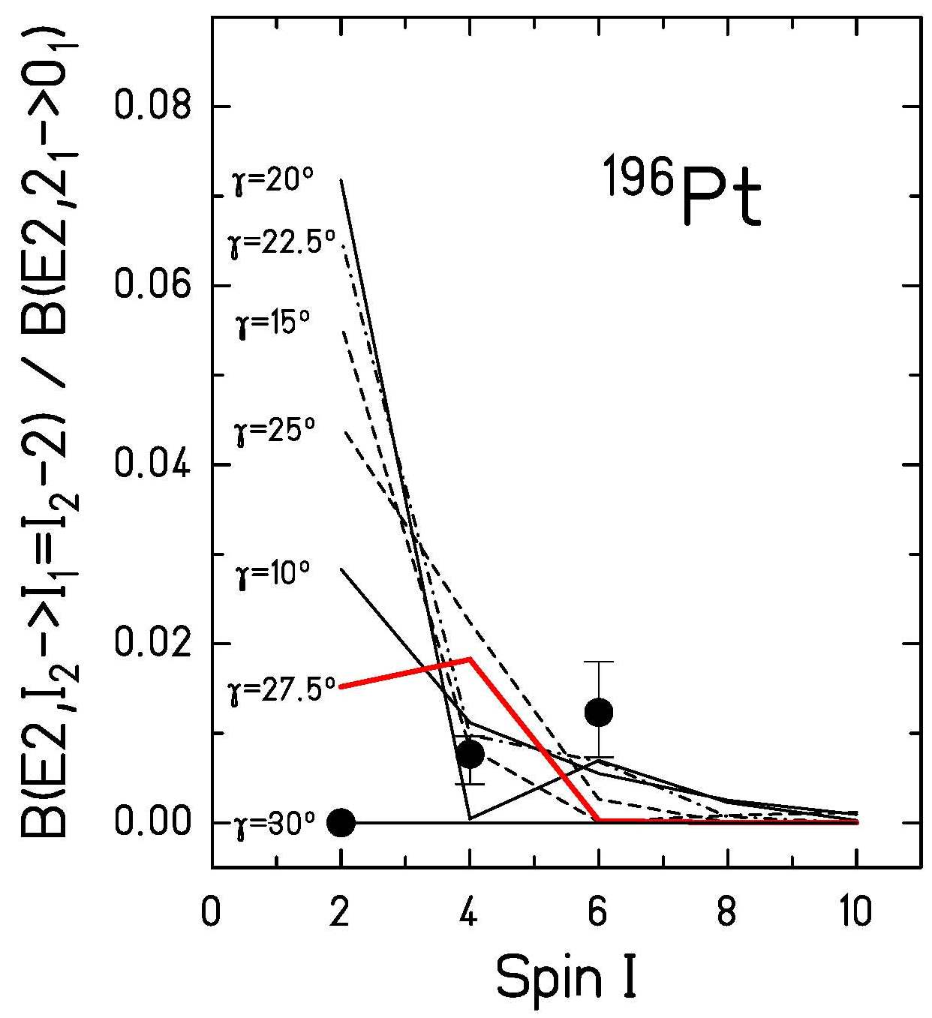
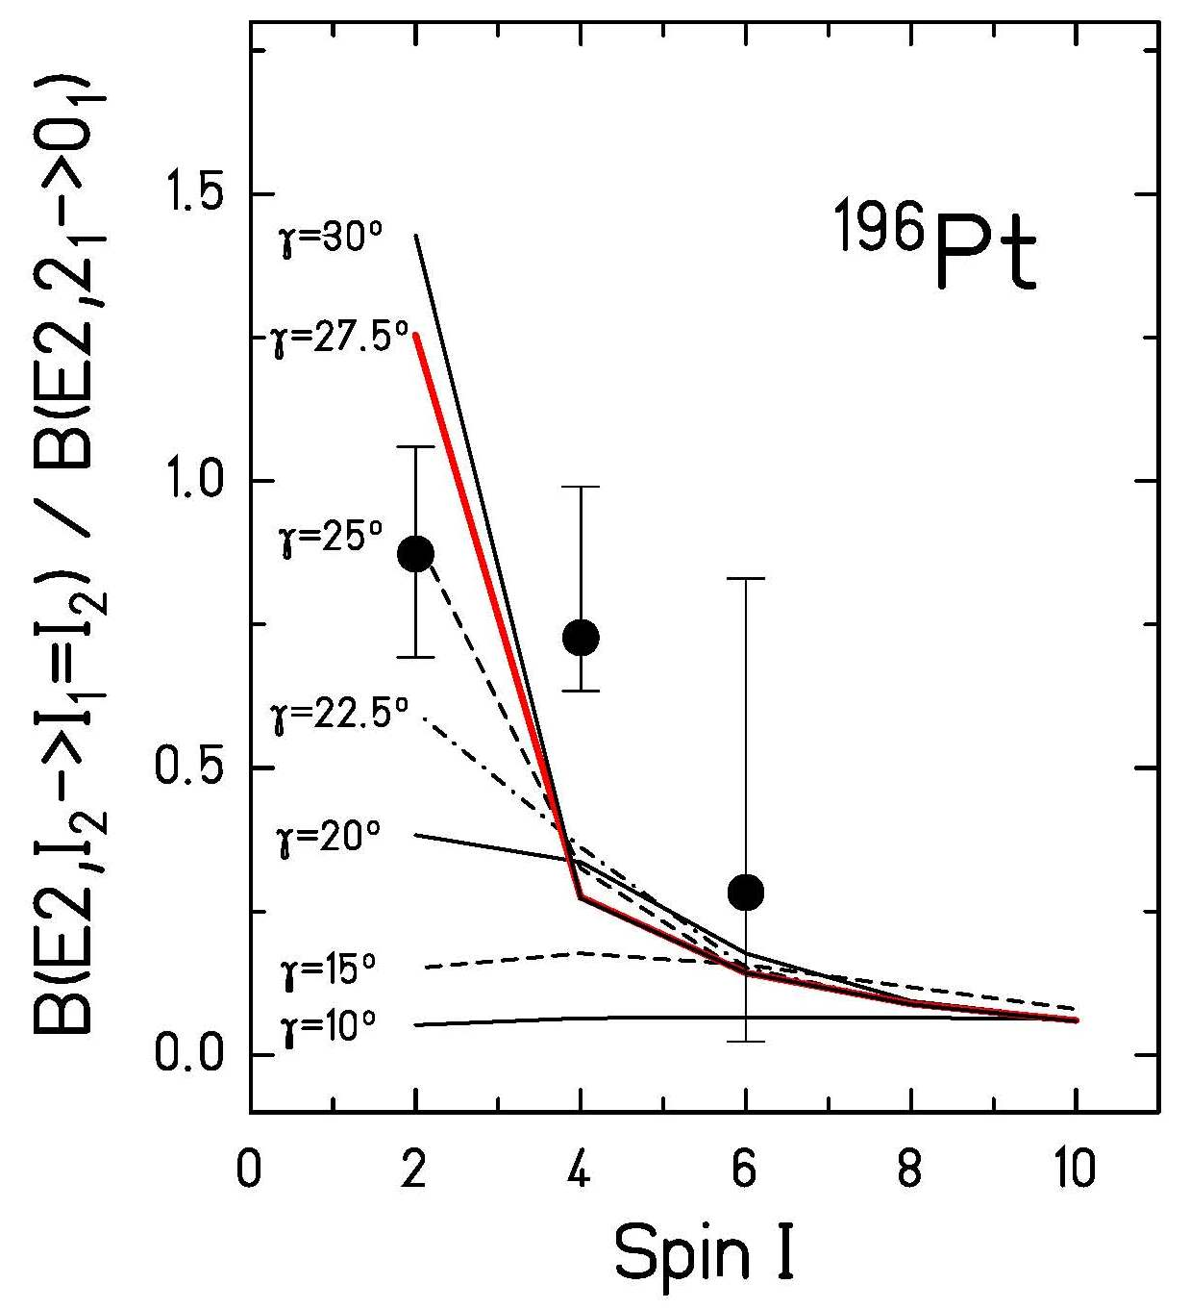
B(E2)-values connecting the γ- and gs-band
I_{γ}→I_{gs}-2
I_{γ}→I_{gs}

Slide 20
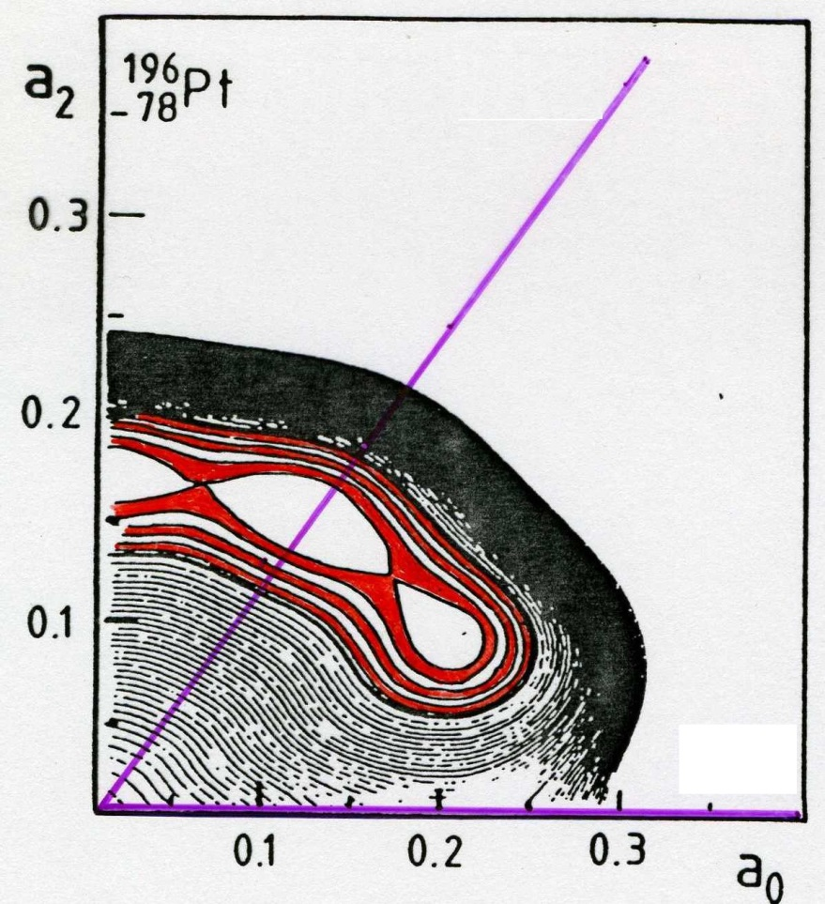
Interpretation of the collective properties in ¹⁹⁶Pt
14 energy levels and 22 E2 matrix elements can be described by the soft asymmetric rotor model assuming the following parameters:
γ=60⁰
γ=0⁰
P.O. Hess et al. J.Phys. G7 (1981), 737

Slide 21
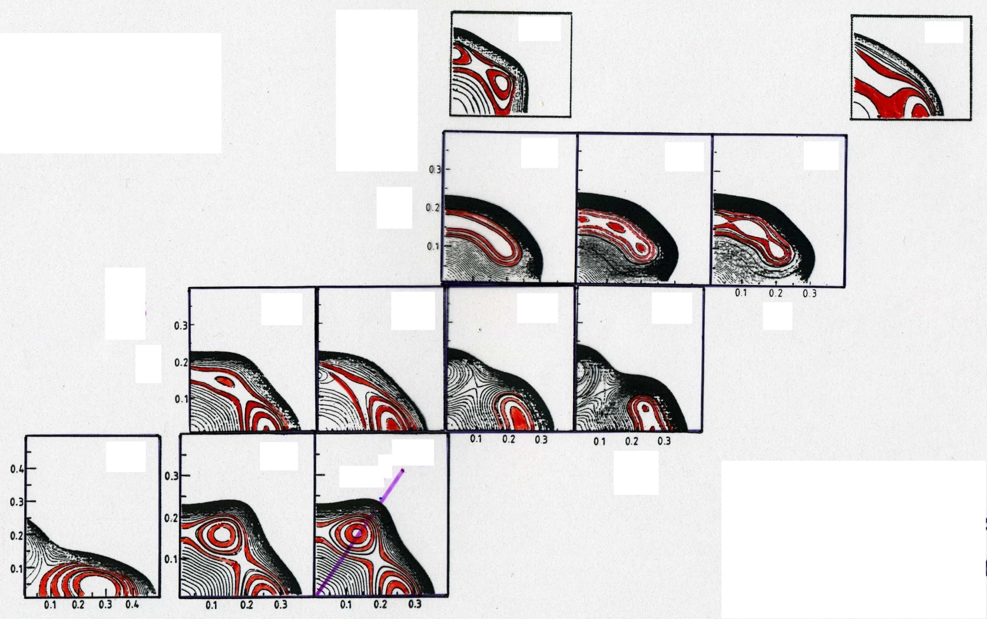
Potential energy surfaces of the W-Os-Pt-Hg chain of isotopes
Hg
194
200
Pt
192
194
196
Os
186
188
190
192
W
182
184
186
α₂
general collective model
α₀
P.O. Hess et al. J.Phys. G7 (1981), 737

Slide 22
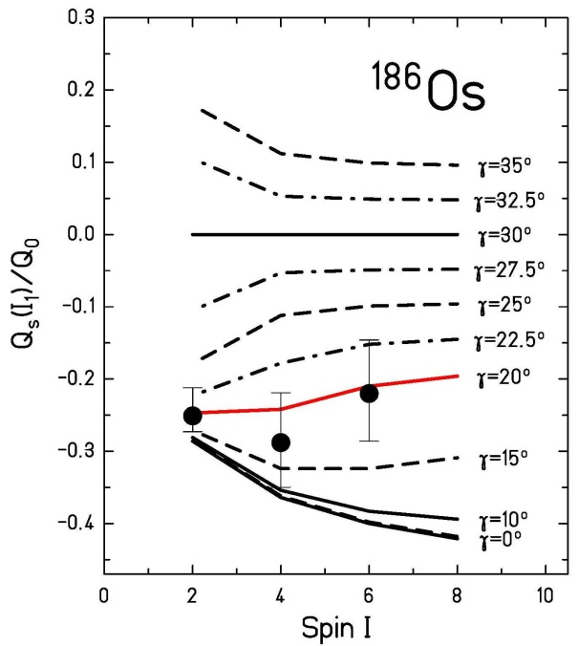
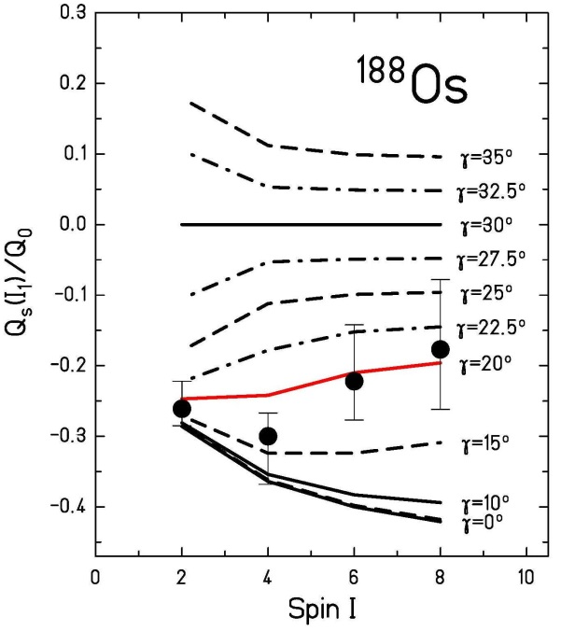
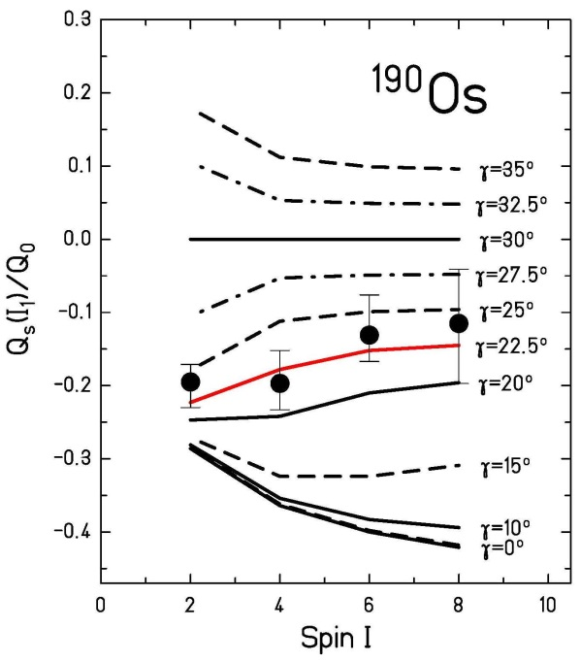
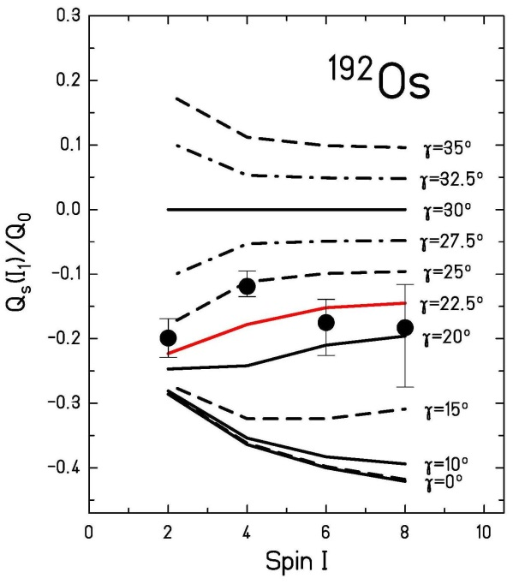
Spectroscopic quadrupole moments in the ground state band of Os-isotopes
C.Y. Wu, D. Cline et al.; Ann. Rev. Nucl. Part Sci 36 (1986), 683

Slide 23
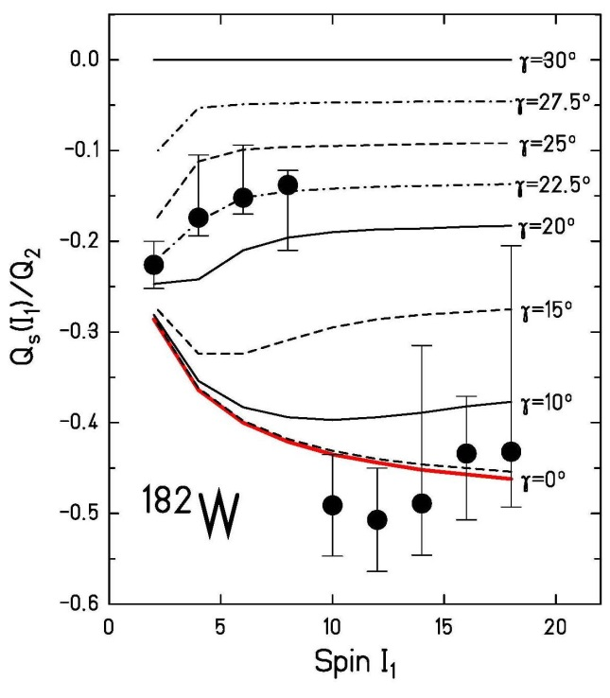
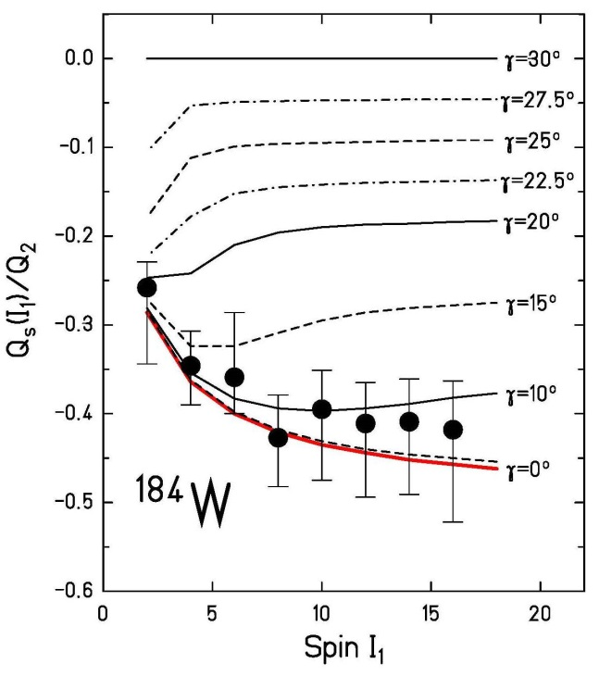
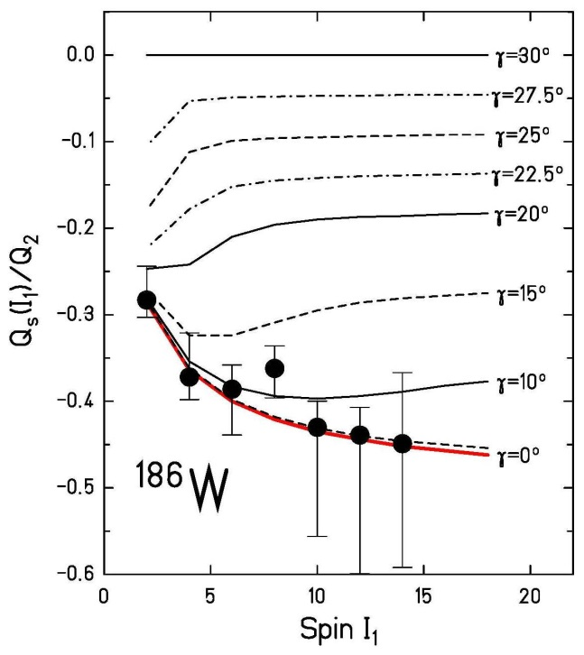
Spectroscopic quadrupole moments in the ground state band of W-isotopes
Q₀ = 7.10 (38) b
β = 0.274 – 0.193
Q₀ = 6.72 (35) b
β = 0.258
Q₀ = 5.87 (29) b
β = 0.223
R. Kulessa et al.; Phys. Lett B218 (1989), 421

Slide 24
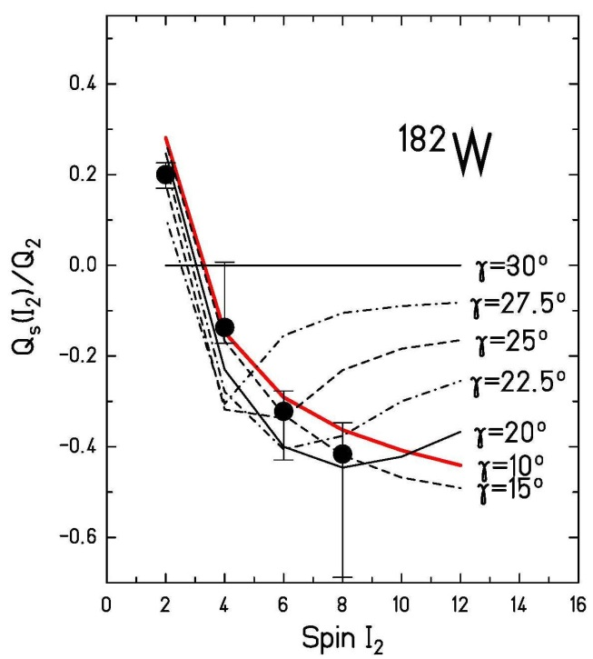
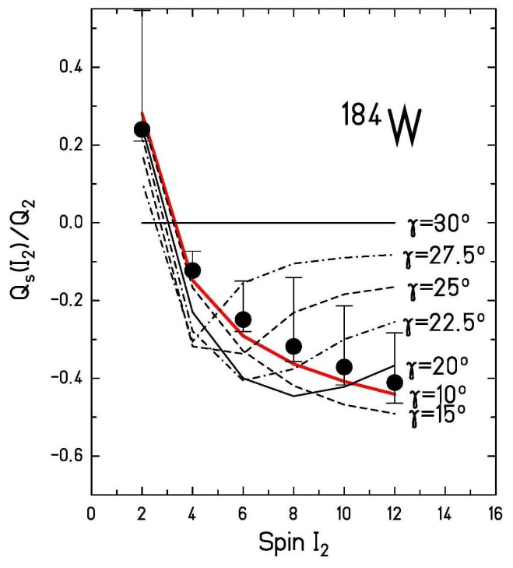
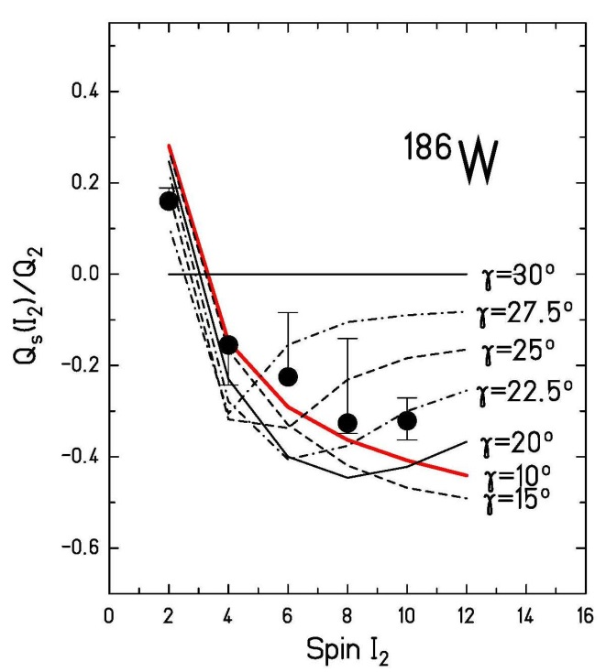
Spectroscopic quadrupole moments in the gamma band of W-isotopes
Q₀ = 5.8 (5) b
β = 0.227
Q₀ = 5.6 (3) b
β = 0.219
Q₀ = 6.3 (4) b
β = 0.239
R. Kulessa et al.; Phys. Lett B218 (1989), 421

Slide 25
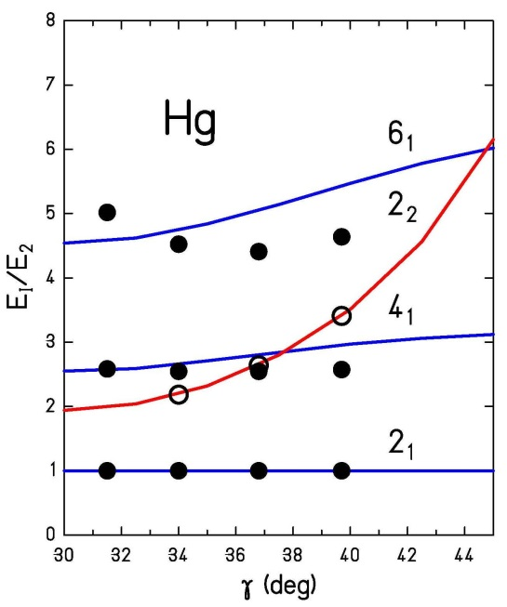
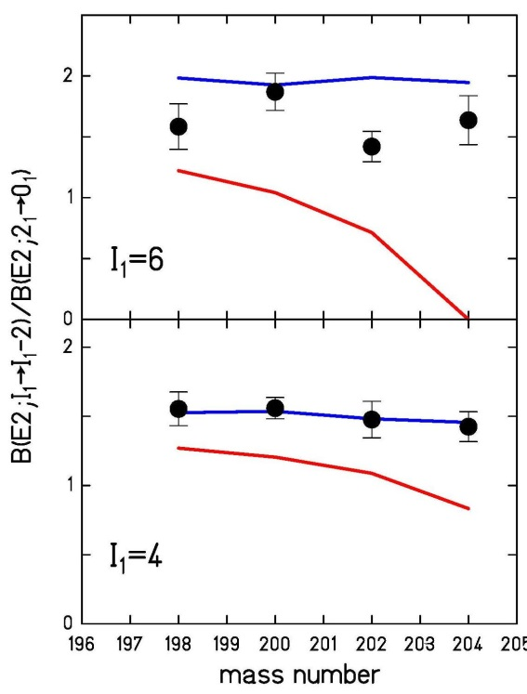
Collective properties in ^{198,200,202,204}Hg
A | B(E2;2₁→0₁)
198 | 29 spu
200 | 25 spu
202 | 17 spu
204 | 12 spu
soft (μ=0.3) asymmetric rotor model:
IBM – O(6) limit:
boson number N = 5 to 2
for Hg-isotopes with A=198 to 204
C. Günther et al.; Z. Phys. A301 (1981), 119
Y.K. Agarwal et al.; Z. Phys. A320 (1985), 295

Slide 26
Parameter of the asymmetric rotor model
isotope | β | γ | γ | μ
¹⁸²W | 0.274 | 11.4⁰ | 11.2⁰ | 0.17
¹⁸⁴W | 0.258 | 13.8⁰ | 13.7⁰ | 0.15
¹⁸⁶W | 0.223 | 15.9⁰ | 15.8⁰ | 0.05
¹⁸⁶Os | 0.196 | 16.5⁰ | 16.1⁰ | 0.26
¹⁸⁸Os | 0.185 | 19.2⁰ | 18.8⁰ | 0.26
¹⁹⁰Os | 0.184 | 22.3⁰ | 22.0⁰ | 0.26
¹⁹²Os | 0.168 | 25.2⁰ | 25.2⁰ | 0.10
¹⁹²Pt | 0.146 | - | 32.5⁰ | 0.35
¹⁹⁴Pt | 0.134 | - | 32.5⁰ | 0.35
¹⁹⁶Pt | 0.135 | - | 32.5⁰ | 0.37
¹⁹⁸Hg | 0.106 | 36.3⁰ | 38.0⁰ | 0.44
²⁰⁰Hg | 0.098 | 39.1⁰ | 41.0⁰ | 0.44
²⁰²Hg | 0.082 | 33.4⁰ | 34.4⁰ | 0.35
²⁰⁴Hg | 0.068 | 31.5⁰ | 31.5⁰ | 0.19

Slide 27
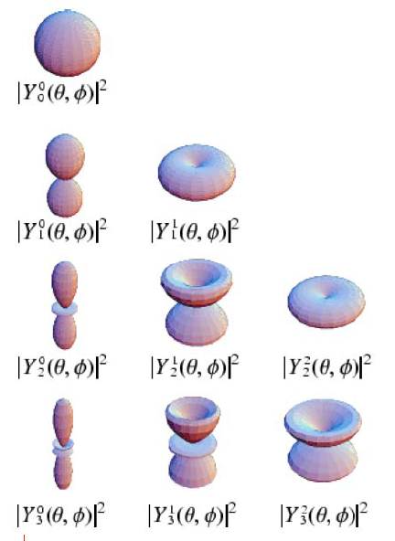
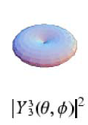
Spherical harmonics

