Slide 1
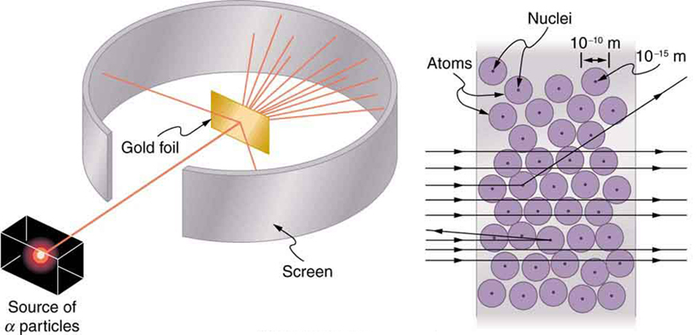
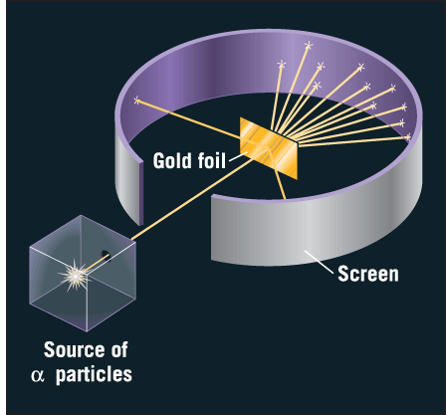
Semi-classical reaction theory

Slide 2
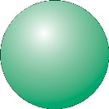
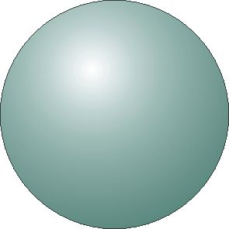
Semi-classical reaction theory
elastic scattering
b

Slide 3
Semi-classical reaction theory
elastic scattering
b

Slide 4
Semi-classical reaction theory
elastic scattering
b

Slide 5
Semi-classical reaction theory
elastic scattering
b
nucleon transfer

Slide 6
Semi-classical reaction theory
elastic scattering
b≈0
nucleon transfer

Slide 7
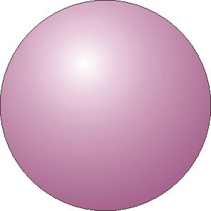
Semi-classical reaction theory
elastic scattering
b≈0
nucleon transfer

Slide 8
Semi-classical reaction theory
elastic scattering
b≈0
compound nucleus
formation
nucleon transfer

Slide 9

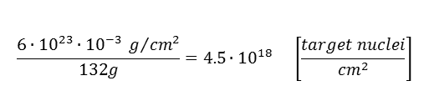

Nuclear reaction cross section
Consider a beam of projectiles of intensity Φ_{a} particles/sec which hits a thin foil of target nuclei with the result that the beam is attenuated by reactions in the foil such that the transmitted intensity is Φ particles/sec.
The fraction of the incident particles disappear from the beam, i.e. react, in passing through the foil is given by
The number of reactions that are occurring is the difference between the initial and transmitted flux
d
A
v_{a}
$$dΦ=−Φ∙n_{b}∙σ∙dx$$
$$Φ_{initial}−Φ_{trans}=Φ_{initial}\left(1−exp\left[−n_{b}∙d∙σ\right]\right)$$
$$≈Φ_{initial}∙N_{b}∙σ$$
(for thin target)
Example:
Φ_{a} = n_{a}·v_{a}
N_{b} = n_{b}·A·d
A particle current of 1 pnA consists of 6·10⁹ projectiles/s.
A ¹³²Sn target (1 mg/cm²) consists of 5·10¹⁸ nuclei/cm²
$$\frac{6∙{10}^{23}∙{10}^{−3} g/{{cm}^{2}}}{132g}=4.5∙{10}^{18} \left[\frac{target nuclei}{{cm}^{2}}\right]$$
Luminosity = projectiles [s⁻¹] · target nuclei [cm⁻²]
Luminosity (projectile → ¹³²Sn) = 3·10²⁸ [s⁻¹cm⁻²]
Reaction rate [s⁻¹] = luminosity · cross section [cm²]
= projectiles [s⁻¹] · target nuclei [cm⁻²] · cross section [cm²]

Slide 10
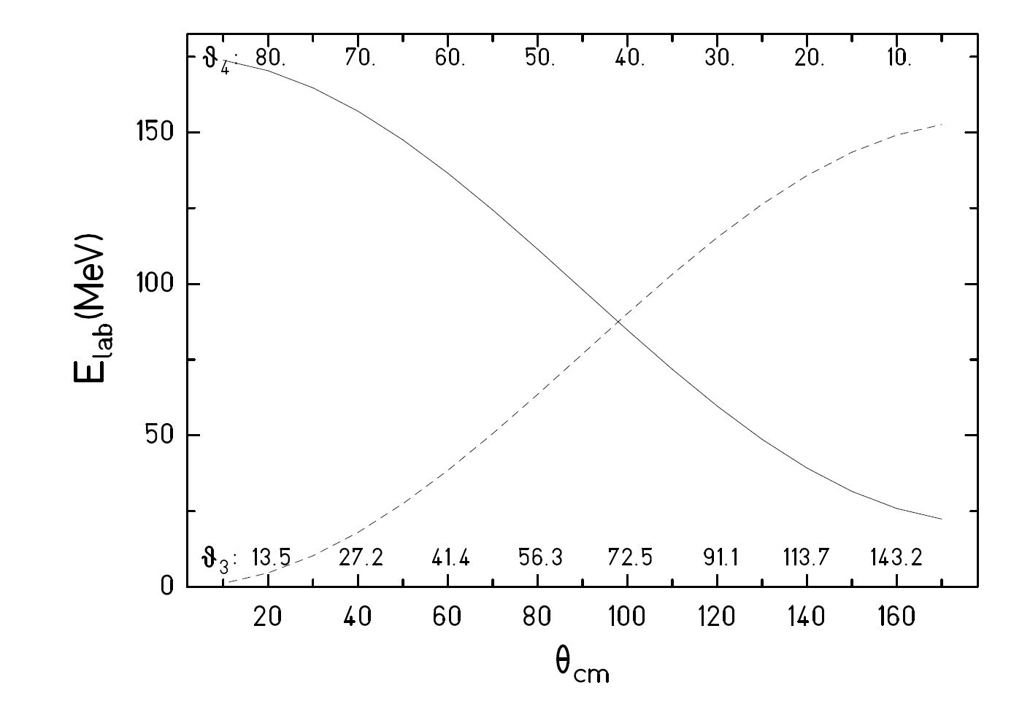

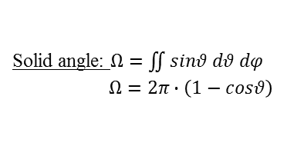

Kinematics
⁵⁸Ni + ¹²⁰Te
Φ $segmentation$
⁵⁸Ni
¹²⁰Te
projectile and target nucleus are measured in PPAC
electrode is made of concentric rings (proportional to polar angle ϑ)
$${15}^{0}≤θ≤{45}^{0}$$
Solid angle: $Ω=\iint{sinθ dθ dφ}$
$Ω=2π∙\left(1−cosθ\right)$
PPAC: 1.626 sr

Slide 11
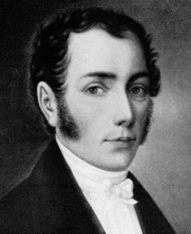
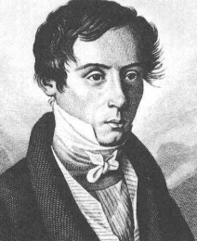
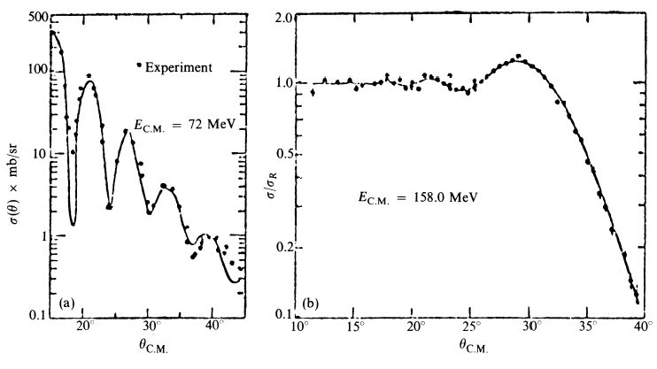

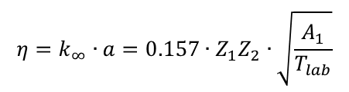


Elastic Scattering
Fraunhofer (left) and Fresnel (right) diffraction
Joseph von Fraunhofer
1787 – 1826
Augustin Jean Fresnel
1788 -1827
¹²C + ¹⁶O
¹⁶O + ²⁰⁸Pb
η = 2
η = 32
Born approximation (quantum description) or classical description:
half distance of closest approach for head-on collision
wave length of projectile ƛ = (k∞)⁻¹
$$η=\frac{a}{λ}$$
ƛ
$$η=k_{∞}∙a=0.157∙Z_{1}Z_{2}∙\sqrt{\frac{A_{1}}{T_{lab}}}$$
$$a=\frac{0.72∙Z_{1}Z_{2}}{T_{lab}}∙\frac{A_{1}+A_{2}}{A_{2}} \left[fm\right]$$
$$k_{∞}=0.219∙\frac{A_{2}}{A_{1}+A_{2}}∙\sqrt{A_{1}∙T_{lab}} \left[{fm}^{−1}\right]$$

Slide 12
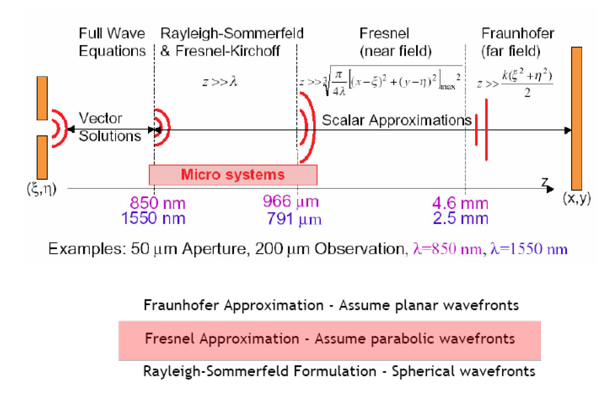
Diffraction regimes

Slide 13
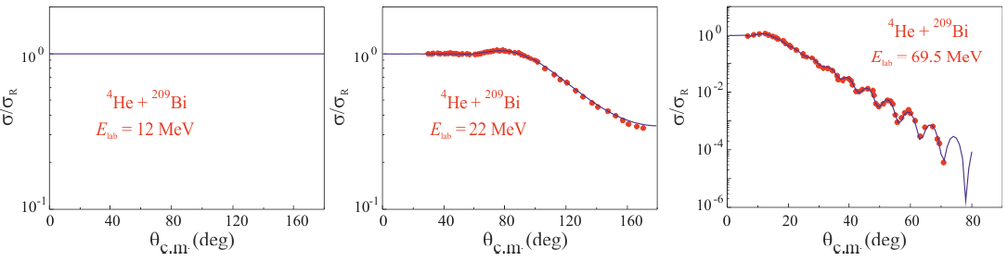
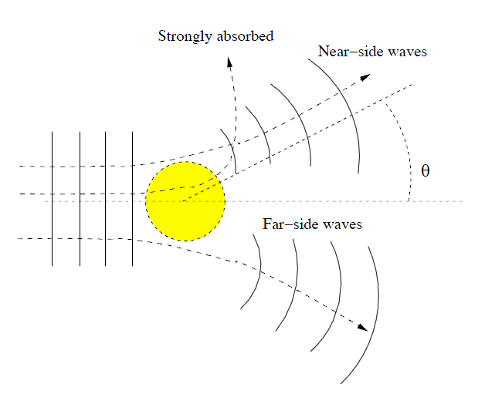
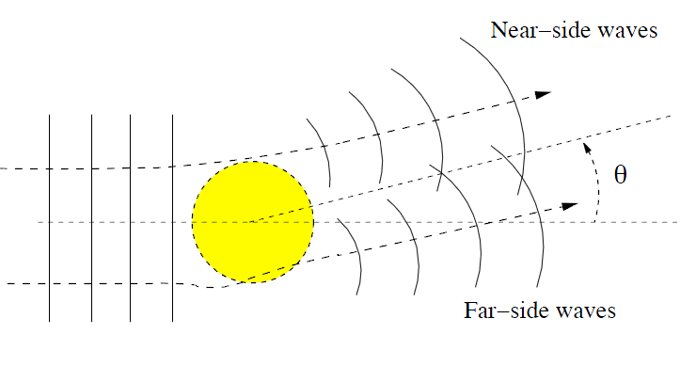
Elastic Scattering
⁴He + ²⁰⁹Bi
E_{lab} = 69.5 MeV
⁴He + ²⁰⁹Bi
E_{lab} = 12 MeV
⁴He + ²⁰⁹Bi
E_{lab} = 22 MeV
Rutherford scattering
η = 15
Fresnel scattering
η = 11
Fraunhofer scattering
η = 6
Transition from classical (optical) picture to quantum picture

Slide 14
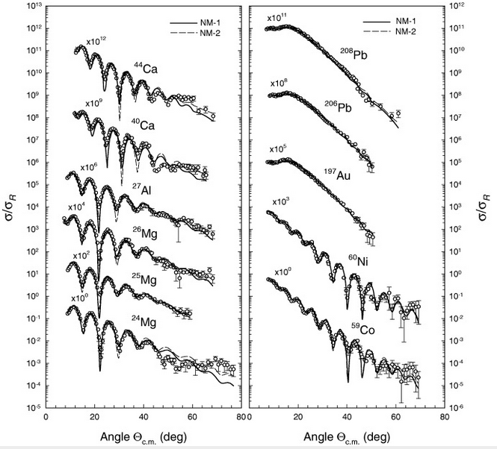

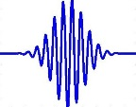
Elastic Scattering
⁶Li elastic scattering @ 88 MeV
Fresnel scattering (η≥10)
particle
η = 2.5
η = 10
η = 1.5
η = 3.3
Fraunhofer scattering (η<10)
wave
Oscillation in angular distribution → good angular resolution required
S. Hossain et al. Phys. Scr. 87 (2013) 015201

Slide 15
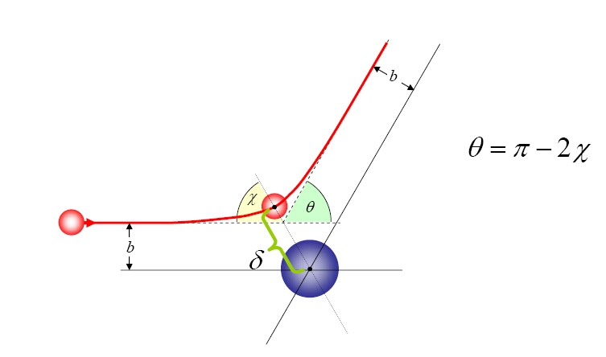
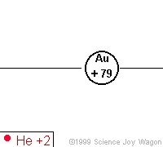





Scattering parameters
D
impact parameter:
$$b=a∙cot\frac{θ_{cm}}{2}$$
distance of closest approach:
half distance of closest approach
in a head-on collision (θ_{cm}=180⁰):
θ_{cm}
$$D=a∙\left[\sin^{−1}\frac{θ_{cm}}{2}+1\right]$$
$$a=\frac{0.72∙Z_{1}Z_{2}}{T_{lab}}∙\frac{A_{1}+A_{2}}{A_{2}} \left[fm\right]$$
b
D
asymptotic wave number:
orbital angular momentum:
$$k_{∞}=0.219∙\frac{A_{2}}{A_{1}+A_{2}}∙\sqrt{A_{1}∙T_{lab}} \left[{fm}^{−1}\right]$$
$$ℓ=k_{∞}∙b=η∙cot\frac{θ_{cm}}{2}$$
Sommerfeld parameter:
$$η=k_{∞}∙a=0.157∙Z_{1}Z_{2}∙\sqrt{\frac{A_{1}}{T_{lab}}}$$
center of mass system

Slide 16
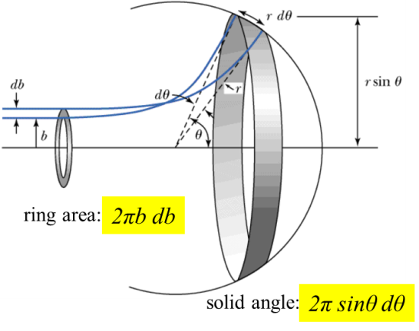
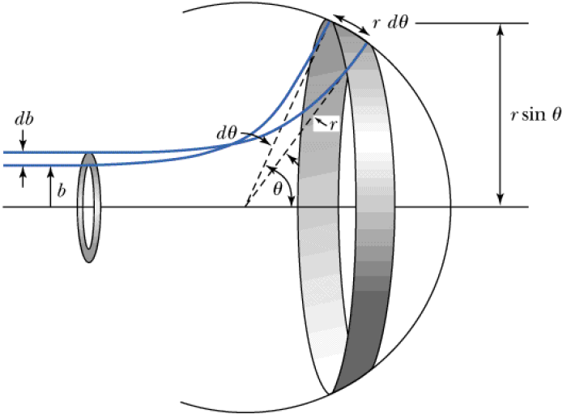
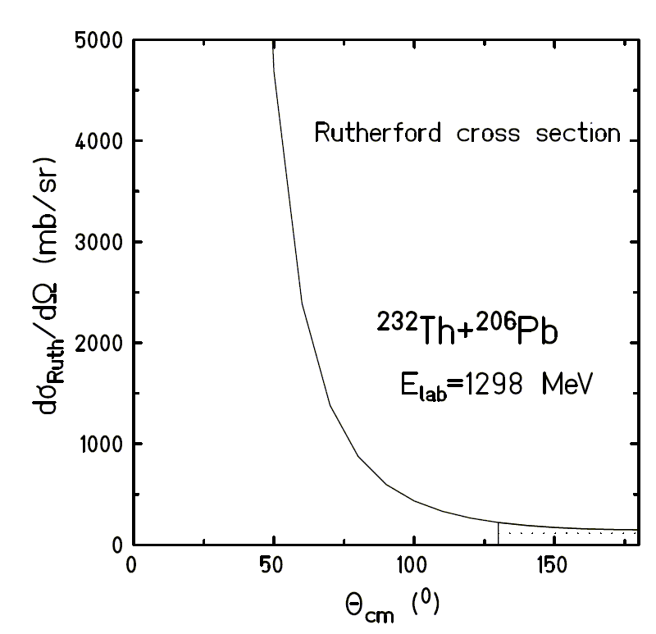
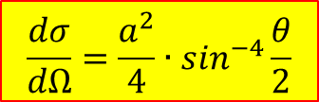
Scattering theory
ring area:
2πb db
solid angle:
2π sinθ dθ
$$\frac{dσ}{dΩ}=\frac{a^{2}}{4}∙\sin^{−4}\frac{θ}{2}$$

Slide 17
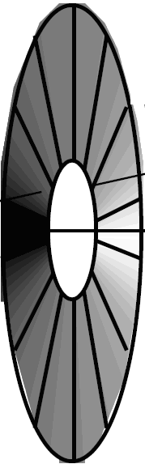
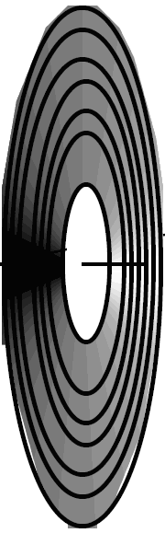
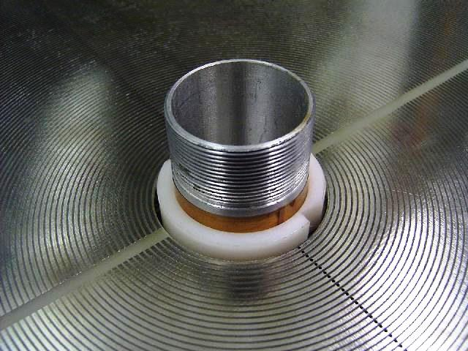
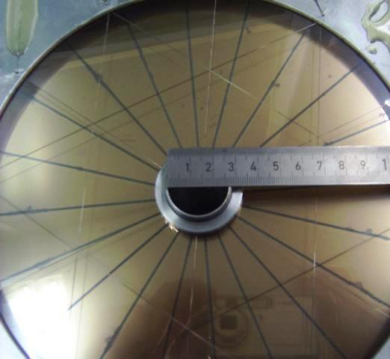
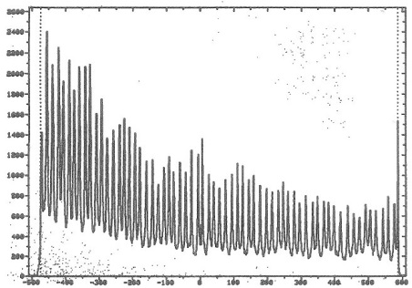
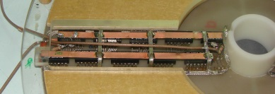
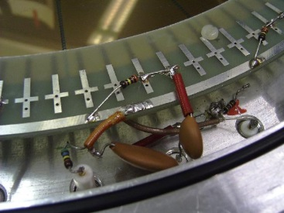
Annular gas-filled parallel-plate avalanche counter (PPAC)
V₀ ~ 500 V
p = 5-10 Torr
gap ~ 3 mm (anode-cathode)
¹²⁰Te
⁵⁸Ni beam
Δt ~ tanϑ
o
i
i
i
delay line
Δtime →
A. Jhingan detector laboratory at IUAC

Slide 18
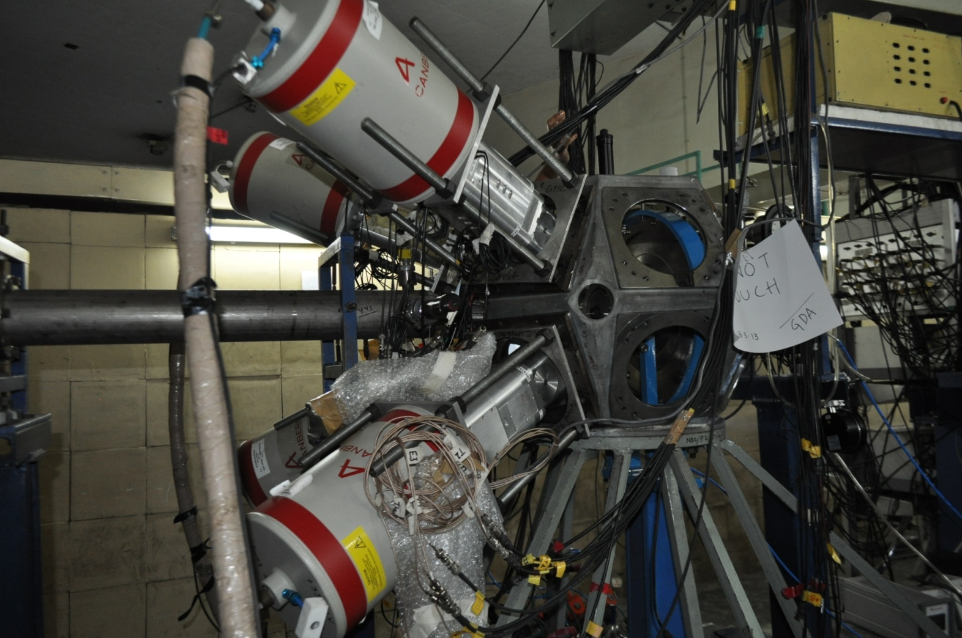

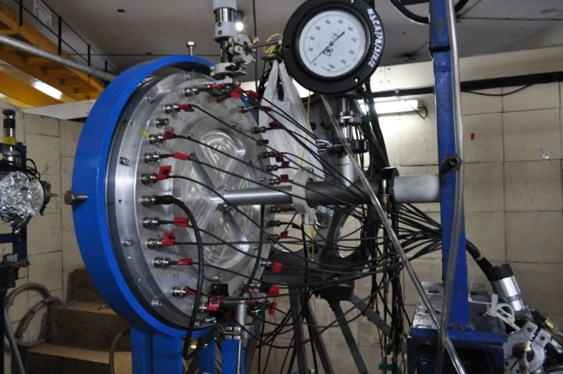
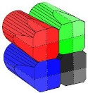
Experimental set-up at IUAC
Target
CLOVER Detectors
@ backward angles
PPAC @ forward angle

Slide 19
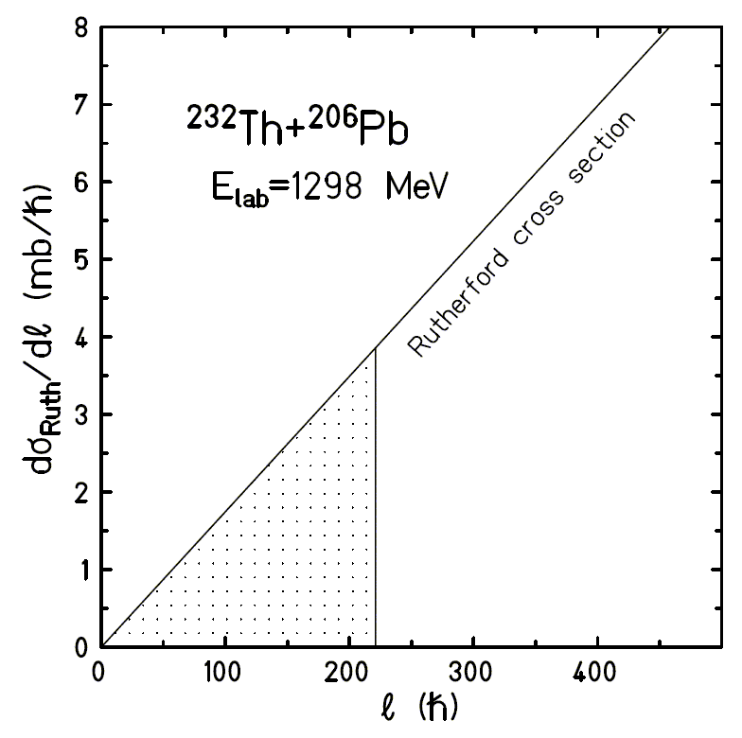










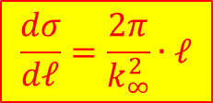
Scattering theory
angular momentum and scattering angle:
$$ℓ=b∙p=b∙\sqrt{2∙m∙T}$$
$$k_{∞}=\frac{\sqrt{2∙m∙T}}{ℏ}$$
$$ℓ=η∙cot\frac{θ}{2}$$
$$η=k_{∞}∙a$$
$$\frac{dσ}{dℓ}=\frac{dσ}{dΩ}∙\frac{dΩ}{dℓ}=\frac{a^{2}}{4}∙\sin^{−4}\frac{θ}{2}∙\frac{dΩ}{dℓ}$$
$$\frac{dΩ}{dℓ}=2π∙sinθ∙\frac{dθ}{dℓ}$$
$$\frac{dℓ}{dθ}=\frac{η}{2}∙\sin^{−2}\frac{θ}{2}$$
$$\frac{dΩ}{dℓ}=2π∙2∙cos\frac{θ}{2}∙sin\frac{θ}{2}∙\frac{2∙\sin^{2}\frac{θ}{2}}{η}$$
$$cos\frac{θ}{2}=\frac{ℓ}{η}∙sin\frac{θ}{2}$$
$$\frac{dσ}{dℓ}=\frac{a^{2}}{4}∙\sin^{−4}\frac{θ}{2}∙\frac{8π∙ℓ}{η^{2}}∙\sin^{4}\frac{θ}{2}$$
$$\frac{dσ}{dℓ}=\frac{2π}{k_{∞}^{2}}∙ℓ$$

Slide 20
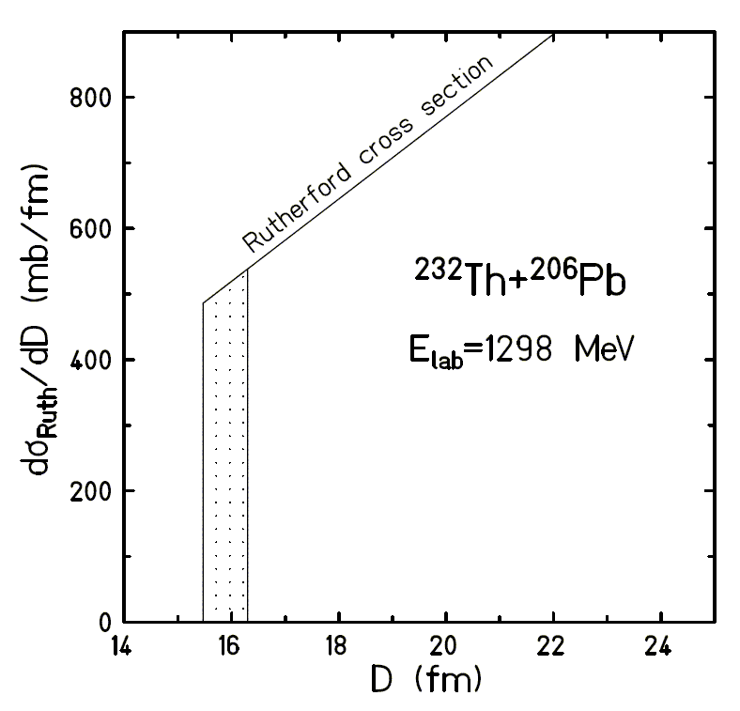
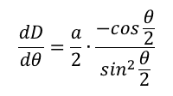

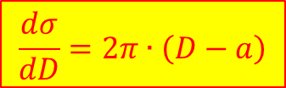
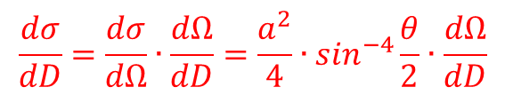




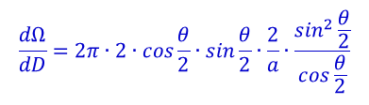
Scattering theory
distance of closest approach and scattering angle:
$$D=a∙\left[\sin^{−1}\frac{θ}{2}+1\right]$$
$$sin\frac{θ}{2}=\frac{a}{D−a}$$
$$\frac{dσ}{dD}=\frac{dσ}{dΩ}∙\frac{dΩ}{dD}=\frac{a^{2}}{4}∙\sin^{−4}\frac{θ}{2}∙\frac{dΩ}{dD}$$
$$\frac{dΩ}{dD}=2π∙sinθ∙\frac{dθ}{dD}$$
$$\frac{dD}{dθ}=\frac{a}{2}∙\frac{−cos\frac{θ}{2}}{\sin^{2}\frac{θ}{2}}$$
$$\frac{dΩ}{dD}=2π∙2∙cos\frac{θ}{2}∙sin\frac{θ}{2}∙\frac{2}{a}∙\frac{\sin^{2}\frac{θ}{2}}{cos\frac{θ}{2}}$$
$$\frac{dΩ}{dD}=\frac{8π}{a}∙\sin^{3}\frac{θ}{2}$$
$$\frac{dσ}{dD}=\frac{a^{2}}{4}∙\sin^{−4}\frac{θ}{2}∙\frac{8π}{a}∙\sin^{3}\frac{θ}{2}=\frac{2π∙a}{sin\frac{θ}{2}}$$
$$\frac{dσ}{dD}=2π∙\left(D−a\right)$$

Slide 21



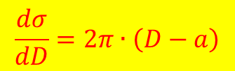
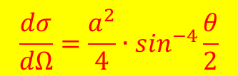


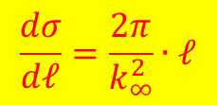
Summary
impact parameter and scattering angle:
$$b=a∙cot\frac{θ}{2}$$
$$a=\frac{Z_{p}∙Z_{t}∙e^{2}}{2∙E_{cm}}$$
$$\frac{dσ}{dΩ}=\frac{a^{2}}{4}∙\sin^{−4}\frac{θ}{2}$$
angular momentum and scattering angle:
$$ℓ=η∙cot\frac{θ}{2}$$
$$k_{∞}=\frac{\sqrt{2∙m∙E_{cm}}}{ℏ}$$
$$η=k_{∞}∙a$$
$$\frac{dσ}{dℓ}=\frac{2π}{k_{∞}^{2}}∙ℓ$$
distance of closest approach and scattering angle:
$$D=a∙\left[\sin^{−1}\frac{θ}{2}+1\right]$$
$$\frac{dσ}{dD}=2π∙\left(D−a\right)$$

Slide 22
Summary
impact parameter and scattering angle:
$$b=a∙cot\frac{θ}{2}$$
$$\frac{dσ}{dΩ}=\frac{a^{2}}{4}∙\sin^{−4}\frac{θ}{2}$$
angular momentum and scattering angle:
$$ℓ=η∙cot\frac{θ}{2}$$
$$\frac{dσ}{dℓ}=\frac{2π}{k_{∞}^{2}}∙ℓ$$
distance of closest approach and scattering angle:
$$D=a∙\left[\sin^{−1}\frac{θ}{2}+1\right]$$
$$\frac{dσ}{dD}=2π∙\left(D−a\right)$$

Slide 23
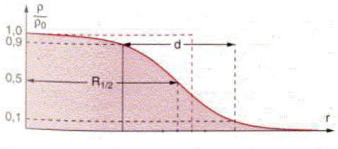
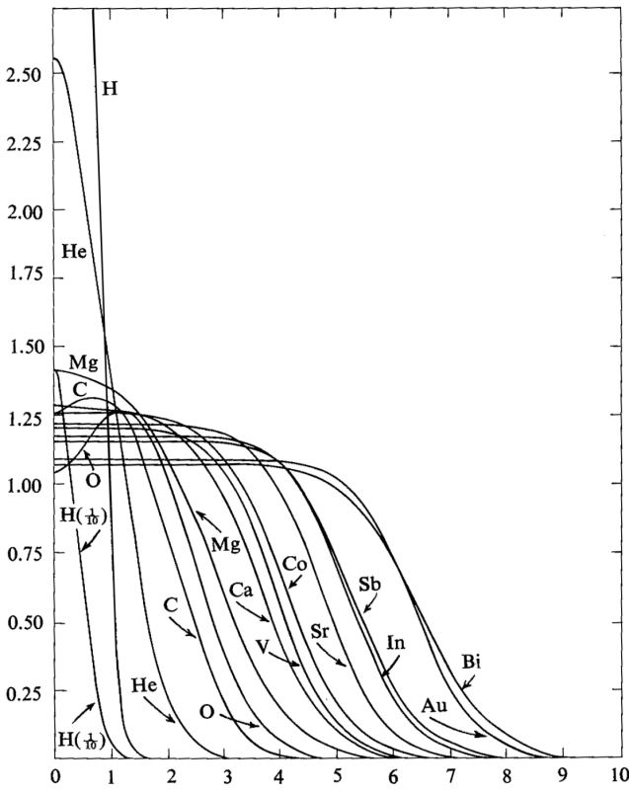


Reminder: Nuclear radius
ρ/ρ₀
ρ/ρ₀
1.0
0.9
0.5
0.1
C
R
nuclear radius of a homogenous charge distribution:
$$R_{i}=1.28∙A_{i}^{1/3}−0.76+0.8∙A_{i}^{−1/3} \left[fm\right]$$
nuclear radius of a Fermi charge distribution:
r
$$C_{i}=R_{i}∙\left(1−R_{i}^{−2}\right) \left[fm\right]$$

Slide 24
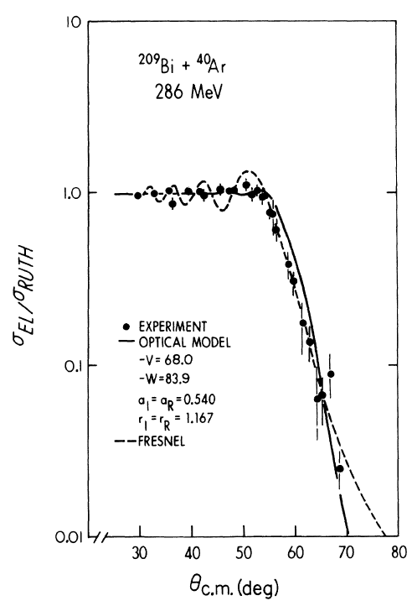
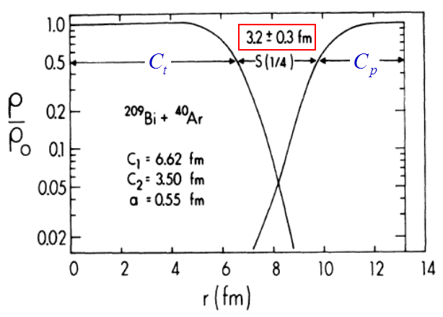




Elastic scattering and the nuclear radius
Nuclear density distributions at the nuclear interaction radius
$$R_{int}=C_{p}+C_{t}+4.49−\frac{C_{p}+C_{t}}{6.35} \left[fm\right]$$
$$C_{i}=R_{i}∙\left(1−R_{i}^{−2}\right) \left[fm\right]$$
$$R_{i}=1.28∙A_{i}^{1/3}−0.76+0.8∙A_{i}^{−1/3} \left[fm\right]$$
θ_{1/4} = 60⁰ → R_{int} = 13.4 [fm]
Nuclear interaction radius: (distance of closest approach)
→ ℓ_{gr} = 152 [ħ]
$$R_{int}=D=a∙\left[\sin^{−1}\frac{θ_{1/4}}{2}+1\right]$$

Slide 25
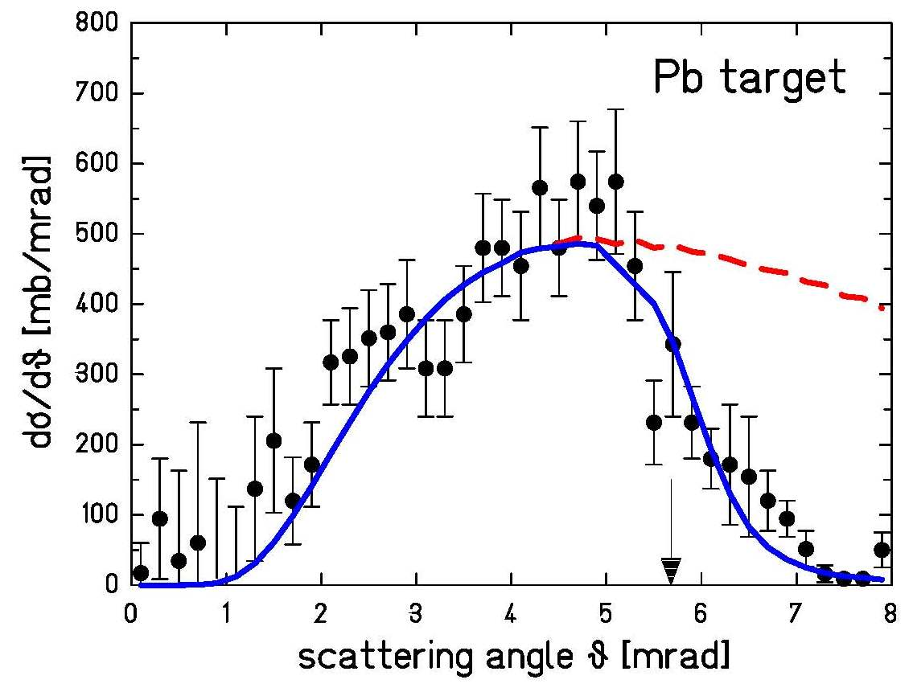
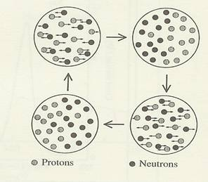
High-energy Coulomb excitation
grazing angle
¹³⁶Xe on ²⁰⁸Pb at 700 MeV/u
excitation of giant dipole resonance
Coulomb ex.
Protons
Neutrons
For relativistic projectiles ( ):
π
ν
A.Grünschloß et al., Phys. Rev. C60 051601 (1999)

Slide 26

High-energy Coulomb excitation
grazing angle
¹³⁶Xe on ²⁰⁸Pb at 700 MeV/u
excitation of giant dipole resonance
Coulomb ex.
Protons
Neutrons
For relativistic projectiles ( ):
π
ν
A.Grünschloß et al., Phys. Rev. C60 051601 (1999)

Slide 27






Elastic scattering and nuclear reactions
impact parameter and scattering angle:
$$b=a∙cot\frac{θ}{2}$$
$$\frac{dσ}{dΩ}=\frac{a^{2}}{4}∙\sin^{−4}\frac{θ}{2}$$
θ_{1/4} = 132⁰
angular momentum and scattering angle:
$$ℓ=η∙cot\frac{θ}{2}$$
$$\frac{dσ}{dℓ}=\frac{2π}{k_{∞}^{2}}∙ℓ$$
distance of closest approach and scattering angle:
ℓ_{gr} = 206 ħ
$$D=a∙\left[\sin^{−1}\frac{θ}{2}+1\right]$$
$$\frac{dσ}{dD}=2π∙\left(D−a\right)$$
R_{int} = 16.2 fm

Slide 28



Elastic scattering and nuclear reactions
impact parameter and scattering angle:
$$b=a∙cot\frac{θ}{2}$$
$$σ_{reaction}={2πa}^{2}∙\left[{\left(1−cos{ θ}_{1/4}^{cm}\right)}^{−1}−0.5\right]$$
θ_{1/4} = 132⁰
a = 7.73 fm
angular momentum and scattering angle:
$$ℓ=η∙cot\frac{θ}{2}$$
$$σ_{reaction}=\frac{π}{k_{∞}^{2}}∙ℓ_{gr}\left(ℓ_{gr}+1\right)$$
distance of closest approach and scattering angle:
ℓ_{gr} = 206 ħ
k∞ = 59.9 fm⁻¹
$$D=a∙\left[\sin^{−1}\frac{θ}{2}+1\right]$$
$$σ_{reaction}=π∙R_{int}^{2}∙\left(1−\frac{V_{C}\left(R_{int}\right)}{E_{cm}}\right)$$
R_{int} = 16.2 fm
V_{C}(R_{int}) = 656 MeV

Slide 29


Classification of heavy ion collisions
partial cross section vs. angular momentum

