Slide 1

Outline: Cyclotron
Lecturer: Hans-Jürgen Wollersheim
e-mail: h.j.wollersheim@gsi.de
web-page: https://web-docs.gsi.de/~wolle/ and click on
radio-frequency accelerator
cyclotron history
electromagnetic forces on charged particles
cyclotron frequency and K-value
cyclotron limits

Slide 2
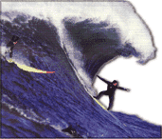
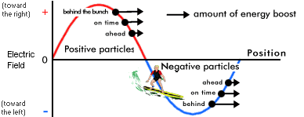
Radio-frequency (RF) accelerators
Key idea: using rapidly changing high frequency voltages instead of electrostatic voltages avoids corona formation and discharge
→ much higher accelerating voltages possible
But: particles must have the correct phase relation to the accelerating voltage
But: need high power RF sources!

Slide 3
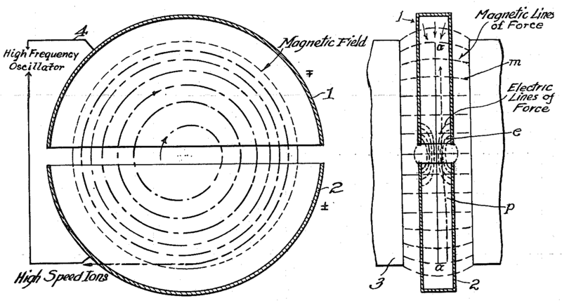




Cyclotron (1930)
side view
top view
A charged particle in a uniform magnetic field will follow a circular path of radius
$$ρ=\frac{p}{q∙B}≈\frac{m∙v}{q∙B} \left(v≪c\right)$$
$$f=\frac{v}{2∙π∙ρ}=\frac{q∙B}{2∙π∙m} \left(constant‼!\right)$$
would not work for electrons
“cyclotron frequency”
$$ω_{s}=2∙π∙f=\frac{q∙B}{m}$$
For a proton:
$$f_{c}=15.2∙B\left[T\right] MHz$$
i.e. “RF” range
Accelerating “DEES”: by applying a voltage which oscillates at f_{c}, we can accelerator the particle a little bit each time around, allowing us to get to high energies with a relatively small voltage.

Slide 4
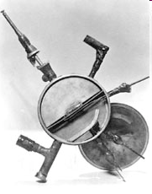
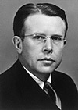
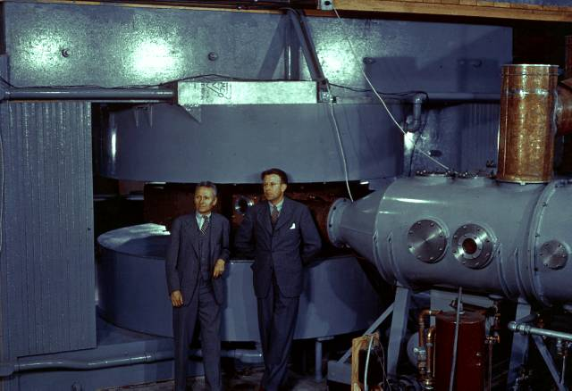
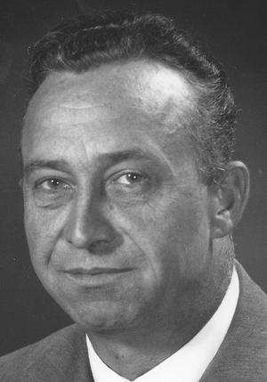
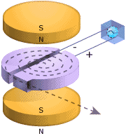
The first Cyclotron 1930
1930: Lawrence proposed the cyclotron
(before he developed a workable color TV screen)
1931: Lawrence and Livingston built first
cyclotron (80 keV)
1932: Lawrence and Livingston used a
cyclotron for 1.25 MeV protons and
mentioned longitudinal (phase) focusing
Ernest O. Lawrence
(1901-1958)
M. Stanley Livingston
(1905-1986)
1935: 60“ cyclotron

Slide 5



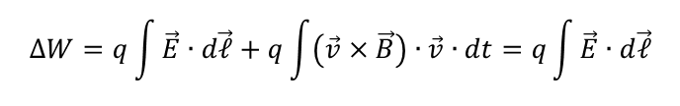
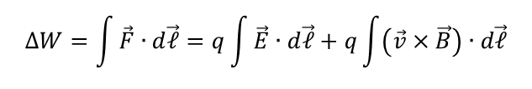
Electromagnetic forces on charged particles
Lorentz force equation gives the force in response to electric and magnetic fields:
The equation of motion becomes:
The kinetic energy of a charged particle increases by an amount equal to the work done (work-energy theorem)
$$\vec{F}=q∙\left(\vec{E}+\vec{v}×\vec{B}\right)$$
$$\frac{d\vec{p}}{dt}=\frac{d}{dt}\left(m_{o}γv\right)=q∙\left(\vec{E}+\vec{v}×\vec{B}\right)$$
$$∆W=\int{\vec{F}∙d\vec{ℓ}}=q\int{\vec{E}∙d\vec{ℓ}}+q\int{\left(\vec{v}×\vec{B}\right)∙d\vec{ℓ}}$$
$$∆W=q\int{\vec{E}∙d\vec{ℓ}}+q\int{\left(\vec{v}×\vec{B}\right)∙\vec{v}∙dt=q\int{\vec{E}∙d\vec{ℓ}}}$$

Slide 6

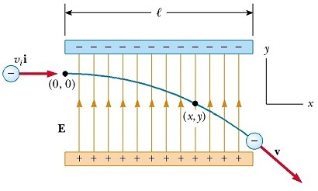





Motion in E and B fields
Governed by Lorentz force:
$$\frac{d\vec{p}}{dt}=q∙\left[\vec{E}+\vec{v}×\vec{B}\right]$$
$$E^{2}={\vec{p}}^{2}c^{2}+{m_{0}}^{2}c^{4}$$
$$⇒ E\frac{dE}{dt}=c^{2}\vec{p}∙\frac{d\vec{p}}{dt}$$
$$⇒ \frac{dE}{dt}=\frac{c^{2}\vec{p}}{E}∙q∙\left(\vec{E}+\vec{v}×\vec{B}\right)=\frac{qc^{2}}{E}∙\vec{p}∙\vec{E}$$
A magnetic field does not alter a particle’s energy. Only an electric field can do this.
Acceleration along a uniform electric field (B = 0):
$$x=v∙t$$
$$y=\frac{1}{2}a∙t^{2}=−\frac{1}{2}\frac{eE}{m}t^{2}$$
parabolic path for v « c

Slide 7
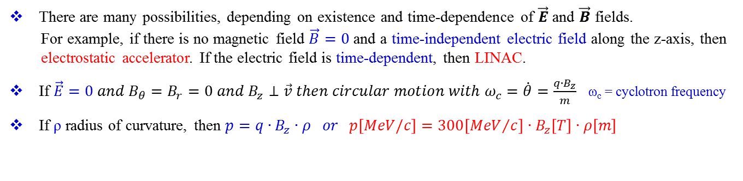
Electromagnetic forces on charged particles
We therefore reach the important conclusion that
- magnetic fields cannot be used to change the kinetic energy of a particle
We must rely on electric fields for particle acceleration
- acceleration occurs along the direction of the electric field
- energy gain is independent of the particle velocity
In accelerators:
- longitudinal electric fields (along the direction of the particle motion)
are used for acceleration
- magnetic fields are used to bend particles for guidance and focusing
There are many possibilities, depending on existence and time-dependence of $\vec{E}$ and $\vec{B}$ fields.
For example, if there is no magnetic field $\vec{B}=0$ and a time-independent electric field along the z-axis, then
electrostatic accelerator. If the electric field is time-dependent, then LINAC.
If $\vec{E}=0 and B_{θ}=B_{r}=0 and B_{z}⊥\vec{v} then circular motion with ω_{c}=\dot{θ}=\frac{q∙B_{z}}{m}$ ω_{c} = cyclotron frequency
If ρ radius of curvature, then $p=q∙B_{z}∙ρ or p\left[MeV/c\right]=300\left[{MeV}/c\right]∙B_{z}\left[T\right]∙ρ\left[m\right]$

Slide 8

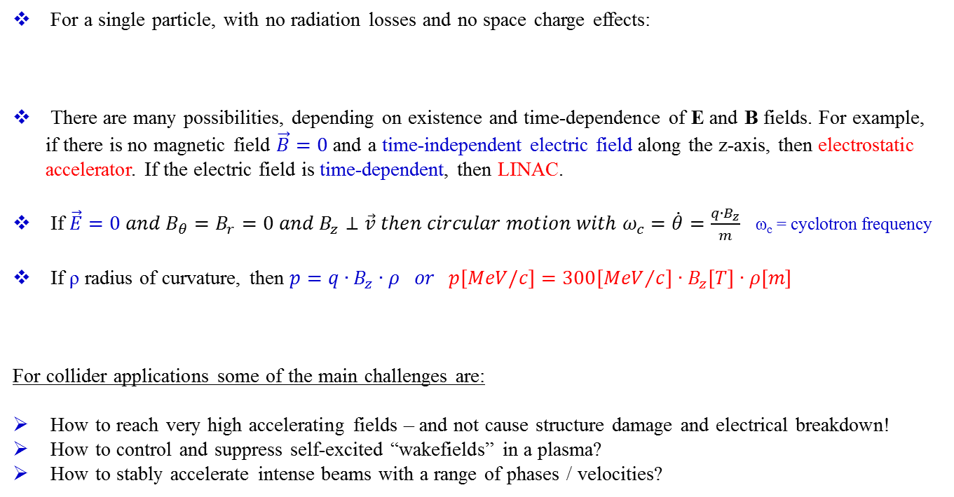
Motion in EM fields
For a single particle, with no radiation losses and no space charge effects:
There are many possibilities, depending on existence and time-dependence of E and B fields. For example, if there is no magnetic field $\vec{B}=0$ and a time-independent electric field along the z-axis, then electrostatic accelerator. If the electric field is time-dependent, then LINAC.
If $\vec{E}=0 and B_{θ}=B_{r}=0 and B_{z}⊥\vec{v} then circular motion with ω_{c}=\dot{θ}=\frac{q∙B_{z}}{m}$ ω_{c} = cyclotron frequency
If ρ radius of curvature, then $p=q∙B_{z}∙ρ or p\left[MeV/c\right]=300\left[{MeV}/c\right]∙B_{z}\left[T\right]∙ρ\left[m\right]$
For collider applications some of the main challenges are:
How to reach very high accelerating fields – and not cause structure damage and electrical breakdown!
How to control and suppress self-excited “wakefields” in a plasma?
How to stably accelerate intense beams with a range of phases / velocities?
$$\frac{d\vec{p}}{dt}=q∙\left(\vec{E}+\vec{v}×\vec{B}\right) (Lorentz)$$

Slide 9
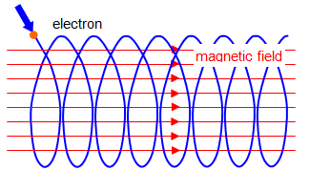
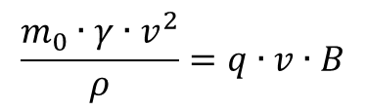




Behavior under constant B-field
Motion in a uniform, constant magnetic field
Constant energy with spiraling along a uniform magnetic field
$$\frac{m_{0}∙γ∙v^{2}}{ρ}=q∙v∙B$$
$$\left(a\right) ρ=\frac{m_{0}∙γ∙v}{q∙B}$$
$$ρ=\left|\frac{p}{q∙B}\right|$$
helical motion
$$\left(b\right) ω=\frac{v}{ρ}=\frac{q∙B}{m_{0}∙γ}$$
$$ω=\frac{q∙B∙c^{2}}{E}=\frac{v}{ρ}$$

Slide 11
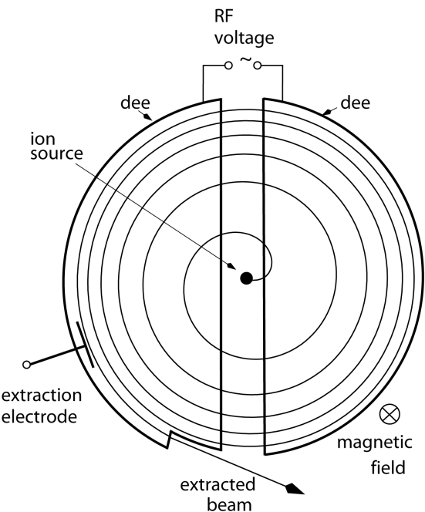
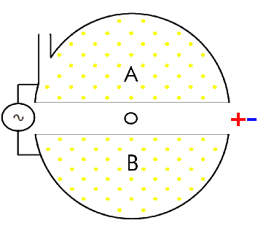
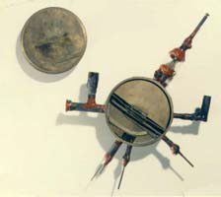
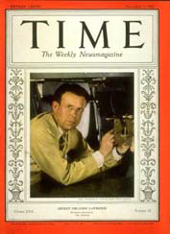
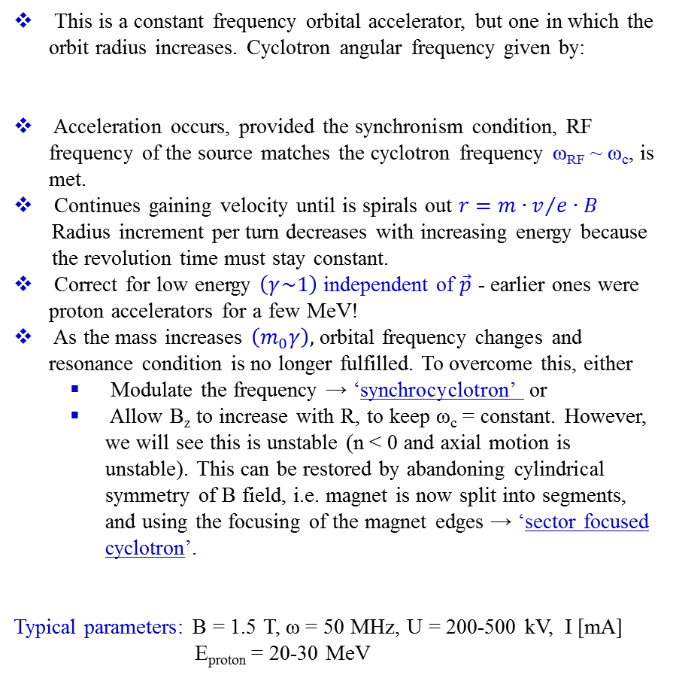
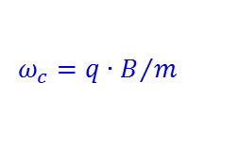
The Cyclotron
This is a constant frequency orbital accelerator, but one in which the orbit radius increases. Cyclotron angular frequency given by:
Acceleration occurs, provided the synchronism condition, RF frequency of the source matches the cyclotron frequency ω_{RF} ~ ω_{c}, is met.
Continues gaining velocity until is spirals out $r={m∙v}/{e∙B}$
Radius increment per turn decreases with increasing energy because
the revolution time must stay constant.
Correct for low energy $\left(γ\sim 1\right)$ independent of $\vec{p}$ - earlier ones were proton accelerators for a few MeV!
As the mass increases $\left(m_{0}γ\right),$orbital frequency changes and resonance condition is no longer fulfilled. To overcome this, either
  Modulate the frequency → ‘synchrocyclotron’ or
  Allow B_{z} to increase with R, to keep ω_{c} = constant. However, we will see this is unstable (n < 0 and axial motion is unstable). This can be restored by abandoning cylindrical symmetry of B field, i.e. magnet is now split into segments, and using the focusing of the magnet edges → ‘sector focused cyclotron’.
Typical parameters: B = 1.5 T, ω = 50 MHz, U = 200-500 kV, I [mA]
E_{proton} = 20-30 MeV
$$ω_{c}={q∙B}/m$$
independent of particle velocity
First successful cyclotron, 4-5 inch model built by Lawrence and Livingston, 1929
Lawrence on the cover of Time magazine, 1937

Slide 12
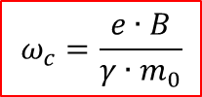
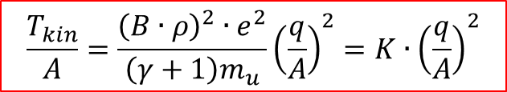


Basics – Cyclotron frequency and K-value
Cyclotron frequency (homogenous) B-field
$$ω_{c}=\frac{e∙B}{γ∙m_{0}}$$
Cyclotron K-value
  K is the relativistic kinetic energy reached for protons from bending strength:
  K can be used to rescale the energy reach of protons to other charge-to-mass ratios (q/A)
  K in [MeV] is often used for naming cyclotrons
  example: K-130 cyclotron, Jyväskylä
$$p^{2}={m_{0}}^{2}c^{2}\left(γ^{2}−1\right)=m_{0}∙m_{0}c^{2}\left(γ−1\right)\left(γ+1\right)=m_{0}T_{kin}\left(γ+1\right)$$
$${→ T}_{kin}=\frac{p^{2}}{m_{0}\left(γ+1\right)}$$
$$\frac{T_{kin}}{A}=\frac{p^{2}}{\left(γ+1\right)m_{u}}∙\frac{1}{A^{2}}=\frac{B^{2}∙ρ^{2}∙q^{2}}{\left(γ+1\right)m_{u}}∙\frac{1}{A^{2}}$$
$$\frac{T_{kin}}{A}=\frac{{\left(B∙ρ\right)}^{2}∙e^{2}}{\left(γ+1\right)m_{u}}{\left(\frac{q}{A}\right)}^{2}=K∙{\left(\frac{q}{A}\right)}^{2}$$

Slide 13
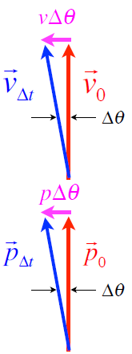

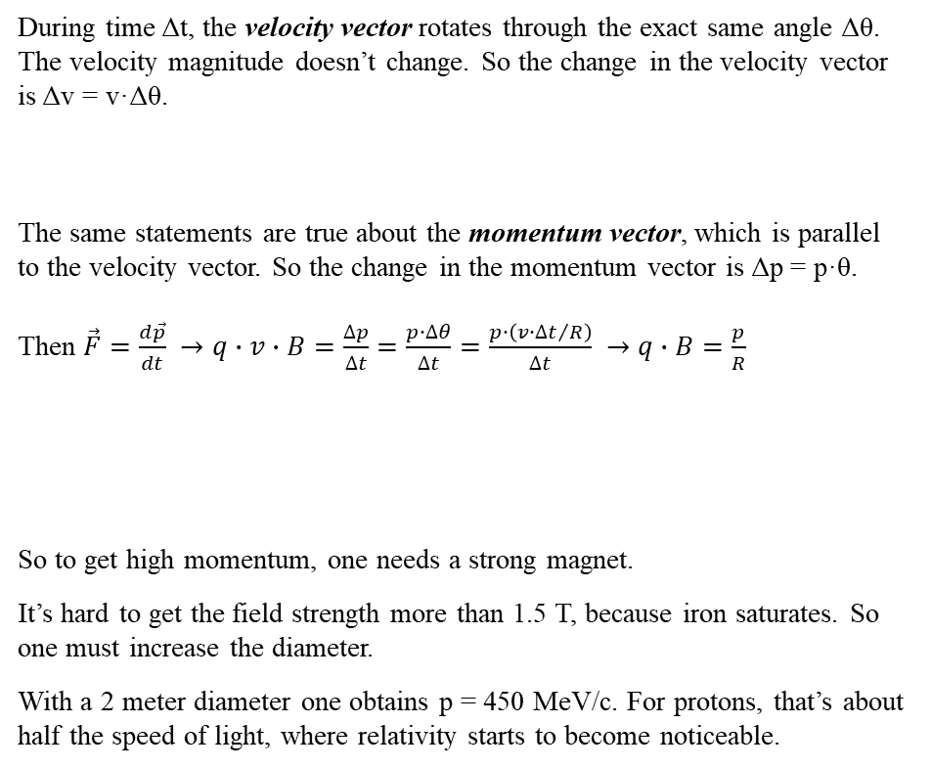

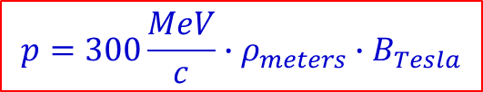
Orbit in uniform magnetic field
During time Δt, the velocity vector rotates through the exact same angle Δθ. The velocity magnitude doesn’t change. So the change in the velocity vector is Δv = v·Δθ.
The same statements are true about the momentum vector, which is parallel to the velocity vector. So the change in the momentum vector is Δp = p·θ.
Then $\vec{F}=\frac{d\vec{p}}{dt} →q∙v∙B=\frac{∆p}{∆t}=\frac{p∙∆θ}{∆t}=\frac{p∙\left({v∙∆t}/R\right)}{∆t} →q∙B=\frac{p}{R}$
So to get high momentum, one needs a strong magnet.
It’s hard to get the field strength more than 1.5 T, because iron saturates. So one must increase the diameter.
With a 2 meter diameter one obtains p = 450 MeV/c. For protons, that’s about half the speed of light, where relativity starts to become noticeable.
$$p=300\frac{MeV}{c}∙ρ_{meters}∙B_{Tesla}$$
beam “rigidity” = $B∙ρ$

Slide 14
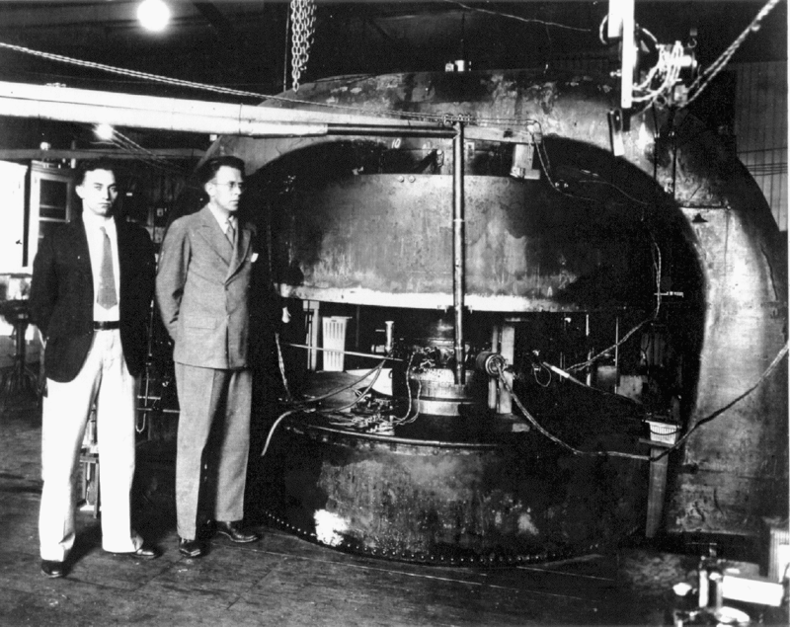
27-inch Cyclotron with Lawrence and Livingstone

Slide 15
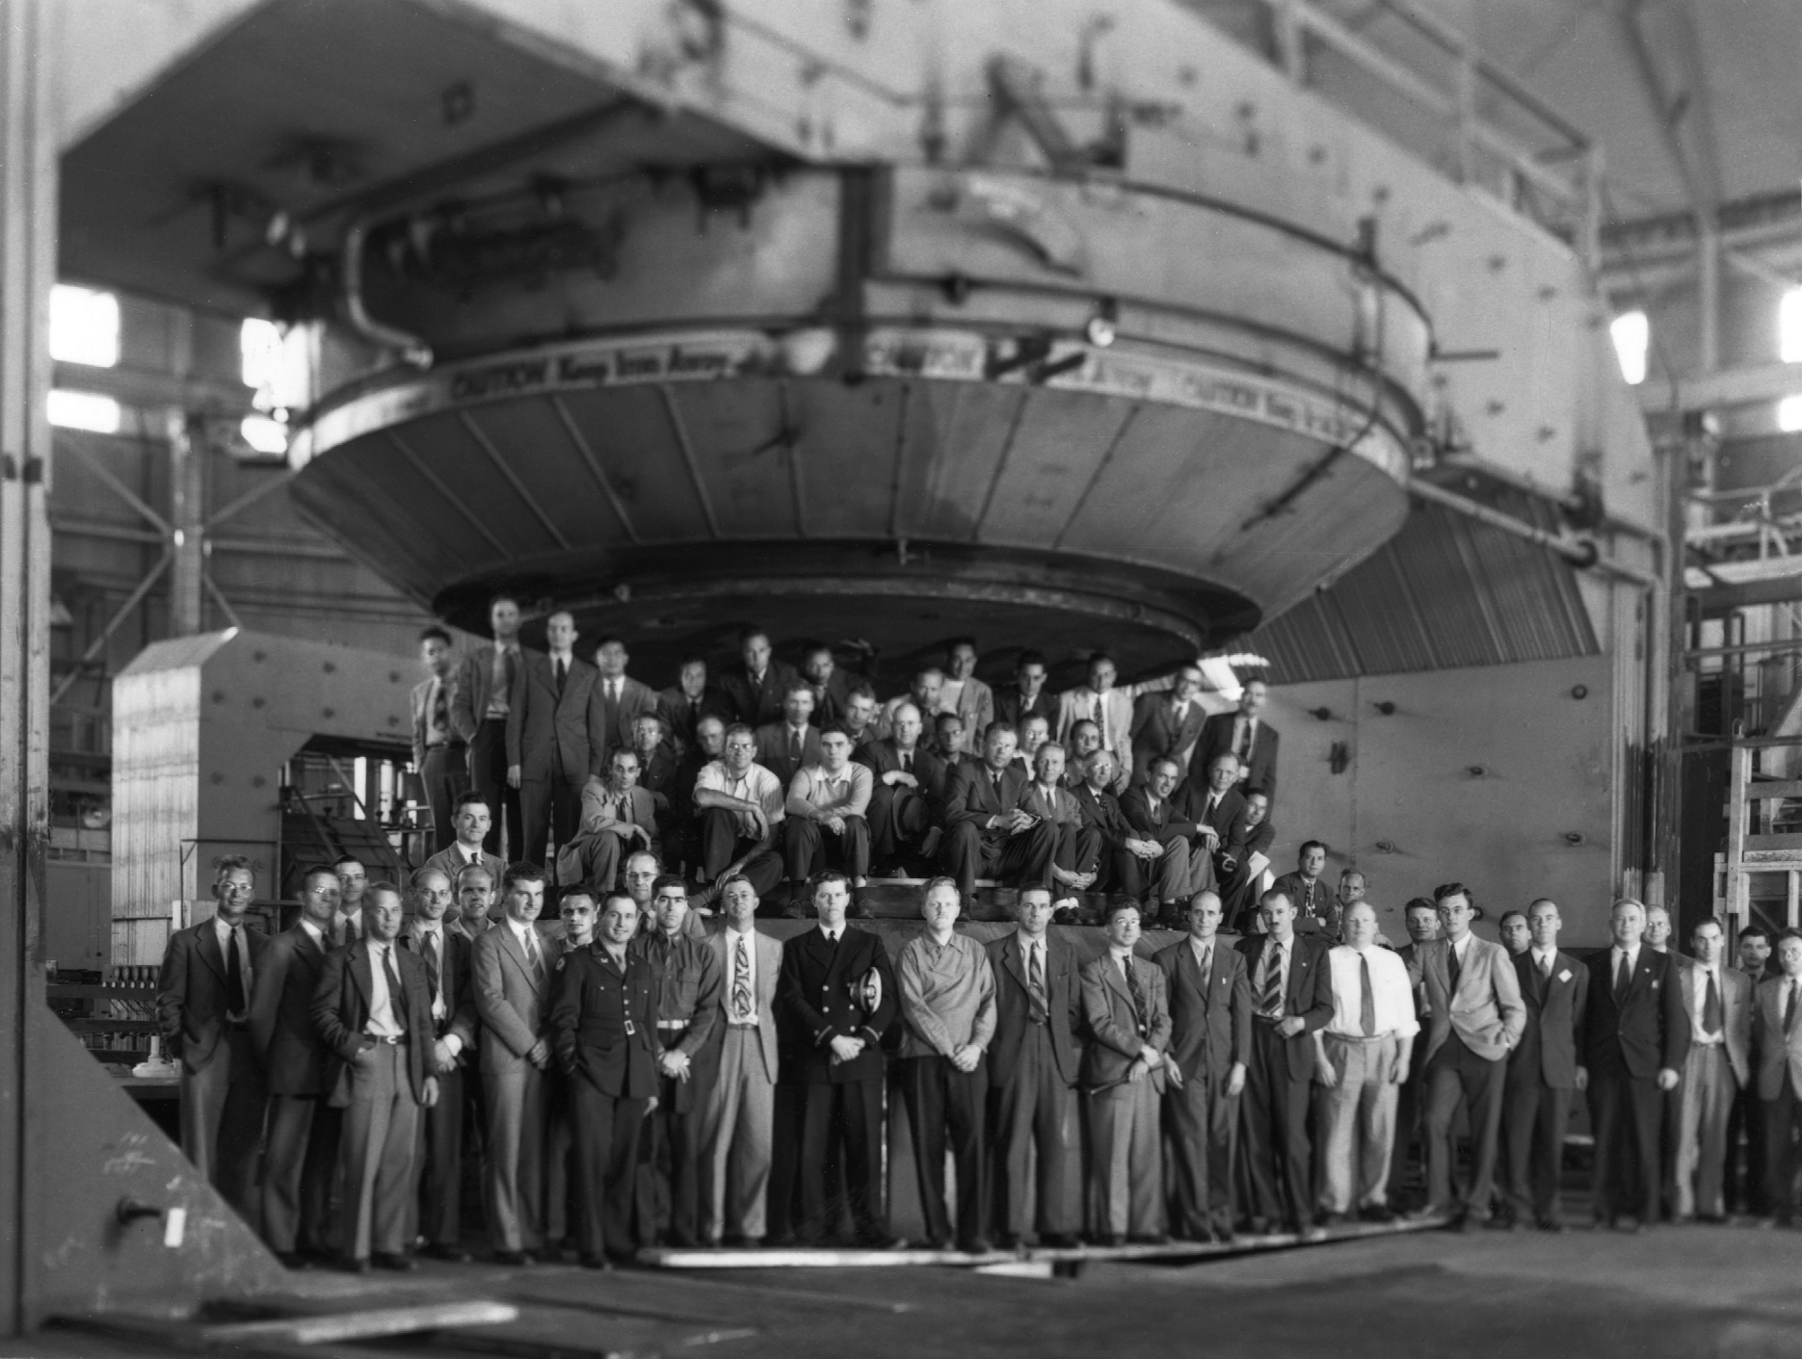
184-inch Cyclotron Magnet in Berkeley

Slide 16
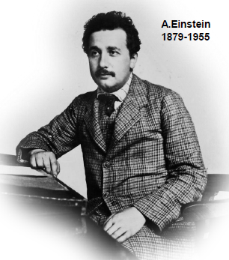


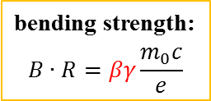
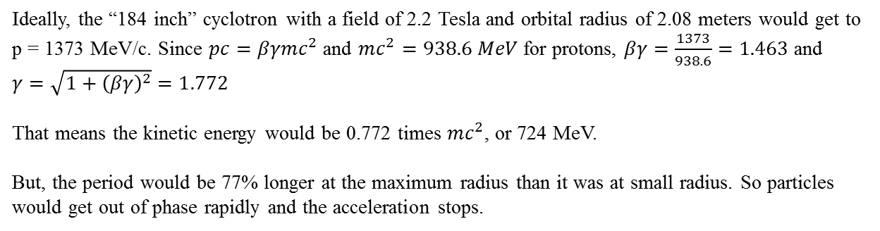



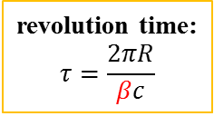
Cyclotron Limits
energy
$$E=γ∙E_{0}$$
kinetic energy:
$$E_{kin}=\left(γ−1\right)∙E_{0}$$
velocity
momentum
$$v=βc$$
$$p=βγ∙m_{0}c$$
revolution time:
$$τ=\frac{2πR}{βc}$$
bending strength:
$$B∙R=βγ\frac{m_{0}c}{e}$$
Ideally, the “184 inch” cyclotron with a field of 2.2 Tesla and orbital radius of 2.08 meters would get to p = 1373 MeV/c. Since $pc=βγmc^{2}$ and $mc^{2}=938.6 MeV$ for protons, $βγ=\frac{1373}{938.6}=1.463$ and $γ=\sqrt{1+{\left(βγ\right)}^{2}}=1.772$
That means the kinetic energy would be 0.772 times $mc^{2}$, or 724 MeV.
But, the period would be 77% longer at the maximum radius than it was at small radius. So particles would get out of phase rapidly and the acceleration stops.

Slide 17
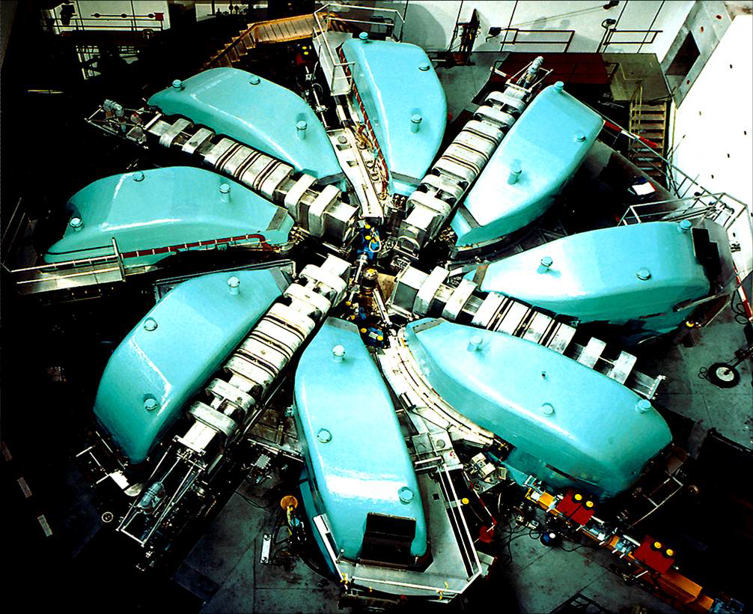
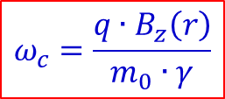

Sector Focusing Cyclotron - PSI
In case $γ>1:$
$$ω_{c}=\frac{q∙B_{z}\left(r\right)}{m_{0}∙γ}$$
K = 592 MeV
I = 2 mA
1.3 MW

Slide 18
Beam parameter
Compare Fermilab (K = 400 MeV) to LHC (K = 7000 GeV)
Parameter | Symbol | Equation | Injection | Extraction
proton mass | m [GeV/c²] |  | 0.938
kinetic energy | K [GeV] |  | .4 | 7000
total energy | E [GeV] |  | 1.3382 | 7000.938
momentum | p [GeV/c] |  | 0.95426 | 7000.938
rel. beta | β |  | 0.713 | 0.999999991
rel. gamma | γ |  | 1.426 | 7461.5
beta-gamma | βγ |  | 1.017 | 7461.5
rigidity | (Bρ) [T-m] |  | 3.18 | 23353.
This would be the radius of curvature in a 1 T magnetic field or the field in Tesla needed to give a 1 m radius of curvature.

Slide 19
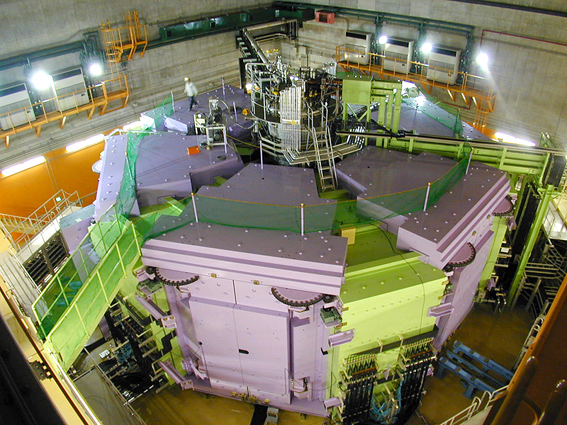
RIKEN – Superconducting Cyclotron (K-2600)

Slide 20
RIKEN – Nishina Center

Slide 21
Pro and contra cyclotrons
pro: • compact and simple design
• efficient power transfer
• only few resonators and amplifiers needed
con: • injection/extraction critical
• energy limited to 1GeV
• complicated bending magnets
• elaborate tuning required
other: • naturally CW operation

