Slide 1

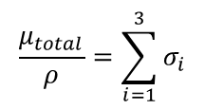
Interaction of gamma rays with matter
Aluminum
Lead
total absorption coefficient: μ/ρ [cm²/g]
i=1 photoelectric effect
i=2 Compton scattering
i=3 pair production

Slide 2
Mass dependence of X-ray absorption
For X-ray radiation the photoelectric effect is the most important interaction.
Lead absorbs more than Beryllium!
₈₂Pb serves as shielding for X-ray and γ-ray radiation; lead vests are used by medical staff people who are exposed to X-ray radiation. Co-sources are transported in thick lead container.
On the contrary:
₄Be is often used as windows in X-ray tubes to allow for almost undisturbed transmission of X-ray radiation.

Slide 3
Mass dependence μ/ρ of X-ray absorption
wave length dependence for Pt as absorber
element number dependence for λ=0.1 nm or 12.4 keV

Slide 4
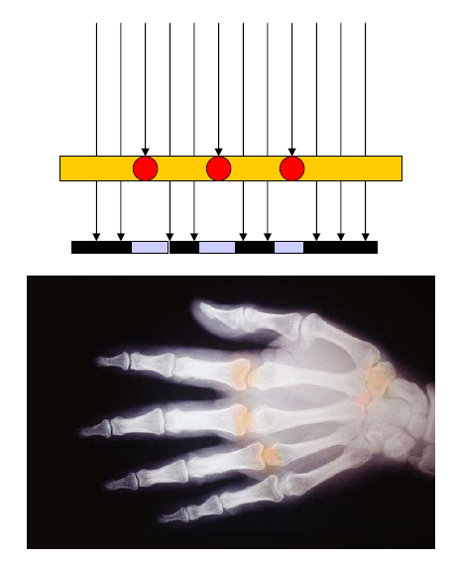
X-ray image shows the effect of different absorptions
Bones absorb more radiation as tissues because of their higher ₂₀Ca content

Slide 5
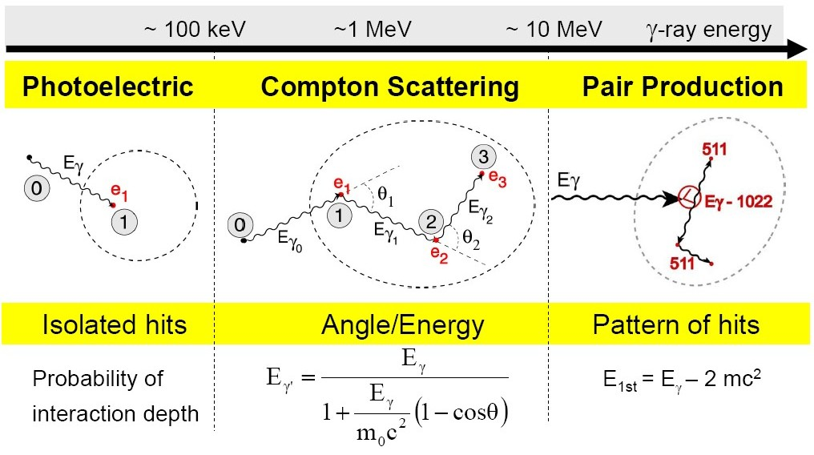
Interaction of gamma rays with matter

Slide 6
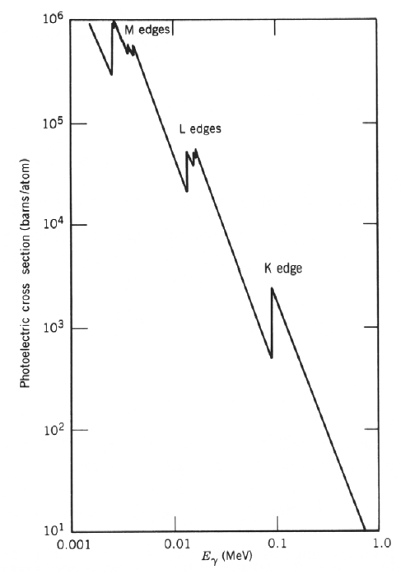
Interaction of gamma rays with matter
Photo effect:
Absorption of a photon by a bound electron and conversion of the γ-energy in potential and kinetical energy of the ejected electron.
(Nucleus preserves the momentum conservation.)

Slide 7
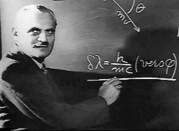




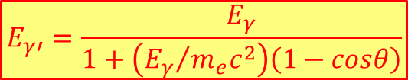


Interaction of gamma rays with matter
relativistic
$$E^{2}={\left(pc\right)}^{2}+{\left(m_{0}c^{2}\right)}^{2}$$
$$photons: m_{0}=m_{γ}=0$$
$$→E_{γ}=p_{γ}c$$
Momentum balance:
$$\vec{p_{e}}=\vec{p_{γ}}−\vec{{p′}_{γ}} → {\left|\vec{p_{e}}c\right|}^{2}={\left|\left(\vec{p_{γ}}−\vec{{p′}_{γ}}\right)c\right|}^{2}$$
$$p_{e}^{2}c^{2}=E_{γ}^{2}+E_{γ′}^{2}−2E_{γ}E_{γ′}∙cosθ$$
Energy balance:
Compton scattering:
Elastic scattering of a γ-ray on a free electron. A fraction of the γ-ray energy is transferred to the Compton electron. The wave length of the scattered γ-ray is increased: λ‘ > λ.
$$E_{γ}+m_{e}c^{2}=E_{γ′}+\sqrt{{\left(p_{e}c\right)}^{2}+{\left(m_{e}c^{2}\right)}^{2}}$$
$$E_{γ′}=\frac{E_{γ}}{1+\left({E_{γ}}/{m_{e}c^{2}}\right)\left(1−cosθ\right)}$$

Slide 8
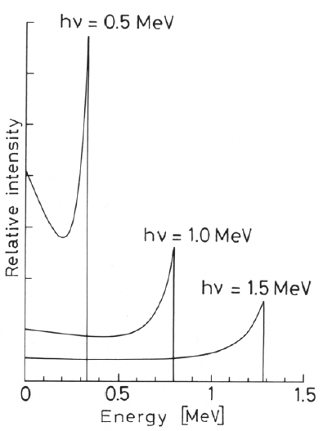
Interaction of gamma rays with matter
Maximum energy of the
scattered electron:
Energy of the scattered
γ-photon:
Special case for E>>m_{e}c²:
γ-ray energy after 180⁰ scatter
is approximately
Compton scattering:
Elastic scattering of a γ-ray on a free electron. A fraction of the γ-ray energy is transferred to the Compton electron. The wave length of the scattered γ-ray is increased: λ‘ > λ.
Gap between the incoming γ-ray and the maximum electron energy.

Slide 9
Interaction of gamma rays with matter
σ_{Compton}
Compton scattering:
Elastic scattering of a γ-ray on a free electron. A fraction of the γ-ray energy is transferred to the Compton electron. The wave length of the scattered γ-ray is increased: λ‘ > λ.

Slide 10
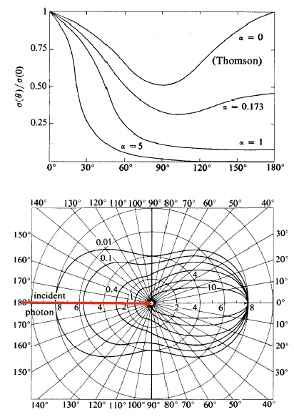
Interaction of gamma rays with matter
Intensity as a function of θ:
$$α={E_{γ}}/{m_{e}c^{2}}$$
Angular distribution:
Compton scattering:
Elastic scattering of a γ-ray on a free electron.
The angle dependence is expressed by the
Klein-Nishina-Formula:
As shown in the plot forward scattering (θ small) is dominant for E_{γ}>100 keV.
MeV
$$\frac{dσ_{c}}{dΩ}=\frac{r_{0}^{2}}{2}{\left(\frac{E_{γ′}}{E_{γ}}\right)}^{2}∙\left\{\frac{E_{γ}}{E_{γ′}}+\frac{E_{γ′}}{E_{γ}}−2\sin^{2}θ∙\cos^{2}φ\right\}$$
r₀=2.818 fm (classical electron radius)

Slide 11
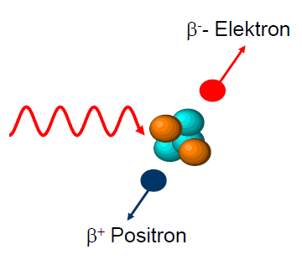
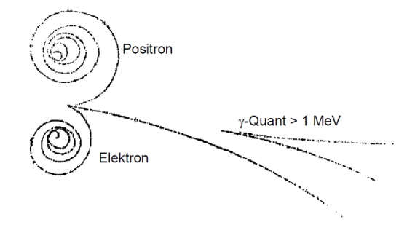
Interaction of gamma rays with matter
Pair production:
If γ-ray energy is >> 2m₀c² (electron rest mass 511 keV), a positron-electron pair can be formed in the strong Coulomb field of a nucleus. This pair carries the γ-ray energy minus 2m₀c².
Pair production for E_{γ}>2m_{e}c²=1.022MeV
e⁻
γ-ray > 1 MeV
γ’s
magnetic field
picture of a bubble chamber

Slide 12
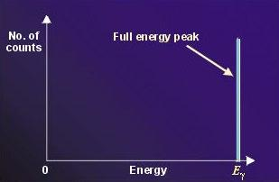
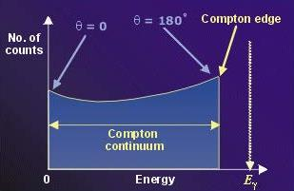
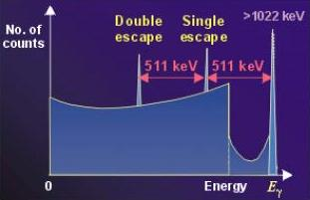
Interaction of gamma rays with matter
γ-rays interaction with matter via three main reaction mechanisms:
Photoelectric absorption
Compton scattering
Pair production

Slide 13
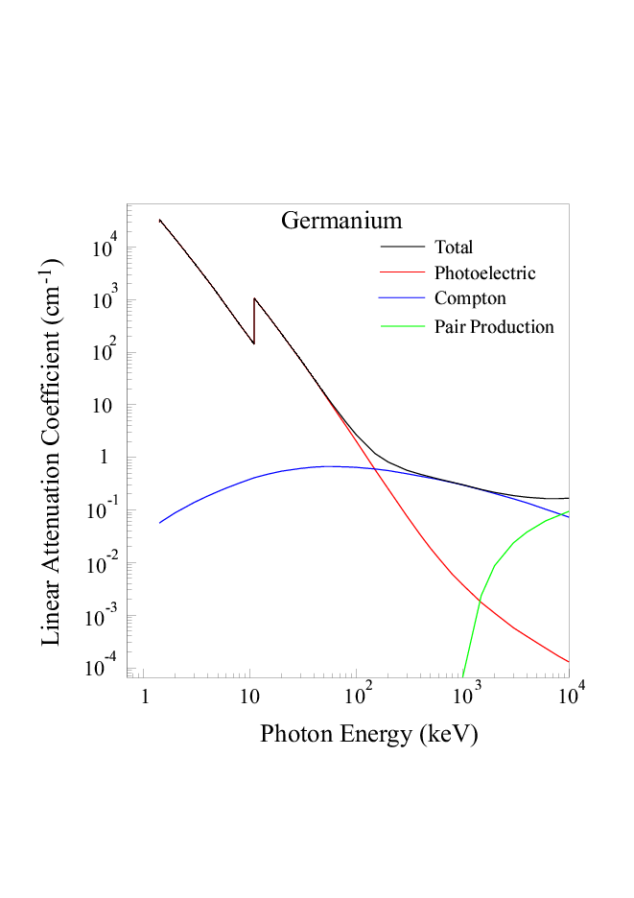
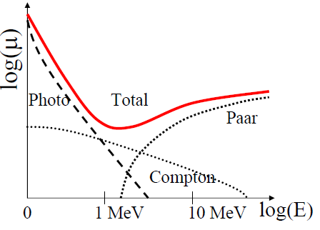
Gamma-ray interaction cross section
All three interaction (photo effect, Compton scattering and pair production) lead to an attenuation of the γ-ray or X-ray radiation when passing through matter. The particular contribution depends on the γ-ray energy:
The absorption attenuates the intensity, but the energy and the frequency of the γ-ray and X-ray radiation is preserved!
Photo effect: ~Z⁴⁻⁵, E_{γ}^{-3.5}
Compton: ~Z, E_{γ}⁻¹
Pair: ~Z², increases with E_{γ}

Slide 14
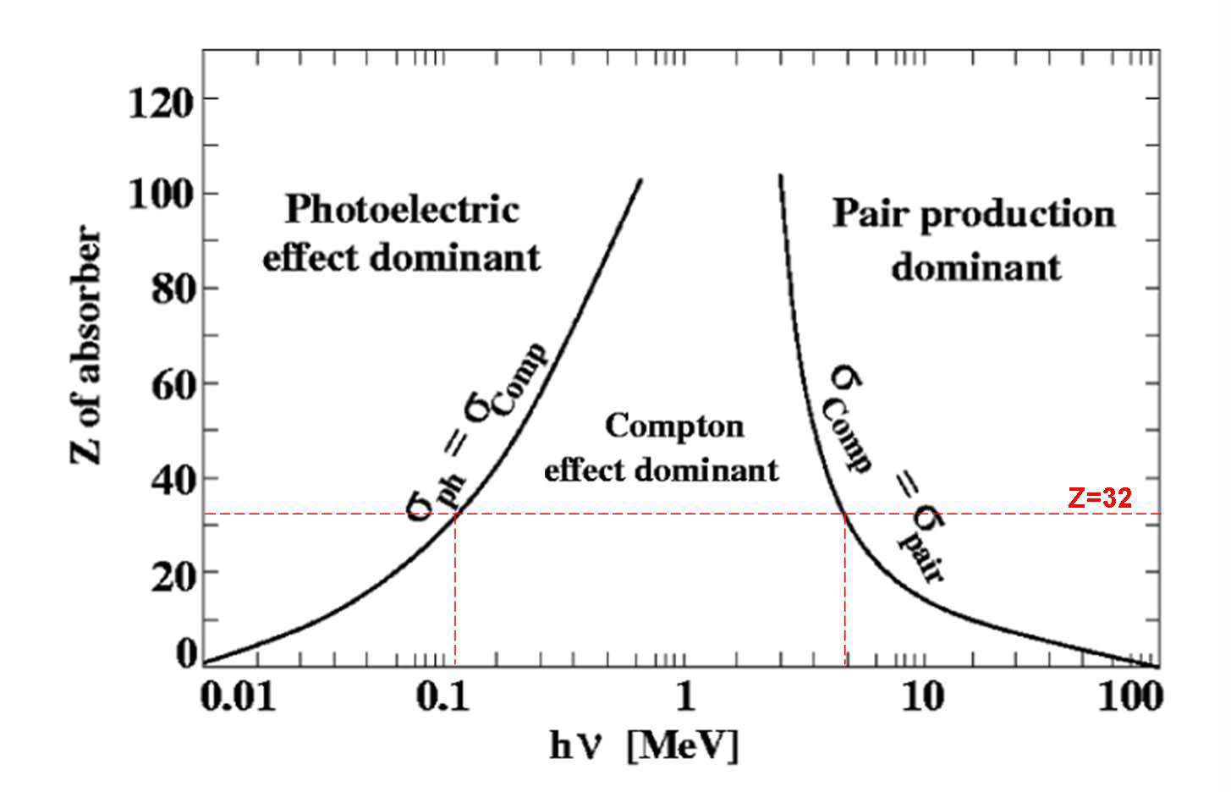
Z dependence of interaction probabilities

Slide 15
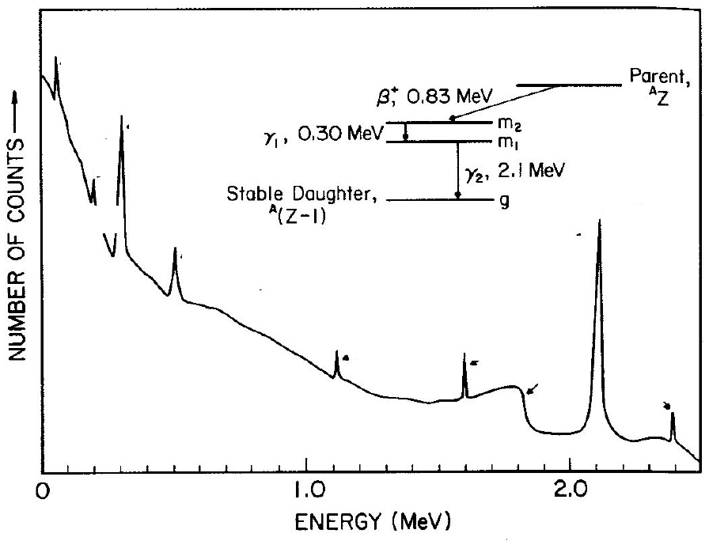
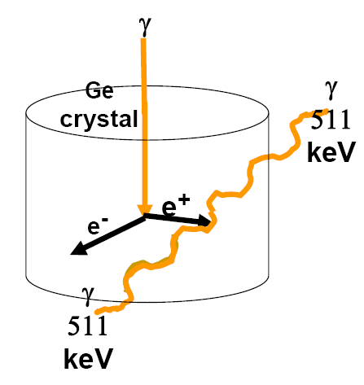
Gamma-ray spectrum of a radioactive decay
Pb-Box
Pb X-ray
γ₁
BSc
γ₂
511 keV
DE γ₂
SE γ₂
CE γ₂
γ₁+γ₂

