Slide 1
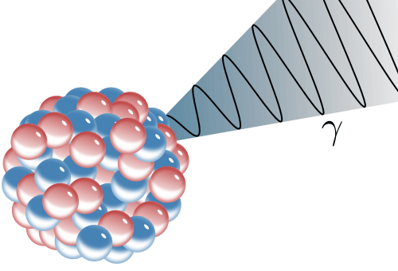
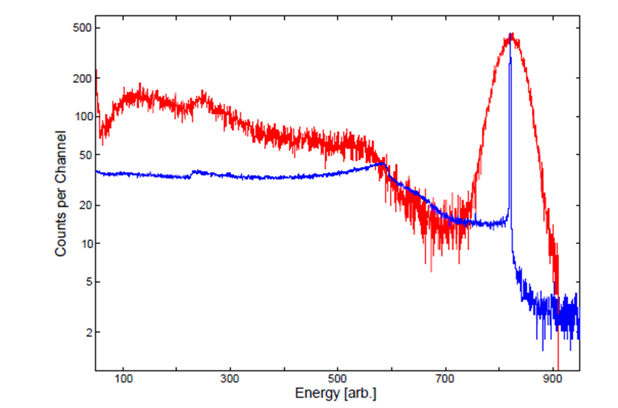
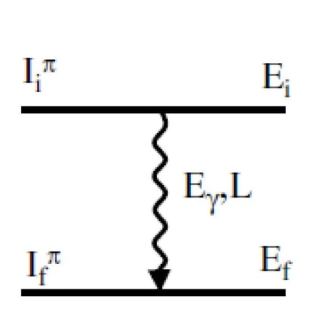
Building a level scheme: γ-decay
Gamma-ray emission is usually the dominant decay mode
Measurements of γ-rays let us deduce:
Energy, Spin (angular distr. / correl.), Parity (polarization), magnetic moment,
lifetime (recoil distance, Doppler shift), …
of the involved nuclear levels.
¹³⁷Cs detected in red: NaI scintillator
blue: HPGe (high purity Ge semiconductor)
$${}_{Z}^{A}{X_{N}^{∗}}→{}_{Z}^{A}{X_{N}^{\left(∗\right)}}$$

Slide 2
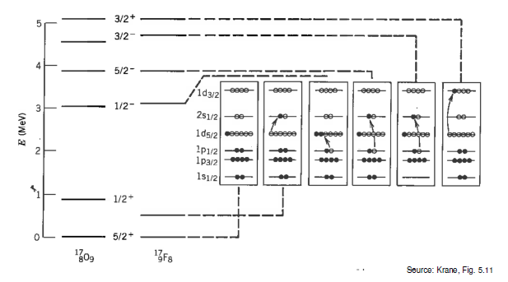
γ-decay in a Nutshell
The photon emission of the nucleus essentially results from a re-ordering of nucleons within the shells.
This re-ordering often follows α or β decay, and moves the system into a more energetically favorable state.

Slide 3
γ-decay
γ-spectroscopy yields some of the most precise knowledge of nuclear structure, as spin, parity and ΔE are all measurable.
Transition rates between initial $Ψ_{N}^{∗}$ and final $Ψ_{N}^{´}$ nuclear states, resulting from electromagnetic decay producing a photon with energy $E_{γ}$ can be described by Fermi´s Golden rule:
where $ℳ_{em}$ is the electromagnetic transition operator and ${dn_{γ}}/{dE_{γ}}$ is the density of final states. The photon wave function $ψ_{γ}$ and $ℳ_{em}$ are well known, therefore measurements of λ provide detailed knowledge of nuclear structure.
$$λ=\frac{2π}{ℏ}{\left|\left\langle Ψ_{N}^{´}ψ_{γ} | ℳ_{em} | Ψ_{N}^{∗}\right\rangle \right|}^{2}\frac{dn_{γ}}{dE_{γ}}$$
A γ-decay lifetime is typically 10⁻¹² [s] and sometimes even as short as 10⁻¹⁹ [s]. However, this time span is an eternity in the life of an excited nucleon. It takes about 4·10⁻²² [s] for a nucleon to cross the nucleus.

Slide 4
Building a level scheme Christopher J. Chiara
Level and γ properties
Measured E_{γ}’s → level energies
Efficiency-corrected γ-peak areas → intensities, branching ratios, level populations
γ ADs/ACs, γ polarizations, internal conversion → multipolarity → level spin, parity
z
Intensity of EM field (emitted photon) given by Poynting vector, which depends on spherical harmonics Y_{lm}(θ,ϕ), where θ is relative to quantization axis
θ
AD: angular distribution, AC: angular correlation

Slide 5
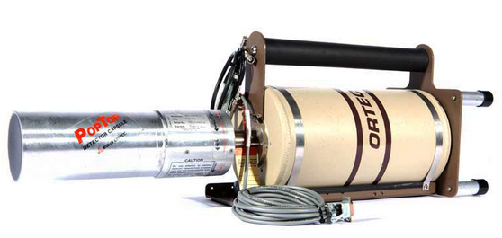
Building a level scheme
Angular distributions
Quantization axis = spin direction
May be known event by event
Reaction plane defines spin vector
z = Î
y
x
b
θ
y
x

Slide 6
Building a level scheme
Angular distributions
Quantization axis = spin direction
May be known event by event
Reaction plane defines spin vector
z = Î
y
x
b
Detect outgoing particle trajectory to determine reaction plane, measure angle ϕ relative to that
φ
y
x
(ϕ is the difference between lab angles ϕ_{γ} and ϕ_{p})

Slide 7
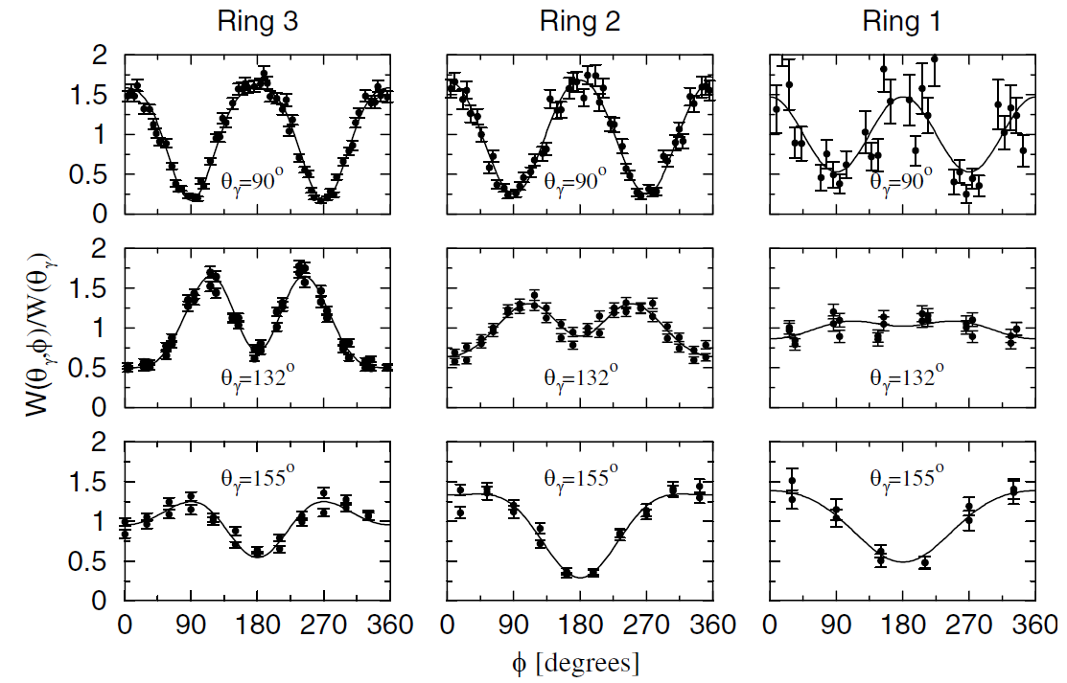
Building a level scheme
Angular distributions
Quantization axis = spin direction
May be known event by event
Reaction plane defines spin vector
z = Î
Stone et al., PRL94, 192501 (2005)
y
x
b
Detect outgoing particle trajectory to determine reaction plane, measure angle ϕ relative to that
φ
y
x
Measure intensity as a function of angle
(ϕ is the difference between lab angles ϕ_{γ} and ϕ_{p})

Slide 8
Building a level scheme
Angular distributions
Quantization axis = spin direction
May be known event by event
…or it may not! What to do then?
$$W\left(θ\right)=\sum_{k=0}^{L}{A_{2k}P_{2k}\left(\cos{θ}\right)}$$
Reaction plane still defines spin vector, even if not determined experimentally
z = Î
y
x
θ
Ensemble of spins perpendicular to beam direction, symmetrically distributed ➔ use beam axis for quantization
y
x
Measure intensity as a function of angle

Slide 9
Building a level scheme
Angular distributions
Quantization axis = spin direction
May be known event by event
…or it may not! What to do then?
$$W\left(θ\right)=\sum_{k=0}^{L}{A_{2k}P_{2k}\left(\cos{θ}\right)}$$
Pure dipole only has P₂ term, quadrupole adds P₄, octupole has P₆, etc.
With M1/E2 mixing, A₄ ≠ 0; mixing ratio δ* can be deduced, providing insight into underlying structure
Strictly speaking, AD in singles; “gated AD”: γγ coincidence with no angle condition on gating γ (clean-up only) → if 4π coverage, same AD as in singles
AD: angular distribution, AC: angular correlation
* δ² = (E2 intensity)/(M1 intensity)

Slide 10
Classical Electrodynamics
The nucleus is a collection of moving charges, which can induce magnetic/electric fields
The power radiated into a small area element is proportional to $\sin^{2}\left(θ\right)$
The average power radiated for an electric dipole is:
$$P=\frac{1}{12πε_{0}}\frac{ω^{4}}{c^{3}}d^{2}$$
For a magnetic dipole is
$$P=\frac{1}{12πε_{0}}\frac{ω^{4}}{c^{5}}μ^{2}$$

Slide 11
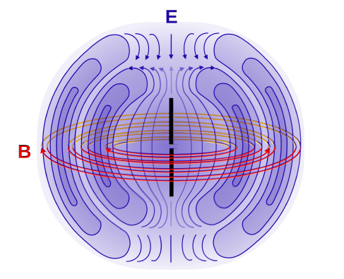
Electric/Magnetic Dipoles
Electric and magnetic dipole fields have opposite parity:
Magnetic dipoles have even parity and electric dipole fields have odd parity.
$$⇒ π\left(Mℓ\right)={\left(−1\right)}^{ℓ+1} and π\left(Eℓ\right)={\left(−1\right)}^{ℓ}$$

Slide 12
Higher Order Multipoles
It is possible to describe the angular distribution of the radiation field as a function of the multipole order using Legendre polynomials.
$ℓ$: The index of radiation
$2^{ℓ}$: The multipole order of the radiation
$ℓ=1 → Dipole$
$ℓ=2 → Quadrupole$
$ℓ=3 → Octupole$
The associated Legendre polynomials $P_{2ℓ}\left(cos\left(θ\right)\right)$ are:
For $ℓ=1: P_{2}=\frac{1}{2}\left(3∙\cos^{2}\left(θ\right)−1\right)$
For $ℓ=2: { P}_{4}=\frac{1}{8}\left(35\cos^{4}\left(θ\right)−30\cos^{2}\left(θ\right)+3\right)$

Slide 13
Angular Momentum in γ-Decay
The photon is a spin-1 boson
Like α-decay and β-decay the emitted γ-ray can carry away units of angular momentum ℓ, which has given us different multipolarities for transitions.
For orbital angular momentum, we can have values $ℓ=0,1,2,3,⋯$ that correspond to our multipolarity.
Therefore, our selection rule is:
$$\left|J_{i}−J_{f}\right|≤ℓ≤\left|J_{i}+J_{f}\right|$$

Slide 14
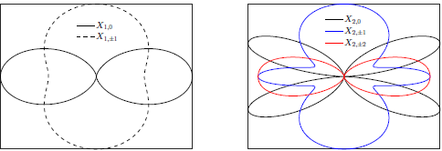
Characteristics of multipolarity
L | multipolarity | π(Eℓ) / π(Mℓ) | angular distribution
1 | dipole | -1 / +1
2 | quadrupole | +1 / -1
3 | octupole | -1 / +1
4 | hexadecapole | +1 / -1
⁞
ℓ = 1
ℓ =2
$$E_{γ}=E_{i}−E_{f}$$
$$\left|I_{i}−I_{f}\right|≤ℓ≤I_{i}+I_{f}$$
$$∆π\left(Eℓ\right)={\left(−1\right)}^{ℓ}$$
$$∆π\left(Mℓ\right)={\left(−1\right)}^{ℓ+1}$$

Slide 15
The basics of the situation
2
ℓ
0
$$\left|2−0\right|≤ℓ≤2+0$$
Here $ΔI=2 and ℓ=2$
this is a stretched transition

Slide 16
The basics of the situation
3
ℓ
2
$$\left|3−2\right|≤ℓ≤3+2$$
Here $ΔI=1 but ℓ=1,2,3,4,5$
and the transition can be a mix of 5 multipolarities

Slide 17
The basics of the situation
$E_{γ}, ℓ, Δπ$
Electromagnetic transitions:
$$Δπ \left(electric\right)= {\left(−1\right)}^{ℓ}$$
$$Δπ \left(magnetic\right)= {\left(−1\right)}^{ℓ+1}$$
$$Δπ$$ | yes | E1 | M2 | E3 | M4
 | no | M1 | E2 | M3 | E4

Slide 18
The basics of the situation
2⁺
ℓ
0⁺
$$\left|2−0\right|≤ℓ≤2+0$$
$$ℓ=2 and no change in parity$$
$$Δπ$$ | yes | E1 | M2 | E3 | M4
 | no | M1 | E2 | M3 | E4

Slide 19
The basics of the situation
3⁺
ℓ
2⁻
$$\left|3−2\right|≤ℓ≤3+2$$
Here $ΔI=1 but ℓ=1,2,3,4,5$
$$Δπ$$ | yes | E1 | M2 | E3 | M4
 | no | M1 | E2 | M3 | E4
mixed E1,M2,E3,M4,E5

Slide 20
The basics of the situation
3⁺
ℓ
2⁺
$$\left|3−2\right|≤ℓ≤3+2$$
Here $ΔI=1 but ℓ=1,2,3,4,5$
$$Δπ$$ | yes | E1 | M2 | E3 | M4
 | no | M1 | E2 | M3 | E4
mixed M1,E2,M3,E4,M5

Slide 21
The basics of the situation
$3^{+}→2^{+}:$ mixed M1,E2,M3,E4,M5
$3^{+}→2^{−}:$ mixed E1,M2,E3,M4,E5
In general only the lowest 2 multipoles compete
and (for reasons we will see later)
$ℓ+1$ multipole generally only competes if it is electric:
$3^{+}→2^{+}:$ mixed M1/E2
$3^{+}→2^{−}:$ almost pure E1 (very little M2 admixture)

Slide 22
Characteristics of multipolarity
L | multipolarity | π(Eℓ) / π(Mℓ) | angular distribution
1 | dipole | -1 / +1
2 | quadrupole | +1 / -1
3 | octupole | -1 / +1
4 | hexadecapole | +1 / -1
⁞
ℓ = 1
ℓ =2
parity: electric multipoles π(Eℓ) = (-1)^{ℓ}, magnetic multipoles π(Mℓ) = (-1)^{ℓ+1}
The power radiated is proportional to:
where σ means either E or M and $ℳ\left(σℓ\right)$ is the E or M multipole moment of the appropriate kind.
$$P\left(σℓ\right)∝\frac{2\left(ℓ+1\right)∙c}{ε_{0}∙ℓ{∙\left[\left(2ℓ+1\right)‼\right]}^{2}}{\left(\frac{ω}{c}\right)}^{2ℓ+2}{\left|ℳ\left(σℓ\right)\right|}^{2}$$

Slide 23
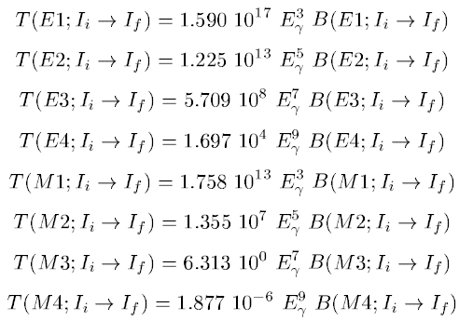
Emission of electromagnetic radiation
where E_{γ} = E_{i} – E_{f} is the energy of the emitted γ quantum in MeV (E_{i}, E_{f} are the nuclear level energies, respectively), and the reduced transition probabilities B(Eℓ) in units of e²(barn)^{ℓ} and B(Mℓ) in units of $μ_{N}^{2}={\left({eℏ}/{2m_{N}c}\right)}^{2} {\left(fm\right)}^{2ℓ−2}$

Slide 24
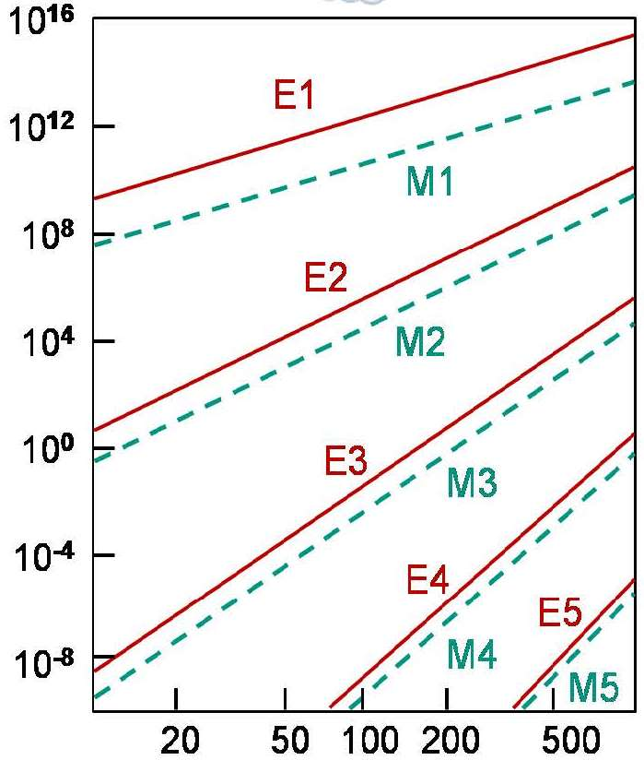
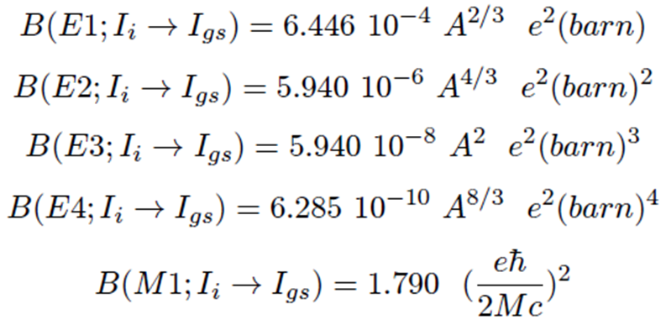
Single particle transition (Weisskopf estimate)
For the first few values of λ, the Weisskopf estimates are
transition probability λ [s⁻¹]
gamma energy E_{γ} [keV]

Slide 25
Measuring g-factors
Angular correlations
Half-lives
g-factors
Stuchbery et al., PRC88, 051304 (2013)
Recoil-in-vacuum (RIV) technique
Nucleus produced in reaction in oriented state
Recoil exits target into vacuum → spin is deoriented by hyperfine interactions
Deorientation dependent on g-factor
$$W\left(θ_{p},θ_{γ},∆φ\right)=1+\sum_{kq}{B_{kq}(θ_{p})Q_{k}G_{k}F_{k}D_{q0}^{k∗}(∆φ,θ_{γ},0)}$$
rotation matrix giving angle dependence of correlation → P(cosθ_{γ})
angles of p(articles) and γ’s
statistical tensor defining initial spin alignment
attenuation factor for finite γ detector size
“usual F coefficients” for ACs/ADs

Slide 26
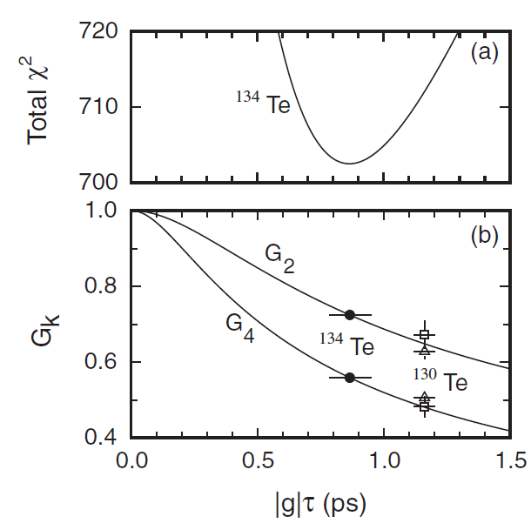
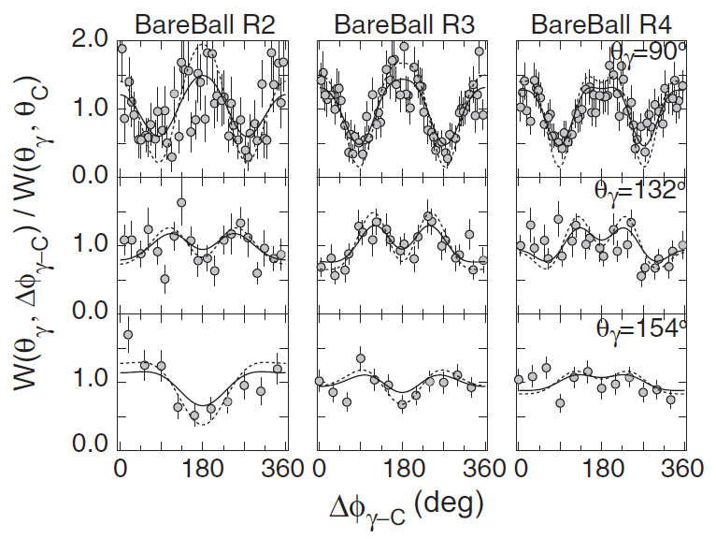
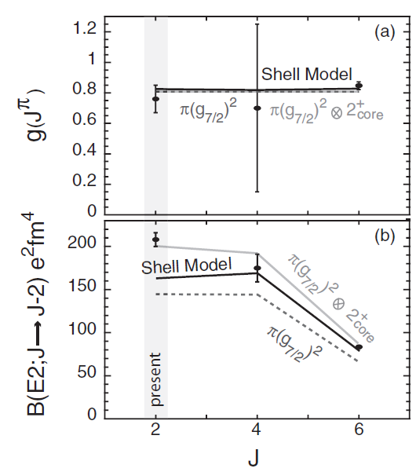
Measuring g-factors
Recoil In Vacuum in ¹³⁴Te
Coulex of ¹³⁴Te RIB (and also ¹³⁰Te SIB)
Simultaneously measure B(E2) and g-factor for 2⁺
Observe attenuated ACs → relate to G_{k} → g-factor
Stuchbery et al., PRC88, 051304 (2013)

Slide 27
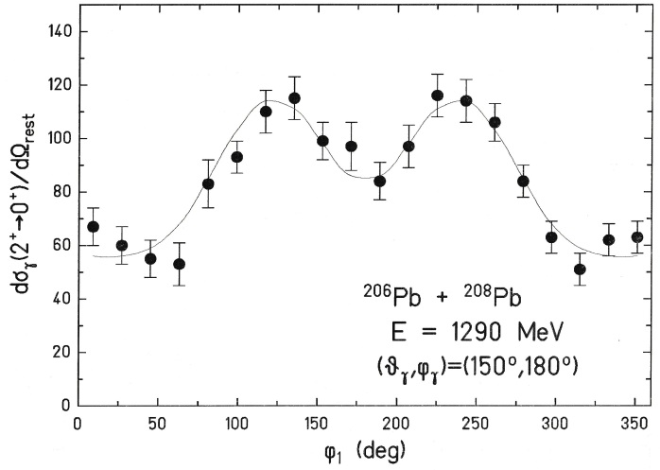
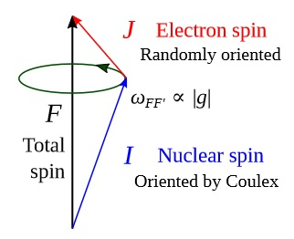
Measuring g-factors
During the collision, the projectile can be firstly excited reaching a certain excited state (I_{f} ).
Before a γ-decay, the scattered projectile and the target recoil nucleus exit the target into the vacuum highly excited and ionized.
At that time, the scattered projectile decays rapidly by gamma emissions. However, the strong fluctuations of the hyperfine fields can lead to a de-orientation of the nuclear state.
particle-γ angular correlation
g(2⁺) = 0 → unperturbed p-γ angular correlation
$$G_{k}={\left[1+k∙\left(k+1\right)∙λ∙τ\left(I\right)\right]}^{−1}$$
$$λ=1/3∙τ_{c}∙ω^{2}$$
$$ω=g∙\frac{H∙μ_{N}}{ℏ}$$
A. Abragam & R.V. Pound, Phys. Rev. 92 (1953) 943
$$G_{4}={3∙G_{2}}/{\left(10−7∙G_{2}\right)}$$

Slide 28
Building a level scheme
Angular distributions
Quantization axis = spin direction
May be known event by event
…or it may not! What to do then?
Spins not aligned indefinitely → AD attenuated through hyperfine interactions
If there is no spin orientation, all substates contribute equally and W(θ) = constant
What to do if alignment is lost (or was never there), e.g. for γ’s below isomers?
AD: angular distribution, AC: angular correlation

Slide 29
Building a level scheme
$$W\left(ψ\right)=\sum_{k=0}^{L}{A_{2k}P_{2k}\left(\cos{ψ}\right)}$$
Angular correlations
Coincidence technique
Detect first γ → defines quantization axis
Detect second γ → determine relative angle
Same form as for AD, different coefficients.
L limit determined by lowest multipole.
E2-E2
E2-E1
E1-E1
ψ
0⁺→2⁺→0⁺

Slide 30
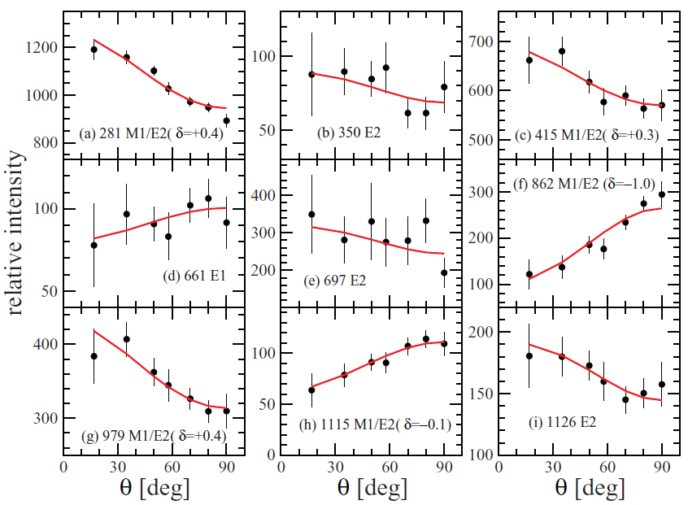
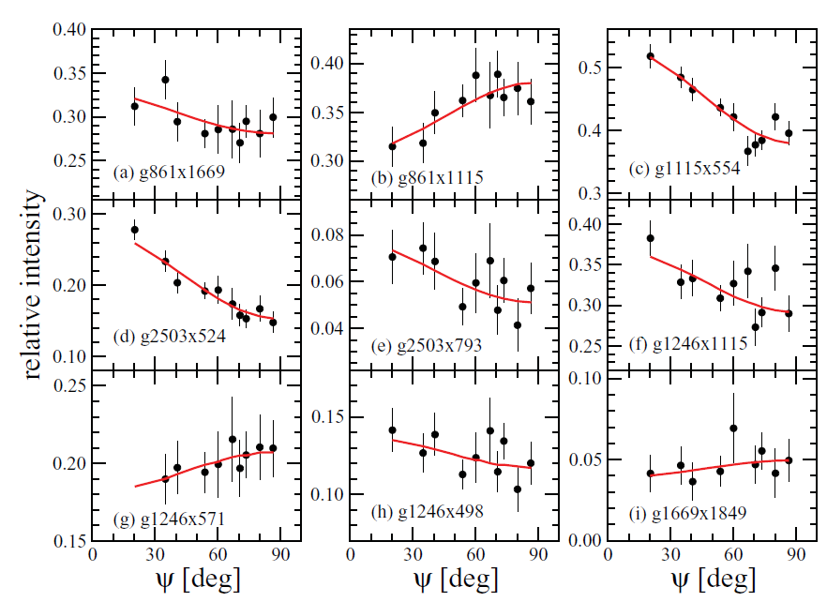
Building a level scheme
E2 – E2
E2 – M1/E2(δ=-0.11)
M1/E2(δ=-0.11) – M1/E2(δ=-0.15)
⁶⁵Cu ADs – ⁴⁸Ca+²⁶Mg
E3 – M1/E2(δ=1.0)
Chiara et al., PRC85, 024309 (2012)
⁶⁷Cu ACs – ⁶⁴Ni+²³⁸U

Slide 31
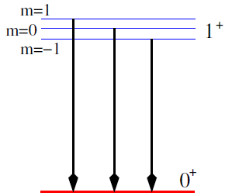
The basics of the situation
Imagine the situation of an M1 decay between two states, the initial one has J^{π} value of 1⁺ and the final one a J^{π} of 0⁺
The initial J^{π}=1⁺ state has 3 degenerate magnetic substates which differ by the magnetic quantum numbers m of $±1$ and 0.
The final J^{π}=0⁺ state has a single magnetic substate with m=0.
When the substates of J^{π}=1⁺ state decay, the γ-rays emitted have different angular patterns.

Slide 32
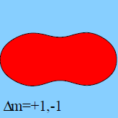
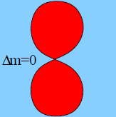
The basics of the situation
For the M1 case the angular distributions W(θ) are:
$$W_{M1, Δm=1}\left(θ\right)=\frac{3}{16π}\left(1+\cos^{2}θ\right)$$
$$W_{M1,Δm=0}\left(θ\right)=\frac{3}{8π}\sin^{2}θ$$
$$W_{M1,Δm=−1}\left(θ\right)=\frac{3}{16π}\left(1+\cos^{2}θ\right)$$
So the total distribution is $W_{M1}=\frac{1}{3}W_{M1,Δm=1}+\frac{1}{3}W_{M1,Δm=0}+\frac{1}{3}W_{M1,Δm=−1}$
$$=\frac{1}{8π}\left(1+\cos^{2}θ+\sin^{2}θ\right)=\frac{1}{4π}$$
no angular dependence

Slide 33
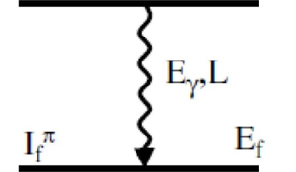
Angular correlation – non-oriented source
Let’s imagine we have two γ-rays which follow immediately after each other in the level scheme.
$$γ_{1}$$
E1
If we measure γ₁ or γ₂ in singles, then the distribution will be isotropic (same intensity at all angles) ... there is no preferred direction of emission
$$γ_{2}$$
Now imagine that we measure γ₁ and γ₂ in coincidence. We say that measuring γ₁ causes the intermediate state to be aligned. We define the z-direction as the direction of γ₁
The angular distribution of the emission of γ₂ then depends on the spin/parities of the states involved and on the multipolarity of the transition.

Slide 34
A simple example:
0⁺
$$J^{π}=0^{+}, m=0$$
$$γ_{1}$$
E1
1⁺
$$J^{π}=1^{+}, m=0, m=±1$$
$$γ_{2}$$
0⁺
$$J^{π}=0^{+}, m=0$$
Hence, for γ₂ we only see the m=±1 to m=0 part of the distribution i.e. we see that the intensity measured as a function of angle (relative to γ₁) follows a $1+\cos^{2}θ$ distribution.

Slide 35
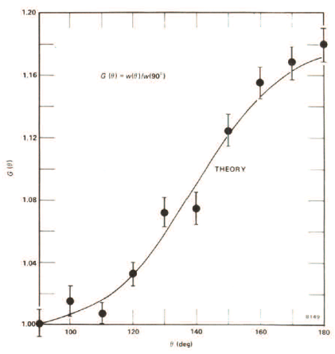
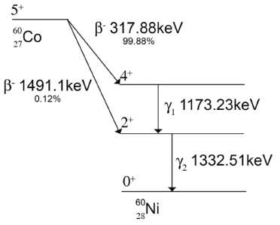
General formula
J₁
In general, the γ-ray intensity varies as:
$$γ_{1}$$
$$W\left(θ\right)=\sum_{k_{even}}{A_{k}\left(γ_{1}\right)A_{k}\left(γ_{2}\right)Q_{k}\left(γ_{1}\right)Q_{k}\left(γ_{2}\right)P_{k}\left(cosθ\right)}$$
E1
J₂
$$γ_{2}$$
where
θ is the relative angle between the two γ-rays
Q_{k} accounts for the fact that we do not have point detectors
A_{k} depends on the details of the transition and the spins of the level
J₃
$$P_{0}=1 P_{2}=\frac{1}{2}\left(3∙\cos^{2}\left(θ\right)−1\right) P_{4}=\frac{1}{8}\left(35\cos^{4}\left(θ\right)−30\cos^{2}\left(θ\right)+3\right)$$
I₁ (ℓ₁) | I₂ (ℓ₂) | I₃ | a₂ | a₄
0 (1) | 1 (1) | 0 | 1 | 0
1 (1) | 1 (1) | 0 | -1/3 | 0
1 (2) | 1 (1) | 0 | -1/3 | 0
2 (1) | 1 (1) | 0 | 1/13 | 0
3 (2) | 1 (1) | 0 | -3/29 | 0
0 (2) | 2 (2) | 0 | -3 | 4
1 (1) | 2 (2) | 0 | -1/3 | 0
2 (1) | 2 (2) | 0 | 3/7 | 0
2 (2) | 2 (2) | 0 | -15/13 | 16/13
3 (2) | 2 (2) | 0 | -3/29 | 0
4 (2) | 2 (2) | 0 | 1/8 | 1/24
$$W\left(θ\right)=1+a_{2}\cos^{2}θ+a_{4}\cos^{4}θ$$
R.D. Evans, The Atomic Nucleus

Slide 36
General formula
J₁
In general, the γ-ray intensity varies as:
$$γ_{1}$$
$$W\left(θ\right)=\sum_{k_{even}}{A_{k}\left(γ_{1}\right)A_{k}\left(γ_{2}\right)Q_{k}\left(γ_{1}\right)Q_{k}\left(γ_{2}\right)P_{k}\left(cosθ\right)}$$
E1
J₂
$$γ_{2}$$
where
θ is the relative angle between the two γ-rays
Q_{k} accounts for the fact that we do not have point detectors
A_{k} depends on the details of the transition and the spins of the level
J₃
$$P_{0}=1 P_{2}=\frac{1}{2}\left(3∙\cos^{2}\left(θ\right)−1\right) P_{4}=\frac{1}{8}\left(35\cos^{4}\left(θ\right)−30\cos^{2}\left(θ\right)+3\right)$$
$$A_{k}\left(γ_{1}\right)=\frac{F_{k}\left(J_{2}J_{1}ℓ,ℓ\right)−2∙δ{∙F}_{k}\left(J_{2}J_{1}ℓ,ℓ+1\right)+δ^{2}{∙F}_{k}\left(J_{2}J_{1}ℓ+1,ℓ+1\right)}{1+δ^{2}}$$
$$A_{k}\left(γ_{2}\right)=\frac{F_{k}\left(J_{2}J_{3}L,L\right)−2∙δ{∙F}_{k}\left(J_{2}J_{3}L,L+1\right)+δ^{2}{∙F}_{k}\left(J_{2}J_{3}L+1,L+1\right)}{1+δ^{2}}$$
Ferentz-Rosenzweig coefficients
$$F_{k}\left(LL′I_{1}I_{2}\right)={\left(−1\right)}^{I_{1}+I_{2}+1}\sqrt{2k+1}\sqrt{2L+1}\sqrt{2L^{′}+1}\sqrt{2I_{2}+1}\left(\begin{matrix}L & L′ & k \\ 1 & −1 & 0\end{matrix}\right)\left\{\begin{matrix}L & L′ & k \\ I_{1} & I_{1} & I_{2}\end{matrix}\right\}$$
https://griffincollaboration.github.io/AngularCorrelationUtility/

Slide 37
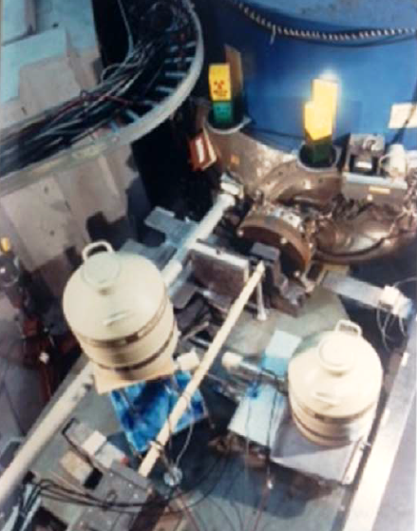
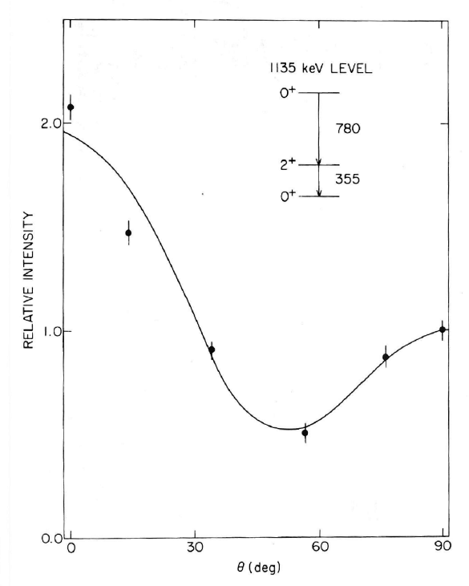
A special case:
$${}_{78}^{195}{Pt}\left(n,γ\right){}_{78}^{196}{Pt}$$

Slide 38
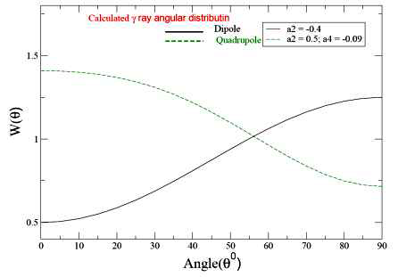
Angular correlations with arrays
Many arrays are designed symmetrically, so the range of possible angles is reduced.
Therefore one measures a Directional Correlation from Oriented Nuclei (DCO ratio)
In the simplest case, if you have an array with detectors at 35⁰ and 90⁰.
Gate on 90⁰ detector, measure coincident intensities in
other 90⁰ detectors
35⁰ detectors
Take the ratio and compare with calculations ... can usually separate quadrupoles from dipoles but cannot measure mixing ratios

Slide 39
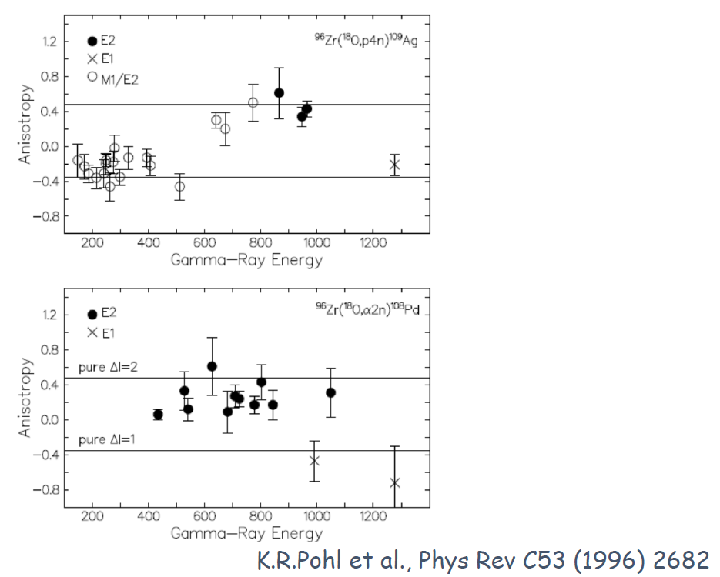
Angular correlations with arrays

Slide 40
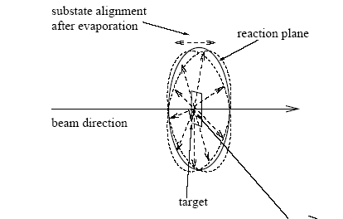
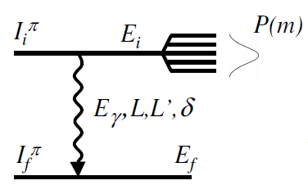
Angular distribution
In heavy-ion fusion-evaporation reactions, the compound nuclei have their spin aligned in a plane perpendicular to the beam axis:
$$\vec{ℓ}=\vec{r}×\vec{p}$$
Depending on the number and type of particles ‘boiled off’ before a γ-ray is emitted, transitions are emitted from oriented nuclei and therefore their intensity shows an angular dependence.
$$W\left(θ\right)=A_{0}\left(1+\frac{A_{2}}{A_{0}}∙B_{2}{∙Q_{2}∙P}_{2}\left(cosθ\right)+\frac{A_{4}}{A_{0}}{∙B}_{4}∙Q_{4}∙P_{4}\left(cosθ\right)\right)$$
where A_{k}, Q_{k} and P_{k} are as before and B_{k} contains information about the alignment of the state
$$P\left(m\right)=\frac{exp\left(−\frac{m^{2}}{2σ^{2}}\right)}{\sum_{m^{′}=−I}^{+I}{exp\left(−\frac{{m′}^{2}}{2σ^{2}}\right)}}$$
$$B_{k}\left(I_{i}\right)=\sqrt{2I_{i}+1}\sum_{m=−I}^{+I}{{\left(−1\right)}^{I_{i}−m}\left\langle I_{i}mI_{i}−m | k0\right\rangle P\left(m\right)}$$

Slide 41
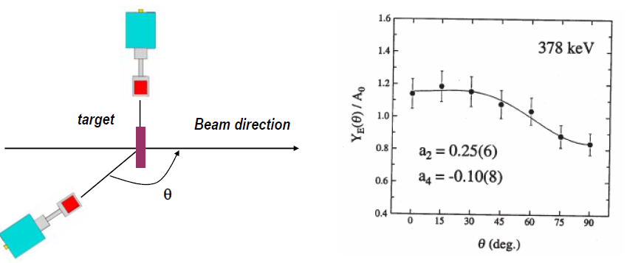
Angular distribution
Measure: the γ-ray yield as a function of θ

Slide 42
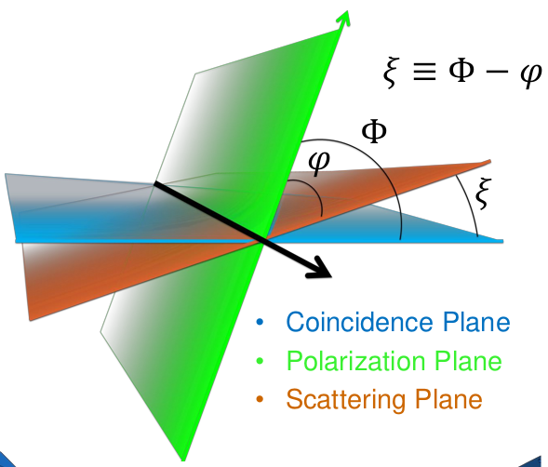
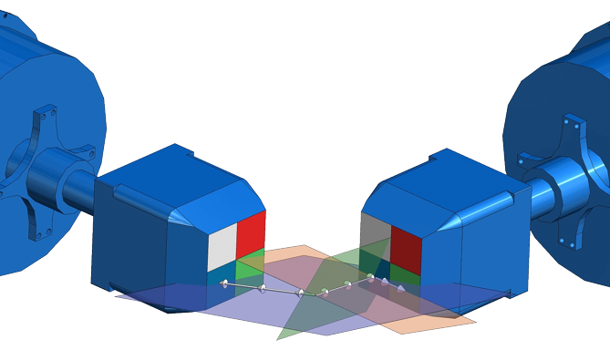
Building a level scheme
ADs/ACs → multipole order L, but do not directly distinguish E vs M
Pure ΔI=1 E1 looks the same as pure ΔI=1 M1, e.g.
Nonzero mixing ratio may change that, as M1/E2 far more likely than E1/M2
For more direct determination of E or M: measure polarization
Measure Compton scattering within and perpendicular to reaction plane
$$P∝\frac{{aN}_{⊥}−N_{∥}}{{aN}_{⊥}+N_{∥}}$$
(a corrects for different intrinsic count rates)
AD: angular distribution, AC: angular correlation

Slide 43
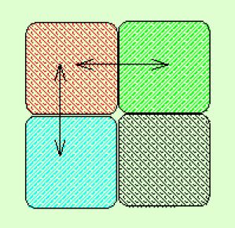
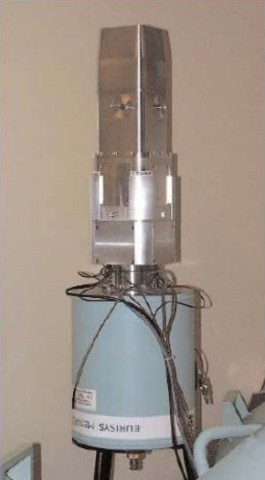
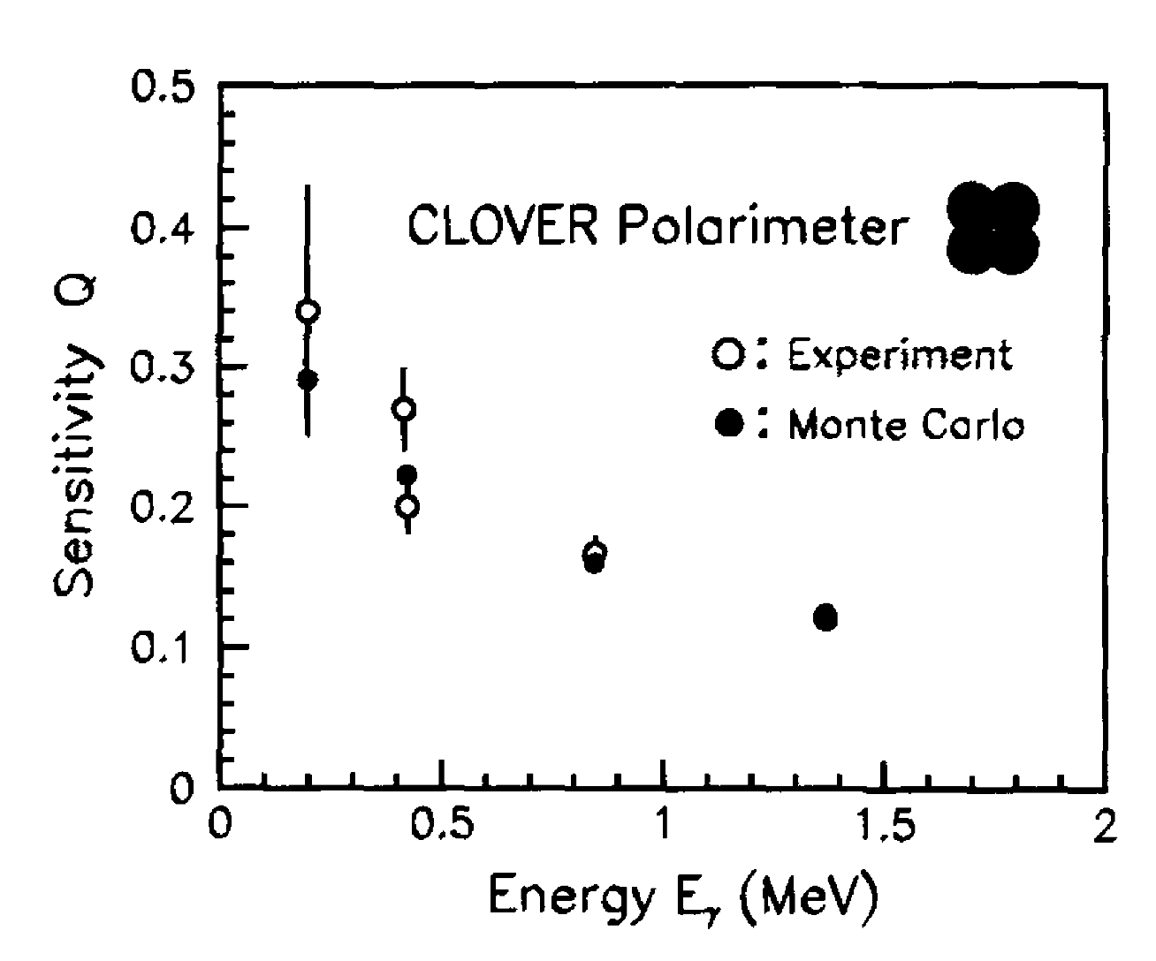
Linear polarization
A segmented detector can be used to measure the linear polarization which can be used to distinguish between magnetic (M) and electric (E) character of radiation of the same multipolarity.
The Compton scattering cross section is larger in the direction perpendicular to the electrical field vector of the radiation.
Define experimental asymmetry as: $A=\frac{N_{90}−N_{0}}{N_{90}+N_{0}}$
where N₉₀ and N₀ are the intensities of scattered photons perpendicular and parallel to the reaction plane.
The experimental linear polarization P=A/Q where Q is the polarization sensitivity of the detector
Q~13% at 1 MeV

Slide 44
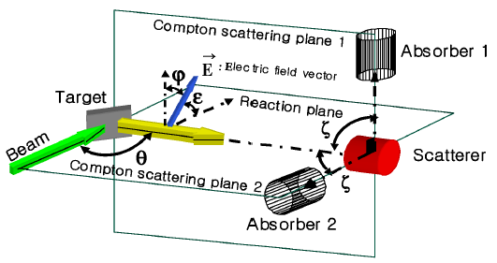
Linear polarization
Klein-Nishina formula:
$$\frac{dσ_{c}}{dΩ}=\frac{r_{0}^{2}}{2}{\left(\frac{E_{γ′}}{E_{γ}}\right)}^{2}∙\left\{\frac{E_{γ}}{E_{γ′}}+\frac{E_{γ′}}{E_{γ}}−2\sin^{2}θ∙\cos^{2}φ\right\}$$
Maximum polarization at θ=90⁰

Slide 45
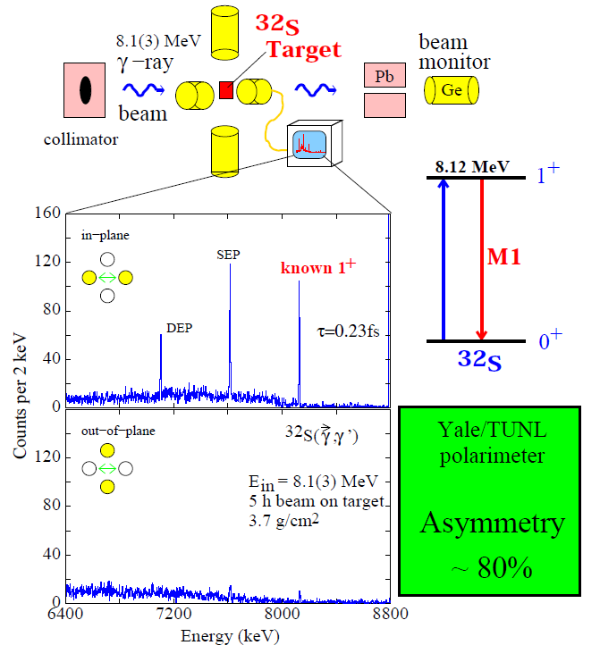
Proof of Principle
N. Pietralla, Nucl Instr Meth A483, 556 (2002)

Slide 46
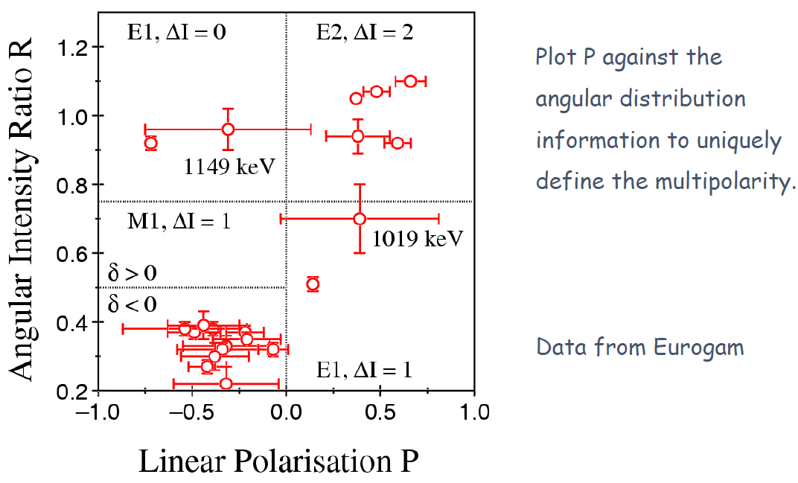
Linear polarization

Slide 47
Building a level scheme
ADs/ACs → multipole order L, but do not directly distinguish E vs M
Pure ΔI=1 E1, e.g., looks the same as pure ΔI=1 M1
Nonzero mixing ratio may change that, as M1/E2 far more likely than E1/M2
For more direct determination of E or M: measure polarization (e.g. Clover detectors)
…or internal-conversion electrons
Nuclear level decay via internal conversion (IC)
first observed over 100 y ago [van Baeyer and Hahn, Physik. Z. 11, 488 (1 910)] *
ubiquitous process
usable as analysis tool
(cf. BrIcc, http://bricc.anu.edu.au/)
Continuum
Initial state
L shell
K shell
Atomic System
Nuclear System
Instead of γ emission, energy transferred to atomic electron, which is ejected
* nucleus discovered in 1911!
AD: angular distribution, AC: angular correlation

Slide 48
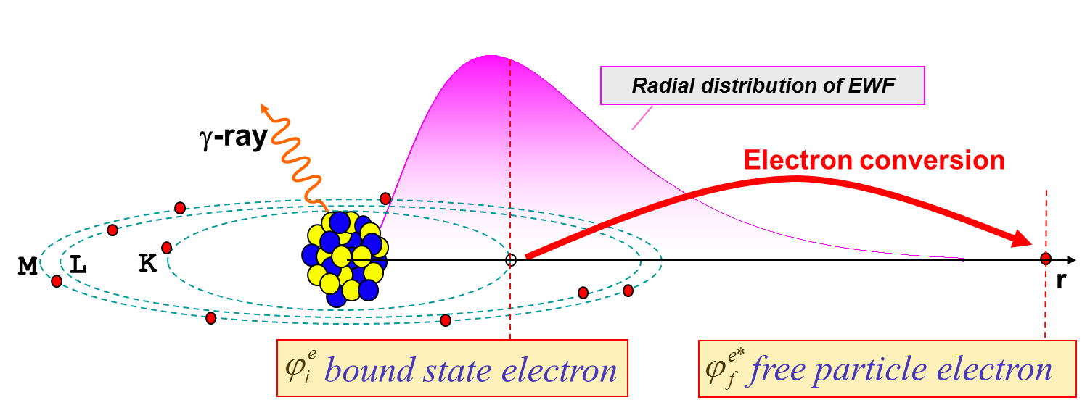
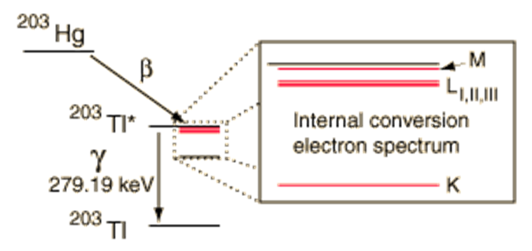
Internal conversion
Energetics of CE-decay (i=K, L, M,….)
E_{i} = E_{f} + E_{ce,i} + E_{BE,i}
γ- and CE-decays are independent; transition probability (λ ~ Intensity)
λ_{T} = λ_{γ} + λ_{CE} = λ_{γ} + λ_{K} + λ_{L} + λ_{M}……
Conversion coefficient
$$α_{i}=\frac{λ_{CE,i}}{λ_{γ}}$$

Slide 49
Internal conversion
For an electromagnetic transition internal conversion can occur instead of emission of gamma radiation. In this case the transition energy Q = E_{γ} will be transferred to an electron of the atomic shell.
T_{e} = E_{γ} - B_{e}
T_{e}: kinetic energy of the electron
B_{e}: binding energy of the electron
internal conversion is important for:
heavy nuclei ~ Z³
high multipolarities Eℓ or Mℓ
small transition energies
$$α_{k}\left(El\right)∝Z^{3}\left(\frac{L}{L+1}\right){\left(\frac{2m_{e}c^{2}}{E}\right)}^{L+5/2}$$

Slide 50
Building a level scheme
Internal conversion
$α_{T}$ = $\frac{Ie}{Iγ}=α_{K}+α_{L}+α_{M}+…$
$$I_{γ+e}=I_{γ}+I_{e}=I_{γ}+α_{T}I_{γ}=I_{γ}(1+α_{T})$$
$$λ=λ_{γ}(1+α_{T})$$
$$T_{1/2}=T_{1/2,γ}{\left(1+α_{T}\right)}^{−1}$$
$α_{T}$ $∝{\left(\frac{Z}{n}\right)}^{3}E^{−L−3/2}$
ICCs larger for:
higher-Z elements
innermost shells
lower-E transitions
M than for E
for ML transitions
$α_{T}$ $∝{\left(\frac{Z}{n}\right)}^{3}E^{−L−5/2}$
for EL transitions

Slide 51
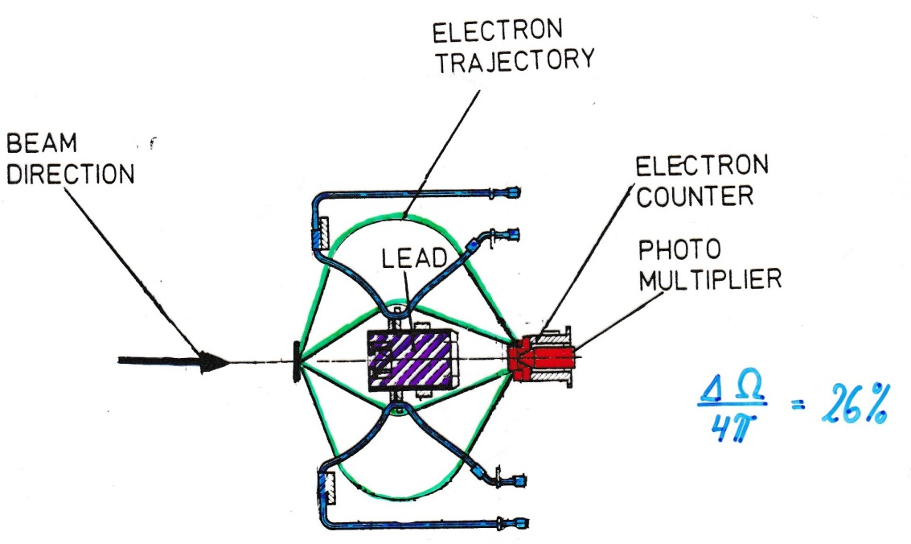
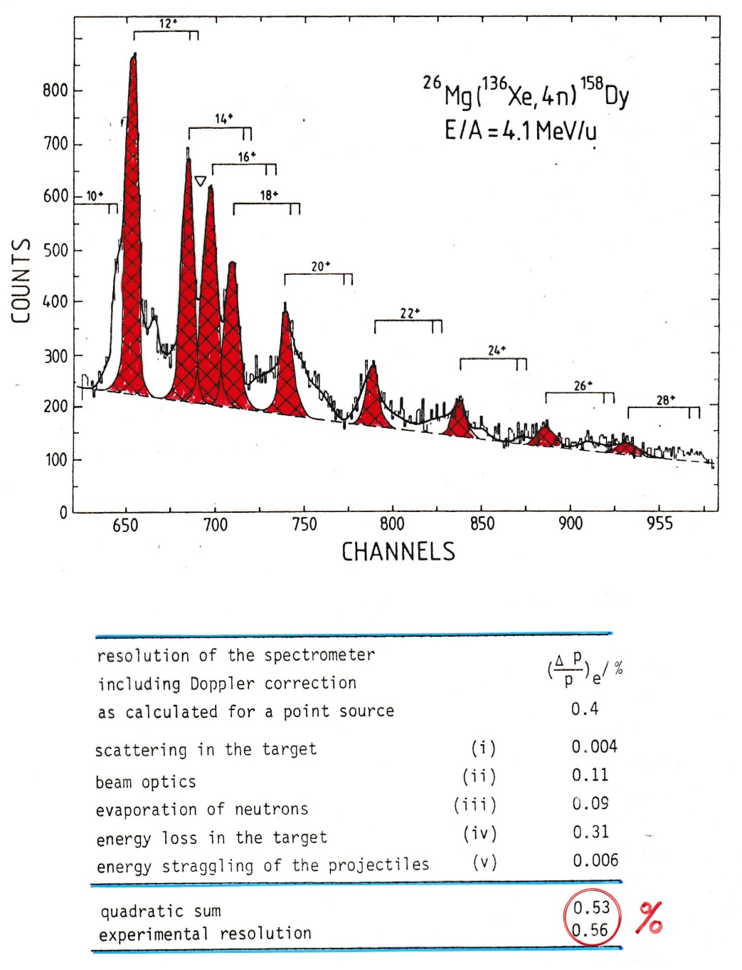
Electron spectroscopy
$$\frac{ΔΩ}{4π}=26\%$$
Doppler shift correction for projectile:
$$T_{e}^{∗}=γ∙T_{e}∙\left\{1−β_{1}∙\sqrt{1+2m_{e}{c^{2}}/{T_{e}}}∙cosθ_{e1}\right\}+m_{e}c^{2}∙\left(γ−1\right)$$
$$cosθ_{e1}=cosθ_{1}cosθ_{e}+sinθ_{1}sinθ_{e}cos\left(φ_{e}−φ_{1}\right)$$

Slide 52
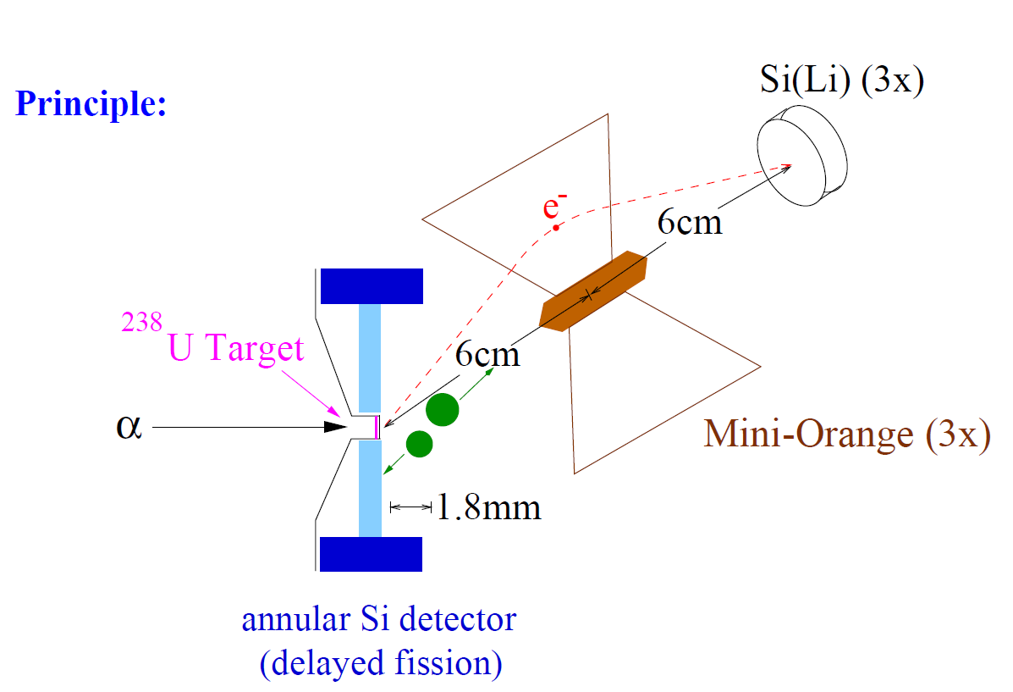
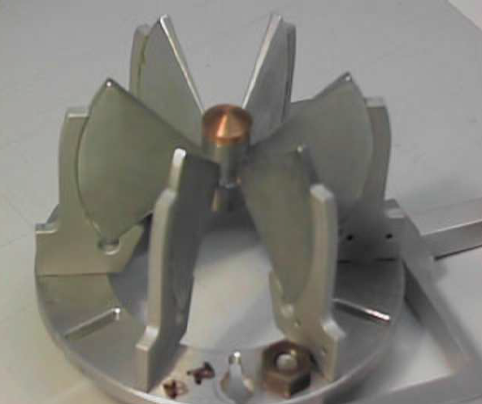
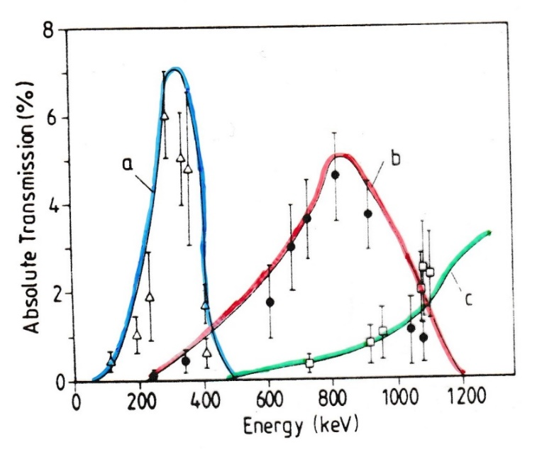
Mini Orange setup for conversion electron spectroscopy
magnetic filters
SmCo₅ magnets
for symmetric configuration 1 – 5 kG

Slide 53
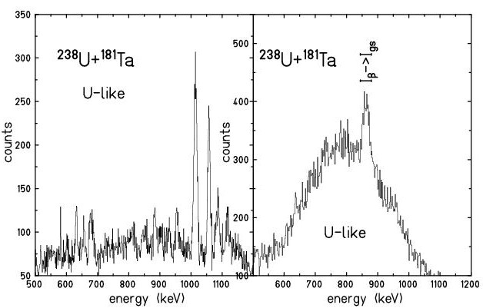
Coulomb excitation experiment

Slide 54
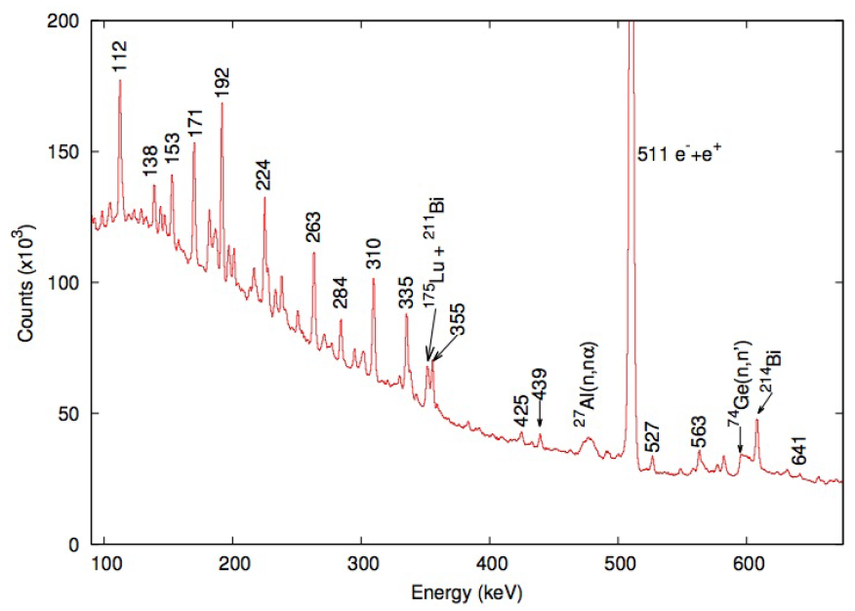
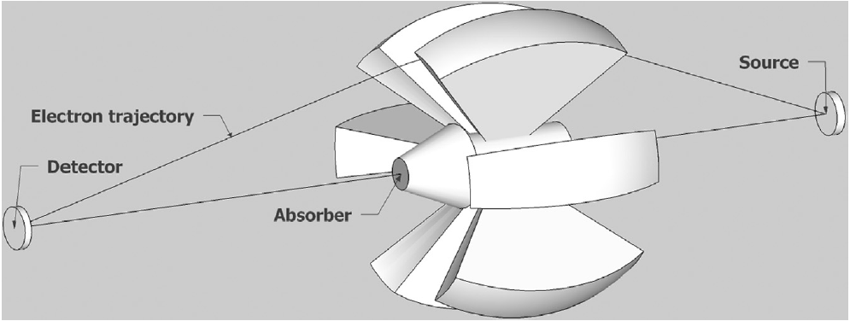
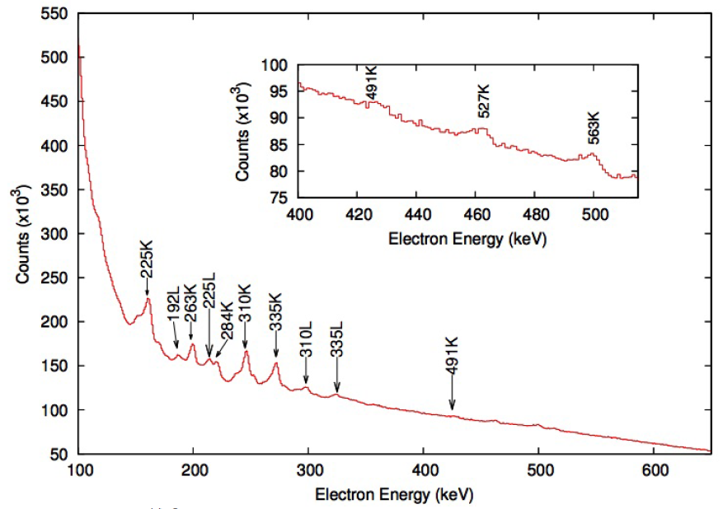
Building a level scheme
Conversion-electron spectroscopy
Electron ejected with energy E = ΔE_{x} – |E_{B}| → measurable spectrum
Multiple electron peaks for each γ, from K, L, …
Mini-orange conversion-electron spectrometer (in-beam)
Guerro et al., NIMA739, 32 (2014)
Battaglia et al., EPJA52, 126 (2016)

Slide 55
Building a level scheme
Conversion-electron spectroscopy
Electron ejected with energy E = ΔE_{x} – |E_{B}| → measurable spectrum
Multiple electron peaks for each γ, from K, L, …
Mini-orange conversion-electron spectrometer (in-beam)
…or delayed spectroscopy
Dracoulis et al., PRC79, 031302 (2009)
(K energies aligned to γ peaks)
Measure γ and e⁻ intensities, compare with calculated ICCs (e.g. BrIcc) → multipolarity
[http://bricc.anu.edu.au/]

Slide 56
Surface oscillations in deformed nuclei
β - vibration
e⁻ γ
E0 or E2 transition

Slide 57
Building a level scheme
E0 decays
Most transitions have γ vs e⁻ competition, but one case that “never” has a γ: 0⁺ → 0⁺
Transition would be E0 (monopole moment = charge), which cannot radiate to points external to nucleus
Andreyev et al., Nature 405, 430 (2000)
reduced α width: $δ^{2}=\frac{h(ln{2)b_{α}}}{T_{1/2}P}$

Slide 58
E0/E2 branching ratio
$$\frac{Y_{e}\left(E0\right)}{Y_{γ}\left(E2\right)}=\frac{Ω_{K} \left[s^{−1}\right]}{2.56∙{10}^{9}{∙A}^{4/3}{∙E_{γ}}^{5} \left[MeV\right]}∙\frac{B\left(E0;I→I′\right)}{B\left(E2;I→I′\right)}$$
= 14 β² for 2_{β}→2
~Z^{7.5}
Ω_{K}: conversion probability electronic factor
D.A. Bell et al.; Can. J. of Phys. 48 (1970),2542

Slide 59
Building a level scheme
E0 decays
Most transitions have γ vs e⁻ competition, but one case that “never” has a γ: 0⁺ → 0⁺
Transition would be E0 (monopole moment = charge), which cannot radiate to points external to nucleus
Why “never” and not never?
If E > 2m_{e}c² = 1.022 MeV, internal pair (e⁺e⁻) production is possible.
e⁺ subsequently annihilates with another e⁻, yielding 511-keV γ’s.

Slide 60
Building a level scheme
Level and γ properties
Measured E_{γ}’s → level energies
Efficiency-corrected γ peak areas → intensities, branching ratios, level populations
γ ADs/ACs, γ polarizations, internal conversion → multipolarity → level spin, parity
Relative γ times → level half-lives, B(XL)’s
$$B\left(XL\right)∝{E_{γ}^{−(2L+1)}T}_{1/2,γ}^{−1}$$
Reduced transition rates
can be a sensitive probe of matrix elements connecting initial and final states:
$$B\left(XL;I_{i}→I_{f}\right)=\frac{1}{2I_{i}+1}{\left\langle ψ_{f}\left\|XL\right.{\left\|ψ\right.}_{i}\right\rangle }^{2}$$

Slide 61
Measuring half-lives
Excited-state half-lives range from ~10⁻²³ s (>10-MeV resonances) to > 4.5x10¹⁶ y (^{180m}Ta). That’s over 47 orders of magnitude!
Most excited states have sub-ns half-lives; why are some exceptionally long?
Low transition energy
Large spin difference
Large difference in underlying configurations
K-forbiddenness (change in spin projection on symmetry axis ΔK > L)
No single approach to measuring half-lives will apply to all cases.

Slide 62
Measuring half-lives
Observe exponential decay for half-lives of ~tens of ps or longer
Measure γ-ray time relative to a fast START signal
START with preceding β decay in e.g. fast plastic
…or START with RF (clock tick marking reaction)
…or START with preceding γ in e.g. Ge (T_{1/2} > ns) or LaBr₃ (sub-ns)
Get half-life from slope of exponential
T_{1/2} = 728(21) ps
Kondev et al., PRC85, 027304 (2012)
Zhu et al., NIMA652, 231 (2011)

Slide 63
Measuring half-lives
Observe exponential decay for half-lives of ~tens of ps or longer
Measure γ-ray time relative to a fast START signal
START with preceding β decay in e.g. fast plastic
…or START with RF (clock tick marking reaction)
…or START with preceding γ in e.g. Ge (T_{1/2} > ns) or LaBr₃ (sub-ns)
Get half-life from slope of exponential…or from centroid shift
T_{1/2} = 40(3) ps
Kondev et al., PRC85, 027304 (2012)
Zhu et al., NIMA652, 231 (2011)

Slide 64
Measuring half-lives
For ~ps half-lives, instrumentation not fast enough
Exploit physics of in-beam measurement: Doppler shifts
Brief Doppler diversion…

Slide 65
Doppler effect
Doppler broadening:
Ge
Doppler shift:
Δθ
v
$$E=E_{0}\frac{\sqrt{1−{(v/c)}^{2}}}{1−(v/c)\cos{θ}}$$
$$∆E∝E_{0}(v/c)\sin{θ}∆θ$$
Ions lose energy while traversing a medium ➔ v/c decreases with time.
By modelling the energy loss, time-dependent Doppler shift determined ➔ Doppler-shift attenuation and (differential) plunger techniques

Slide 66
Measuring half-lives
For ~ps half-lives, instrumentation not fast enough
Exploit physics of in-beam measurement: Doppler shifts
Recoil-distance method (plunger)
v ~ 0.3c
Produce nucleus of interest with initial velocity v₀ via Coulex or KO reactions
Observe Doppler-shifted γ’s emitted between target and degrader
Ion slows in the degrader to velocity v_{d} < v₀
Observe Doppler-shifted γ’s emitted after degrader
Increase distance between target and degrader; change in relative peak intensities depends on T_{1/2}
T_{1/2} ~ 10-100s of ps can be measured
Figure: adapted from K. Starosta

Slide 67
Recoil distance method
$$I_{degraded}=I∙e^{−d/{vτ}}$$
$$I_{shifted}=\left(1−e^{−d/{vτ}}\right)$$
$$\frac{I_{degraded}}{I_{degraded}+I_{shifted}}=e^{−d/{vτ}}$$

Slide 68
Measuring half-lives
Double-degrader plunger
T_{1/2} → B(E2) → indicator for collectivity
Behavior of the 4⁺ and 2⁺ states in ⁷²Kr suggest rapid shape evolution occurring
Iwasaki et al., PRL112, 142502 (2014).

Slide 69
Doppler Shift Attenuation Method
target
stopper
beam
Germanium
detector

Slide 70
Measuring half-lives
For ~ps half-lives, instrumentation not fast enough
Exploit physics of in-beam measurement: Doppler shifts
Recoil-distance method (plunger)
Doppler-broadened line shapes
T_{1/2} = 0.13 ps 0.19 ps 0.17 ps
If ion slows substantially in foil, variation in Doppler shift → line shape
Sensitive to sub-ps T_{1/2}’s
Chiara et al., PRC61, 034318 (2000)

Slide 71
Lorentz transformation

Slide 72
Efficiency versus resolution
With a source at rest, the intrinsic resolution of the detector can be reached;
efficiency decreases with the increasing detector-source distance.
With a moving source also the effective energy resolution depends on the detector-source distance (Doppler effect)
Small d Large d
Large Ω Small Ω
High ε Low ε
Poor FWHM Good FWHM

Slide 73
Energy resolution
The major factors affecting the final energy resolution (FWHM) at a particular energy are as follows:
$$ΔE_{γ}^{final}={\left(ΔE_{Int}^{2}+Δθ_{det}^{2}+Δθ_{N}^{2}+Δv^{2}\right)}^{1/2}$$
$$v±∆v$$
$ΔE_{Int} −$The intrinsic resolution of the detector system.
It includes contributions from the detector itself and
the electronic components used to process the signal.
$$Δθ_{N}$$
$$Δθ_{det}$$
$Δθ_{det} −$The Doppler broadening arising from the opening angle of
the detectors
$Δθ_{N} −$The Doppler broadening arising from the angular spread of the
recoils in the target
$Δv −$ The Doppler broadening arising from the velocity (energy)
variation of the excited nucleus

Slide 74
Special relativity
Lorentz transformation:

Slide 75
Lorentz transformation
P* = const.
total energy:
$$E^{∗}=γ∙E−γ∙v∙P∙cosθ$$
with
$$E=\sqrt{{\left(mc^{2}\right)}^{2}+{\left(Pc\right)}^{2}}$$
rest system
laboratory system
E*, P* total energy and momentum in the rest system
E, P total energy and momentum in the laboratory system
Doppler formula for zero-mass particle (photon): E=Pc
$$E^{∗}=γ∙E−γ∙β∙E∙cosθ$$
$$E^{∗}=γ∙E\left(1−β∙cosθ\right)$$
Hendrik Lorentz
E. Byckling, K. Kajantie J. Wiley & Sons London

Slide 76
Doppler effect
for

Slide 77
Doppler broadening and position resolution
Position resolution
γ ray
Angular resolution
beam
projectile
Energy resolution

Slide 78
Doppler broadening (opening angle of detector)
for
with

Slide 79
Doppler broadening (velocity variation)
for
with

Slide 80
Experimental arrangement
experimental problem:
Doppler broadening due to finite size of Ge-detector
$$\frac{∆E}{E}\sim 1\%$$
for
$$∆θ_{γ}={20}^{0} β_{1}≅10\%$$
For projectile excitation:
$$E^{∗}=γ∙E∙\left(1−β_{1}∙cosθ_{γ1}\right)$$
Doppler shift
with
$$cosθ_{γ1}=cosθ_{1}cosθ_{γ}+sinθ_{1}sinθ_{γ}cos\left(φ_{γ}−φ_{1}\right)$$
$$ΔE≅E^{∗}∙β_{1}∙sinθ_{γ1}∙∆θ_{γ1}$$
Doppler broadening

Slide 81
Inelastic heavy-ion scattering
¹⁸¹Ta
raw γ-ray spectrum
²³⁸U

Slide 82
Lorentz transformation
γ-ray angular distribution
Contraction of the solid angle element in the laboratory system
$$\frac{dΩ}{dΩ^{∗}}={\left\{\frac{E^{∗}}{E}\right\}}^{2}$$
with
$$E^{∗}=γ∙E∙\left(1−β∙cosθ\right)$$
Doppler formula

Slide 83
Experimental arrangement (electron detection)
Doppler broadening
Δϑ_{e} = 20⁰
target – Mini-Orange: 19 cm
Mini-Orange – Si detector: 6 cm
For projectile excitation:
$$T_{e}^{∗}=γ∙T_{e}∙\left\{1−β_{1}∙\sqrt{1+2m_{e}{c^{2}}/{T_{e}}}∙cosθ_{e1}\right\}+m_{e}c^{2}∙\left(γ−1\right)$$
with
$$cosθ_{e1}=cosθ_{1}cosθ_{e}+sinθ_{1}sinθ_{e}cos\left(φ_{e}−φ_{1}\right)$$

Slide 84
Lorentz transformation
γ-rays
10%
energy shift
γ-rays
20%
solid angle contraction

Slide 85
Segmented detectors
70cm
target
beam
20cm

Slide 86
Gamma-ray tracking
Gamma Arrays based on Compton Suppressed Spectrometers
Tracking Arrays based on
Position Sensitive Ge Detectors
EUROBALL
GAMMASPHERE
AGATA
GRETA
ε ~ 10 - 7 %
( M_{γ} = 1 – M_{γ} = 30)
ε ~ 50 - 25 %
( M_{γ} = 1 - M_{γ} = 30)

