Slide 1

Outline: Super Heavy Elements
Lecturer: Hans-Jürgen Wollersheim
e-mail: h.j.wollersheim@gsi.de
web-page: https://web-docs.gsi.de/~wolle/ and click on
history
cold and hot fusion
nuclear structure of SHE
chemistry of SHE

Slide 2
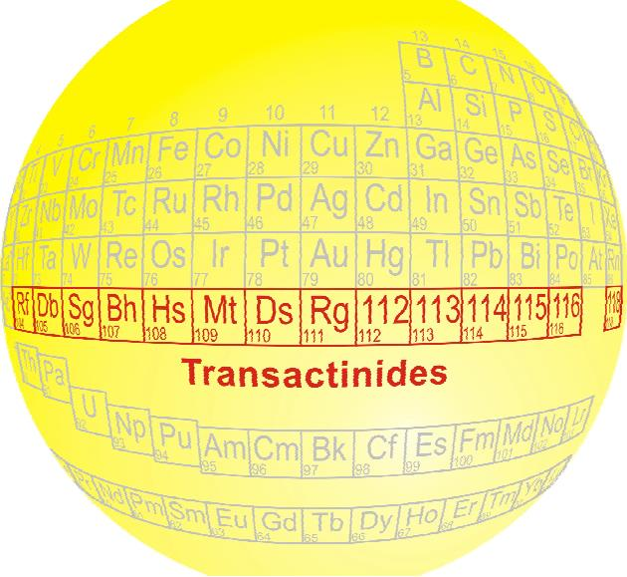
Super Heavy Elements

Slide 3
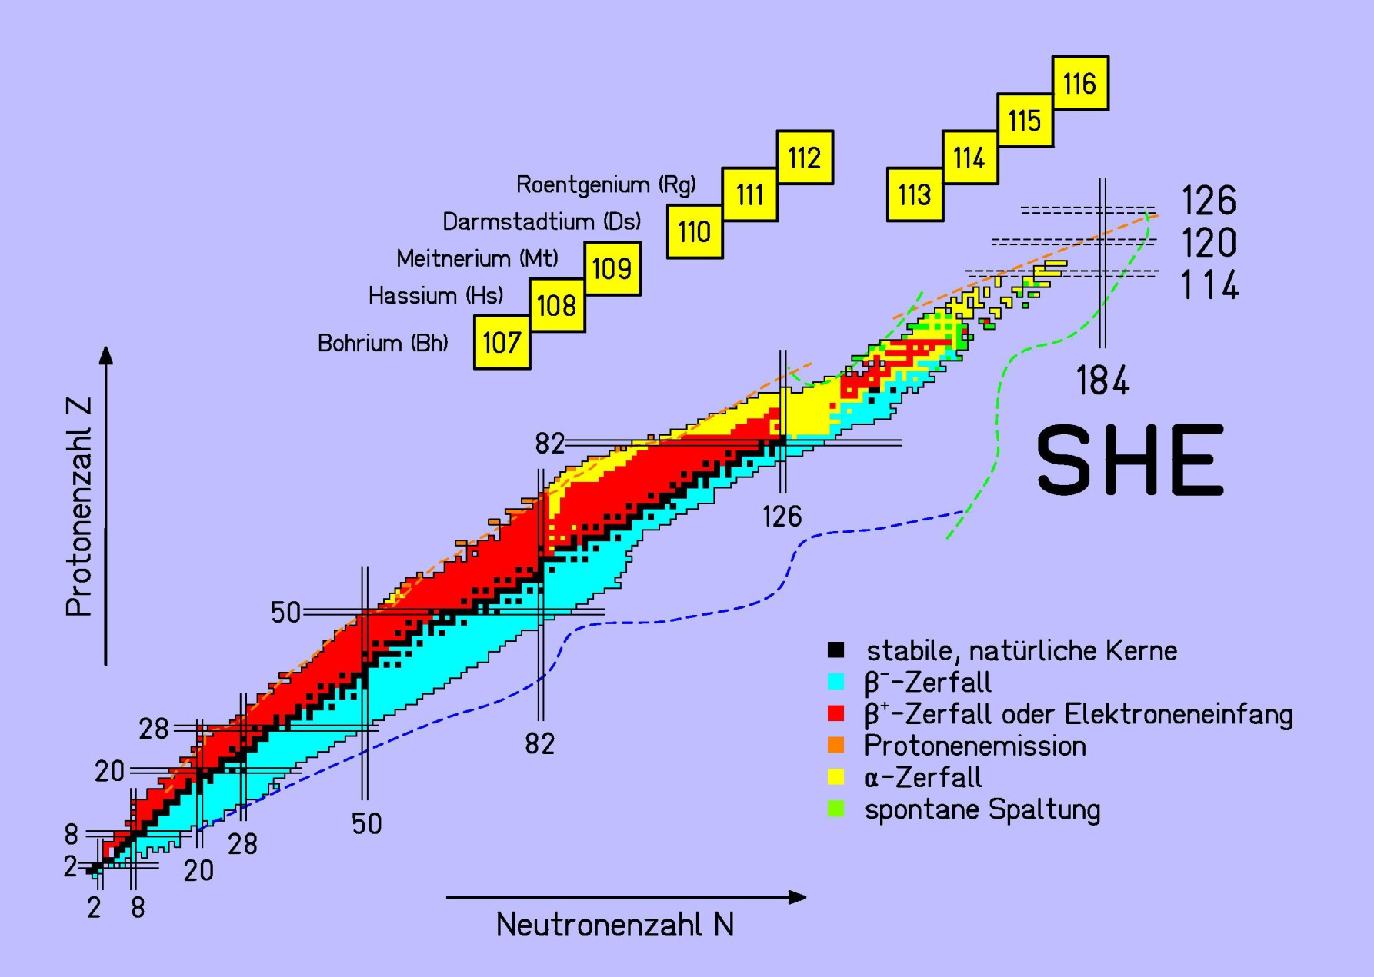
The Chart of Nuclides the “playground” for Nuclear Physics
chart of nuclides:
representation of isotopes in the Z-N plane
isotope: atom (nucleus) of an element with
different number of neutrons
?
island of
stability
Pb (lead) and Bi (bismuth)
stabilisation via
shell effects
Z = 100
proton number Z
U (uranium) and Th (thorium)
black: stable isotope
red: β⁺-unstable isotope
blue: β⁻-unstable isotope
yellow: α-instable isotope
green: spontaneous fission
neutron number N

Slide 4
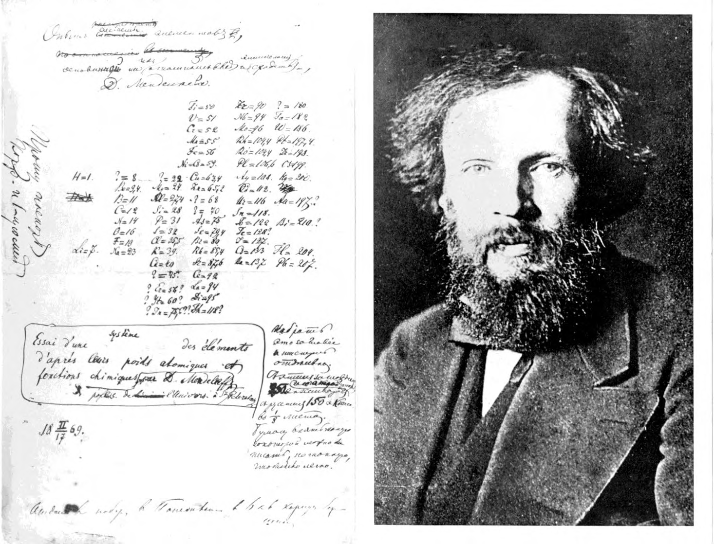
Periodic table of the elements
Dmitri Mendeleev (1869)

Slide 5
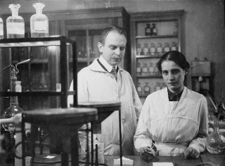
Search for transuranium elements (1934)
$${}_{92}^{238}U+n→{}_{92}^{239}{U^{∗}}→{}_{93}^{239}{Np}+e^{−}+\overline{ν}$$
Otto Hahn and Lise Meitner

Slide 6
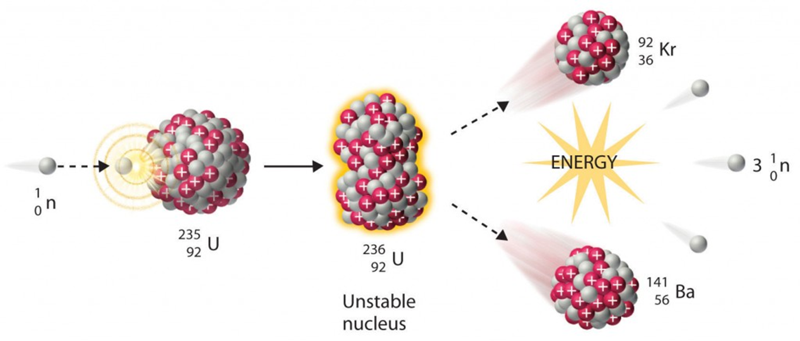
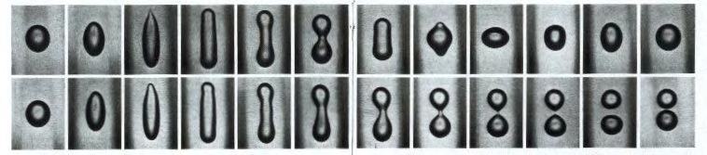
Discovery of nuclear fission (1938)
Liquid drop model: G. Gamow; Proc. Roy. Soc. London A123, 373 (1929)
N. Bohr & J.A. Wheeler; Phys. Rev. 56, 426 (1939)

Slide 7
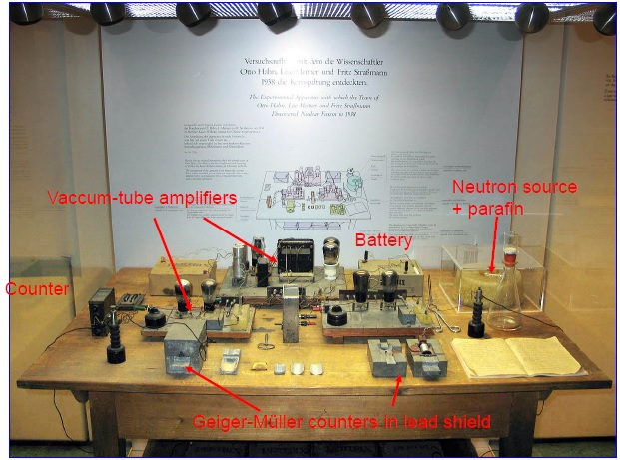
Hahn-Meitner-Strassmann experimental set-up

Slide 8
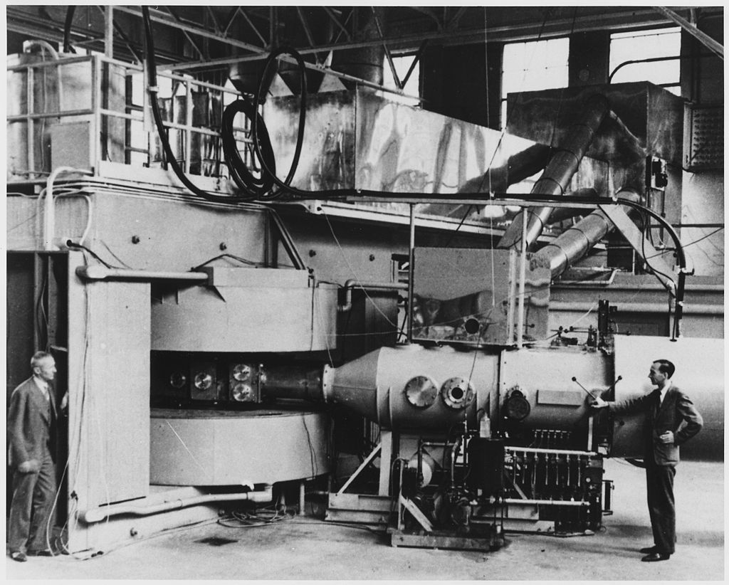
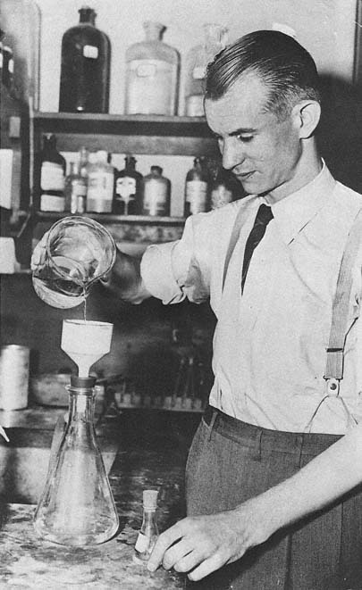
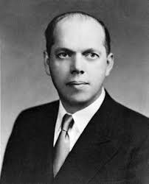

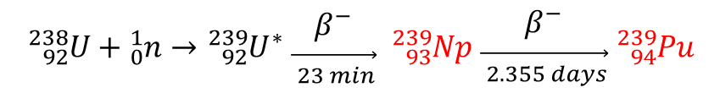
Transuranium elements (1940)
60-inch cyclotron (Berkeley, 1939)
Edwin M. McMillan
H₂⁺, ²H & ⁴He beams (Q/A = ½)
$${}_{92}^{238}U+{}_{0}^{1}n→{}_{92}^{239}{U^{∗} }\begin{matrix}β^{−} \\ \vec{ _{23 min}}\end{matrix} {}_{93}^{239}{Np} \begin{matrix}β^{−} \\ \vec{ _{2.355 days}}\end{matrix} {}_{94}^{239}{Pu}$$
Neptunium sphere
with Ni clad in U shells
Philip H. Abelson

Slide 9
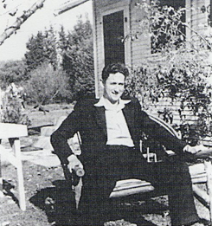
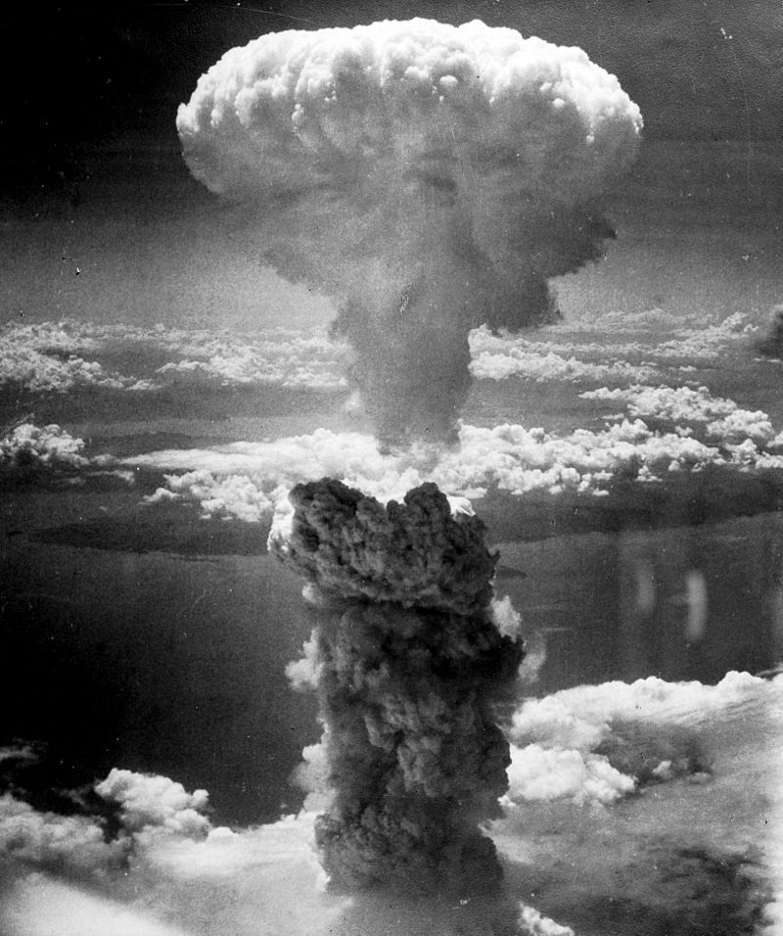
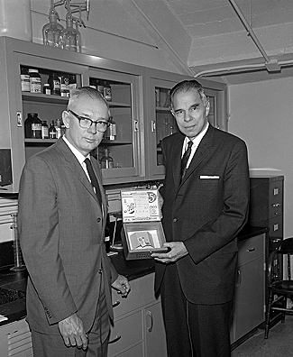

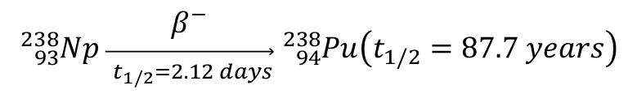
Making new elements by simple reactions
$${}_{92}^{238}U+{}_{1}^{2}H→{}_{93}^{238}{Np}+2{}_{0}^{1}n$$
$${}_{93}^{238}{Np }\begin{matrix}β^{−} \\ \vec{ _{t_{1/2}=2.12 days}}\end{matrix} {}_{94}^{238}{Pu}\left(t_{1/2}=87.7 years\right)$$
Joseph W. Kennedy 1940
Arthur C. Wahl and
Glenn T. Seaborg (1966)

Slide 10
Making new elements by simple reactions (chemical separation)
1944:
$${}_{94}^{239}{Pu}\left(24.1 yr\right)+{}_{2}^{4}{He}→{}_{96}^{242}{Cm}\left(162.8 d\right)+{}_{0}^{1}n$$
$${}_{94}^{239}{Pu\left(24.1 yr\right)}+{}_{0}^{1}n→{}_{94}^{240}{Pu}\left(6.56 yr\right)+{}_{0}^{1}n→{}_{94}^{241}{Pu}\left(14.4 yr\right)$$
$${}_{94}^{241}{Pu\left(14.4 yr\right)→}{}_{95}^{241}{Am}\left(432.7 yr\right)+{}_{0}^{1}n→{}_{95}^{242}{Am}\left(16.0 h\right)→{}_{96}^{242}{Cm}\left(162.8 d\right)$$
$${}_{95}^{241}{Am\left(432.7 yr\right)}+{}_{2}^{4}{He}→{}_{97}^{243}{Bk\left(4.5 h\right)}+2 {}_{0}^{1}n$$
$${}_{96}^{242}{Cm\left(162.8 d\right)}+{}_{2}^{4}{He}→{}_{98}^{245}{Cf\left(45 min\right)}+{}_{0}^{1}n$$
1952: the next two elements, Einsteinium (Es, Z = 99) and Fermium (Fm, Z = 100) were found in the debris from “Mike” thermonuclear explosion.
$${}_{99}^{253}{Es\left(20.5 d\right)}+{}_{2}^{4}{He}→{}_{101}^{256}{Md\left(78.1 min\right)}+{}_{0}^{1}n$$
1958:
$${}_{96}^{246}{Cm\left(4730 yr\right)}+{}_{6}^{12}C→{}_{102}^{254}{No\left(55 s\right)}+4 {}_{0}^{1}n$$

Slide 11
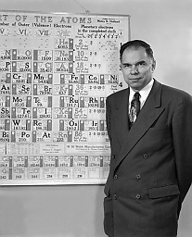
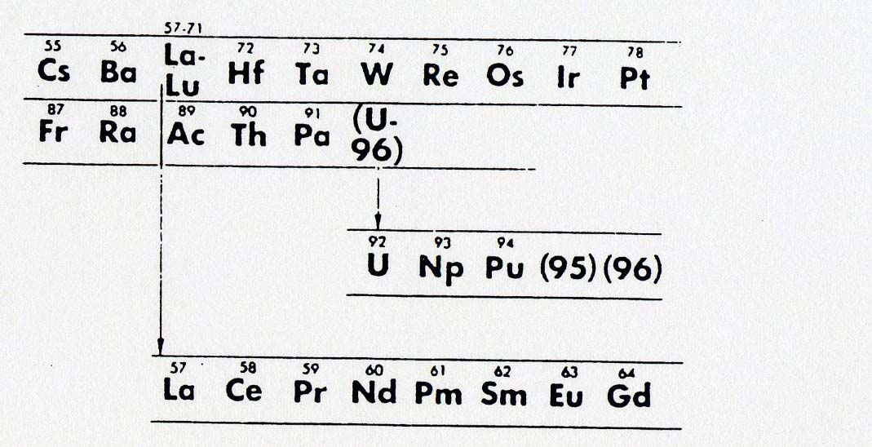



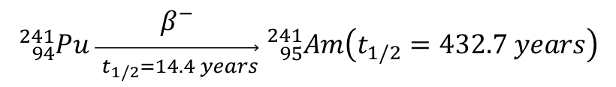
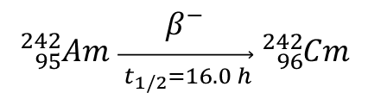
Making new elements by simple reactions – the role of chemistry
The discovery of elements 95 (Am) and 96 (Cm)
Glenn T. Seaborg
$${}_{94}^{239}{Pu}+{}_{0}^{1}n→{}_{94}^{240}{Pu}+γ$$
$${}_{94}^{240}{Pu}+{}_{0}^{1}n→{}_{94}^{241}{Pu}+γ$$
$${}_{94}^{241}{Pu }\begin{matrix}β^{−} \\ \vec{ _{t_{1/2}=14.4 years}}\end{matrix} {}_{95}^{241}{Am}\left(t_{1/2}=432.7 years\right)$$
$${}_{95}^{241}{Am}+{}_{0}^{1}n→{}_{95}^{242}{Am}+γ$$
$${}_{95}^{242}{Am }\begin{matrix}β^{−} \\ \vec{ _{t_{1/2}=16.0 h}}\end{matrix} {}_{96}^{242}{Cm}$$

Slide 12
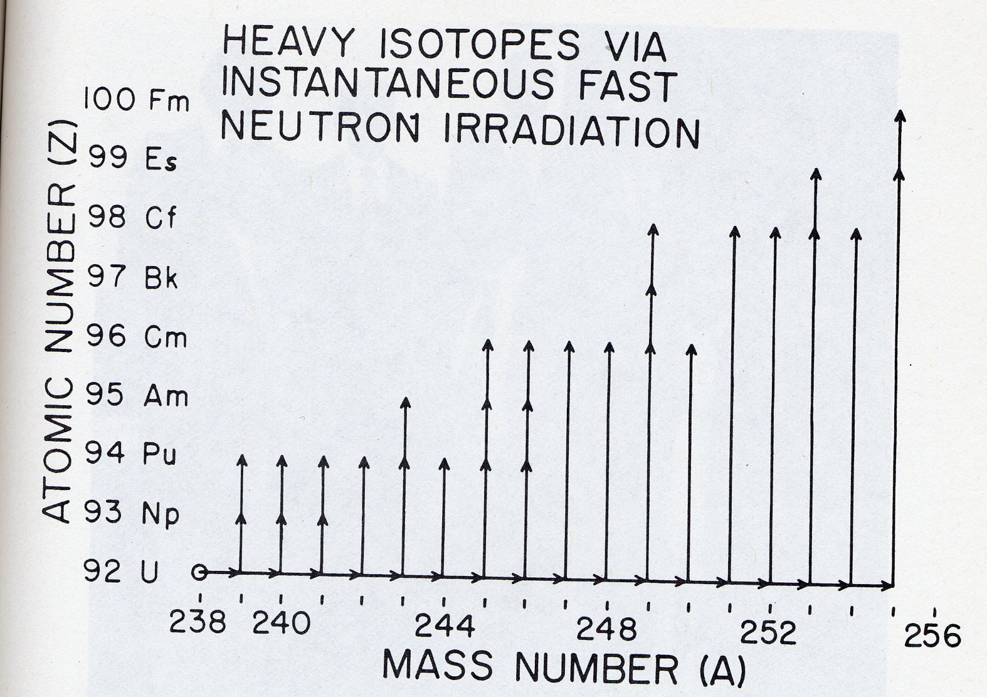
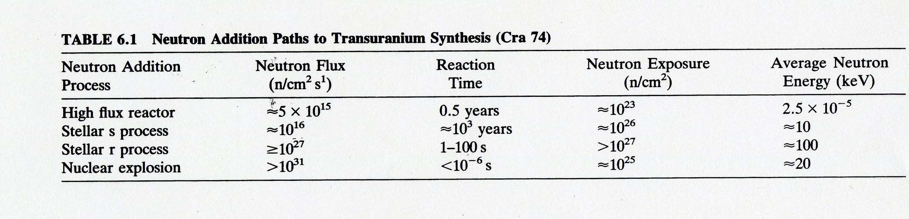
Making new elements with nuclear weapons
The discovery of elements 99 (Md) and 100 (Fm)

Slide 13
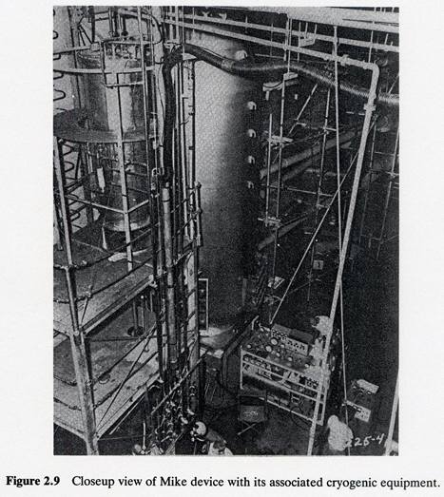
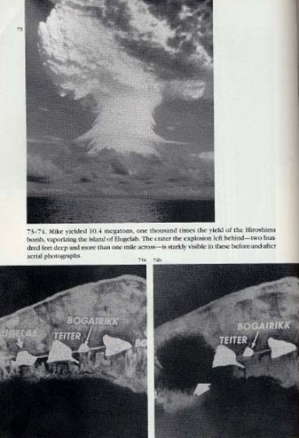
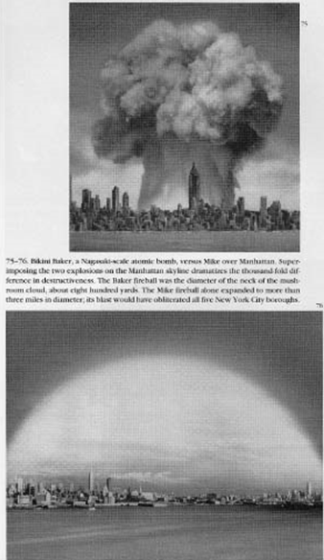
MIKE
MIKE
MIKE-2
Samples of the bomb debris were collected on filter papers by aircraft flying through the mushroom cloud

Slide 14
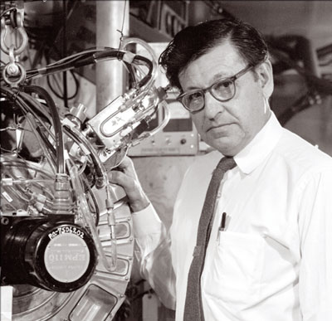
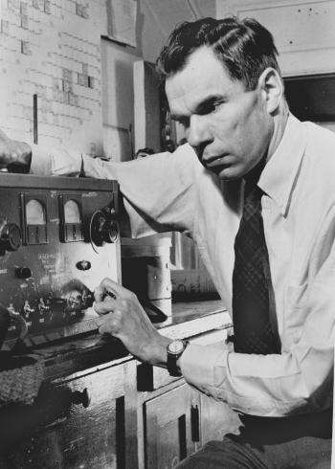
Using heavy ion reactions to make new elements – the Berkeley area
Albert Ghiorso
Glenn Seaborg

Slide 15
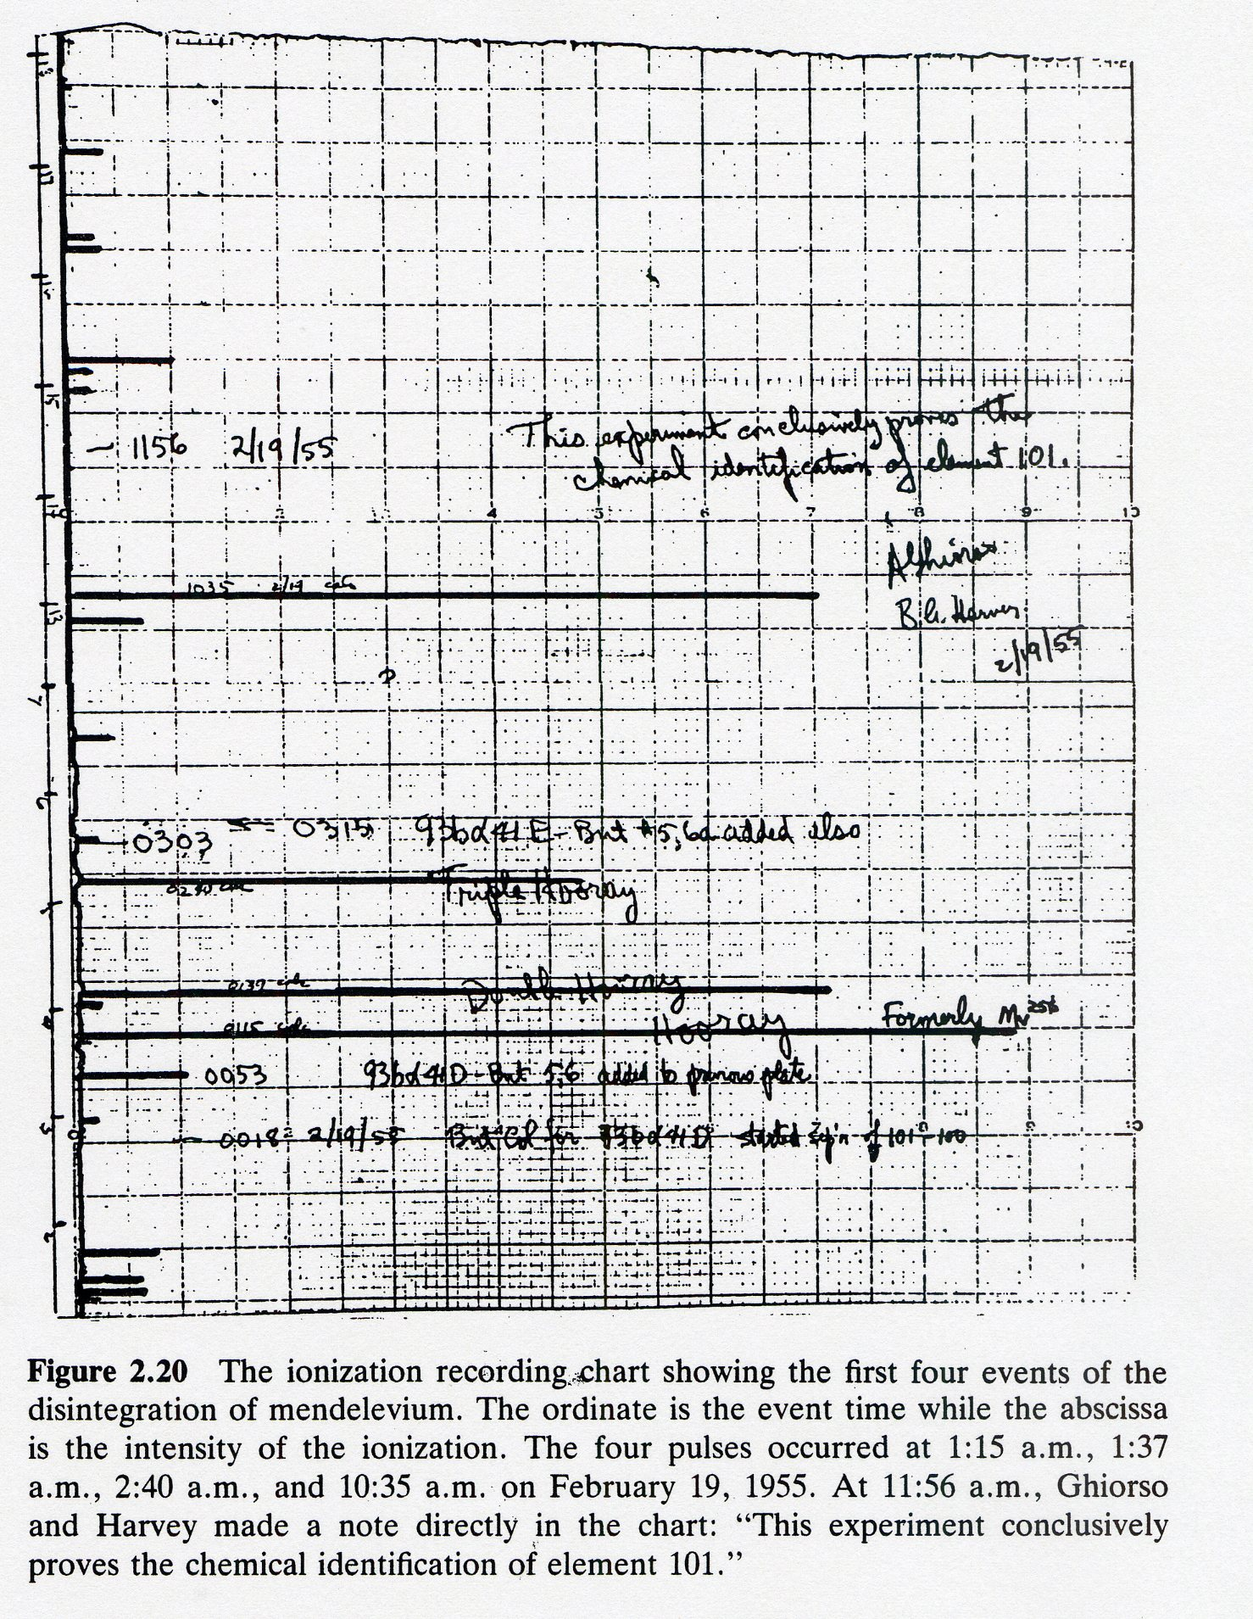
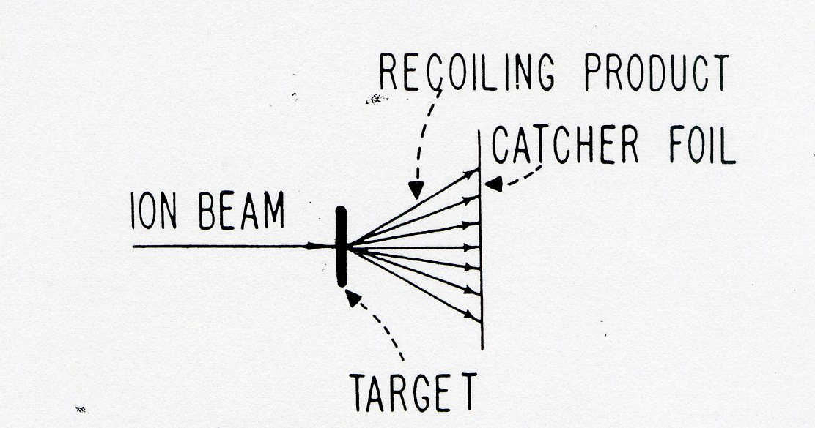
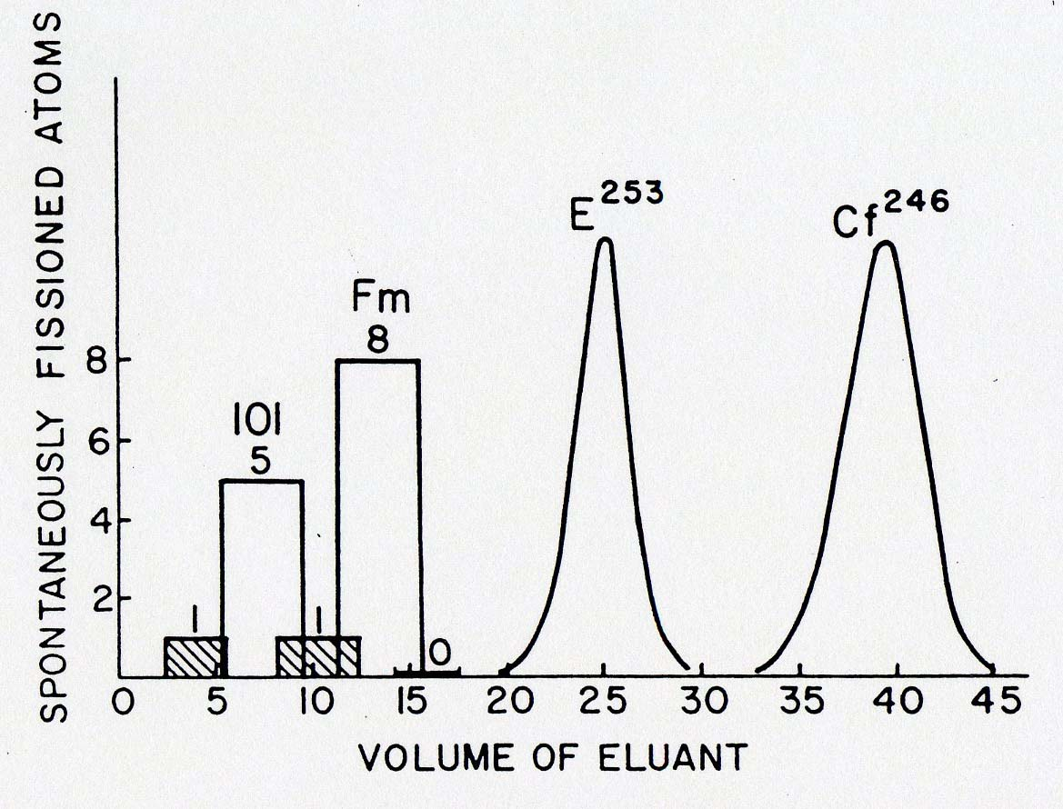
Synthesis of elements 101 - 106
Making elements one atom at a time
²⁵⁴Es + ⁴He → ²⁵⁶Md + n

Slide 16
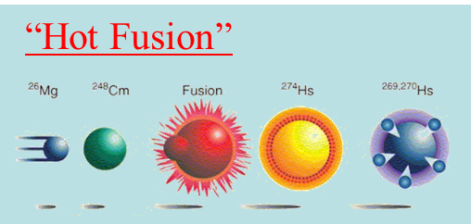



Hot fusion (1961-1974) successful up to element 106 (Seaborgium)
Coulomb barrier V_{C} between projectile and target nucleus
has to be exceeded
$$V_{C}=\frac{Z_{p}∙Z_{t}∙e^{2}}{R_{int}}$$
$$=126.2 MeV \left({}_{}^{26}{Mg}+{}_{}^{248}{Cm}\right)$$
reaction: a + A → C* → B + b
Δm = m_{a} + m_{A} - m_{CN}
Δm = (25.983 + 248.072 – 274.143) * 931.478 MeV/c²
= -82.153 MeV/c²
excitation energy of compound nucleus
E* = E_{kin} + Δm·c²
= 126.2 MeV – 82.2 MeV
= 44.0 MeV
approximate 4 neutrons will be evaporated to avoid fission
r
http://nuclear.lu.se/database/masses/

Slide 17
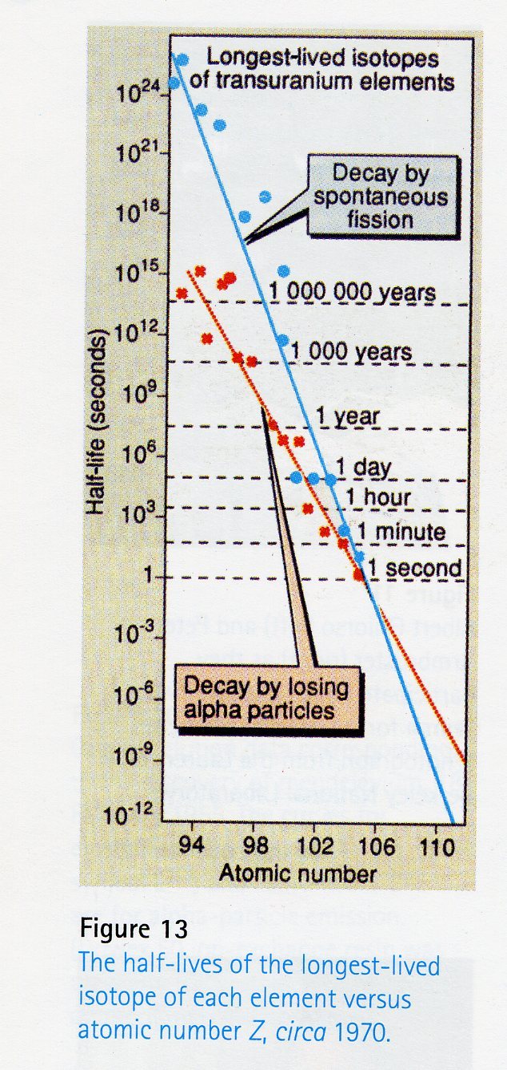
The problem
element | name | longest-lived isotope | half-life [s]
95 | Americium | ²⁴³Am | 2.3·10¹¹
96 | Curium | ²⁴⁷Cm | 5.0·10¹⁴
97 | Berkelium | ²⁴⁷Bk | 3.2·10¹⁰
98 | Californium | ²⁵¹Cf | 2.8·10¹⁰
99 | Einsteinium | ²⁵²Es | 4.1·10⁷
100 | Fermium | ²⁵⁷Fm | 8.7·10⁶
101 | Mendelevium | ²⁵⁸Md | 4.4·10⁶
102 | Nobelium | ²⁵⁹No | 3.5·10³
103 | Lawrencium | ²⁶⁶Lr | 3.6·10⁴
104 | Rutherfordium | ²⁶⁷Rf | 4.7·10³
105 | Dubnium | ²⁶⁸Db | 1.1·10⁵
106 | Seaborgium | ²⁶⁹Sg | 1.8·10²
107 | Bohrium | ²⁷⁰Bh | 6.0·10¹
108 | Hassium | ²⁷⁷Hs | 3.0·10¹
109 | Meitnerium | ²⁷⁸Mt | 4.0·10⁰
110 | Darmstadtium | ²⁸¹Ds | 1.4·10¹
111 | Roentgenium | ²⁸²Rg | 1.2·10²
112 | Copernicium | ²⁸⁵Cn | 3.0·10¹
113 | Nihonium | ²⁸⁶Nh | 8.0·10⁰
114 | Flerovium | ²⁸⁹Fl | 2.0·10⁰
115 | Moscovium | ²⁹⁰Mc | 8.0·10⁻¹
116 | Livermorium | ²⁹³Lv | 6.0·10⁻²
117 | Tennessine | ²⁹⁴Ts | 5.0·10⁻²
118 | Organesson | ²⁹⁴Og | 7.0·10⁻⁴

Slide 18
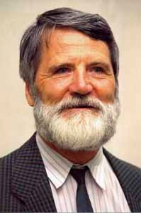
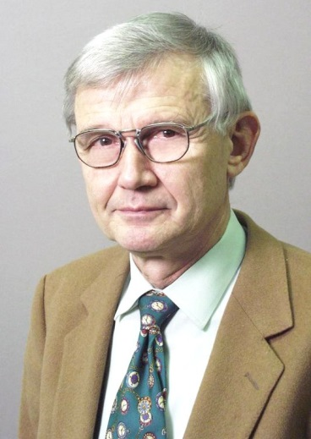

The solution – The Darmstadt Area
“Cold fusion” reactions
Bombarding Pb or Bi with heavy ions – the resulting species are borne “cold”
- with low excitation energies – they survive better
Peter Armbruster
Gottfried Münzenberg
Sigurd Hofmann

Slide 19
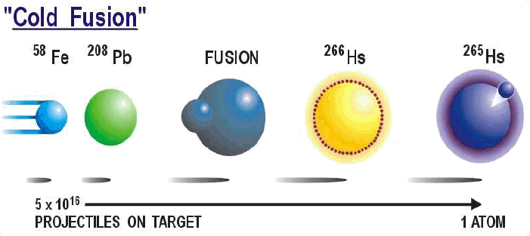



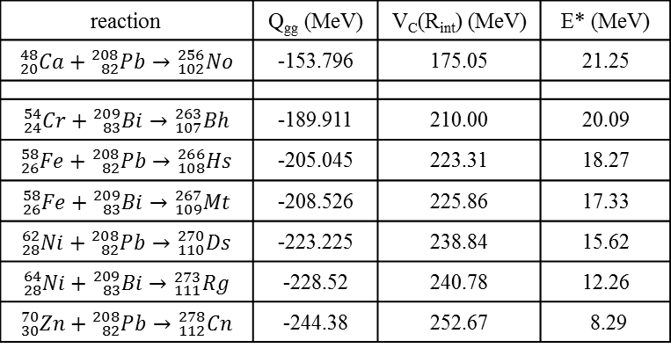
Cold fusion (1981-1996)
Coulomb barrier V_{C} between projectile and target nucleus
has to be exceeded
$$V_{C}=\frac{Z_{p}∙Z_{t}∙e^{2}}{R_{int}}$$
$$=223.3 MeV \left({}_{}^{58}{Fe}+{}_{}^{208}{Pb}\right)$$
reaction: a + A → C* → B + b
Δm = m_{a} + m_{A} - m_{CN}
Δm = (57.933 + 207.977 – 266.130) * 931.478 MeV/c²
= -205.045 MeV/c²
excitation energy of compound nucleus
E* = E_{kin} + Δm·c²
= 223.3 MeV – 205.0 MeV
= 18.2 MeV
approximate 1-2 neutrons will be evaporated to avoid fission
reaction | Q_{gg} (MeV) | V_{C}(R_{int}) (MeV) | E* (MeV)
$${}_{20}^{48}{Ca}+{}_{82}^{208}{Pb}→{}_{102}^{256}{No}$$ | -153.796 | 175.05 | 21.25
$${}_{24}^{54}{Cr}+{}_{83}^{209}{Bi}→{}_{107}^{263}{Bh}$$ | -189.911 | 210.00 | 20.09
$${}_{26}^{58}{Fe}+{}_{82}^{208}{Pb}→{}_{108}^{266}{Hs}$$ | -205.045 | 223.31 | 18.27
$${}_{26}^{58}{Fe}+{}_{83}^{209}{Bi}→{}_{109}^{267}{Mt}$$ | -208.526 | 225.86 | 17.33
$${}_{28}^{62}{Ni}+{}_{82}^{208}{Pb}→{}_{110}^{270}{Ds}$$ | -223.225 | 238.84 | 15.62
$${}_{28}^{64}{Ni}+{}_{83}^{209}{Bi}→{}_{111}^{273}{Rg}$$ | -228.52 | 240.78 | 12.26
$${}_{30}^{70}{Zn}+{}_{82}^{208}{Pb}→{}_{112}^{278}{Cn}$$ | -244.38 | 252.67 | 8.29
r
http://nuclear.lu.se/database/masses/
G. Audi et al. Nucl. Phys. A729 (2003) 337

Slide 20
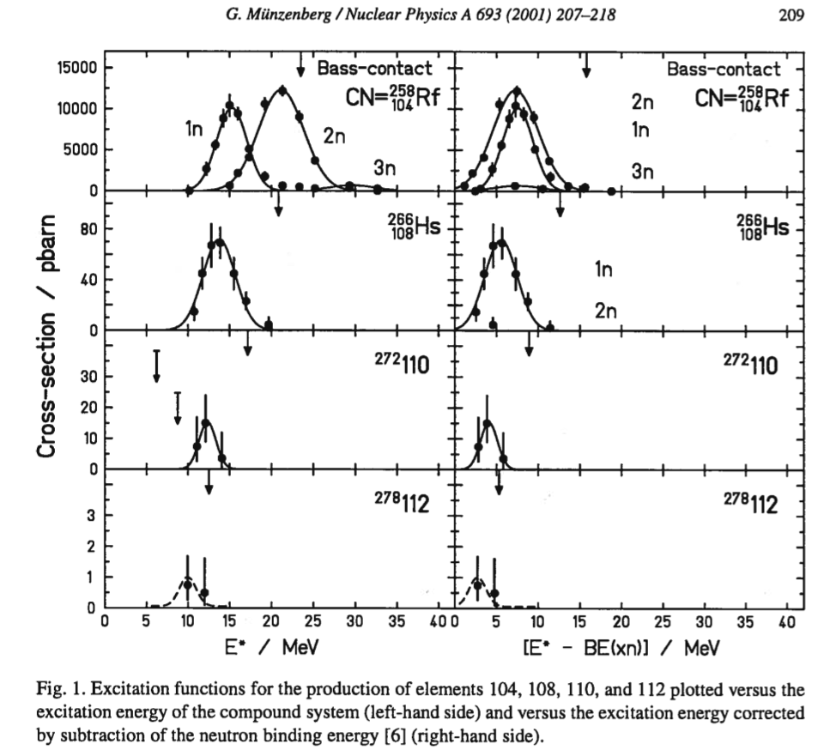




Excitation functions
$${}_{22}^{50}{Ti}+{}_{82}^{208}{Pb}→{}_{104}^{258}{Rf}$$
Q_{gg} = -169.5 MeV
V_{C} = 194.2 MeV _{Bass}
$${}_{26}^{58}{Fe}+{}_{82}^{208}{Pb}→{}_{108}^{266}{Hs}$$
Q_{gg} = -205.0 MeV
V_{C} = 227.1 MeV _{Bass}
$${}_{28}^{64}{Ti}+{}_{82}^{208}{Pb}→{}_{110}^{272}{Ds}$$
Q_{gg} = -224.9 MeV
V_{C} = 242.2 MeV _{Bass}
$${}_{30}^{70}{Zn}+{}_{82}^{208}{Pb}→{}_{112}^{278}{Cn}$$
Q_{gg} = -244.2 MeV
V_{C} = 257.2 MeV _{Bass}

Slide 21
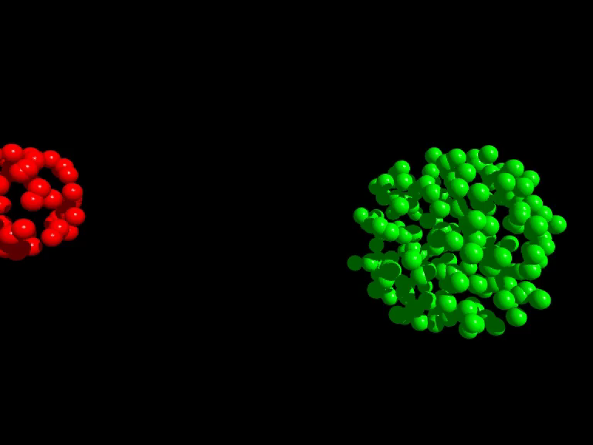
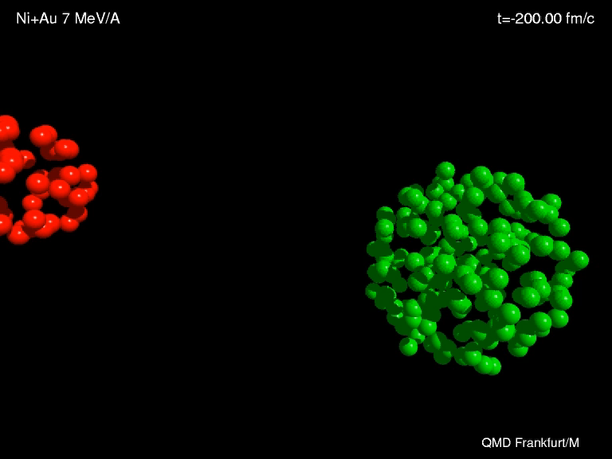
Synthesis of heavy elements
n
⁷⁰Zn
²⁰⁸Pb
²⁷⁷112
Fusion
_1_
10¹²
Compound Fission

Slide 22
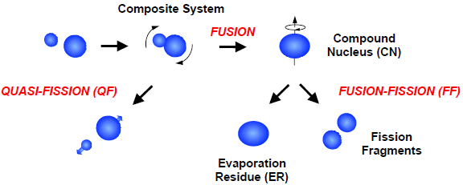
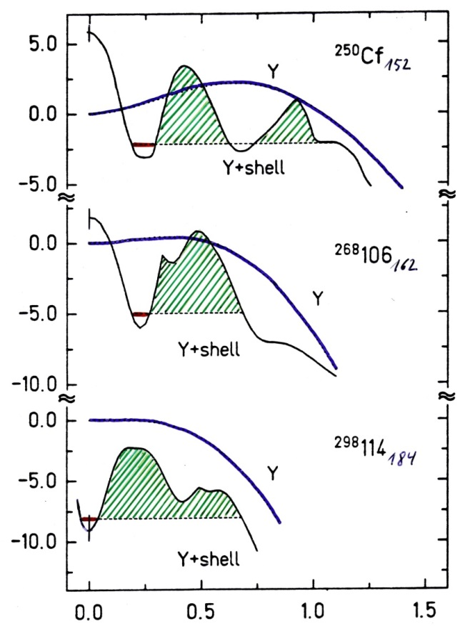
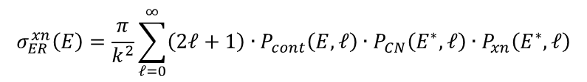


Fusion / fission competition
²⁵⁰98₁₅₂
LD
$$σ_{ER}=σ_{capture}∙P_{CN}∙P_{survival}$$
LD + shell
²⁶⁸106₁₆₂
$$σ_{ER}^{xn}\left(E\right)=\frac{π}{k^{2}}\sum_{ℓ=0}^{∞}{\left(2ℓ+1\right)∙P_{cont}\left(E,ℓ\right)∙P_{CN}\left(E^{∗},ℓ\right)∙P_{xn}\left(E^{∗},ℓ\right)}$$
Potential energy / MeV
capture formation survival
competing: quasi-elastic quasi-fission fission
²⁹⁸114₁₈₄
Superheavy system: $σ_{ER}≪σ_{capture}$
Deformation β₂
A. Sobiczewski et al.

Slide 23
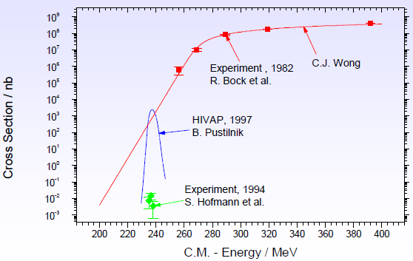

Fusion / fission competition
⁶⁴Ni + ²⁰⁸Pb → ²⁷¹Ds + 1n
$$V_{C}\left(R_{int}\right)=238 MeV$$
$$σ_{ER}=σ_{capture}∙P_{CN}∙P_{survival}$$
fusion-fission

Slide 24
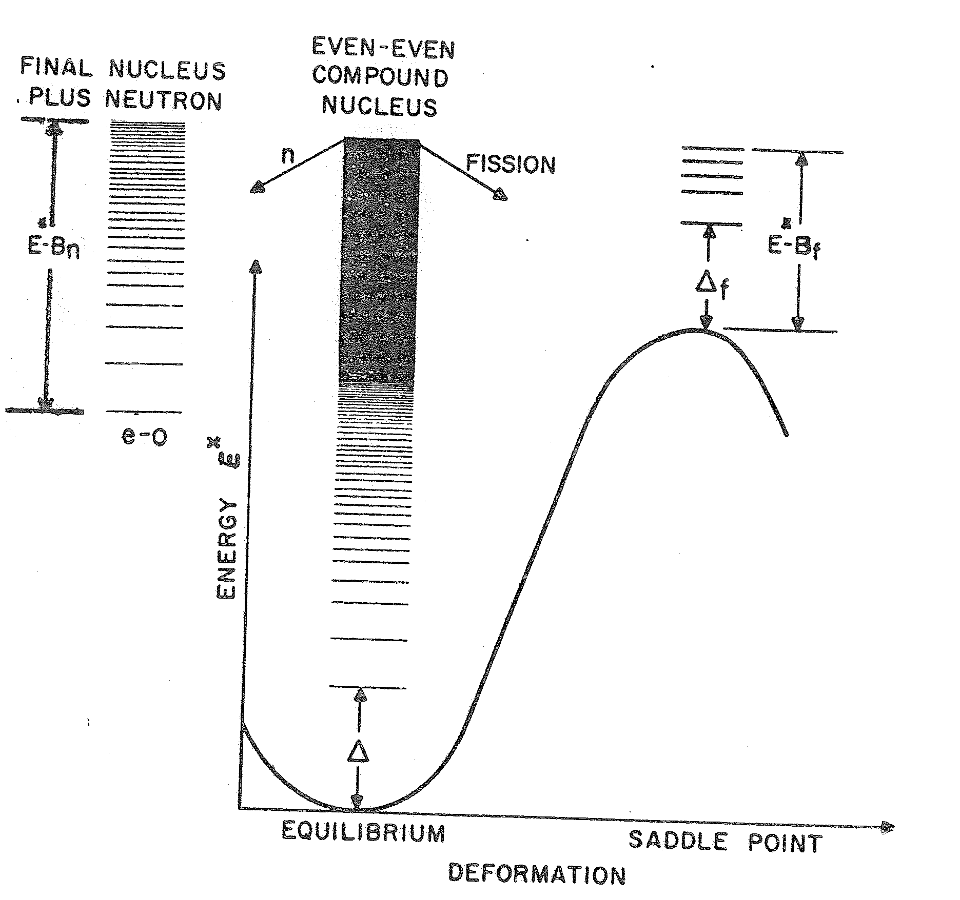
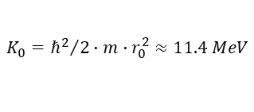
Fusion and evaporation
final nucleus
plus neutron
even-even
compound
nucleus
n
fission
⁵⁰Ti + ²⁰⁸Pb ⇒ ²⁵⁸Rf*
(HIVAP calculations)
Fusion
Fission
σ [mbarn]
≈5-7 orders of magnitude
Both decay processes are determined by the level density, either from the residual nucleus or at the saddle point.
level density:
1n
2n
3n
evaporation residues (ER)
E_{lab} [MeV]
$$K_{0}={ℏ^{2}}/{2∙m∙r_{0}^{2}}≈11.4 MeV$$

Slide 25
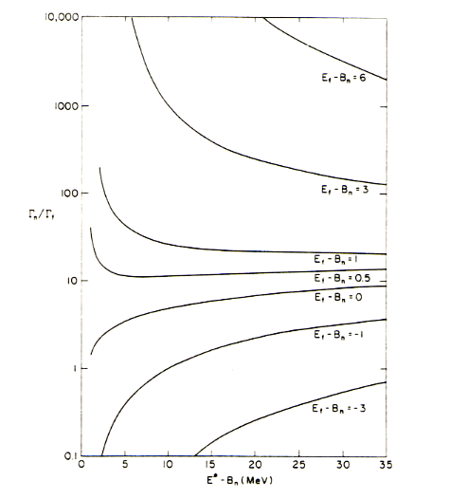
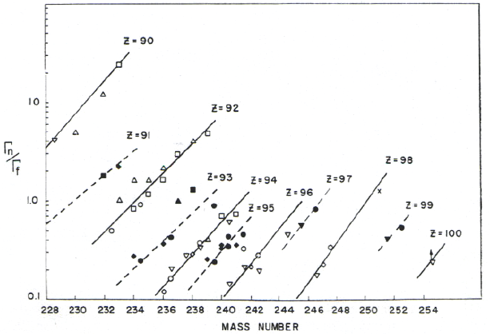
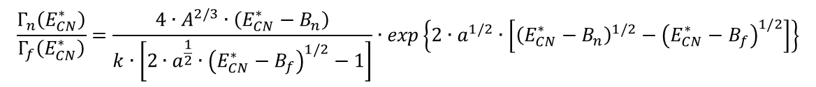
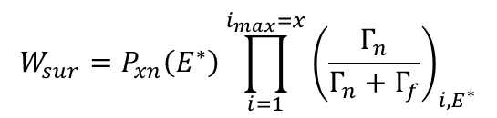
Survival probability
$$W_{sur}=P_{xn}\left(E^{∗}\right)\prod_{i=1}^{i_{max}=x}{{\left(\frac{Γ_{n}}{Γ_{n}+Γ_{f}}\right)}_{i,E^{∗}}}$$
A more rigorous expression of Γ_{n}/Γ_{f} (Vandenbosch and Huizenga) can be used over a wider range of excitation energies:
$$\frac{Γ_{n}\left(E_{CN}^{∗}\right)}{Γ_{f}\left(E_{CN}^{∗}\right)}=\frac{4∙A^{2/3}∙\left(E_{CN}^{∗}−B_{n}\right)}{k∙\left[2∙a^{\frac{1}{2}}∙{\left(E_{CN}^{∗}−B_{f}\right)}^{1/2}−1\right]}∙exp\left\{2∙a^{1/2}∙\left[{\left(E_{CN}^{∗}−B_{n}\right)}^{1/2}−{\left(E_{CN}^{∗}−B_{f}\right)}^{1/2}\right]\right\}$$
with k = 9.8 MeV and a = A/12 MeV⁻¹, B_{n}, B_{f} from Möller et al., At. Data Nucl. Data Tables 39, 213 & 59, 185

Slide 26
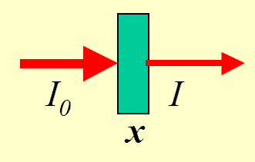
Event rate for SHE production
2·10¹²/s projectiles → ²⁰⁸Pb target (0.5 mg/cm²)
$$N_{p}\left(x\right)=N_{p}\left(0\right)∙\left(1−e^{N_{t}∙σ∙x}\right)≅N_{p}\left(0\right)∙N_{t}∙σ∙x$$
N_{p}
N_{p}(x)
208g ≡ 6.02·10²³ atoms
0.5mg ≡ 1.45·10¹⁸ atoms
luminosity: N_{p}·N_{t} = 2.9·10³⁰ [s⁻¹cm⁻²]
SHIP transmission: ε = 40%
cross section: σ = 1 [pb] = 10⁻³⁶ [cm²]
event rate: N_{p}·N_{t}·ε·σ = 1·10⁻⁶ [s⁻¹] = 0.1 [d⁻¹]

Slide 27
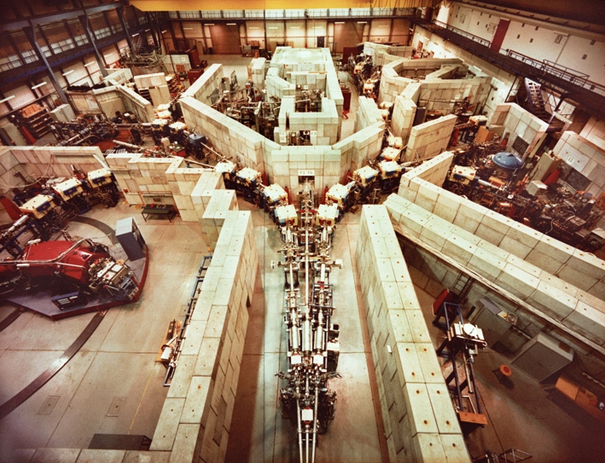

Separator for Heavy Ion Products (SHIP)

Slide 28







Separator for Heavy Ion Products (SHIP)
Fusion products are slower than scattered or transfer particles
E- and B-field are perpendicular to each other
$$v_{CN}=\left[{m_{p}}/{\left(m_{p}+m_{t}\right)}\right]∙v_{p}$$
$$e.q. v_{p}≈10.3\% → v_{CN}≈2.2\%$$
$$B∙ρ=\frac{m∙v}{e∙q}$$
$$E∙ρ=\frac{m∙v^{2}}{e∙q}$$
$$F_{mag}=F_{el}⇒F_{tot}=0$$
electric deflectors: ±330 kV dipole magnets: 0.7 T max

Slide 29

Separator for Heavy Ion Products (SHIP)
The choice of E and B determines the transmitted velocity
The rejected beam will be stopped on a cooled Cu plate
$$v=\frac{E}{B}$$

Slide 30

SHIP – stop detector
γ
α (ΔE signal)
SHE will be measured in a pixel
position sensitive Silicon detector determines the position an energy of SHE and α, β, ...
area: 27*87mm², thickness: 0.3mm, 16 strips
energy resolution ΔE=18-20 keV @ E_{α}> 6MeV (cooling 260K)
position resolution Δx=0.3mm (FWHM)
Wait for the emission of an α-particle
(or β-particle)
correlation method: implantation and decay event in the same pixel

Slide 31

Synthesis and identification of heavy elements with SHIP
n
⁷⁰Zn
²⁰⁸Pb
²⁷⁷112
²⁷⁷112
²⁷⁷112
ER
²⁷³110
11.45 MeV
280 μs
12 m
²⁶⁹Hs
11.08 MeV
110 μ s
²⁶⁵Sg
9.23 MeV
19.7 s
²⁶¹Rf
4.60 MeV (escape)
7.4 s
known
kinematical separation (in flight)
using electric deflectors
and dipole magnets
→ velocity filter
8.52 MeV
4.7 s
²⁵⁷No
²⁵³Fm
8.34 MeV
15.0 s
$$v=E/B$$
Date: 09-Feb-1996
Time: 22:37 h

Slide 32


Synthesis and identification of heavy elements with SHIP
n
⁷⁰Zn
²⁰⁸Pb
²⁷⁷112
²⁷⁷112
8 cm
²⁷⁷112
ER
²⁷³110
11.45 MeV
280 μs
12 m
²⁶⁹Hs
11.08 MeV
110 μ s
31 cm
9.23 MeV
19.7 s
²⁶⁵Sg
Identification by
α-α correlations
down to known
isotopes
²⁶¹Rf
4.60 MeV (escape)
7.4 s
known
kinematical separation (in flight)
using electric deflectors
and dipole magnets
→ velocity filter
8.52 MeV
4.7 s
²⁵⁷No
²⁵³Fm
8.34 MeV
15.0 s
$$v=E/B$$
Date: 09-Feb-1996
Time: 22:37 h

Slide 33

²⁰⁸Pb + ⁶⁴Ni → ²⁷²Ds*
T_{decay}
E_{α} (MeV)

Slide 34


Representation of decay curve maximum likelihood estimate of the lifetime τ
K.H.Schmidt, Z.Phys. A316 (1984), 19

Slide 35
Representation of decay curve maximum likelihood estimate of the lifetime τ
K.H.Schmidt, Z.Phys. A316 (1984), 19

Slide 36



Geiger-Nuttall relationship
The average decay properties of even mass decay chains match the Geiger-Nuttall relationship
Coulomb barrier
nuclear potential
binding energy of α-particle
binding energy per nucleon in nucleus
Y. Oganessian; J. Phys. G: Nucl. Part. Phys. 34 (2007) E165

Slide 37


Increase of Q_{α} values for the isotopes with Z = 112-118
deformed shell closure
N=162
N=152
Micro-macro predictions:
nuclei with N ≥ 175 are close to spherical (β₂ ≈ 0.09)
Y. Oganessian; J. Phys. G: Nucl. Part. Phys. 34 (2007) E165

Slide 38

Increase of Q_{α} values for the isotopes with Z = 112-114

Slide 39

Increase of Q_{α} values for the isotopes with Z = 112-114
Alpha-decay energy versus neutron number of trans-fermium nuclei. (a) Isotopes of even-Z elements with Z ≥100. (b) Isotopes of odd-Z elements with Z ≥103. Circles denote nuclei synthesized in hot fusion reactions with light ions (²²Ne, ²⁶Mg, ³⁶S) and in cold fusion with massive projectiles; squares correspond to the nuclei, produced in ⁴⁸Ca-induced reactions. Dashed lines represent long sequences of correlated decays of the nuclei ²⁸⁸115 and ²⁹¹116, observed in the reactions ²⁴³Am + ⁴⁸Ca and ²⁴⁵Cm + ⁴⁸Ca (see panel (a)), respectively. The solid lines are drawn through the values of Q_{α} (small open circles), calculated in the MM-model [39, 144]. The closed neutron shells N = 152 and N = 162 are shown by the vertical dashed-dotted lines.

Slide 40

α-decay energy: theory / experiment

Slide 41

α-decay energy: theory / experiment

Slide 42


The end of the “cold fusion” path?

Slide 43



“Hot fusion” – The Dubna Era
Yuri Oganessian
1 pico barn →
1 nucleus / week
→ requires very efficient separation and detection techniques

Slide 44

Using ⁴⁸Ca beams with actinide targets
Joint Institute of Nuclear Research (Dubna) has extended the periodic table to Z=118
⁴⁸Ca projectiles produced by U400 heavy ion accelerator
energy: 235 -250 MeV
beam intensity: 1.0 – 1.5 pμA
consumption: 0.5 – 0.8 mg/h
beam dose: (0.3 – 3.0)·10¹⁹
year | element | reaction | number of atoms
2000 | 114 | ⁴⁸Ca → ²⁴⁴Pu | 50
2004 | 113 | decay product of Z=115 | 8
2004 | 115 | ⁴⁸Ca → ²⁴³Am | 30
2005 | 116 | ⁴⁸Ca → ²⁴⁸Cm | 30
2006 | 118 | ⁴⁸Ca → ²⁴⁹Cf | 3 - 4
2010 | 117 | ⁴⁸Ca → ²⁴⁹Bk | 6
prices per 1 mg
¹⁹⁷Au ≈ 0.03 $
²³⁹Pu ≈ 4 $
⁴⁸Ca ≈ 80 $
²⁴⁹Cf ≈ 60 000 $

Slide 45

Using ⁴⁸Ca beams with actinide targets
Joint Institute of Nuclear Research (Dubna) has extended the periodic table to Z=118
⁴⁸Ca projectiles produced by U400 heavy ion accelerator
energy: 235 -250 MeV
beam intensity: 1.0 – 1.5 pμA
consumption: 0.5 – 0.8 mg/h
beam dose: (0.3 – 3.0)·10¹⁹
reaction | Q_{gg} (MeV) | V_{C}(R_{int}) (MeV) | E* (MeV)
$${}_{20}^{48}{Ca}+{}_{94}^{244}{Pu}→{}_{114}^{292}{Fl}$$ | -160.5 | 197.3 | 36.8
$${}_{20}^{48}{Ca}+{}_{95}^{243}{Am}→{}_{115}^{291}{Mc}$$ | -170.6 | 199.7 | 29.1
$${}_{20}^{48}{Ca}+{}_{96}^{248}{Cm}→{}_{116}^{296}{Lv}$$ | -166.6 | 201.1 | 34.5
$${}_{20}^{48}{Ca}+{}_{97}^{249}{Bk}→{}_{117}^{297}{Ts}$$ | -170.1 | 203.2 | 33.1
$${}_{20}^{48}{Ca}+{}_{98}^{249}{Cf}→{}_{118}^{297}{Og}$$ | -174.3 | 205.4 | 31.1
Q_{gg} and V_{C}(Bass) from http://nrv.jinr.ru/nrv/webnrv/qcalc/

Slide 46




Irradiation of targets at HFIR reactor (Oak Ridge)
$${}_{92}^{238}U+{}_{0}^{1}n \begin{matrix} \\ \vec{{ }_{ }}\end{matrix} {}_{92}^{239}{U }\begin{matrix}β^{−} \\ \vec{ _{23.5 min}}\end{matrix} {}_{93}^{239}{Np }\begin{matrix}β^{−} \\ \vec{ _{2.357 d}}\end{matrix} {}_{94}^{239}{Pu}$$
$${}_{94}^{239}{Pu }\begin{matrix}\left(n,γ\right) \\ \vec{ }\end{matrix} {}_{94}^{240}{Pu} \begin{matrix}\left(n,γ\right) \\ \vec{ }\end{matrix} {}_{94}^{241}{Pu} \begin{matrix}β^{−} \\ \vec{ _{14.35 a}}\end{matrix} {}_{95}^{241}{Am}\left(\begin{matrix}α \\ \vec{ _{432.2 a}}\end{matrix} {}_{93}^{237}{Np}\right)$$
Irradiation in the HFIR flux trap (18 month)
- thermal-neutron flux of
2.5·10¹⁵ neutrons/(s·cm²)
- 31 target positions
(10 – 13 targets typically irradiated)
- produces ~35 mg ²⁵²Cf per target
(smaller quantities of Bk, Es, Fm)

Slide 47

22 mg of ²⁴⁹Bk ≈ 1 M$, 250 day irradiation in HIFR (ORNL)
Bk(NO₃)₃ product
The two year experimental campaign began with a 250 day irradiation in HFIR, producing 22 milligram of ²⁴⁹Bk, which has a 320 day half-life. The irradiation was followed by 90 days of processing at radiochemical Engineering Development Center (REDC) to separate and purify the Berkelium. The ²⁴⁹Bk target was prepared at Dimitrovgrad and then bombarded for 150 days at the Dubna facility.

Slide 48

22 mg of ²⁴⁹Bk ≈ 1 M$, 250 day irradiation in HIFR (ORNL)

Slide 49


²⁴⁹Cf target

Slide 50


Dubna gas filled recoil separator (DGFRS)

Slide 51
“Hot fusion” – The Dubna Era
Yuri Oganessian
1 pico barn →
1 nucleus / week
→ requires very efficient separation and detection techniques

Slide 52



Cross sections – fission barriers
$$σ_{ER}=σ_{capture}∙P_{CN}∙P_{survival}$$
$$\frac{Γ_{n}}{Γ_{f}}\sim \frac{2∙T∙A_{CN}^{2/3}}{K_{0}}∙exp\left[{\left(B_{f}−B_{n}\right)}/T\right]$$
Y. Oganessian; J. Phys. G: Nucl. Part. Phys. 34 (2007) E165

Slide 53


Cross sections – fission barriers
$$σ_{ER}=σ_{capture}∙P_{CN}∙P_{survival}$$
$$\frac{Γ_{n}}{Γ_{f}}\sim \frac{2∙T∙A_{CN}^{2/3}}{K_{0}}∙exp\left[{\left(B_{f}−B_{n}\right)}/T\right]$$
²⁰⁹Bi
LDM + Shell corr.
LDM barrier
fission barrier height (MeV)
²²⁶Ra
²³²Th
²⁴⁰Pu
²⁹⁸Lv
²³⁶U
²⁴⁵Cm
²⁵³Cf
Atomic number

Slide 54

Fission barrier and half-lives
(a) Fission barrier heights as a function of the fissility parameter x = (Z²/A)/(Z²/A)_{crit} [5] at (Z²/A)_{crit} = 50.883. The black points are experimental data, the solid line is calculations in the liquid-drop model [3,6], crosses are calculated fission barrier heights in the macro-microscopic model for the isotopes of elements 114 and 116 [7], the open squares are nuclei, produced in the ^{242,244}Pu, ^{245,248}Cm + ⁴⁸Ca reactions. (b) Half-lives with respect to spontaneous fission as a function of the fissility parameter x. The black points and the open circles denote experimental values TSF(exp) for spontaneous fission of even–even nuclei from the ground and isomeric states. The dashed line is an extrapolation into the trans-actinide region before the synthesis of heavy nuclei in heavy-ion-induced reactions (macroscopic concept). Crosses are calculated values TSF(th) in the macro-microscopic model for even–even isotopes of elements 114 and 116 [7], open squares are nuclei, produced in the reactions ^{242,244}Pu, ^{245,248}Cm + ⁴⁸Ca, black squares are isotopes for which the SF-half-lives have been measured
Y. Oganessian; J. Phys. G: Nucl. Part. Phys. 34 (2007) E165

Slide 55

Spontaneous fission half-lives of actinides
Y. Oganessian; J. Phys. G: Nucl. Part. Phys. 34 (2007) E165

Slide 56

Chart of nuclides: the domain of heavy and super heavy elements

Slide 57




Chart of nuclides: the domain of heavy and superheavy elements
162
184
120
152
Og
Ts
Mc
114
Nh
sperical shell-stabilised
superheavy nuclei
108
E_{shell}
-8.3
-7.4
-6.4
-5.4
-4.4
-3.4
-2.4
-1.4
-0.4
deformed shell-stabilised
superheavy nuclei
Calc.: A. Sobiczewski

Slide 58

The heaviest known nuclei

Slide 59

Experimental and theoretical cross sections for ⁶⁴Ni + ²⁰⁸Pb → ²⁷¹Ds + 1n

Slide 60

What is the structure of SHE?

Slide 61

Influence of shell effects on fission barrier
macroscopic barrier:
disappears at Z ~ 104!

Slide 62

Influence of shell effects on fission barrier
macroscopic barrier:
disappears at Z ~ 104!
with shell structure:
spherical ↔ deformed ground state
fission barrier is also > 0 for Z ≥ 104
some fission barriers have complicated shapes,
multi-humped structure
elements exist only due to shell effects:
superheavy elements

Slide 63
The JUROGAM array + RITU + GREAT spectrometer

Slide 64




The JUROGAM array + RITU + GREAT spectrometer
tagging instrumentation at JYFL (Jyväskylä) JUROGAM, RITU, GREAT

Slide 65






Spinning the heaviest elements
rotational energy: $E_{I}=\frac{ℏ^{2}}{2ℑ}∙I\left(I+1\right)$
γ-ray energy: $E_{I}−E_{I−2}=\frac{ℏ^{2}}{2ℑ}∙\left(4I−2\right)$
dependence of the fission barrier on spin I
S. Eeckhaupt et al.; EPJA 26 (2005), 227

Slide 66
Rotational Bands

Slide 67

Rotational Bands

Slide 68



Single particle orbitals
R. Chasman et al. Rev. Mod. Phys. 49 (1977), 833
oblate
$${}_{102}^{254}{{No}_{152}} β_{2}\sim 0.28$$
prolate

Slide 69


What is the structure of SHE?

Slide 70

Stability of heavy elements – Nilsson level energy gap
N = 152
²⁵⁴No (Z=102), ²⁵²Fm (Z=100) and ²⁵⁰Cf (Z=98) with N=152
seem to be more stable than their neighbors

Slide 71


Shiptrap: Probing the strength of shell effects
$$δ_{2n}\left(N,Z\right)=2∙B\left(N,Z\right)−B\left(N−2,Z\right)−B\left(N+2,Z\right)$$
$$δ_{2n}\left(N,Z\right)=S_{2n}\left(N,Z\right)−S_{2n}\left(N+2,Z\right)$$
No
Muntian (mic-mac), Z=114 N=184
Möller FRDM, Z=114 N=184
TW-99, Z=120 N=172
SkM* Z=126 N=184
neutron number
50 MeV
²⁰⁶Pb(⁴⁸Ca,2n)²⁵²No
²⁰⁷Pb(⁴⁸Ca,2n)²⁵³No
²⁰⁸Pb(⁴⁸Ca,2n)²⁵⁴No
²⁰⁸Pb(⁴⁸Ca,1n)²⁵⁵No
eV
E. Minaya Ramirez et al.; Science 337 (2012), 1207

Slide 72



Isomeric states in even-even nuclei
Why K-isomers occur?
deformed nuclei
breaking of particle pair at Fermi surface
selection rule for electromagnetic transitions $λ≥ΔK$ is not fulfilled
excitation energy of quasi-particle:
$E=\sqrt{{\left(ε−λ\right)}^{2}+Δ^{2}}$
I=R
K=0
What we can learn?
information about Nilsson level energy gaps
influence on stability of superheavy elements
pairing interaction

Slide 73

Isomeric states in even-even nuclei
Why K-isomers occur?
deformed nuclei
breaking of particle pair at Fermi surface
selection rule for electromagnetic transitions $λ≥ΔK$ is not fulfilled
excitation energy of quasi-particle: $E=\sqrt{{\left(ε−λ\right)}^{2}+Δ^{2}}$
I=R
I=R+j
K=0
Ω₁+Ω₂=K
K=8⁻
K=8⁻
What we can learn?
information about Nilsson level energy gaps
influence on stability of superheavy elements
pairing interaction

Slide 74





K-isomers in ²⁵²No
K=8⁻
$$ν\left[734\right]{9/2}^{−}⊗ν\left[624\right]{7/2}^{+}$$
K=8⁻
K=2⁻
B. Sulignano st al; Phys. Rev. C 86, 044318 (2012)

Slide 75





Neutron single particle states in ²⁵²No
7/2⁺[624] Nilsson configuration i_{11/2}
9/2⁻[734] Nilsson configuration j_{15/2}
$$g\left(j\right)=\left\{\begin{aligned}\frac{2ℓ∙g_{ℓ}+g_{s}}{2ℓ+1} for j=ℓ+1/2 \\ \frac{2\left(ℓ+1\right)∙g_{ℓ}−g_{s}}{2ℓ+1} for j=ℓ−1/2\end{aligned}\right.$$
proton: g_{ℓ} = 1 g_{s} = 5.59
neutron: g_{ℓ} = 0 g_{s} = -3.83
g(i_{11/2}) = +0.295 g(j_{15/2}) = -0.255
$$g\left(j_{1}×j_{1};J\right)=\frac{1}{2}∙\left(g_{1}+g_{2}\right)+\frac{j_{1}\left(j_{1}+1\right)−j_{2}\left(j_{2}+1\right)}{2J\left(J+1\right)}∙\left(g_{1}−g_{2}\right)$$
g(i_{11/2} x j_{15/2}; 8) = 0.09
$$B\left(M1;I→I−1\right)=\frac{3}{4π}{\left[g_{K}−g_{R}\right]}^{2}∙K^{2}{\left|\left\langle IK10 | \left(I−1\right)K\right\rangle \right|}^{2}$$
$$B\left(E2;I→I−2\right)=\frac{5}{16π}Q_{0}^{2}{\left|\left\langle IK20 | \left(I−2\right)K\right\rangle \right|}^{2}$$
g_{R} = Z/A = 0.40

Slide 76


K-isomeric states
Exp. results: excitation of isomeric states
Yrast – plot ( ²⁵⁴No)
²⁵⁴No with Z=102 and N=152 – protons will be excited easily
²⁵⁰Fm with Z=100 and N=150 – neutrons will be excited easily

Slide 77



Level scheme of ²⁵³No (151 neutrons)
9/2⁻ [734]
7/2⁺ [624]
R. Chasman et al.; Rev. Mod. Phys. 49 (1977) 833

Slide 78


Level scheme of ²⁵³No (151 neutrons)
ground state 9/2⁻
excited state 7/2⁺
rotational band observed at Gammasphere & JUROGAM
9/2⁻ [734]
7/2⁺ [624]
M1
R. Chasman et al.; Rev. Mod. Phys. 49 (1977) 833

Slide 79

Alpha decay of ²⁵³No
²⁵³No
²⁴⁹Fm
In general, α-decay in even-even parents lead to the ground state of the daughter nucleus so that the emitted particle carries away as much energy as possible and as little angular momentum as possible.
α-decays of odd-A heavy nuclei populate predominantly low-lying excited states that match the spin of the parent so that the orbital angular momentum of the α-particle can be zero.

Slide 80



Spectroscopy of element 115
TASCA
Recoil separator for superheavy element chemistry and physics
1 chain (out of 30) is compatible with
2 chains (out of 37) associated with the 4n channel ${}_{115}^{287}{Mc}$ by Oganessian et al.
Mc = Moscovium
Dubna Gas Filled Recoil Separator

Slide 81



Spectroscopy of element 115
TASCA
target chamber side view
²⁴³Am target wheel
0.83 mg/cm²
20 mg, 5·10¹⁹
> 150 MBq α,β,γ
⁴⁸Ca beam
6·10¹² /s

Slide 82


Spectroscopy of element 115
trigger: 100/s
Highly efficient multi-coincidence spectroscopy set-up for TASCA’s very compact focal plane image
Clover
Clover
Clover
1 Implantation DSSSD (1024 pixels)
4 box-DSSSDs (1024 pixels)
→ ~ 80% α-detection efficiency
Clover
4 Ge Clover (4·4 crystals)
1 Ge Cluster (7 crystals)
→ ~ 40% γ-detection eff. at 150 keV
Cluster
L.-L. Andersson et al.; NIM A622, 164 (2010)
L. G. Sarmiento et al.; NIM A667, 26 (2011)

Slide 83


TAsca Small Image mode SPECtroscopy
trigger: 100/s
Highly efficient multi-coincidence spectroscopy set-up for TASCA’s very compact focal plane image
Clover
Clover
Clover
1 Implantation DSSSD (1024 pixels)
4 box-DSSSDs (1024 pixels)
→ ~ 80% α-detection efficiency
Clover
4 Ge Clover (4·4 crystals)
1 Ge Cluster (7 crystals)
→ ~ 40% γ-detection eff. at 150 keV
Cluster
Ba₅₆ K X-rays ≡ Nh₁₁₃ L X-rays !!!
L.-L. Andersson et al.; NIM A622, 164 (2010)
L. G. Sarmiento et al.; NIM A667, 26 (2011)

Slide 84


Digital (or Sampling) electronics
96 DSSSD p-sides
60 MHz dead-time free sampling ADC
“FEBEX” cards developed at GSI-EE
25 Ge crystals
100 MHz commercial sampling ADCs,
4x SIS3302 cards, FPGA processed:
flat-top energy
baseline
pile-up flagging
detect summing, reduce background
software optimization (MWD)
towards best possible resolution
large dynamic range (linear within
0.1 – 100 MeV, time-over threshold)
That allows to …
restore baseline in software
retain (almost) nominal Ge-detector
energy resolution
… at high counting rates.

Slide 85

Results – ²⁸⁸Mc (3n – channel)

Slide 86


α – photon coincidences
Correlation time between implantation DSSSD detector and any Ge detector.
White line marks the gate for prompt coincidences.
Total projection of Ge-detector events in prompt coincidence with events in the implantation DSSSD, both accumulated during beam-off periods.
200 400
photon energy (keV)

Slide 87

Identification of Z
X-ray
fingerprinting

Slide 88

Characteristic X-rays
first X-ray candidate was seen!
K_{α2} K_{β} Bh (Z = 107)
T.A. Carlson et al.; NIM A622, 164 (1969)
accurate to 0.5%
difference between neighboring Z: 3 - 4 keV

Slide 89

Chemistry of superheavy elements
Are the new elements in the same period?
Does e.g. Lv show the same chemical properties as O, S, Se, Te and Po?
Lv = Livermorium

Slide 90






Chemistry of superheavy elements
relativistic effect: important for large Z
$$E=mc^{2}$$
High atomic number: strong Coulomb attraction causes electrons to move faster.
Causes relativistic mass increase $m=m_{0}{\left(1−β^{2}\right)}^{−1/2}$, with β = v/c; and as a consequence, contraction of spherical orbitals (ns, np_{1/2})
The s and p_{1/2} atomic orbitals contract relativistically.
The shrinking of the inner shells results in an increased screening of the nuclear charge, and this gives rise to an expansion of the p_{3/2} and of higher angular momentum orbitals.
Strong spin-orbit splitting
Bohr model:
$$E=−\left(2π^{2}e^{4}/n^{2}h^{2}\right)∙m∙Z^{2}$$
$$r=Ze^{2}/m∙v^{2}$$
$$v=\left(2πe^{2}/n∙h\right)∙Z$$
for hydrogen, m/m₀ = 1.000027, for element Z=114 , m/m₀ = 1.79, for element Z=118, m/m₀ = 1.95

Slide 91



Chemistry of superheavy elements
relativistic effect: important for large Z
$$E=mc^{2}$$
Solution of the Dirac equation (relativistic quantum mechanics) for a hydrogen-like atom:
$$E_{1s}=mc^{2}\sqrt{1−{\left(Zα\right)}^{2}}\sim mc^{2}∙\left(1−\frac{{\left(Zα\right)}^{2}}{2}−\frac{{\left(Zα\right)}^{4}}{8}+⋯\right)$$
relativistic effect

Slide 92


Famous example of relativistic effects: the color of gold
Gold looked like silver if there was no relativistic effect!

Slide 93

Famous example of relativistic effects: the color of gold

Slide 94

Famous example of relativistic effects: the color of gold
Ag
Au

Slide 95
Chemistry of superheavy elements
Gold is smaller than Silver
Roentgenium is of the same size as Copper

Slide 96
Chemistry of superheavy elements
How do the relativistic effects alter the periodic table for SHE?
→ a big open question

Slide 97

Chemistry of superheavy elements
Dubnium does not behave like Tantalum (1993)
Sg (1997) Bh (2000) and Hs (2001) confirmed relativistic calculations predicting the expected behavior in the periodic table.
Hassium, for instance, forms a gaseous oxide similar to Osmium.
The atomic orbitals s_{1/2} and p_{1/2} are contracted relativistically. The shrinking of the inner shells results in an increased screening of the nuclear charge, and this gives rise to an expansion of the p_{3/2} and of higher angular momentum orbitals. Another relativistic effect is a change in the spin-orbit coupling. Both can produce drastic rearrangements of orbital levels. That is what is predicted to happen for Cn. Recent calculations indicate that the 7s orbital should be shifted below the 6d_{5/2} orbital due to relativistic effects. It is the large relativistic stabilization of its valence 7s orbital, combined with its closed shell electron configuration, that has led to the prediction that element 112 is chemically inert (not very reactive).
Chemistry of the superheavy elements with Z > 118 is believed to show relativistic effects that are so large that comparison with
lighter elements or nonrelativistic results is meaningless.

Slide 98
Example: the relativistic 6s/7s contraction in Au and Rg
Consequence: Cu, Ag, Au nd¹⁰(n+1)s¹
Zn⁺,Cd⁺,Hg⁺
however: Rg, 112⁺ nd⁹(n+1)s² (²D_{5/2})
P. Schwerdtfeger
E.Eliav, U.Kaldor, P.Schwerdtfeger, B.Hess, Y.Ishikawa, Phys. Rev. Lett. 73, 3203 (1994).
M.Seth, P.Schwerdtfeger, M.Dolg, K.Faegri, B.A.Hess, U.Kaldor, Chem. Phys. Lett. 250, 461 (1996).

Slide 99

The limits of the periodic table
Can this go forever? NO!!!
The relativistic Dirac equation gives the ground state energy as
where m₀ is the rest mass of the electron. For Z > 137, the wave function of the Dirac ground state is oscillatory, rather than bound.
More accurate calculations taking into account the effects of the finite size of the nucleus indicate that the binding energy first exceeds 2mc² for Z > 173.
$$E=\frac{m_{0}∙c^{2}}{\sqrt{1+\frac{Z^{2}∙α^{2}}{n−\left(j+1/2\right)+\sqrt{{\left(j+1/2\right)}^{2}−Z^{2}∙α^{2}}}}}$$
The end of chemistry
Does the periodic table has limits? Yes!!!
At some point (Z ~ 122) all the electron energy levels of adjacent elements are similar so that there are no differences in their chemical behavior.

Slide 100
Chart of nuclides: the domain of heavy and superheavy elements
162
184
120
152
Og
Ts
Mc
114
Nh
sperical shell-stabilised
superheavy nuclei
108
E_{shell}
-8.3
-7.4
-6.4
-5.4
-4.4
-3.4
-2.4
-1.4
-0.4
deformed shell-stabilised
superheavy nuclei
Calc.: A. Sobiczewski

Slide 101

Representation of decay curve maximum likelihood estimate of the lifetime τ
no. | t (ms)
1 | 0.6
2 | 1.8
3 | 4.4
4 | 0.5
5 | 2.6
average value: 2.0 ms
Logarithmic decay-time distribution of 5 events observed in the α decay of ²⁷¹110 with alpha energies close to 10.74 MeV. Data are taken from S.Hofmann, Rep.Prog.Phys. 61(1998), 639. The curve shows the logarithmic decay-time distribution (τ=2.3 ms). The units on the ordinate are arbitrary.

