Slide 1

Outline: Future UNILAC experiments
Lecturer: Hans-Jürgen Wollersheim
e-mail: h.j.wollersheim@gsi.de
web-page: https://web-docs.gsi.de/~wolle/ and click on
Coulomb excitation
α-transfer reaction
electron spectroscopy
K-isomerism
transient magnetic field
spectroscopy of fission fragments

Slide 2
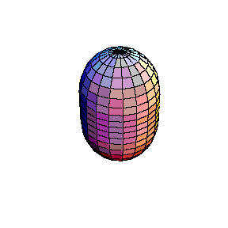
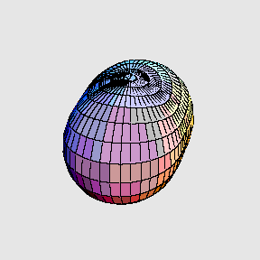
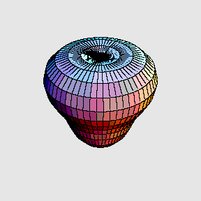

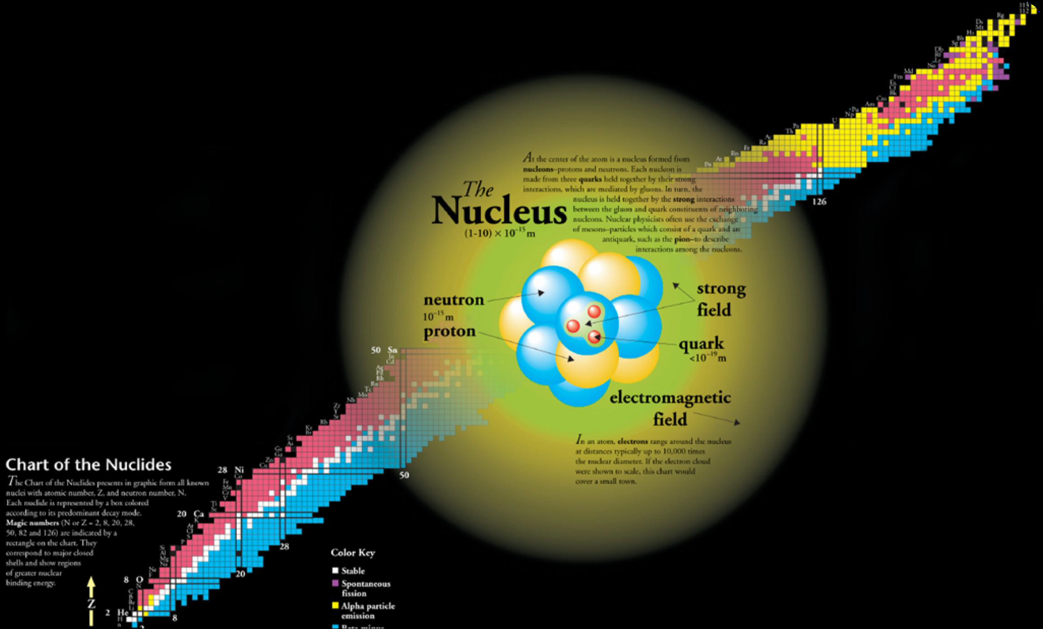
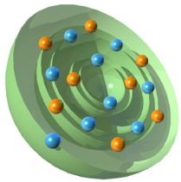
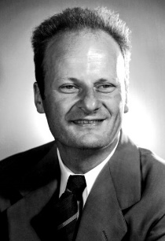

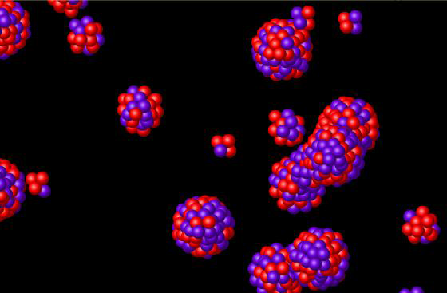
heavy ion
nuclear reactions

Slide 3


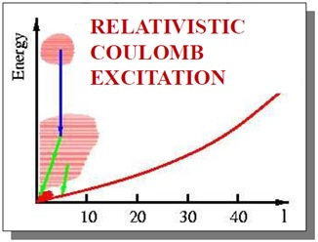
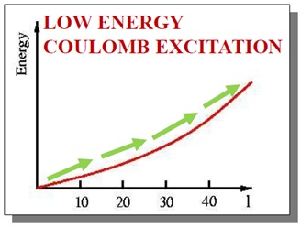
Heavy ion nuclear reactions
SIS-18
UNILAC

Slide 4
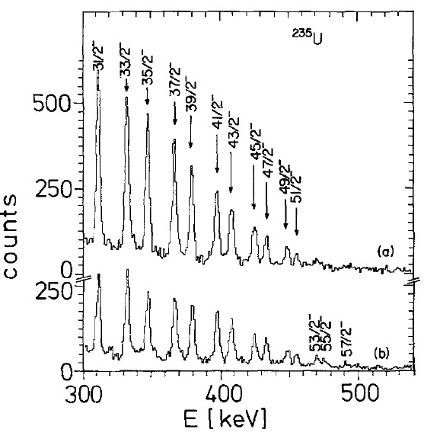
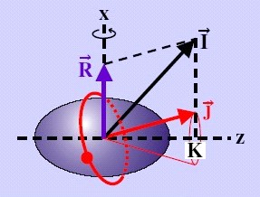
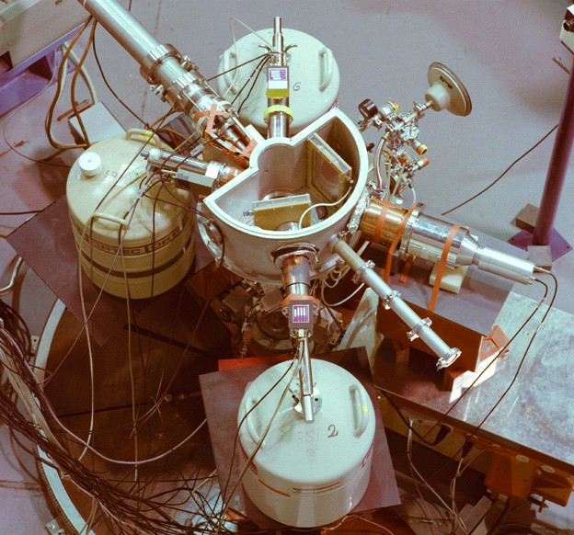
First Coulomb excitation experiment at UNILAC 1980
²⁰⁸Pb (5.3MeV/u) → ²³⁵U
Doppler-corrected γ-ray spectrum for ²³⁵U
i_{13/2} proton and j_{15/2} neutron alignment in ²³⁵U and ²³⁷Np

Slide 5
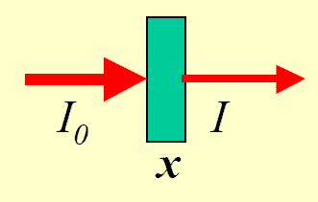

Count rate estimate for UNILAC experiments
Reaction rate [s⁻¹] = luminosity · cross section [cm²]
= projectiles [s⁻¹] · target nuclei [cm⁻²] · cross section [cm²]
accelerator current: 1 pnA consists of 6·10⁹ projectiles [s⁻¹]
target thickness: 1 mg/cm²
$$\frac{6∙{10}^{23}∙{10}^{−3}\left[g/{{cm}^{2}}\right]}{A_{target}\left[g\right]}=target nuclei \left[{cm}^{−2}\right]$$
A_{target} | target nuclei | projectiles | luminosity [s⁻¹ cm⁻²]
200 | 3·10¹⁸ [cm⁻²] | 6·10⁹ [s⁻¹] | 18·10²⁷ [s⁻¹ cm⁻²]
100 | 6·10¹⁸ [cm⁻²] | " | 36·10²⁷ [s⁻¹ cm⁻²]
50 | 12·10¹⁸ [cm⁻²] | " | 72·10²⁷ [s⁻¹ cm⁻²]
beam structure:
5 ms
duty factor: 25%
50 Hz
present beam structure:
3 ms
duty factor: 3%
10 Hz

Slide 6
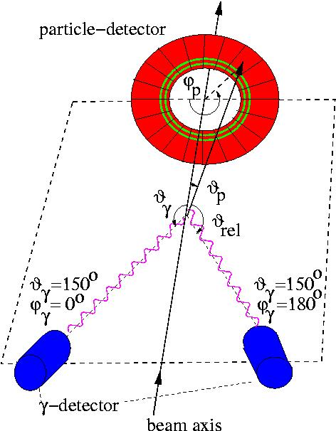
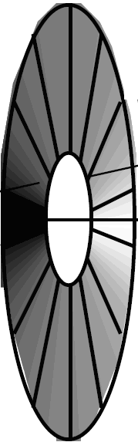
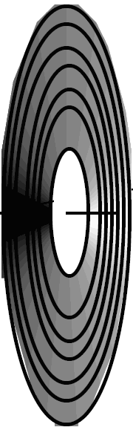
Coulomb excitation: particle identification
¹⁶⁴Dy
²⁰⁸Pb beam
²³⁸U target
¹⁶⁴Dy target
²⁰⁸Pb beam
V₀ ~ 500 V
p = 5-10 Torr
gap ~ 3 mm (anode-cathode)
distance target – PPAC: 11 cm

Slide 7
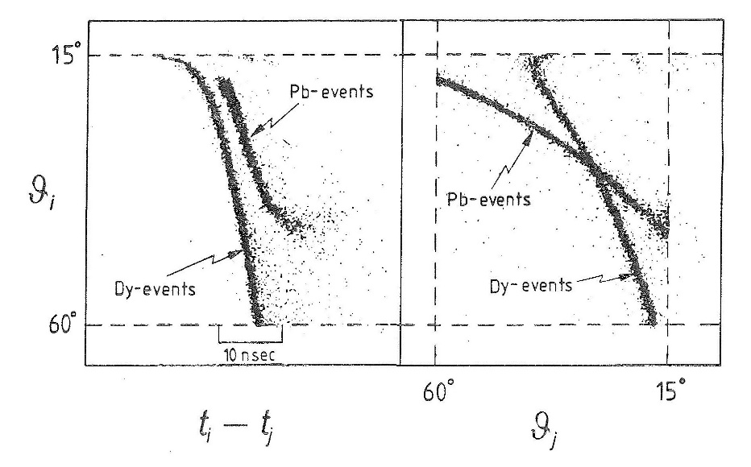

Coulomb excitation: particle identification
²³⁸U target
¹⁶⁴Dy target
52⁰
²⁰⁸Pb beam
$$max. scattering angle=arc sin\frac{A_{2}}{A_{1}}$$
distance target – PPAC: 11 cm

Slide 8
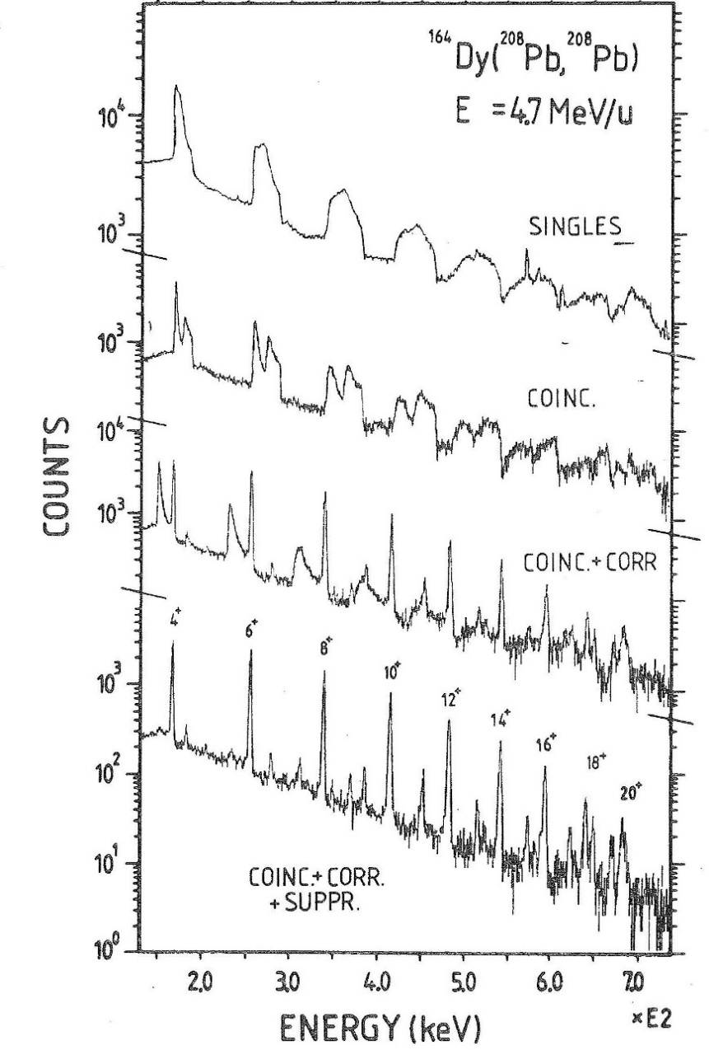
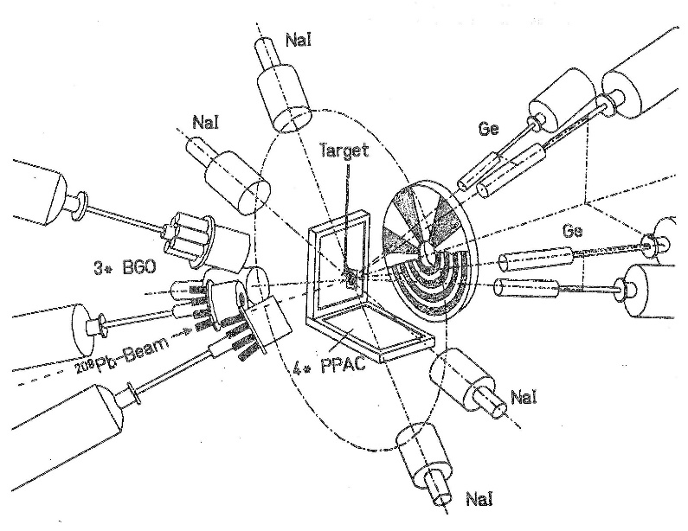
Doppler shift correction ²⁰⁸Pb + ¹⁶⁴Dy at 978 MeV
¹⁶⁴Dy target nucleus measured with PPAC (¹⁶⁴Dy target excitation)
index 1≡projectile (²⁰⁸Pb)
index 2≡target nucleus (¹⁶⁴Dy)
(=0.02746)
D. Schwalm et al. Nucl.Phys. A192 (1972), 449

Slide 9
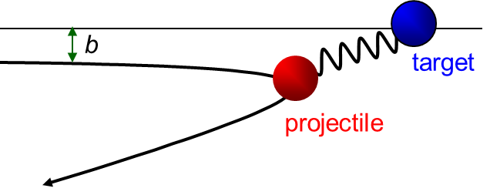
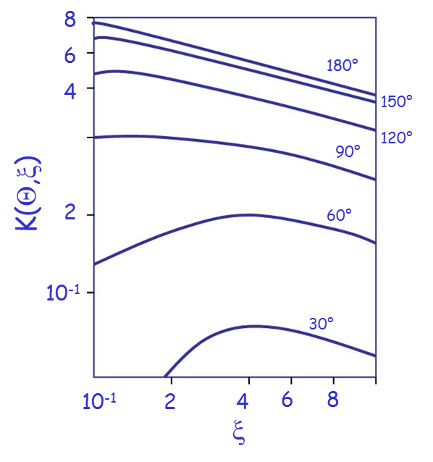
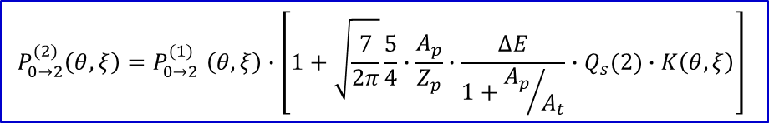
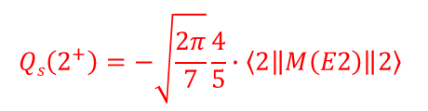
The reorientation effect at backward angles
The excitation cross section is a
direct measure of the Eλ matrix elements.
M_{f}
$$Qs\left(2^{+}\right)=−\sqrt{\frac{2π}{7}}\frac{4}{5}∙\left\langle 2\left\|M\left(E2\right)\right\|2\right\rangle$$
I_{f}
τ
I_{f}
I_{i}
I_{i}
1st order:
reorientation effect:
$$P_{0→2}^{(2)}\left(θ,ξ\right){=P}_{0→2}^{(1)}\left(θ,ξ\right)∙\left[1+\sqrt{\frac{7}{2π}}\frac{5}{4}∙\frac{A_{p}}{Z_{p}}∙\frac{∆E}{1+{A_{p}}/{A_{t}}}∙Q_{s}(2)∙K\left(θ,ξ\right)\right]$$

Slide 10
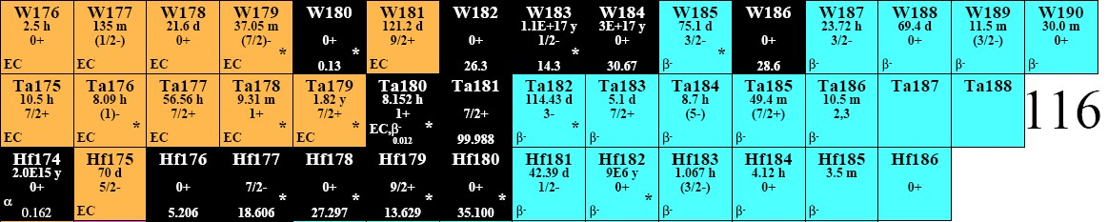
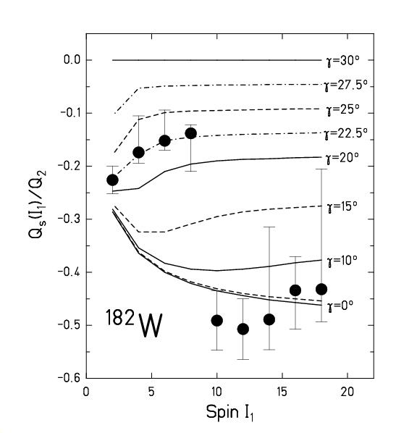
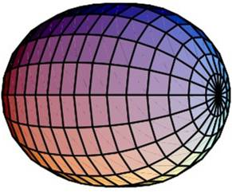
Quadrupole deformation in ^{182,184,186}W
Vibrator
Soft
Rotor
Spherical
Transitional
Deformed
Energy
Deformation
prolate
R. Kulessa et al., Phys. Lett. B218 (1989), 421

Slide 11
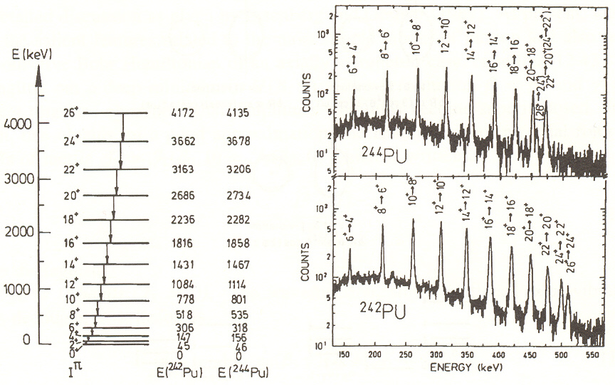





Alignment of i_{13/2} protons in ^{242,244}Pu
Alignment of i_{13/2} protons in ^{242,244}Pu
z
$$E_{I}=\frac{ℏ^{2}}{2ℑ}I\left(I+1\right)$$
b
a
$$E_{γ}=E_{I}−E_{I−2}=\frac{ℏ^{2}}{2ℑ}\left(4I−2\right)$$
$$ℑ=\frac{2}{5}A∙M∙R_{0}^{2}∙β^{2}$$
$$B\left(E2;I→I−2\right)=\frac{15}{32π}\frac{I\left(I+1\right)}{\left(2I−1\right)\left(2I+1\right)}∙Q_{2}$$
$$Q_{2}=\frac{3ZR_{0}^{2}}{\sqrt{5π}}∙β$$
analysis with GOSIA code
W. Spreng et al., Phys. Rev. Lett. 51 (1983), 1522

Slide 12
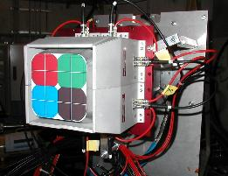
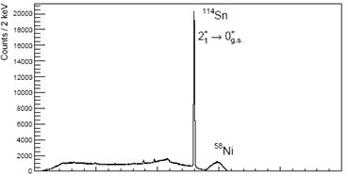

Coulomb excitation of ¹¹⁴Sn projectile excitation
^{114,116}Sn→⁵⁸Ni at 3.6MeV/u
E_{x}=1300, 1294 MeV
B(E2)↑=0.25(5), 0.209(5)e²b²
γ-efficiency = 0.005
accelerator duty factor=10%
beam intensity = 1pnA
target thickness = 1mg/cm²
pγ-rate (Sn) = 1/s
²³⁸U target
⁵⁸Ni target
²⁰⁸Pb beam
^{114,116}Sn beam
$$∆E_{γ}≅1\%$$
natural abundance of ¹¹⁴Sn: 0.65%
P. Doornenbal, A.Jhingan, R.Kumar, et al., Phys.Rev C 78 (2008) 031303

Slide 13
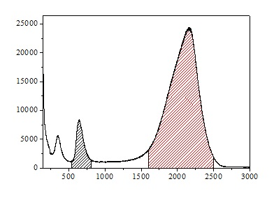
α-transfer reactions
¹¹⁴Sn
4⁺ → 2⁺
2⁺ → 0⁺
51º
65º
5⁻ → 4⁺
79º
3⁻ → 2⁺
e⁻e⁺
counts
¹¹⁸Te
2⁺ → 0⁺
4⁺ → 2⁺
Si spectrum
¹²C
2₂⁺ → 2⁺
e⁻e⁺
6⁺ → 4⁺
counts
α
E_{γ} (keV)
channel

Slide 14
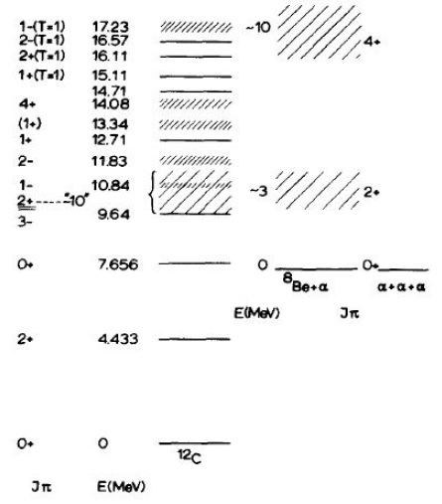
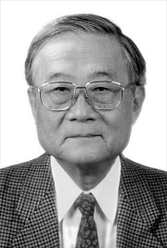
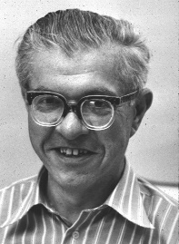
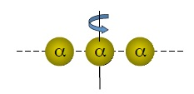
α-clustering in ¹²C
Haruhiko Morinaga
1956
7.27 MeV
Fred Hoyle 1953
2.4 MeV per bound

Slide 15
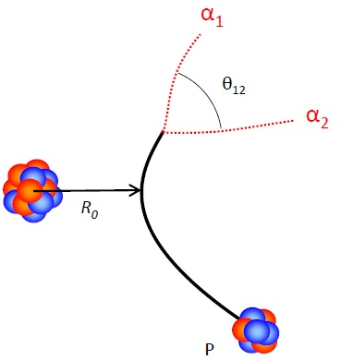




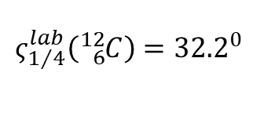
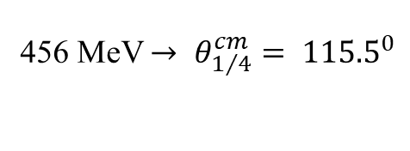
α-transfer experiment
^{112,114,116}Sn*
^{112,114,116}Sn + ¹²C
4 Euroball Cluster at ±65°
^{116,118,120}Te*
456 MeV $→ θ_{1/4}^{cm}= {115.5}^{0}$
^{nat}C
$$ς_{1/4}^{lab}\left({}_{6}^{12}C\right)={32.2}^{0}$$
Gd
Cu
0.7
10.8
4.9
mg/cm²
delayed breakup
recoil detection
23° ≤ Θ ≤ 38°
^{112,114,116}Sn
@ 4 MeV/u
⁸Be 0⁺ τ ~ 10⁻¹⁵ s
$$cosθ_{12}≅1−\frac{Q_{Be}}{E_{1}}≅1$$
$$Q_{Be}=92 keV$$
target
¹²C projectile
$$E_{rel}=\frac{m_{2}E_{1}+m_{1}E_{2}−2\sqrt{m_{1}E_{1}m_{2}E_{2}}∙cosθ_{12}}{m_{1}+m_{2}}$$

Slide 16
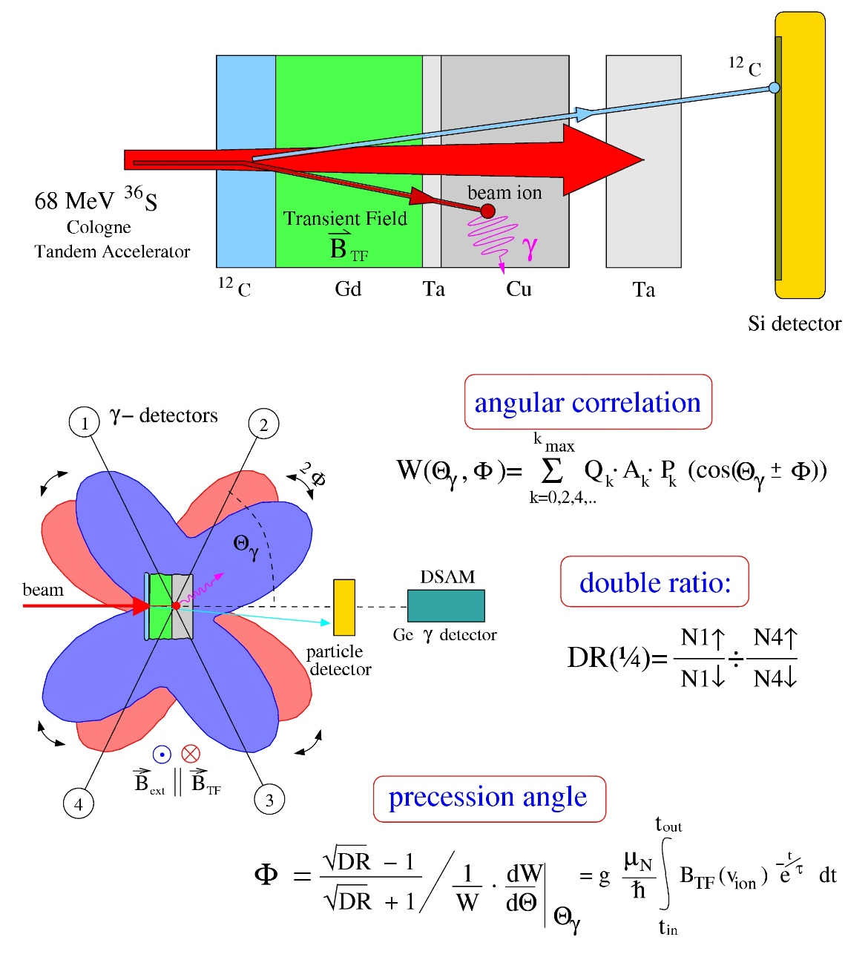
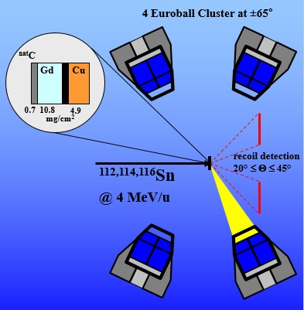
Transient magnetic fields g-factor measurement

Slide 17
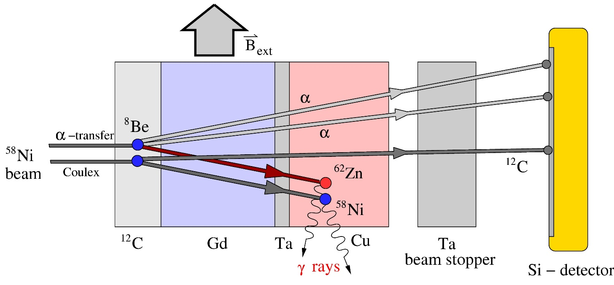
α-transfer experiment

Slide 18
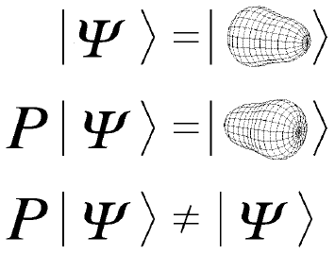
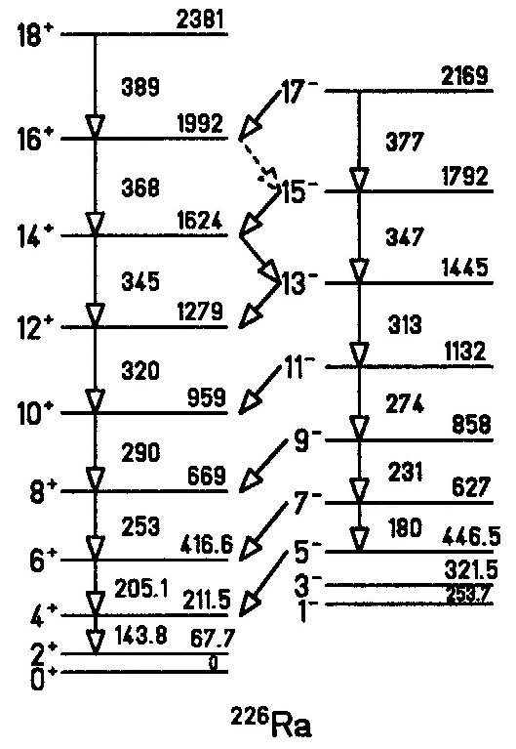

Space inversion invariance: octupole deformed nucleus ²²⁶Ra
π: +
π: -
E2
E1
rotation
H.J.Wollersheim, C. Fleischmann et al., Nucl. Phys. A556 (1993), 261

Slide 19
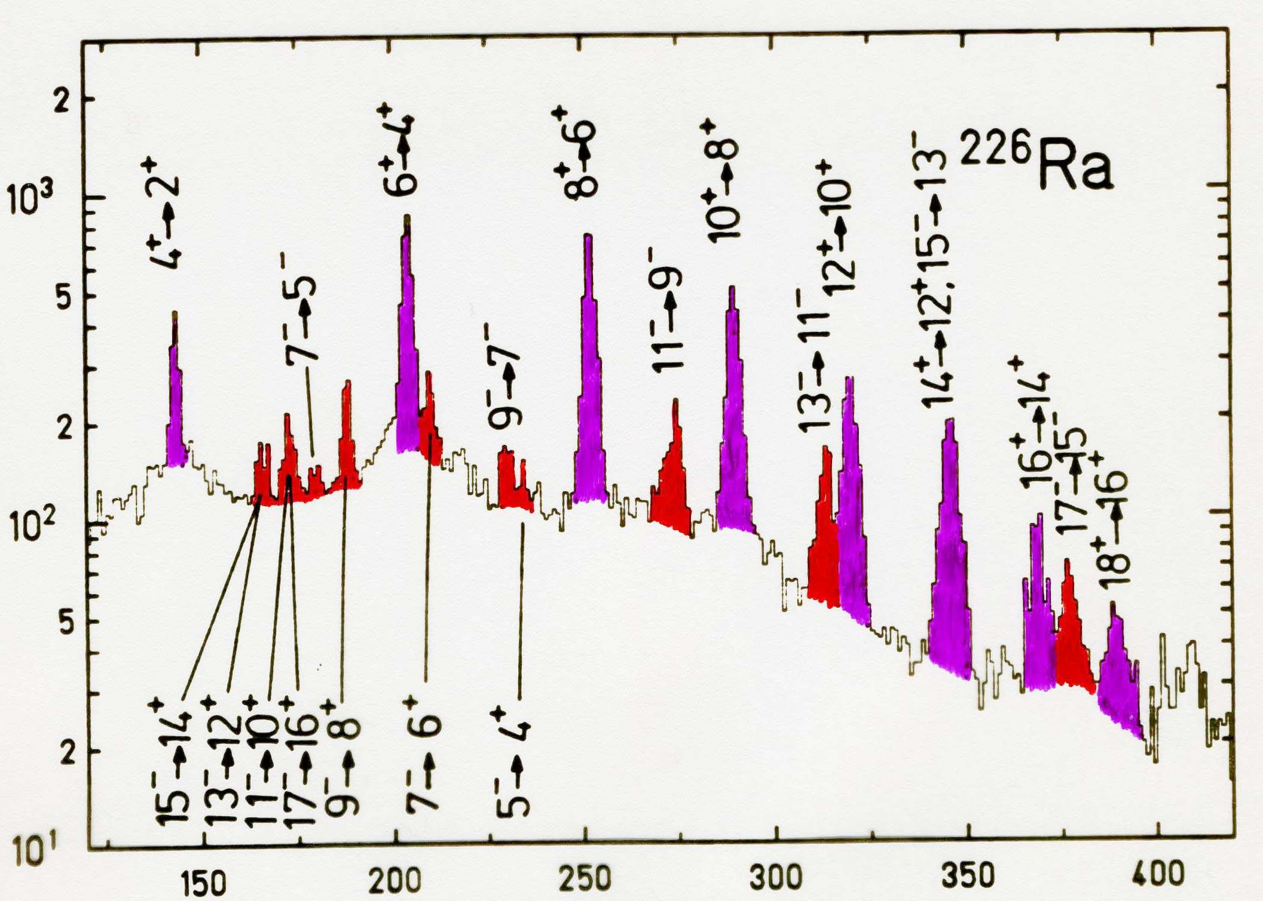
Coulomb excitation of ²²⁶Ra
²⁰⁸Pb → ²²⁶Ra
E_{lab} = 4.7 AMeV
15⁰ ≤ θ_{lab} ≤ 45⁰
0⁰ ≤ φ_{lab} ≤ 360⁰
counts
energy [keV]
²²⁶Ra target broken after 8 hours
H.J.Wollersheim, C. Fleischmann et al., Nucl. Phys. A556 (1993), 261

Slide 20
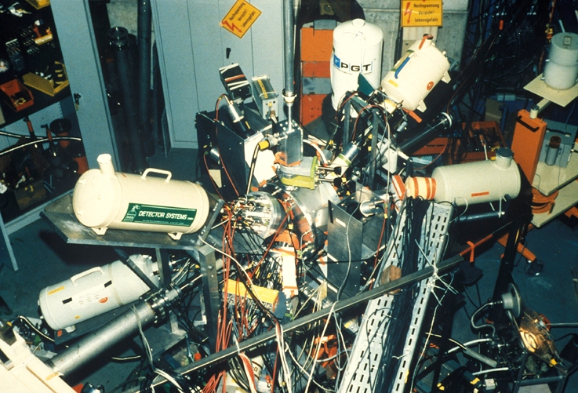
Coulomb excitation of ²²⁶Ra 1992

Slide 21
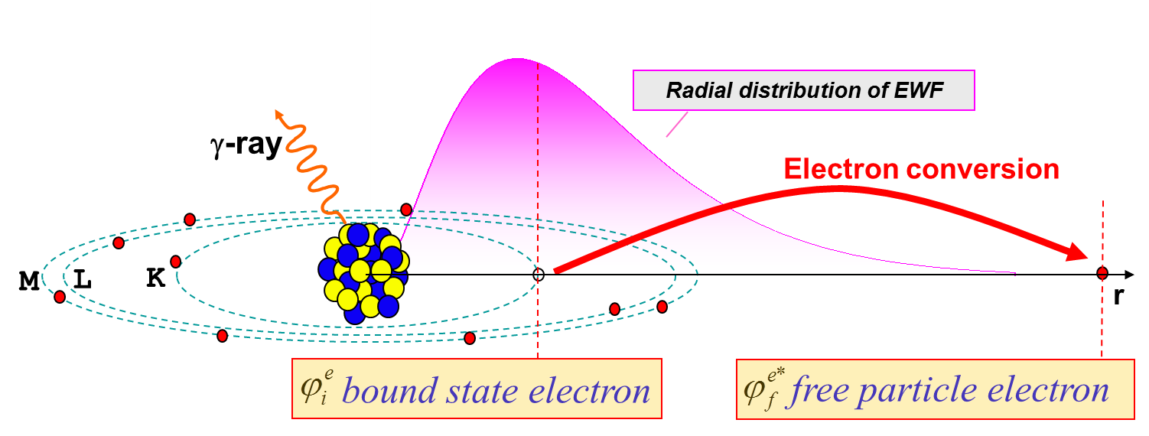
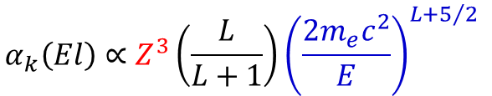
Conversion electrons
For an electromagnetic transition internal conversion can occur instead of emission of gamma radiation. In this case the transition energy Q = E_{γ} will be transferred to an electron of the atomic shell.
T_{e} = E_{γ} - B_{e}
T_{e}: kinetic energy of the electron
B_{e}: binding energy of the electron
internal conversion is important for:
heavy nuclei ~ Z³
high multipolarities Eℓ or Mℓ
small transition energies
$$α_{k}\left(El\right)∝Z^{3}\left(\frac{L}{L+1}\right){\left(\frac{2m_{e}c^{2}}{E}\right)}^{L+5/2}$$

Slide 22
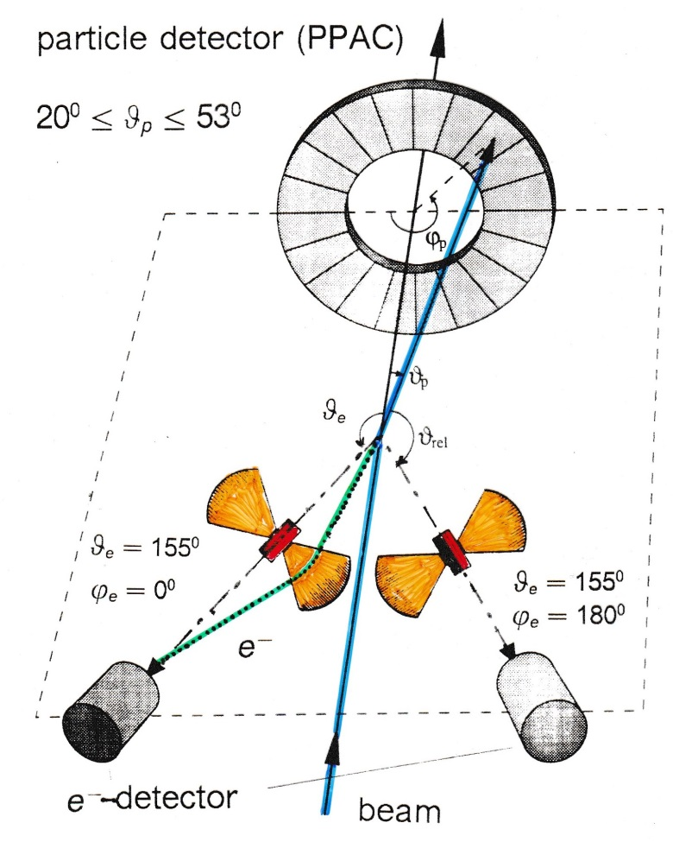
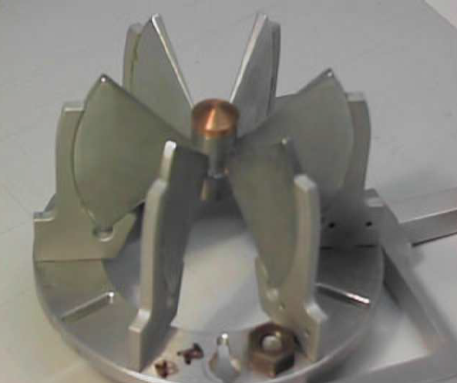
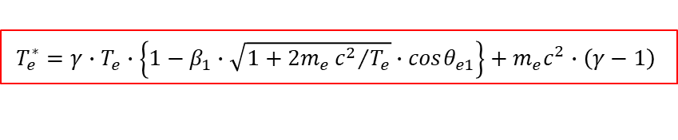
Electron spectroscopy with Mini-Orange devices
Doppler broadening
Δϑ_{e} = 20⁰
target – Mini-Orange: 19 cm
Mini-Orange – Si detector: 6 cm
Doppler correction for projectile excitation:
$$T_{e}^{∗}=γ∙T_{e}∙\left\{1−β_{1}∙\sqrt{1+2m_{e}{c^{2}}/{T_{e}}}∙cosθ_{e1}\right\}+m_{e}c^{2}∙\left(γ−1\right)$$
$$cosθ_{e1}=cosθ_{1}cosθ_{e}+sinθ_{1}sinθ_{e}cos\left(φ_{e}−φ_{1}\right)$$

Slide 23
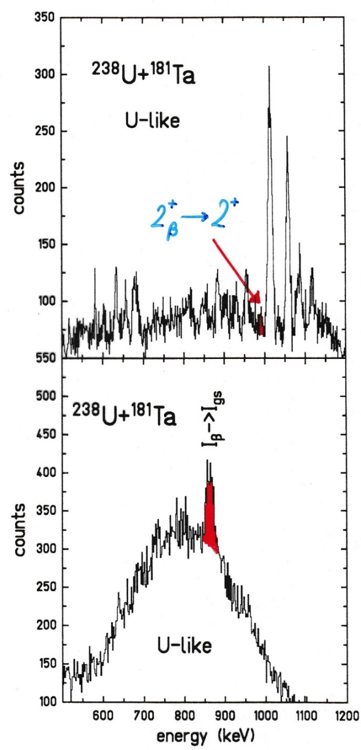

Doppler-corrected e⁻- and γ-ray spectra
γ-ray spectrum
$$2_{β}^{+}→2^{+}$$
e⁻ spectrum

Slide 24







Electron spectroscopy
Doppler shift correction for projectile:
$$T_{e}^{∗}=γ∙T_{e}∙\left\{1−β_{1}∙\sqrt{1+2m_{e}{c^{2}}/{T_{e}}}∙cosθ_{e1}\right\}+m_{e}c^{2}∙\left(γ−1\right)$$
$$cosθ_{e1}=cosθ_{1}cosθ_{e}+sinθ_{1}sinθ_{e}cos\left(φ_{e}−φ_{1}\right)$$
$$\frac{ΔΩ}{4π}=26\%$$
¹³⁶Xe + ²⁶Mg → ¹⁵⁸Dy
$$θ_{c}=0^{0}$$
$$β_{c}=β_{cm}=0.079$$
L. Handschug et al.; NIM 161 (1979) 117

Slide 25





Nuclear structure of ¹⁷⁸Hf
31y
J
K=0
J
K_{max}
E_{x}~2Δ_{p}
E_{x}~2Δ_{n}
¹⁷⁸Hf
high-K orbitals near the Fermi surface

Slide 26





Coulomb excitation of the K = 8⁻ isomer in ¹⁷⁸Hf
¹⁷⁸Hf + ¹³⁰Te at 560, 590, 620 MeV
4 s
$${→M}_{30}\left(E3\right)≤0.01$$
delayed γ-spectrum
Darmstadt Heidelberg Crystal Ball
Delayed γ-ray spectrum of the Crystal Ball with $850keV≤E_{sum}^{del}≤1100keV$
and $3≤N_{det}≤6$. In addition at least one of the delayed γ-rays must have been detected in one of the Ge-detectors.
ΔE_{γ} = 90 keV
H. Xie et al.; Phys. Rev. C48 (1993), 2517

Slide 27

Darmstadt-Heidelberg Crystal Ball and EUROBALL-3 demonstrator 1993

Slide 28

Doppler shift attenuation method
target
stopper
beam
Germanium
detector

Slide 29

Spectroscopy of binary and ternary fission fragments
Double ionization chamber
with sectored cathode
BGO anticompton shield
Ge clover
FF
Ge clover
120 mm
FF
LCP
140 mm
²⁵²Cf fission source
25k f/sec
²⁵²Cf source (25k f/s)
2 rings of 12 ΔE-E telescopes
T_{1/2}=2.645y
E_{α} = 6.118 and 6.076 MeV
bin. fiss./α-decay = 1/31
ter. fiss./α-decay = 1/8308

Slide 30



4π twin ionization chamber for fission fragments
The origin of fragment spins and their alignment
transitions
¹³⁸Xe
¹⁴⁴Ba

Slide 31



Search for diabolic pair transfer
Nuclear Josephson Effects:
Enhanced transfer of nucleon pairs between two superfluid heavy nuclei in a cold reaction correspond to a super-current

Slide 32
Proposed systems
^{172,174}Yb on ²⁰⁶Pb
^{174,176}Hf on ²⁰⁶Pb
The Hf and Yb-chain : The interaction strength in the level crossing between the ground state band and the s-band characterized by the minimal distance between the yrast band and the first excited band ΔE_{min.} Connected lines correspond to minimal distances for the angular momenta I= 10-16ħ. Full dot symbols indicate the even mass Yb-isotopes. The position of the deformed single-particle energies of the v i_{13/2} levels for the nucleus ¹⁶⁶Yb and ¹⁷⁰Hf are given on the abscissa.
Y. Sun et al, Z. Phys. A339 (1991) 51

Slide 33

Proposed systems 2n-transfer probability as a function of spin
yrast-states
yrare-states
¹⁷⁴Hf(²⁰⁶Pb,²⁰⁸Pb)¹⁷²Hf
The calculation show the diabolic effect for ²⁰⁶Pb on ¹⁷⁴Hf. This calculation assumes ¹⁷⁴Hf transfers to ¹⁷²Hf. The symbol o’s are non diabolic case and Δ’s are diabolic cases.
L F Canto et al PRC 47,2836(1993).

Slide 34

EUROBALL at RISING scattering experiment (2003-2005)

Slide 35



Cluster and MINIBALL detectors at RISING 2005
70cm
target
beam
20cm

Slide 36




EUROBALL (2006-2009) at RISING Rare ISotope INvestigation at GSI
σ_{exp}(¹³⁰Cd)~150 pb
variable
degrader
4 g/cm² Be
¹³⁶Xe
750 MeV/u
ΔE
15 Cluster detectors with 105 Ge crystals
ε_{γ} = 11% at 1.3 MeV, 20% at 550 keV, 35% at 100 keV
very high γ-ray efficiency
high granularity (prompt flash problem)
implantation in Cu-plate or in 9 DSSSD
S. Pietri et al., NIM B261 (2007), 1079

Slide 37
Open problems
Coulomb excitation of isomeric states in deformed nuclei
Nuclear structure of ²⁰⁸Pb
Studies in the ¹⁰⁰Sn region (Magda Gorska)
Search for diabolic pair transfer at higher angular momentum states
Mini Orange devices from Johan van Klinken are with Torsten Kröll (TU Darmstadt)
10 radioactive targets (0.3 mg/cm²) from LMU München stored in Mainz (C. Düllmann)
²³⁵U (1 mg ≡ 80 Bq), ²³⁷Np (1 mg ≡ 26 kBq), ²⁴²Pu (1 mg ≡ 145 kBq) (area = 0.2 cm²)
²²⁶Ra material

