Slide 1

Outline: Cosmic clocks
Lecturer: Hans-Jürgen Wollersheim
e-mail: h.j.wollersheim@gsi.de
web-page: https://web-docs.gsi.de/~wolle/ and click on
stellar and nuclear cosmic clocks
black body radiation
Hertzsprung-Russell-diagram
age of the Earth – Pb-Pb method
¹⁸⁷Re/¹⁸⁷Os clock – ESR experiment

Slide 2
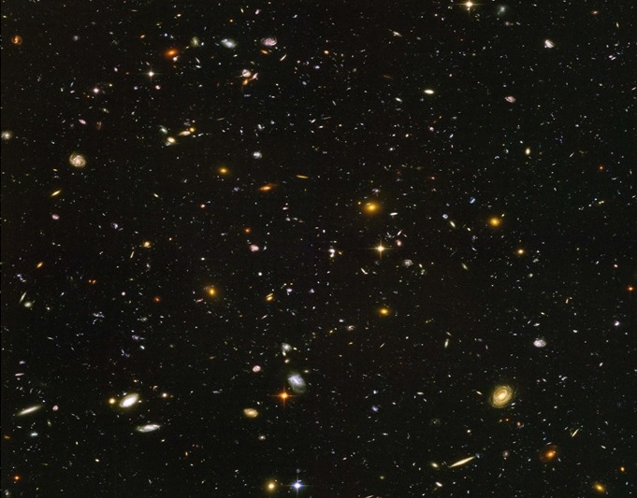
How old is the Universe?
Hubble Ultra Deep Field, Hubble Space Telescope, advanced camera for surveys

Slide 3
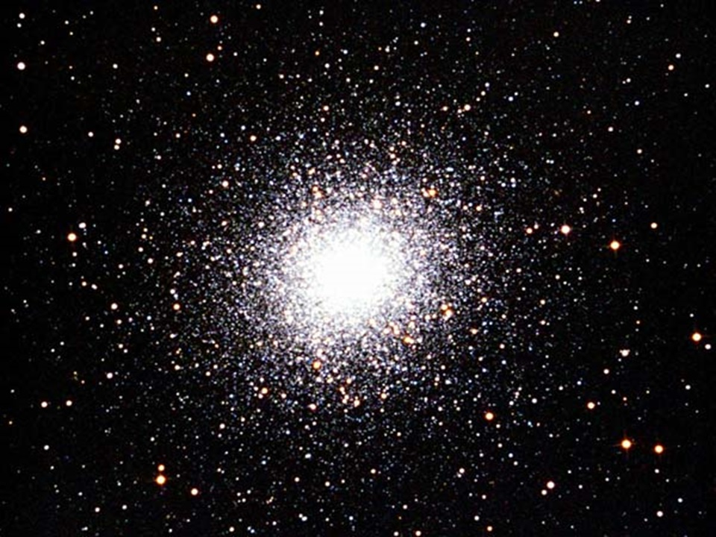
Stellar and nuclear cosmic clocks Globular Cluster M13 in the constellation Hercules
M13 was discovered by Edmond Halley (1714)

Slide 4

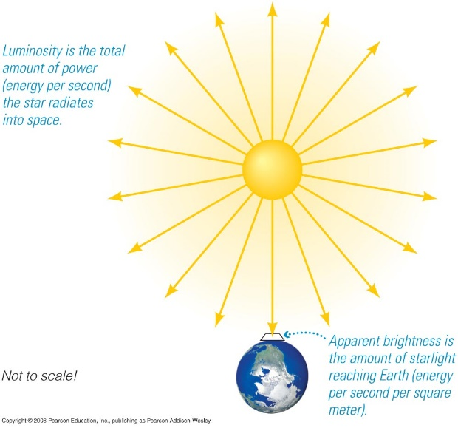
Stellar brightness
The brightness of an object depends on both distance and energy output.
Amount of energy output a star radiates is called the Luminosity L: the energy per second
Amount of starlight that reaches Earth is called the apparent brightness (m)

Slide 5
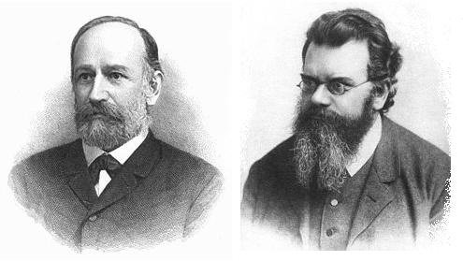
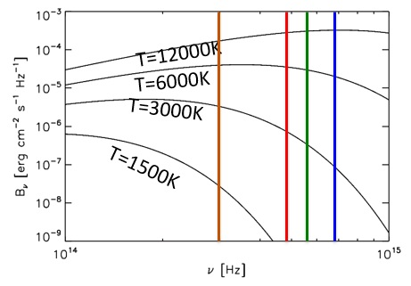
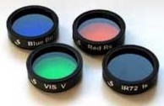





Stars show spectra very close to black-body radiation
d
R*
J. Stefan & L. Boltzmann
flux at the surface:
measured flux:
$$F={\left(\frac{R_{∗}}{d}\right)}^{2}∙σ_{SB}∙T_{∗}^{4}$$
$$F=σ_{SB}∙T_{∗}^{4}$$
luminosity (Stefan-Boltzmann law):
$$L=4π∙R_{∗}^{2}∙σ_{SB}∙T_{∗}^{4}$$
spectrum of a black-body:
$$F_{ν}=π∙B_{ν}$$
$$B_{ν}=2∙\frac{ν^{2}}{c^{2}}∙hν∙\frac{1}{exp\left({hν}/{k_{B}T}\right)−1}$$

Slide 6
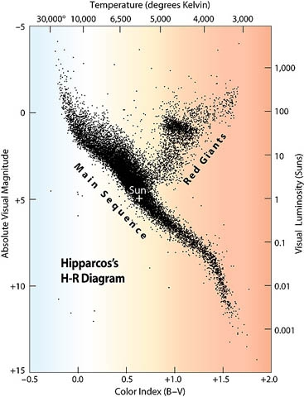
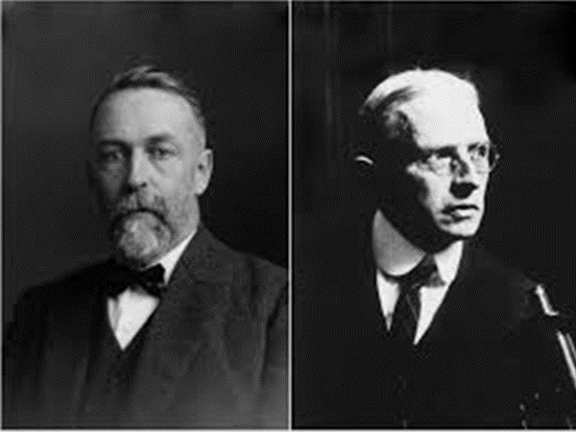
Hertzsprung-Russell-diagram of all stars at a range of 300 light years
Ejnar Hertzsprung, Henry Norris Russell
absolute luminosity
versus
temperature
The stars are stationary on the
´main sequence´,
as long as the fusion of protons to helium persists
This time depends very sensitively on the mass of the individual star

Slide 7
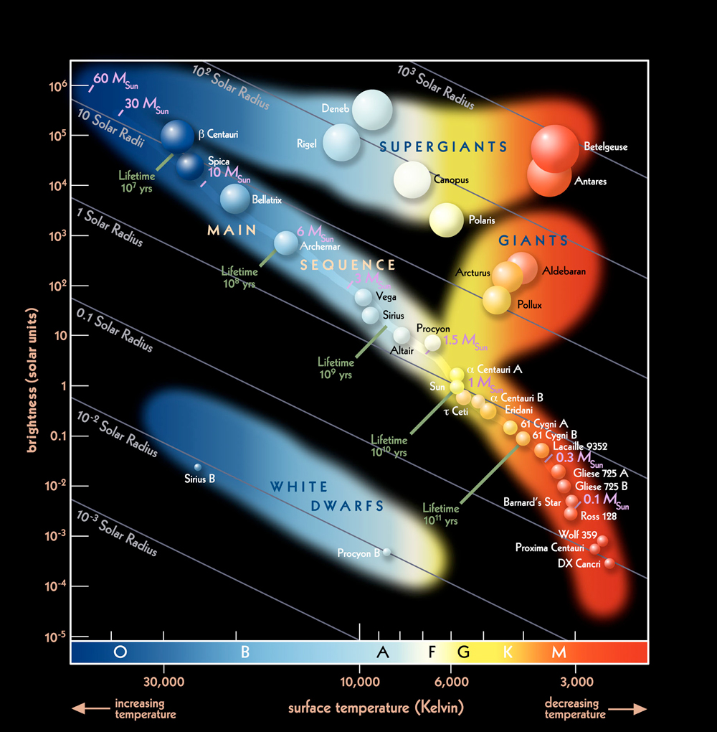
Hertzsprung – Russell - diagram

Slide 8
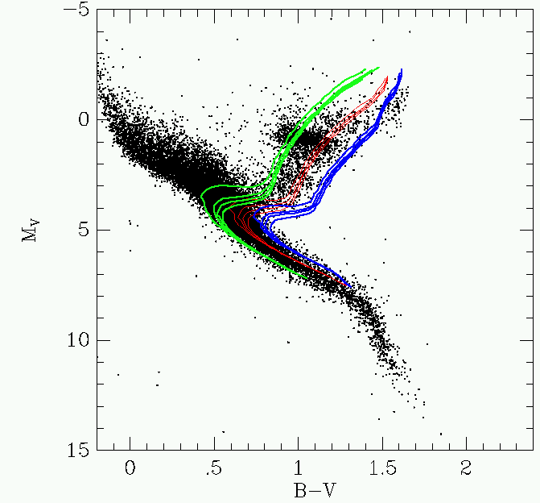
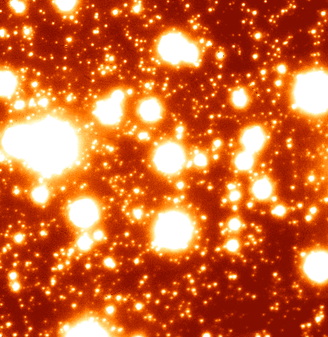
Where is a GC leaving the main sequence?
Hertzsprung-Russel of all stars nearby
Globular Cluster (GC) M13 in Hercules

Slide 9
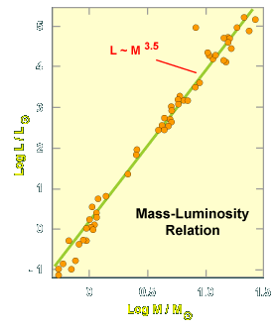
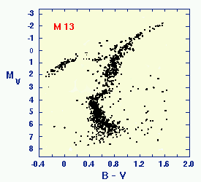





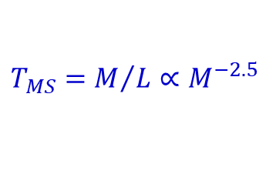






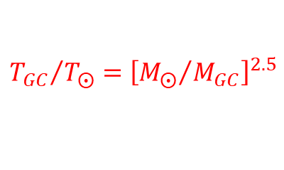



Age of GC from ´kink´ at main sequence
$$5$$
$$4$$
$$3$$
$$\log{L/L_{⨀}}$$
$$2$$
$$1$$
$$0$$
$$−1$$
$$0$$
$$0.5$$
$$1.0$$
$$1.5$$
$$\log{M/M_{⨀}}$$
$$T_{MS}=M/L∝M^{−2.5}$$
mass (M_{sun}) lifetime (years)
1 ~10¹⁰
5 ~10⁸
10 ~10⁷
$${T_{GC}}/{T_{⨀}}={\left[{M_{⨀}}/{M_{GC}}\right]}^{2.5}$$
$$T_{⨀}=9.4 Ga$$

Slide 10
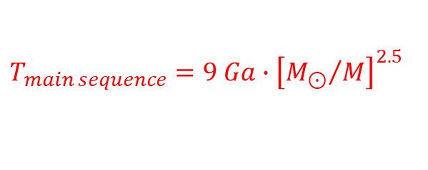
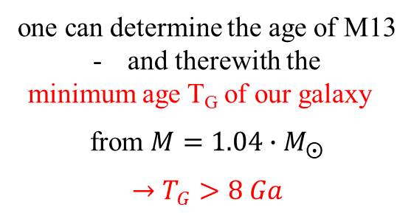

For our Sun this time
is about 9 billion years (Gyr)
for lighter stars longer,
for heavier ones shorter
$$T_{main sequence}=9 Ga∙{\left[{M_{⊙}}/M\right]}^{2.5}$$
when observing at which mass M the stars of M13 are leaving the main sequence
$$\frac{M}{M_{⨀}}=1.04$$
one can determine the age of M13
and therewith the
minimum age T_{G} of our galaxy
from $M=1.04∙M_{⨀}$
$$→T_{G}>8 Ga$$

Slide 11
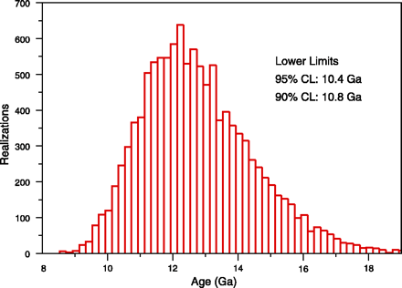
Lower limit of the age of our galaxy ~ 11 Ga
B. Charboyer, L. M. Krauss 2003

Slide 12
Nuclear cosmic clocks independent on stellar evolution models!??
only four at most:
1. ⁸⁷Rb/⁸⁷Sr (β) T_{1/2} = 50 Ga Q_{β} = 273 keV (3/2⁻→ 9/2⁺)
2. ¹⁷⁶Lu/¹⁷⁶Hf (β) T_{1/2} = 30 Ga Q_{β} = 1186 keV (7⁻→ 0⁺)
3. ¹⁸⁷Re/¹⁸⁷Os (β) T_{1/2} = 42 Ga Q_{β} = 2.6 keV (5/2⁺→ 1/2⁻)
4. ²³⁸U...²⁰⁶Pb (α, β) T_{1/2} = 4.5 Ga
4a. ²³⁵U…²⁰⁷Pb (α,β) T_{1/2} = 0.7 Ga
4b. ²³²Th...²⁰⁸Pb (α, β) T_{1/2} = 14 Ga
from measured mother/daughter abundance ratio and known half-life
age of the sample

Slide 13
Nuclear cosmic clocks
1. select a long-lived radioactive mother/daughter (β) couple
2. determine N(m), N(d) at time t
3. N(m) (t) = N(m) (t₀) · exp[-λ·(t-t₀)]
N(d) (t) = N(m) (t₀) · [1 – exp[-λ·(t-t₀)]
→ [N(d)/N(m)] (t) = exp[ λ·(t-t₀)] – 1
one has to measure 'only'
the relative amount at time t and the decay probability λ of the mother
→ nuclear eon clocks
independent on stellar/galactic
evolution models

Slide 14
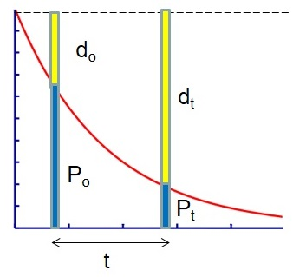

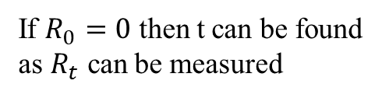

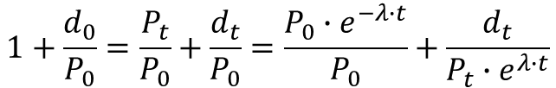


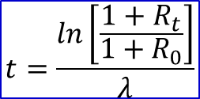


How can radioactive decay be used to estimate dates in the past?
daughter (d)
$$P_{t}=P_{0}∙e^{−λ∙t}$$
parent (P)
$$P_{0}+d_{0}=P_{t}+d_{t}$$
$$R_{0}=\frac{d_{0}}{P_{0}}$$
$$R_{t}=\frac{d_{t}}{P_{t}}$$
$$t=\frac{ln\left[\frac{1+R_{t}}{1+R_{0}}\right]}{λ}$$
$$1+\frac{d_{0}}{P_{0}}=\frac{P_{t}}{P_{0}}+\frac{d_{t}}{P_{0}}=\frac{P_{0}∙e^{−λ∙t}}{P_{0}}+\frac{d_{t}}{P_{t}∙e^{λ∙t}}$$
1$+R_{0}=e^{−λ∙t}+R_{t}∙e^{−λ∙t}$
If $R_{0}=0$ then t can be found as $R_{t}$ can be measured
$$\frac{1+R_{0}}{1+R_{t}}=e^{−λ∙t}$$

Slide 15
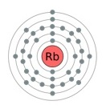
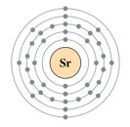

Rubidium strontium dating
Rubidium and strontium are both reactive metals
This uses a very simple decay process, which has very long half life. Therefore the dating method is only suitable for rocks which are thought to be very old indeed
$${}_{37}^{87}{Rb}→{}_{38}^{87}{Sr}+β^{−}+\overline{ν}$$
half life = 48 800 000 000 years
The problem with using Rb/Sr dating is that the rocks in question already have strontium present before cooling. Therefore the initial conditions are not known.
This means that a special technique has to be used which is called
ISOCHRON DATING

Slide 16
Isochron dating
The initial conditions of rock can never be measured – only assumed.
Some radioisotopes in rocks produce a daughter product that has a stable version (another isotope of the daughter element) already in the rock. If the two isotopes of the daughter element are evenly mixed when the rock is formed and the parent element is unevenly distributed then isotope ratio measurements can in fact yield an age estimate.
This means that the original amount of daughter product does not need to be known, i.e. the original parent/daughter isotope ratio is not needed.
Several isotope ratio measurements need to be taken from different parts of the same rock sample. In this way variable amounts of the parent isotope will be present.
Isochron dating is theoretically wonderful but in practice there are problems.

Slide 17
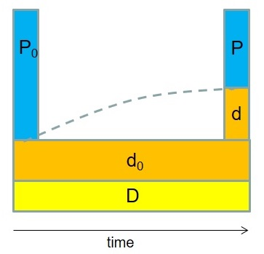
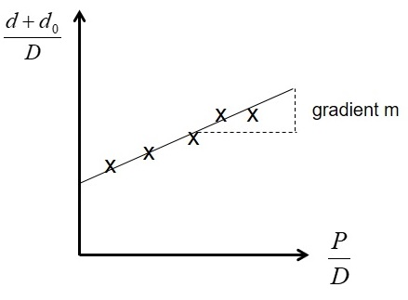



Isochron dating
Two isotope ratios need to be measured to determine an isochron date. These are:
$\frac{P}{D}$ and $\frac{d+d_{0}}{D}$
A graph is plotted of $\frac{d+d_{0}}{D}$ against $\frac{P}{D}$
The gradient of this line gives the age of the rock via a simple formula
$$t=ln\left[\frac{m+1}{λ}\right]$$
λ = decay constant

Slide 18
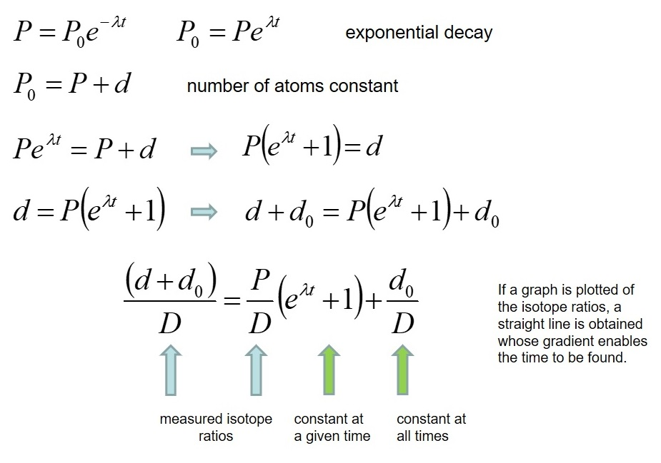
Isochron theory

Slide 19
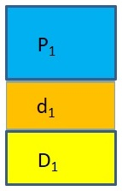
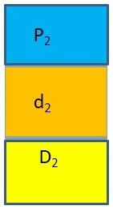
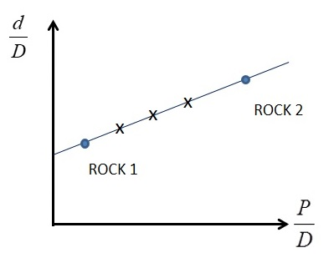
Isochron dating promises mathematical perfection, but …
Mixing of rocks can produce fictitious isochron plots
If these two rocks are mixed together but not perfectly, and various samples are taken and analyzed to produce an isochron plot, then a straight line graph is obtained whose slope is meaningless.
rock-1
rock-2

Slide 20




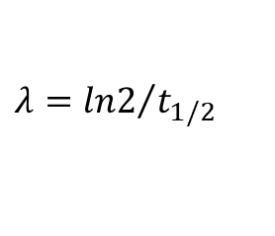
Radioactive dating: Rb-Sr method
Rubidium and strontium are trace elements in natural rocks. Rb can replace K or Na in the crystal lattice, Sr can replace Ca. Rubidium has a radioactive isotope that decays into a strontium isotope by β-decay.
$${}_{37}^{87}{Rb}→{}_{38}^{87}{Sr}+β^{−}+\overline{ν}$$
half life = 48.8 Ga
$$λ={ln2}/{t_{1/2}}$$
Over geological time t after the formation of a rock, the concentration of ⁸⁷Rb decreases and that that of ⁸⁷Sr increases
$${\left[87Rb\right]}_{t}={\left[87Rb\right]}_{0}∙e^{−λ∙t}$$
$${\left[87Sr\right]}_{t}={\left[87Sr\right]}_{0}+{\left[87Rb\right]}_{0}∙\left(1−e^{−λ∙t}\right)={\left[87Sr\right]}_{0}+{\left[87Rb\right]}_{t}∙\left(e^{λ∙t}−1\right)$$
Because isotope ratios can be measured much more precisely than absolute abundance, it is useful to normalize all concentrations with that of a reference isotope, ⁸⁶Sr, which is stable and not produced by decay, so that it does not change with time:
$$\frac{{\left[87Sr\right]}_{t}}{\left[86Sr\right]}=\frac{{\left[87Sr\right]}_{0}}{\left[86Sr\right]}+\left(e^{λ∙t}−1\right)∙\frac{{\left[87Rb\right]}_{t}}{\left[86Sr\right]}$$
$$y ={ y}_{0} + const ∙ x$$
When a rock forms from magma (or solid bodies from the protoplanetary nebula), the source material is well mixed, but during this process it becomes differentiated. The absolute and relative concentrations of Rb and Sr will be different in different mineral grains, in different batches of magma erupted from a magma chamber at different times or in different protoplanets formed from the nebula. The different minerals in a piece of rock, different lava flows coming from the same magma source, or different protoplanets, from a suite of samples with a common origin.

Slide 21
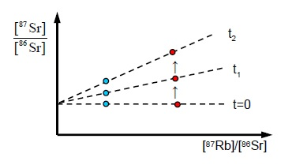
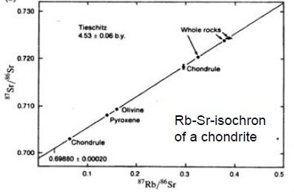
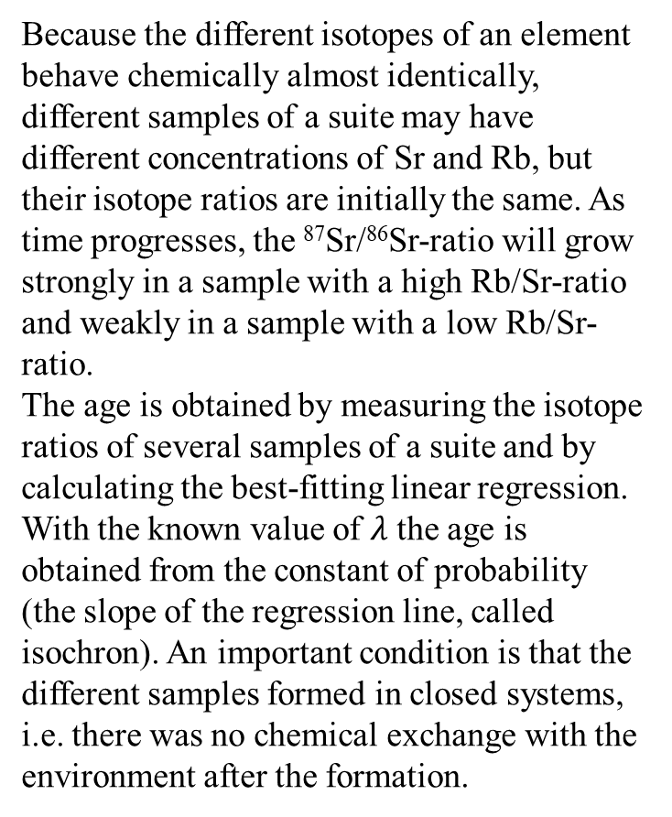
Rb-Sr method
Because the different isotopes of an element behave chemically almost identically, different samples of a suite may have different concentrations of Sr and Rb, but their isotope ratios are initially the same. As time progresses, the ⁸⁷Sr/⁸⁶Sr-ratio will grow strongly in a sample with a high Rb/Sr-ratio and weakly in a sample with a low Rb/Sr-ratio.
The age is obtained by measuring the isotope ratios of several samples of a suite and by calculating the best-fitting linear regression. With the known value of $λ$ the age is obtained from the constant of probability (the slope of the regression line, called isochron). An important condition is that the different samples formed in closed systems, i.e. there was no chemical exchange with the environment after the formation.

Slide 22
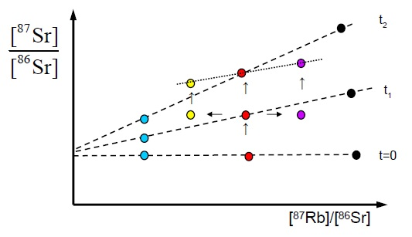
Dating a second step of differentiation
At t=0 a reservoir (e.g. protosolar nebula) splits up into several bodies (planets). At a later time t₁ the red one differentiates into different sub-samples (yellow, red and pink) with different Rb/Sr-ratios. Their ⁸⁷Sr/⁸⁶Sr ratio is the same at t₁, because they are all drawn from the same reservoir. However, subsequently it will evolve differently because of the different Rb concentrations. The slope connecting these three samples at t₂ indicates the time lapse between t₁ and t₂, i.e., the age of the second differention event. When we want to use the samples from the “red planet” in order to date the first event, we must “remix” them and use them together with data from the other planets (blue and black). If we use at t₂ the blue, yellow and black points, they do not fall on a straight line.

Slide 23
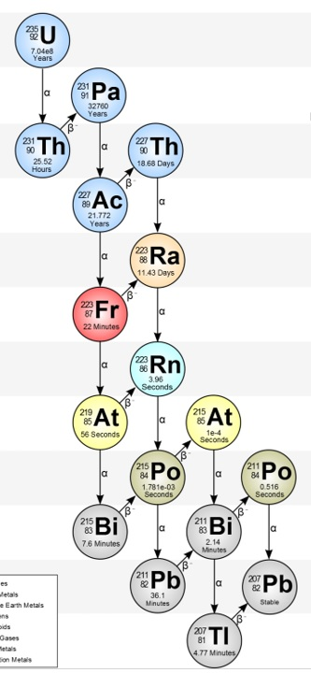
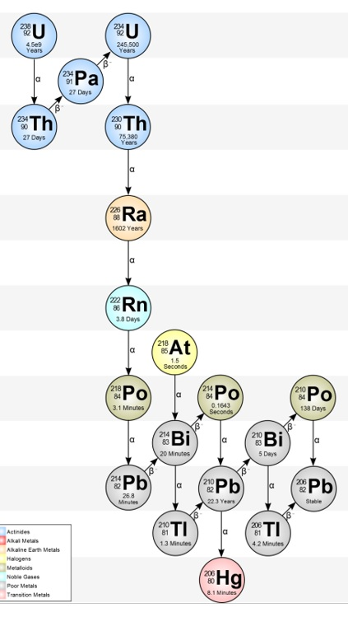
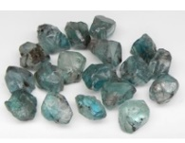
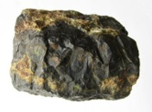
Age of the Earth Pb –Pb method
The Pb-Pb method of dating makes use of two decay series, both starting at an isotope of uranium and ending at a lead isotope
parent | half-life [10⁹ a] | daughter | material dated
²³⁵U | 0.704 | ²⁰⁷Pb | zircon, uraninite, pitchblende
²³⁸U | 4.468 | ²⁰⁶Pb | Zircon, uraninite, pitchblende

Slide 24

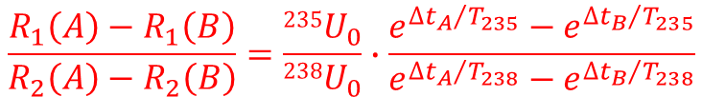
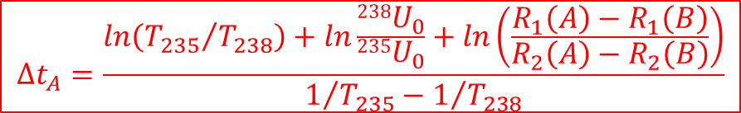
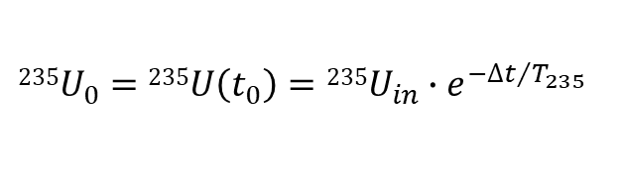

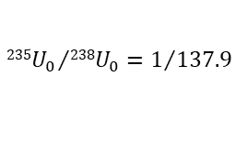

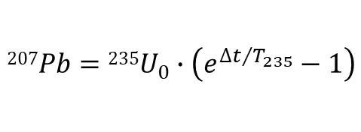
Age of the Earth Pb –Pb method
rock dating:
²³⁵U decays into ²⁰⁷Pb with T_{1/2} = 7.038·10⁸ y. ²³⁸U decays into ²⁰⁶Pb with T_{1/2} = 4.47·10⁹ a
²⁰⁴Pb is a stable isotope (²³²Th → ²⁰⁸Pb)
$$235U_{0}=235U\left(t_{0}\right)=235U_{in}∙e^{−{∆t}/{T_{235}}}$$
$$207Pb=235U_{in}−235U_{0}$$
$$207Pb=235U_{0}∙\left(e^{{∆t}/{T_{235}}}−1\right)$$
$$R_{1}≡\frac{207{Pb}_{in}}{204Pb}+\frac{235U_{0}∙\left(e^{{∆t}/{T_{235}}}−1\right)}{204Pb}$$
$$R_{2}≡\frac{206{Pb}_{in}}{204Pb}+\frac{238U_{0}∙\left(e^{{∆t}/{T_{238}}}−1\right)}{204Pb}$$
and
$$\frac{R_{1}\left(A\right)−R_{1}\left(B\right)}{R_{2}\left(A\right)−R_{2}\left(B\right)}=\frac{235U_{0}}{238U_{0}}∙\frac{e^{{∆t_{A}}/{T_{235}}}−e^{{∆t_{B}}/{T_{235}}}}{e^{{∆t_{A}}/{T_{238}}}−e^{{∆t_{B}}/{T_{238}}}}$$
$$∆t_{A}=\frac{ln\left({T_{235}}/{T_{238}}\right)+ln\frac{238U_{0}}{235U_{0}}+ln\left(\frac{R_{1}\left(A\right)−R_{1}\left(B\right)}{R_{2}\left(A\right)−R_{2}\left(B\right)}\right)}{1/{T_{235}}−1/{T_{238}}}$$
$${235U_{0}}/{238U_{0}}=1/{137.9}$$
assumption for both rocks: same initial conditions of ²⁰⁷Pb/²⁰⁴Pb and ²⁰⁶Pb/²⁰⁴Pb

Slide 25
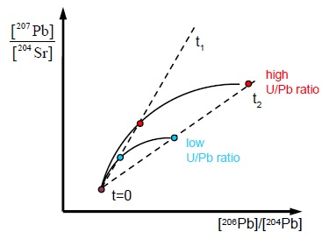
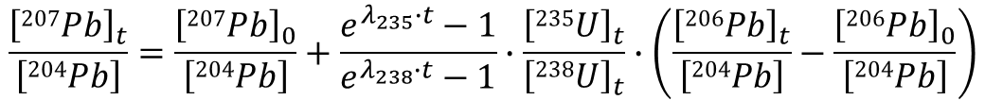
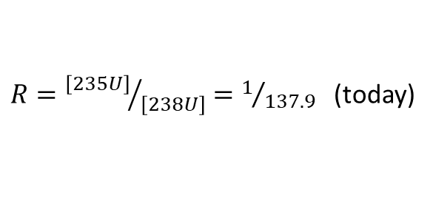
Pb-Pb method
$$\frac{{\left[207Pb\right]}_{t}}{\left[204Pb\right]}=\frac{{\left[207Pb\right]}_{0}}{\left[204Pb\right]}+\frac{e^{λ_{235}∙t}−1}{e^{λ_{238}∙t}−1}∙\frac{{\left[235U\right]}_{t}}{{\left[238U\right]}_{t}}∙\left(\frac{{\left[206Pb\right]}_{t}}{\left[204Pb\right]}−\frac{{\left[206Pb\right]}_{0}}{\left[204Pb\right]}\right)$$
$$y ={ y}_{o} + const ∙ \left(x−x_{0}\right)$$
$R={\left[235U\right]}/{\left[238U\right]}=1/{137.9}$ (today)
At a given time, R is the same for all samples. Because of the short half-life of ²³⁵U, the ²⁰⁷Pb/²⁰⁴Pb-ratio grew rapidly early on, but grows more slowly in more recent times. Again, samples from a cogenetic suite fall on an isochron, whose slope relates to the age through the above equation. With this method only isotopes ratios of a single element need to be measured.

Slide 26
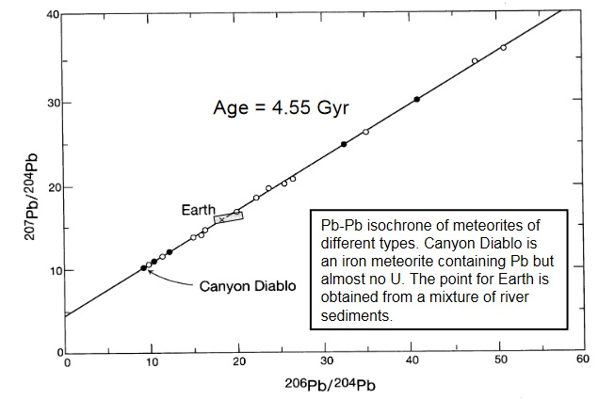
Age of the Earth and the Solar system
oldest stones on Earth | 3.7·10⁹ a
oldest stones on Moon | (4.5 – 4.6)·10⁹ a
oldest meteorites | 4.57·10⁹ a
age of the solar system | (4.57±0.07)·10⁹ a
Ga

Slide 27
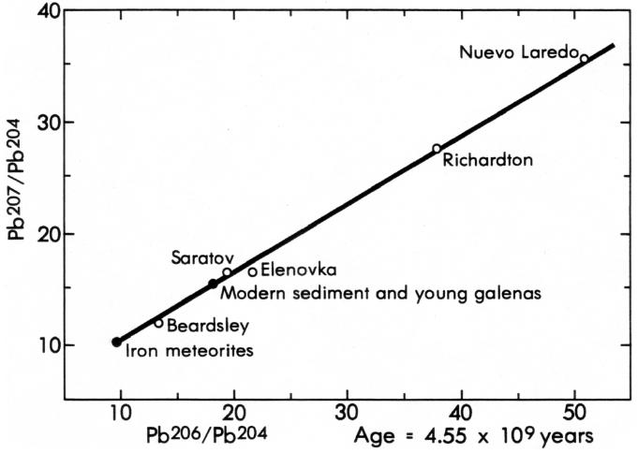
Age of meteorite parent bodies

Slide 28
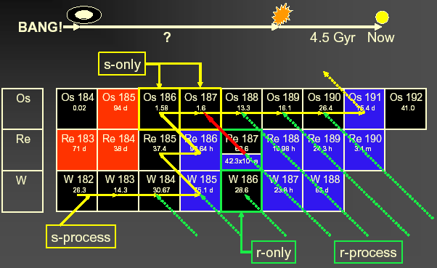
Re/Os cosmos-chronometer
Red Giants
Supernovae

Slide 29

¹⁸⁷Re/¹⁸⁷Os clock

Slide 30
The ´best-suited´ eon clock: ¹⁸⁷Re/¹⁸⁷Os
T_{N} > τ(¹⁸⁷Re) x R (¹⁸⁷Os/¹⁸⁷Re)_{d}
61.3 Ga x 0.137
= 8.4 Ga
but...
bare and H-like ¹⁸⁷Re undergoes
β_{b} decay to the first excited state
of ¹⁸⁷Os
nuclear matrix element not known
measurement of lifetime τ of
bare ¹⁸⁷Re at the ESR gives
→ τ(bare ¹⁸⁷Re) = (48 ± 3) a
instead of (61.3 ± 1.9) Ga
21.9 keV
85.8 keV
T_{½} = 33±2 a
453.9 keV
469.2 keV
T_{½} = 44±1 Ga

Slide 31


The ´best-suited´ eon clock: ¹⁸⁷Re/¹⁸⁷Os
T_{N} > τ(¹⁸⁷Re) x R (¹⁸⁷Os/¹⁸⁷Re)_{d}
61.3 Ga x 0.137
= 8.4 Ga
but...
bare and H-like ¹⁸⁷Re undergoes
β_{b} decay to the first excited state
of ¹⁸⁷Os
nuclear matrix element not known
measurement of lifetime τ of
bare ¹⁸⁷Re at the ESR gives
→ τ(bare ¹⁸⁷Re) = (48 ± 3) y
instead of 61.3 Ga
E
¹⁸⁷Re⁷⁵⁺
$${5/2}^{+}$$
T_{½} = 33 a
β_{b}
Q = 62 keV
10 keV
g.s.
¹⁸⁷Re⁰
β⁻
Q = 2.7 keV
10 keV
$${5/2}^{+}$$
g.s.
T_{½} = 42 Ga
¹⁸⁷Os^{x}

Slide 32

The ´best-suited´ eon clock: ¹⁸⁷Re/¹⁸⁷Os

Slide 33




Atomic physics in the extremely strong Coulomb fields
hydrogen
Z=1
E_{K} = -13.6 eV
<E> = 1·10¹⁰ V/cm
$$Z∙α≪1$$
uranium ion
Z=92
E_{K} = -132 keV
<E> = 1.8·1016 V/cm
$$Z∙α≈1$$
~ Z³

Slide 34


Level scheme of hydrogen
hydrogen
Z=1
E_{b} = 13.6 eV
$$Z∙α≪1$$
uranium ion
Z=92
E_{b} = 132 keV
$$Z∙α≈1$$

Slide 35

Level scheme of hydrogen

Slide 36

Level scheme of hydrogen

Slide 37

The real structure of hydrogen

Slide 38


The experiment

Slide 39

How to determine a long (33 y) beta half-life?
store and cool bare ¹⁸⁷Re for various times (hours)
2. the β_{b} daughters, H-like ¹⁸⁷Os, are
not resolved in Schottky spectrum.
Q value only 62 keV at the same
atomic charge state q = 75⁺
3. after the (long) storage time
strip the one electron of ¹⁸⁷Os
in an intense gas jet, acting for
a few minutes only
4. the bare ¹⁸⁷Os ions are well-
resolved now, at q = 76⁺
5. the number of nuclear reaction
products (Hf, W,..) does not
depend on storage time
F. Bosch et al., PRL 77 (1996) 5190

Slide 40
Summary
Ion storage-cooler rings (and traps) allow to address for the first time
β decays of ions at high, well-defined charge states
which is important in the framework of stellar nucleosynthesis in hot environments.
The temperature of the s-process can be directly determined from β_{b} decay.
Significant, even dramatic changes of β lifetimes due to β_{b} decay have been observed.
The Re/Os cosmic clock is strongly affected by the atomic charge state:
nuclear cosmic clocks are not independent on stellar evolution models

Slide 41

CNO - cycle

