Slide 1

Outline: Gravitational waves
Lecturer: Hans-Jürgen Wollersheim
e-mail: h.j.wollersheim@gsi.de
web-page: https://web-docs.gsi.de/~wolle/ and click on
Albert Einstein: ripple of space-time
Isaac Newton vs Albert Einstein
gravitational waves
LIGO observatories
gravitational waves vs EM waves

Slide 2
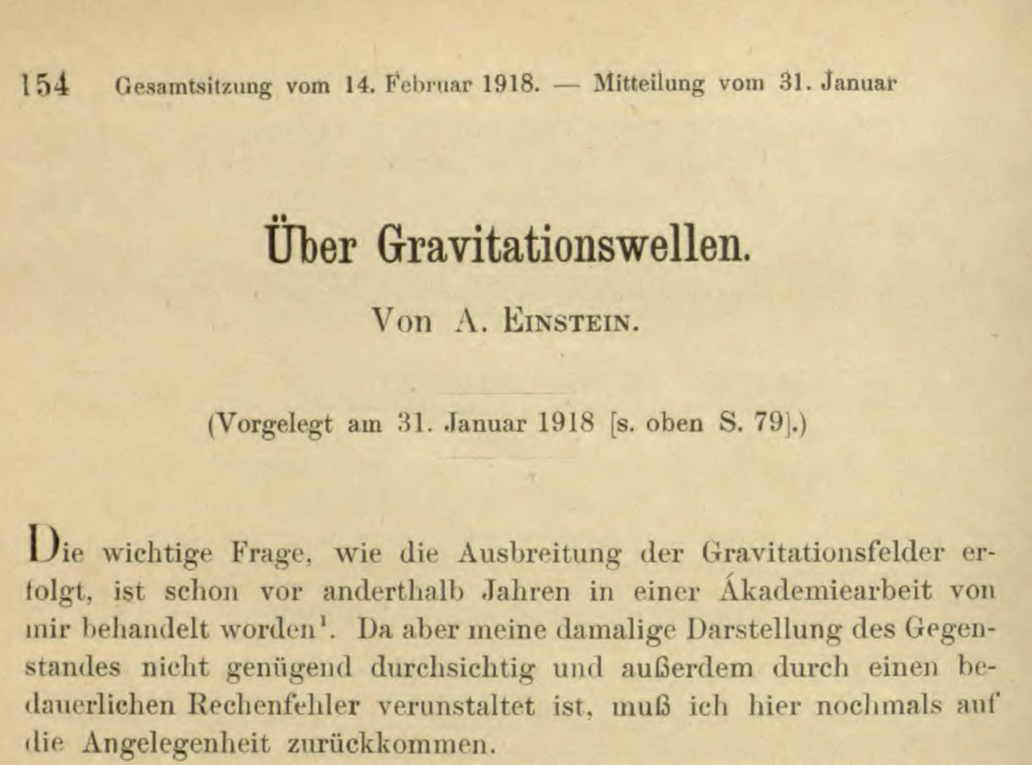
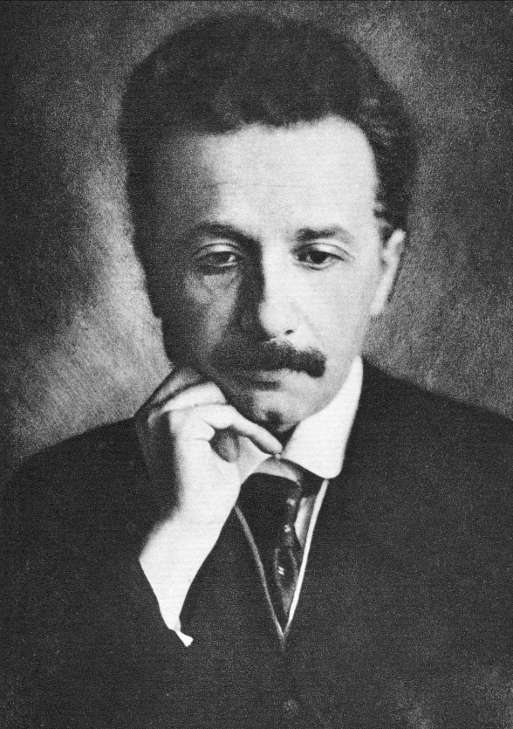
Gravitational waves – ripples of space-time
First publication on gravitational waves in June 1916

Slide 3
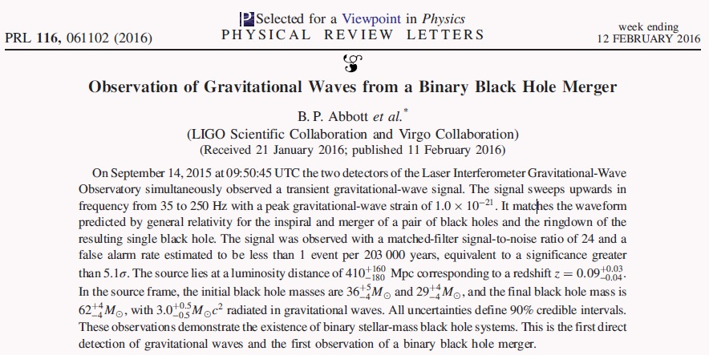
Almost 100 years later
first direct evidence of gravitational waves
signal indicates the merging of two black holes
LIGO: Laser Interferometer Gravitational-Wave Observatory

Slide 4

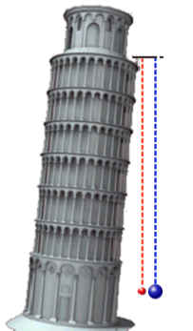
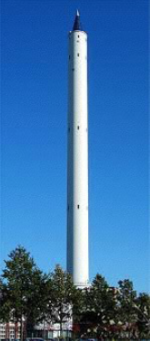
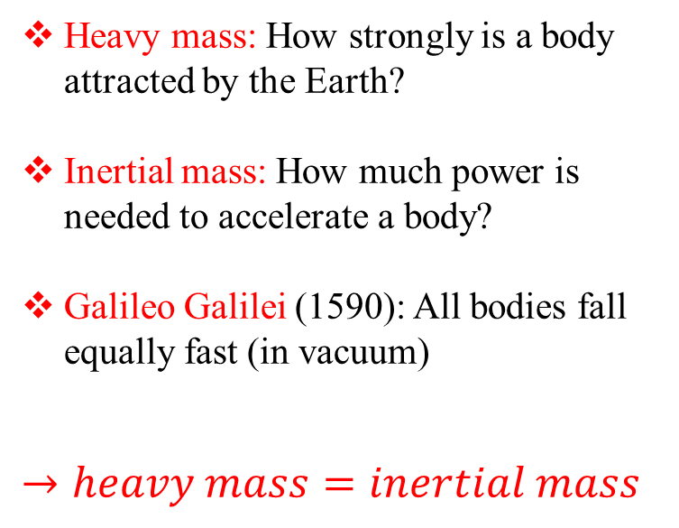
Equivalence principle
Heavy mass: How strongly is a body attracted by the Earth?
Inertial mass: How much power is needed to accelerate a body?
Galileo Galilei (1590): All bodies fall equally fast (in vacuum)
$$→heavy mass=inertial mass$$
The Bremen drop tower

Slide 5
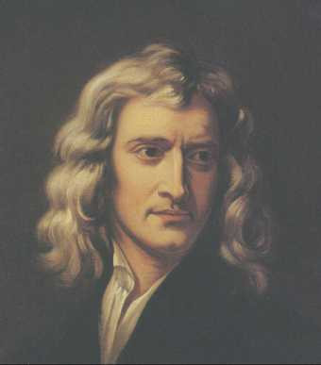
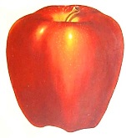
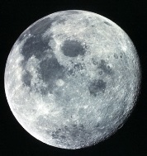
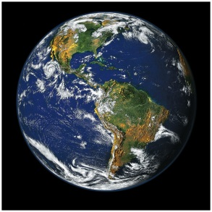
Gravity: the old school
Sir Isaac Newton (1684)
universal law of gravitation
Unified the gravity on Earth, the motion of the Moon, planets and comets
Final confirmation of Newton´s theory:
Halley´s Comet returns as predicted in 1758
Newton´s theory good, but not perfect!
5

Slide 6
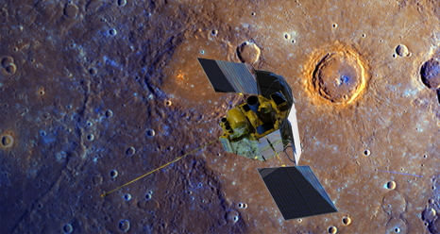
Geometry moves mass Mercury´s perihelion
1687 Newtonian triumph
1859 Le Verrier´s puzzle (Mercury orbit anomaly)
1900 A turn-of-the century crisis
575 “
per
century

Slide 7
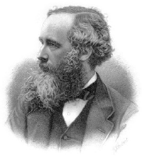
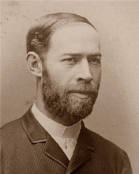
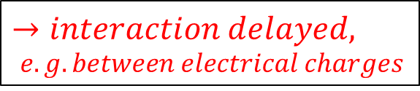

Electromagnetism
James Clerk Maxwell (1864):
Unification of electricity and magnetism
$$→electromagnetism$$
Heinrich Hertz (1888):
Light, radio waves, X-rays
are electromagnetic waves
velocity: 299792 km/s
duration Sun – Earth ~ 8 min
$$→interaction delayed,$$
$e.g. between electrical charges$

Slide 8
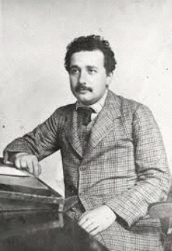
The special relativity
Newton´s gravitation:
Foundation for classical mechanics.
  no maximum velocity
  instantaneous interaction
Albert Einstein (1905):
Theory of special relativity:
  velocity of light is the limit
  instantaneous interaction
  is not allowed! contradiction with Newton!
  Space and time (space-time) are curved
  Matter causes this curvature
  Space tells matter how to move
  Gravity is geometry

Slide 9
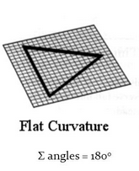
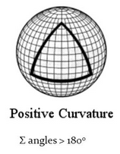
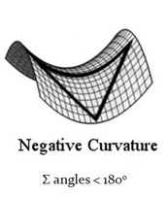
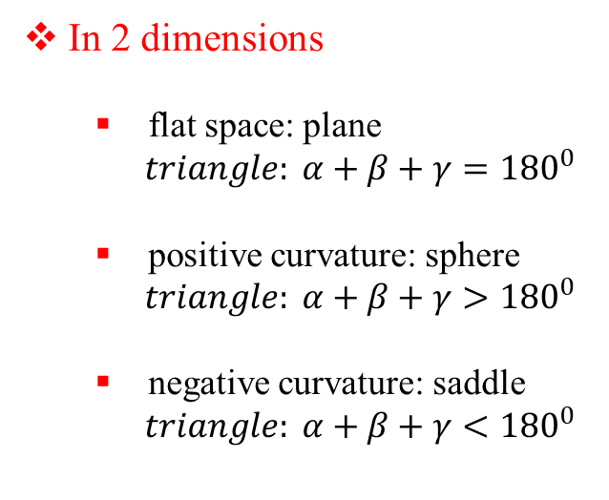
Curved space
In 2 dimensions
  flat space: plane
  $triangle: α+β+γ={180}^{0}$
  positive curvature: sphere
  $triangle: α+β+γ>{180}^{0}$
  negative curvature: saddle
  $triangle: α+β+γ<{180}^{0}$

Slide 10
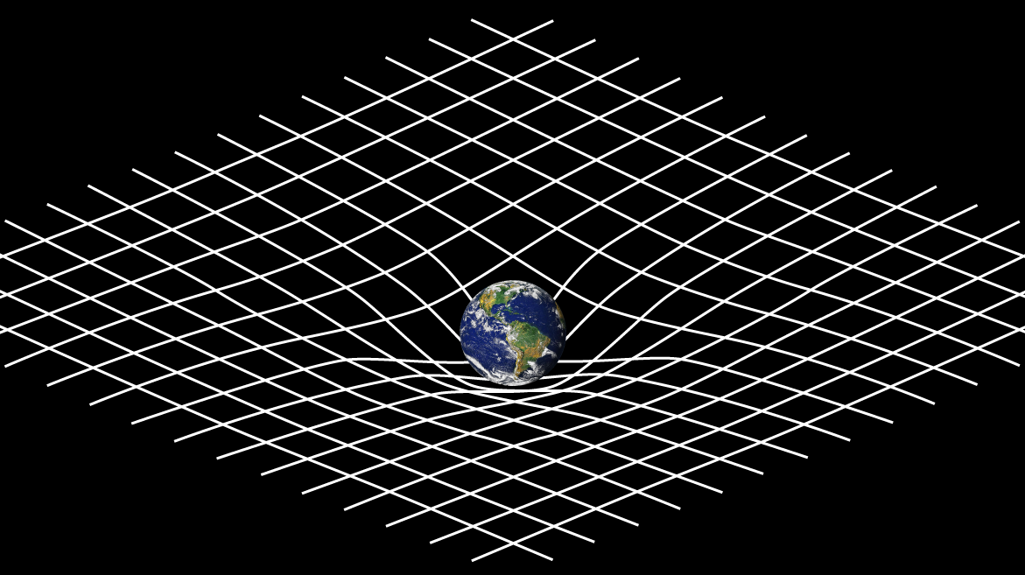
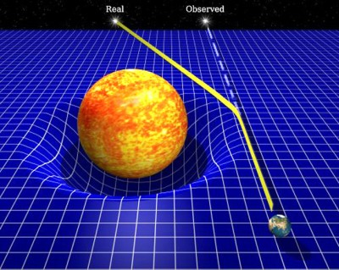
Curved space-time
Space-time curved by the Earth mass
Arthur Eddington (1919):
Deflection of light by sun´s gravitational field
First successful test of Einstein´s theory
Geometry bends light

Slide 11
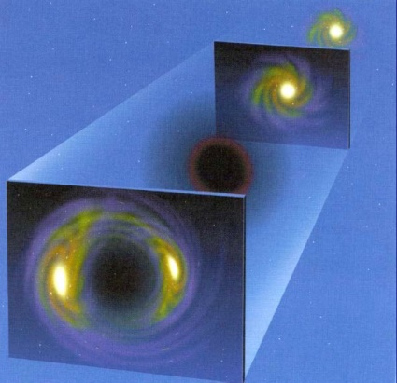
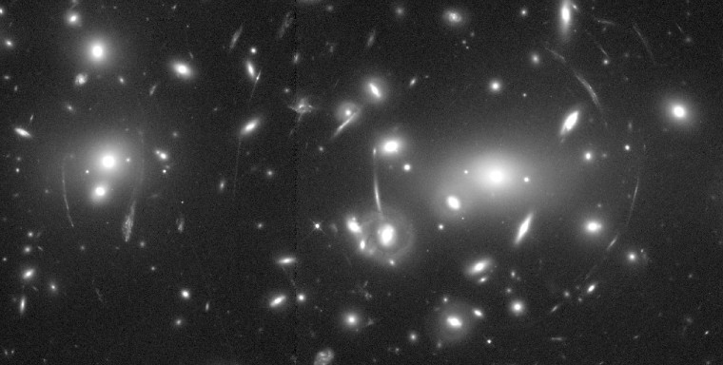
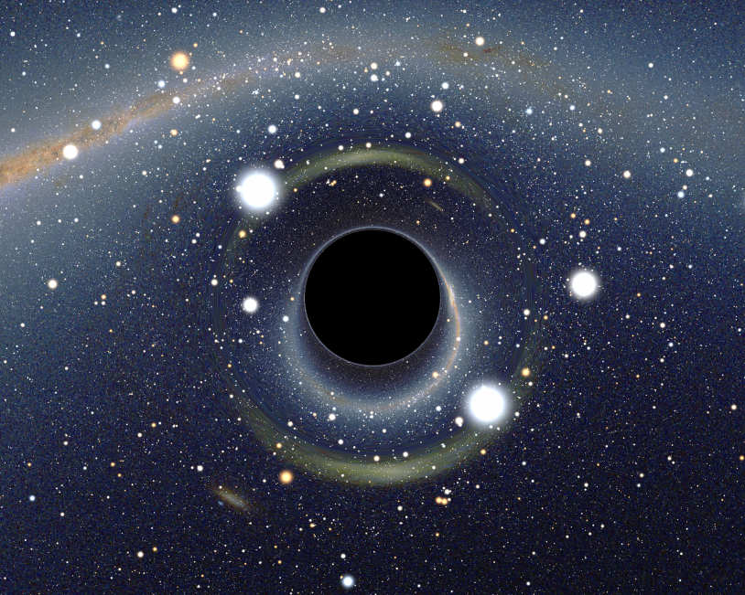
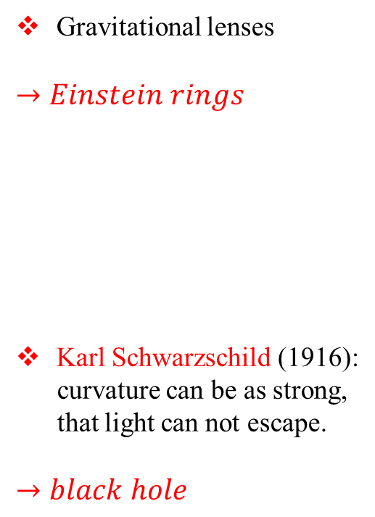
Other phenomena
Gravitational lenses
$→Einstein rings$
Karl Schwarzschild (1916):
curvature can be as strong,
that light can not escape.
$→black hole$

Slide 12
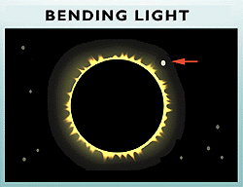
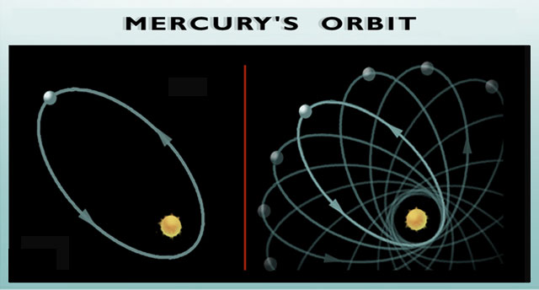
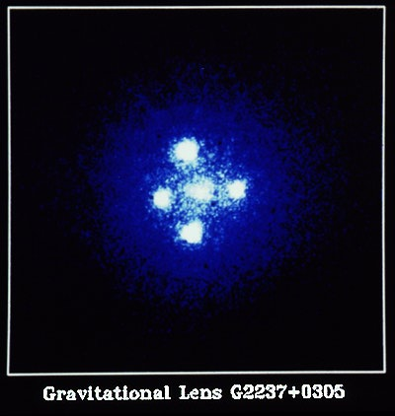
Einstein´s theory of gravitation experimental tests
bending of light
as it passes in the vicinity of massive objects
First observed during the solar eclipse of 1919 by Sir Arthur Eddington, when the Sun was silhouetted against the Hyades star cluster
Mercury’s orbit
perihelion shifts forward
twice Post-Newton theory
Mercury's elliptical path around the Sun
shifts slightly with each orbit such that its closest point to the Sun (or perihelion) shifts forward with each pass.
“Einstein Cross”
the bending of light rays
gravitational lensing
Quasar image appears around the central glow formed by nearby galaxy. Such gravitational lensing images are used to detect a ‘dark matter’ body as the central object

Slide 13
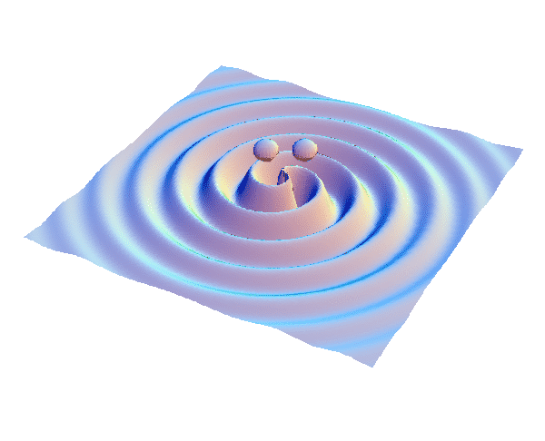
What are gravitational waves?
Einstein’s General theory of relativity:
Gravity → Curvature of 4-dimensional
space-time produced by matter
Gravitational waves:
Ripples on space-time
produced by accelerated matter
not EM or particles

Slide 14
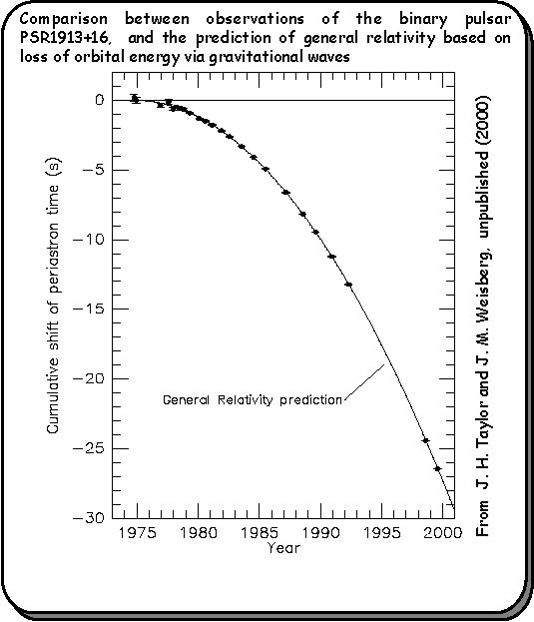
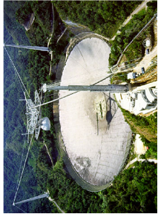
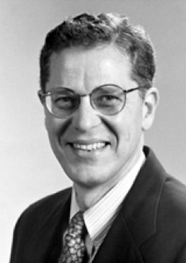
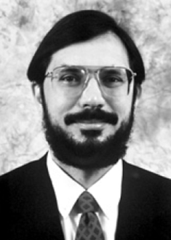
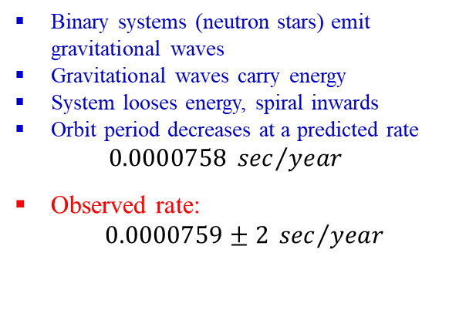
Decay of the orbit strong indirect evidence
Emission of gravitational waves
Binary systems (neutron stars) emit gravitational waves
Gravitational waves carry energy
System looses energy, spiral inwards
Orbit period decreases at a predicted rate
$$0.0000758 {sec}/{year}$$
Observed rate:
$0.0000759±2 {sec}/{year}$
Joseph Taylor & Russell Hulse
Nobel Price 1993

Slide 15
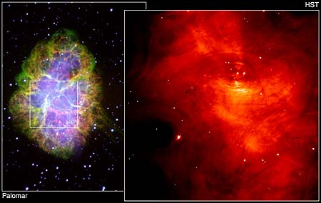
Hulse-Taylor binary pulsar
Neutron Binary System
PSR 1913 + 16 -- Timing of pulsars
17 / sec
•
A rapidly spinning pulsar (neutron star beaming EM radiation at us 17 x / sec)
orbiting around an ordinary star with 8 hour period
Only 7 kpc away
discovered in 1975, orbital parameters measured
continuously measured over 25 years!
•
~ 8 hr

Slide 16
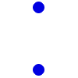


Binary orbit evolution
A binary system in a close orbit
has a time-varying quadrupole moment
➔ emits gravitational waves
f_{GW} = 2 f_{orbit}
Gravitational waves carry away energy and angular momentum
Frequency increases, orbit shrinks
Objects spiral in until they finally coalesce
Additional relativistic effects kick in as (Gm/rc²) grows away from zero

Slide 17
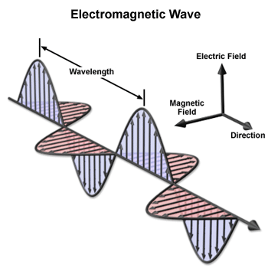
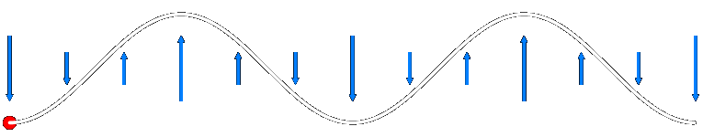
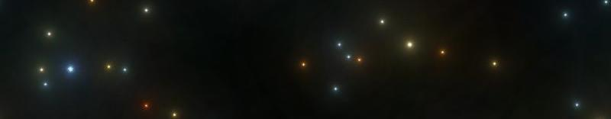
Electromagnetic waves
So far, nearly all our knowledge of the Universe comes from electromagnetic radiation
Time-varying disturbance in electromagnetic field (vector field)
Arise as a direct consequence of relativity (causality)
  field of a stationary charge
  field of a moving charge
  field of an accelerated charge
Oscillating charges → waves with characteristic lengths

Slide 18
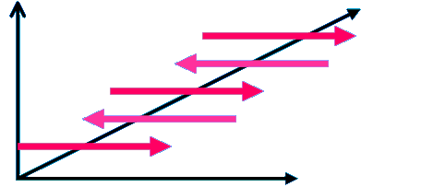
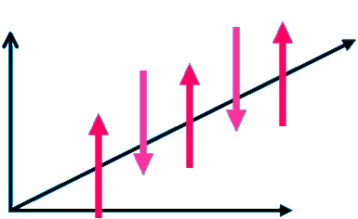
Electromagnetic waves
Electromagnetic Waves oscillate perpendicular to their motion.
They oscillate in the X and Y directions and the wave moves in the Z direction.

Slide 19
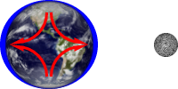
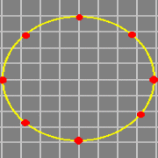
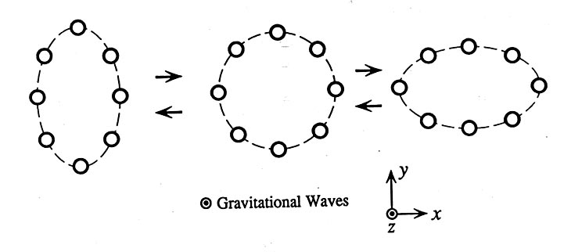
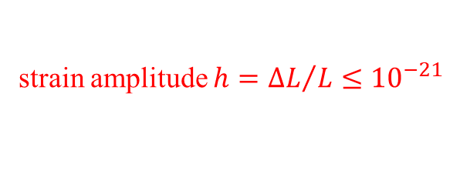
Gravitational waves
The key property of gravity is that it affects all bodies equivalently, with a force that is proportional to the body´s mass.
This means that it is impossible to measure directly an overall gravitational field (tensor field). The best one can do is to measure the change in the gravitational field.
The effect of gravity from a remote object, such as the Sun or Moon, can be felt by the manner in which it changes from location to location, gravity tidal field.
strain amplitude $h={∆L}/L≤{10}^{−21}$

Slide 20
How small is 10⁻¹⁸ meter?
One meter
Human hair, about 100 microns
Wavelength of light, about 1 micron
Atomic diameter, 10⁻¹⁰ meter
Nuclear diameter, 10⁻¹⁵ meter
LIGO sensitivity, 10⁻¹⁸ meter

Slide 21
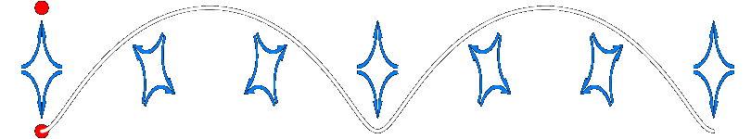
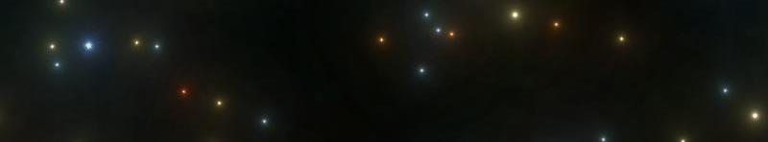



Gravitational waves
The key property of gravity is that it affects all bodies equivalently, with a force that is proportional to the body´s mass.
This means that it is impossible to measure directly an overall gravitational field (tensor field). The best one can do is to measure the change in the gravitational field.
The effect of gravity from a remote object, such as the Sun or Moon, can be felt by the manner in which it changes from location to location, gravity tidal field.
two polarizations: plus (⊕) and cross (⊗)
spin of graviton = 2
contrast with EM
dipole radiation:
$$\hat{x} \left(\left(⟷\right)\right)$$
$$\hat{y}$$
$$\left(\left(⟷\right)\right)$$

Slide 22
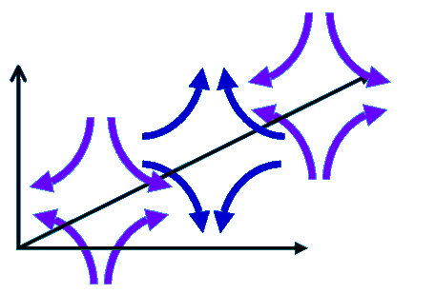
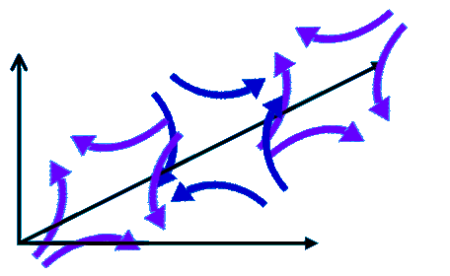
Gravitational waves
Gravity waves have 2 polarizations like electromagnetic waves.
The only difference is that gravitational wave polarization lies in a horizontal-vertical “+” shape and 45 degrees to that in a “x” shape.

Slide 23
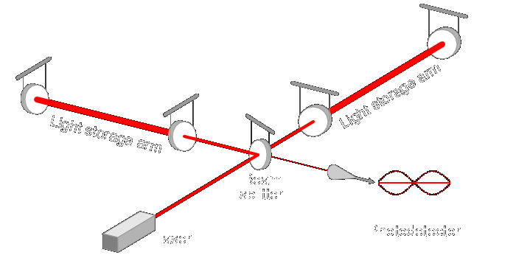

Detecting gravitational waves
Laser interferometers: measure relative motions of separate, freely-hanging masses

Slide 24

Sketch of a Michelson interferometer
End Mirror
End Mirror
Beam Splitter
Viewing
Laser
Screen

Slide 25
Sensing the effect of a gravitational wave
Gravitational wave changes arm lengths and amount of light in signal
Change in arm length is
10⁻¹⁸ meters
Laser
signal

Slide 26

Gravitational waves

Slide 27

Gravitational waves

Slide 28

Inspiralling Compact Binaries
Ringdown
Ground-Based (hectohertz)
  Last few minutes (10K cycles)
  for NS-NS
  0.4 - 400 per year by 2018
  BH-BH could be 0.4 - 1000
Space-Based (millihertz)
  MBH pairs (10⁵ - 10⁷ M_{s}) in
  galaxies to large Z
  EMRIs
  Close WD binaries
Pulsar Timing Arrays (nanohertz)
  MBH pairs
Merger waveform
A chirp waveform
Last 4 orbits
NS ≡ neutron star BH ≡ black hole MBH ≡ massive black holes EMRI ≡ extreme mass ratio inspiral WD ≡ white dwarf

Slide 29




The LIGO observatories

Slide 30






Global Network of Interferometers
LIGO Hanford 4 km (2015)
GEO Hannover 600 m
Kamioka Japan
3 km (2018)
LIGO Livingston 4 km (2015)
Virgo 3 km (2016)

Slide 31

Experimental results

Slide 32




LISA: Laser Interferometer Space Antenna (ESA 2034)
three freely-orbiting spacecraft
$distance between mirrors:5∙{10}^{6} km$
with NASA participation

Slide 33

LISA: Laser Interferometer Space Antenna (ESA 2034)
three freely-orbiting spacecraft
$distance between mirrors:5∙{10}^{6} km$
with NASA participation

Slide 34



Astrophysical sources of gravitational waves
Compact binary systems
  Black holes and neutron stars
  Inspiral → merger → ring-down
  Probe internal structure, nuclear equation of state of NS crust, populations, and space-time geometry
Spinning neutron stars
  known & unknown pulsars
  low mass X-ray binaries LMXBs
  Probe internal structure and populations
Neutron star birth
  Supernova core collapse
  Instabilities: tumbling, convection
  Correlations with EM observations
Stochastic background
  Big bang & other early universe
  Background of GW bursts
Analog from cosmic microwave background
-- WMAP 2003

Slide 35


Supernova
Mechanism of the core-collapse SNe still unclear
Shock revival mechanism(s) after the core bounce
Gravitational waves generated by a SNe should bring information from the inner massive part of the process and could constrains on the core-collapse mechanism

Slide 36

Supernova collapse sequence
Within about 0.1 second, the core collapses and gravitational waves are emitted.
After about 0.5 second, the collapsing envelope interacts with the outward shock. Neutrinos are emitted.
Within 2 hours, the envelope of the star is explosively ejected. When the photons reach the surface of the star, it brightens by a factor of 100 million.
Over a period of months, the expanding remnant emits X-rays, visible light and radio waves in a decreasing fashion.
Gravitational waves

Slide 37



Pulsar
Rotating neutron star
Asymmetry of shape
Structure of interior

Slide 38


Gravitational waves from Big Bang
Cosmic
microwave background

Slide 39

Gravitational waves probe the universe at earliest after the Big Bang

Slide 40
Gravitational waves: differences from EM waves
Electromagnetism:
Gravity:
A strong force, but with
opposing charges ( + and - )
A weak force, but with
only one charge (mass)
Fields built up incoherently from
microscopic charge separations
Fields built up coherently from
bulk accumulation of matter
Wavelengths smaller than the source
Wavelengths larger than the source
Waves are easy to detect, but
easily blocked
Waves are hard to detect, but
pass undisturbed through anything
Show the surfaces of energetic bodies
Reveal the bulk motion of dense matter
Used to construct images of
celestial objects
Can be though of as sounds emitted
by those objects
photon massless, J = 1
graviton massless, J = 2
A fundamentally different way of observing the Cosmos!
EM-waves: 10⁷ – 10²⁰ Hz GW: 10⁻⁹ – 10⁴ Hz

